Slide 1
Transition Scheduling Plan Webinar
October 17, 2016

Slide 2
Disclaimer
Nothing herein is intended to supersede any provision of the Commission's rules or public notices.
These slides should not be used as a substitute for reviewing the Commission's relevant orders, rules, and public notices regarding the Incentive Auction and the post-auction transition.
The examples presented herein are for illustrative purposes only and are based on hypothetical channel assignments that do not rely upon or predict any auction results.

Slide 3
Prohibited Communications
Commission rules prohibit broadcasters and forward auction applicants from communicating any incentive auction applicant’s bids or bidding strategies, including the results of bid processing by the Auction System, to other parties covered by the relevant rules. See 47 CFR 1.2105(c), 1.2205; Transition Schedule PN, DA 16-1095, paras. 28-31
  A covered party may violate the prohibition when it communicates past or future bids or bidding strategies of any incentive auction applicant, regardless of the communicating party’s intent.
  A communication that leaves little doubt about an incentive auction applicant’s bids and bidding strategies may violate the rule, regardless of the lack of direct communication.
  Publicly available statements that disclose an auction applicant’s bids or bidding strategies may violate the rule, including statements in oral or written comments.

Slide 4
Prohibited Communications
Comments that address the advantages and/or disadvantages generally of aspects of the Transition Scheduling Plan (e.g., comments on technical interdependencies or resource constraints to be considered) would not violate the rule.

Slide 5
Questions?
Send questions to IAtransition@fcc.gov

Slide 6
Agenda
Transition Scheduling Plan Overview
Dependency Graph
Phase Assignment Tool
Phase Scheduling Tool
Questions

Slide 7
Overview
The FCC will create a phased transition schedule for stations moving to new channels after the Incentive Auction.
Using a phased transition schedule:
Provides a clear schedule and early notice
Limits disruption to broadcasters
Prioritizes clearing the 600 MHz Band
Minimizes consumer disruption
Prioritizes demands on limited resources
Facilitates the tracking of transition progress by the FCC

Slide 8
Generating the Transition Schedule
Final Channel Assignment
Phase Assignment Tool
Assignment of stations to phases
Phase Scheduling Tool
Average time to complete each phase
Transition Schedule

Slide 9
Getting a Jump on the Transition
Release of the Auction Closing and Channel Reassignment Public Notice signifies the close of the auction and the start of the 39-month post-auction transition period.
Prior to the close of the auction, confidential letters will be sent out to broadcasters identifying their post-auction channel and phase assignment.
Provides broadcasters as much time as possible to prepare for the transition.

Slide 10
Key Aspects of the Transition Scheduling Plan
All stations that are required to transition will be assigned to a transition phase.
All transition phases start at the release of the Auction Close and Channel Reassignment Public Notice and end with a testing period for stations in that phase.
At the start of the testing period, stations in that phase can begin testing on their post-auction channel.
At the end of the testing period, stations in that phase must cease operations on their pre-auction channel and can begin broadcasting on their final channel.

Slide 11
Hypothetical Transition Schedule

Slide 12
Why Transition Phases?
Phases preferred by industry
Phases facilitate tracking of transition progress
Phases provide prioritization for the limited resources
Phases help alleviate the problems caused by dependencies
Phases provide more flexibility to clear spectrum in the 600 MHz Band for wireless services faster
Phases help with international coordination efforts

Slide 13
Agenda
Transition Plan Overview
Dependency Graph
Phase Assignment Tool
Phase Scheduling Tool
Questions

Slide 14
What are Dependencies?
Stations do not create additional interference when they are all on their pre-auction channels or when they are all on their post-auction channels.
But one station operating on its pre-auction channel can have interference with another station operating on its post-auction channel.
Station | Pre-Auction Channel | Post-Auction Channel
A | 25 | 20
B | 42 | 25
If Station A and B have co-channel interference protections, then they cannot both be on channel 25

Slide 15
What are Dependencies?
Station | Pre-Auction Channel | Post-Auction Channel
A | 25 | 20
B | 42 | 25
Before Station B can move to its Post-Auction Channel, Station A must move to its Post-Auction Channel.
Station B’s move is dependent on Station A’s move.
We can graphically represent these dependencies by making each station a node of the graph and use arrows to illustrate the direction of the dependencies.
A
B

Slide 16
Dependencies Create Daisy Chains
If multiple dependencies are connected, they create a daisy chain.
A
B
C
D
In this example, Station A must transition before Station B, Station B must transition before Station C, and station C must transition before Station D.
This means that Station D must wait for Stations A, B and C all to transition before it can transition.

Slide 17
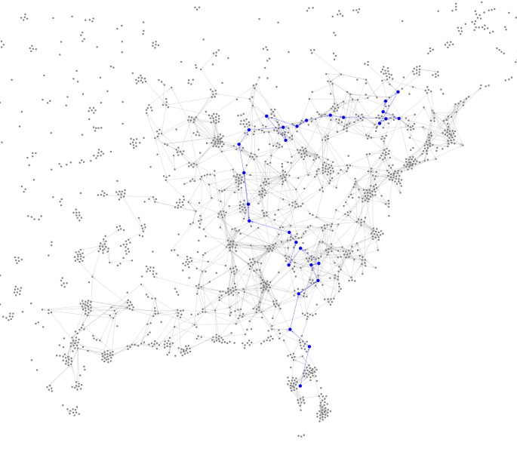
Daisy Chains Can Be Very Large
This daisy chain of 29 stations extends from central Florida all the way into Canada.

Slide 18
What are Cycles?
If a set of dependencies do not have a starting or ending point, then they form a cycle.
In this example, Station A must transition before Station B, Station B must transition before Station C, and Station C must transition before Station A.
If Stations A, B, and C do not transition at the same time, at least one station will experience additional interference.
A
C
B

Slide 19
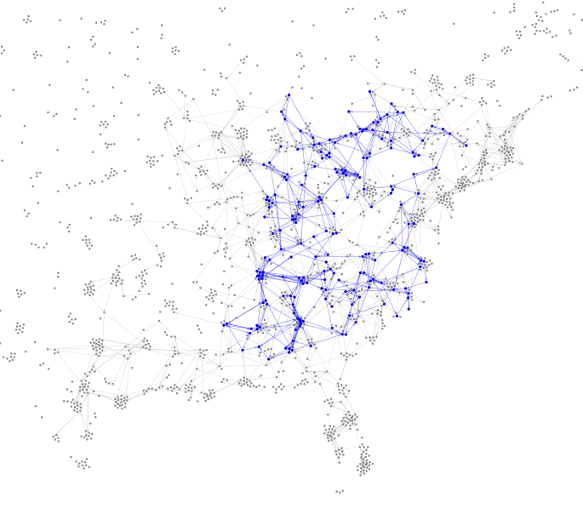
Cycles Can Also Be Very Large
This cycle of 196 stations spans much of eastern North America.

Slide 20
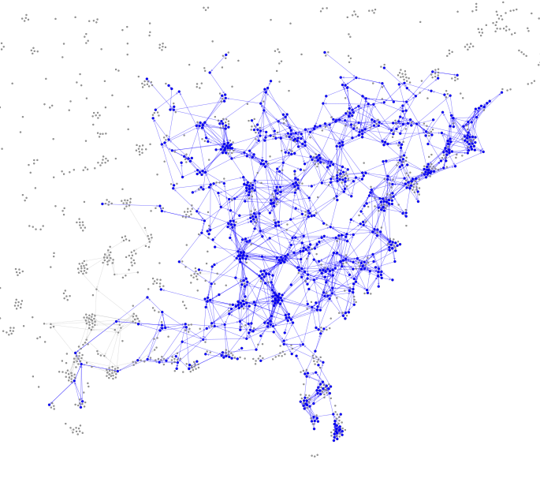
Overlapping Cycles and Daisy Chains Make a Mess
These 796 stations are all connected by dependencies, creating one long daisy chain, including many cycles.

Slide 21
Challenges Created by Dependencies
For each station in a daisy chain to be able to test without causing additional unacceptable interference, the number of phases would have to be the same as the length of the chain.
On the other hand, stations in cycles must be assigned to the same phase or else they will cause unacceptable interference.
In order to have a reasonable number of phases and to facilitate coordination, a transition plan must address these long daisy chains and large cycles.

Slide 22
Methods To Address Dependencies– Linked Station Sets
One way to address large daisy chains and cycles is to group parts of the daisy chain and entire cycles into a single phase.
Collapsing daisy chains and cycles into the same phase will require stations to coordinate testing and flash cut to their new channels together in order for the stations not to interfere.
These are called Linked Station Sets.

Slide 23
Methods To Address Dependencies– Linked Station Sets
Transition Phase
Transition Phase
F
6
4
E
5
Linked
Station Set
3
D
4
C
3
Linked
Station Set
2
B
2
A
1
1

Slide 24
Methods To Address Dependencies– Increased Interference
Temporarily increasing interference above the current protections of 0.5% additional interference will decrease the number of dependencies and, therefore, decrease the length and complexity of daisy chains and cycles.
Increased interference will only occur when one station is on its pre-auction channel and one station is on its post-auction channel.
Increased interference was used in order to facilitate transitions to new services.

Slide 25
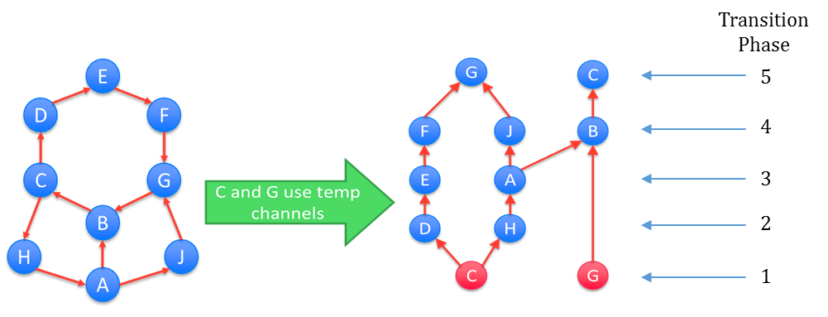
Methods To Address Dependencies– Temporary Channels
Assigning a station to a temporary channel before it transitions to its post-auction channel could also be used to break up complicated cycles and excessively long daisy chains.
In this example, 2 stations using temporary channels breaks a set of 9 stations with dependencies into 5 phases with no linked sets.
At this time, however, we do not propose to use temporary channels because of the increased inconvenience and cost but will consider comment on this proposal.

Slide 26
Agenda
Transition Plan Overview
Dependency Graph
Phase Assignment Tool
Phase Scheduling Tool
Questions

Slide 27
How are Stations Assigned to Transition Phases?
The Phase Assignment Tool uses both constraints and goals to determine which stations are assigned to which phases.
  Constraints are rules that assignments must satisfy.
  Goals or objectives choose among assignments that satisfy the constraints.
  Commercially available optimization software is used to create the assignments with respect to these goals and constraints.
The next few slides describe the specific constraints and objectives proposed.
Results show the impact of using this tool.

Slide 28
Constraints
All constraints must be satisfied. The constraints are:
Every transitioning station will be assigned to one transition phase.
There will be no more than 10 transition phases.
No U.S. station will be assigned to a temporary channel.
No station falling into the “complicated” category for purposes of the Phase Scheduling Tool can be assigned to Phase 1.
All stations within a DMA will be assigned to no more than two different transition phases.

Slide 29
Constraints
All constraints must be satisfied. The constraints are:
The difference in the number of stations in the largest transition phase and the smallest transition phase will be no more than 30 stations.
No phase can have more than 125 linked-stations.
A station cannot cause more than two percent new interference to another station during the transition.
No stations in Canada will be assigned to transition before the third transition phase and no Canadian stations will be assigned to a temporary channel.

Slide 30
Goals
The Phase Assignment Tool prioritizes the proposed objectives in the sequence listed below. Subsequent objectives would be constrained by prior objectives.
Objective #1: Assign U.S. stations whose pre-auction channels are in the 600 MHz Band to earlier phases in order to clear the 600 MHz Band as quickly as possible, while simultaneously assigning Canadian stations and U.S. stations whose pre-auction channel is in the remaining television bands (U.S. TV-band stations) to later phases, where possible.

Slide 31
Goals
The Phase Assignment Tool prioritizes the proposed objectives in the sequence listed below. Subsequent objectives would be constrained by prior objectives.
Objective #2: Minimize the sum, over all DMAs, of the number of times TV viewers in a DMA must rescan.
Objective #3 : Minimize the total number of linked-stations.
Objective #4: Minimize the difference between the number of stations in the largest transition phase and the smallest transition phase.

Slide 32
International Assumptions in Proposal
FCC and ISED Canada are coordinating closely on transition timing, consistent with the agencies’ intent to jointly repack TV stations in both countries.
  This proposal therefore assumes a joint repack with Canada.
  Canadian stations are generally assigned to later stages.
Consistent with our coordination with Mexico, this proposal assumes that Mexican stations will have transitioned to their new channels before the phase completion date of Phase 1.

Slide 33
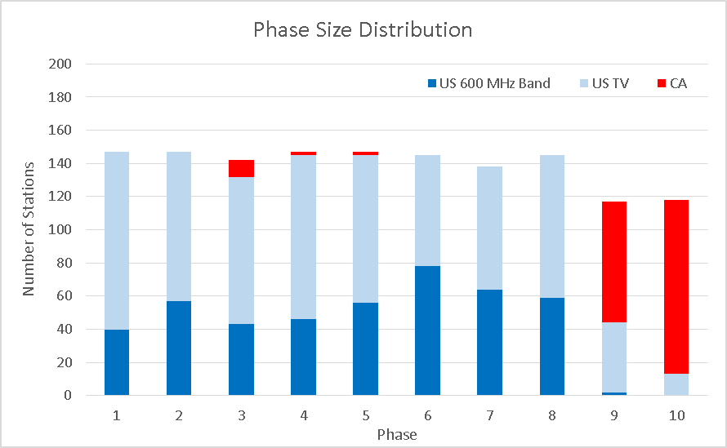
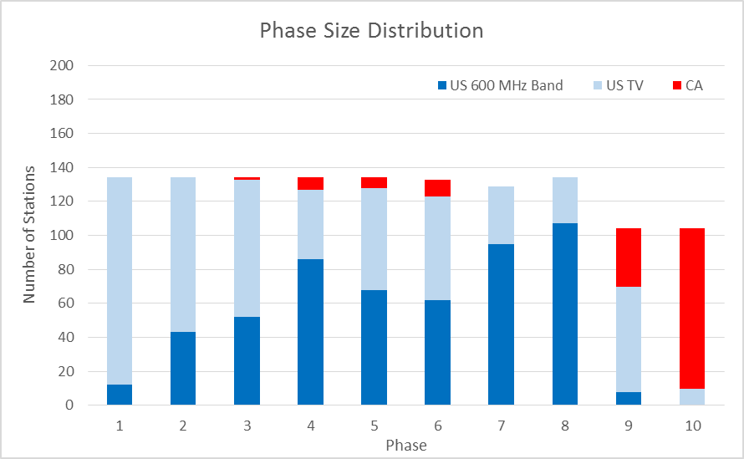
Results
114 MHz Clearing Scenario
84 MHz Clearing Scenario
Wireless nearly complete in Phase 8 (shown in dark blue).
Relatively equal-sized phases allows better management of resources by ensuring a more even distribution of the draw on limited resources.

Slide 34
Results
Clearing target | # of stations that must move to new channels | # of linked- stations | Size of the largest linked-station set | Median linked-station set size | # of linked- station sets | # of stations in largest phase | % of U.S. DMAs with more than one rescan
114MHz | 1,393 | 799 | 105 | 3 | 95 | 147 | 31%
84 MHz | 1,274 | 710 | 105 | 3 | 85 | 134 | 42%
Median size of linked-station sets is only 3 stations.
The largest linked-station set is only about 100 stations.
More than 50% of DMAs will require only one rescan.

Slide 35
Aggregate Interference
Clearing Target | Number of stations with more than 2% aggregate interference | Maximum aggregate interference
114 MHz | 15 | 3.20%
84 MHz | 14 | 2.96%

Slide 36
Overview of Phase Assignments
In the next two series of slides, we show how these phase assignments look in our 114 MHz scenario when plotted on a map.
The first set of maps shows which stations are transitioning in each phase and the number of rescans remaining for each DMA.
In the next set of maps, we once again show all ten phases, but this time we show the progress in clearing the new 600 MHz Band in each PEA.

Slide 37
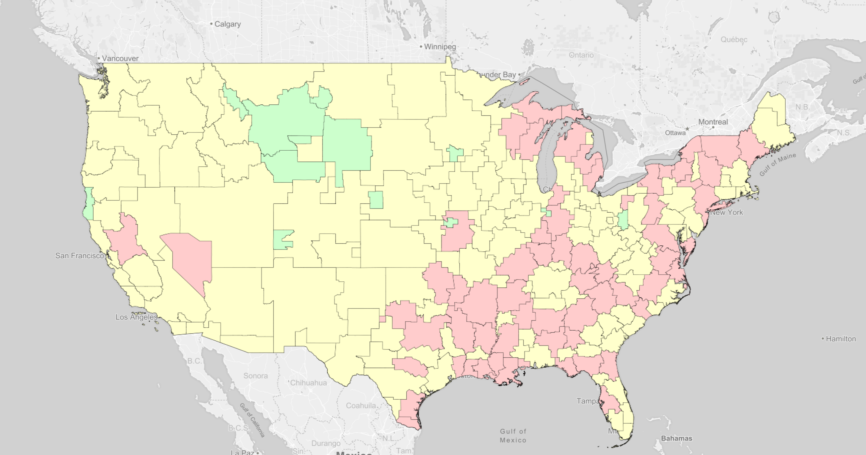
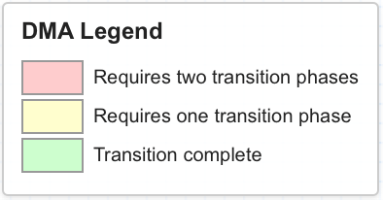
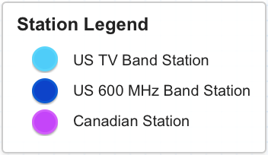
Quick Explanation of First Set of Maps
The maps in this first set have color coded the DMAs based on how many transition phases will be required for each DMA:
GREEN at start of transition indicates that the DMA has no stations required to transition; GREEN in subsequent phases means that all stations within the DMA will have completed their transition by the end of the phase.
YELLOW at the start of the transition means that only one transition phase is required for all stations within the DMA; YELLOW in subsequent phases means that at least some stations within the DMA have completed their transition by the end of the phase, but there remains other stations which will have to complete their transition in a second later phase.
RED at the start of the transition means that two transition phases are required for all stations within the DMA; RED in subsequent phases means that no stations within the DMA will have completed their transition by the end phase (i.e., two transition phases are still required).

Slide 38
Transitioning Stations at 114 MHz: Start

Slide 39
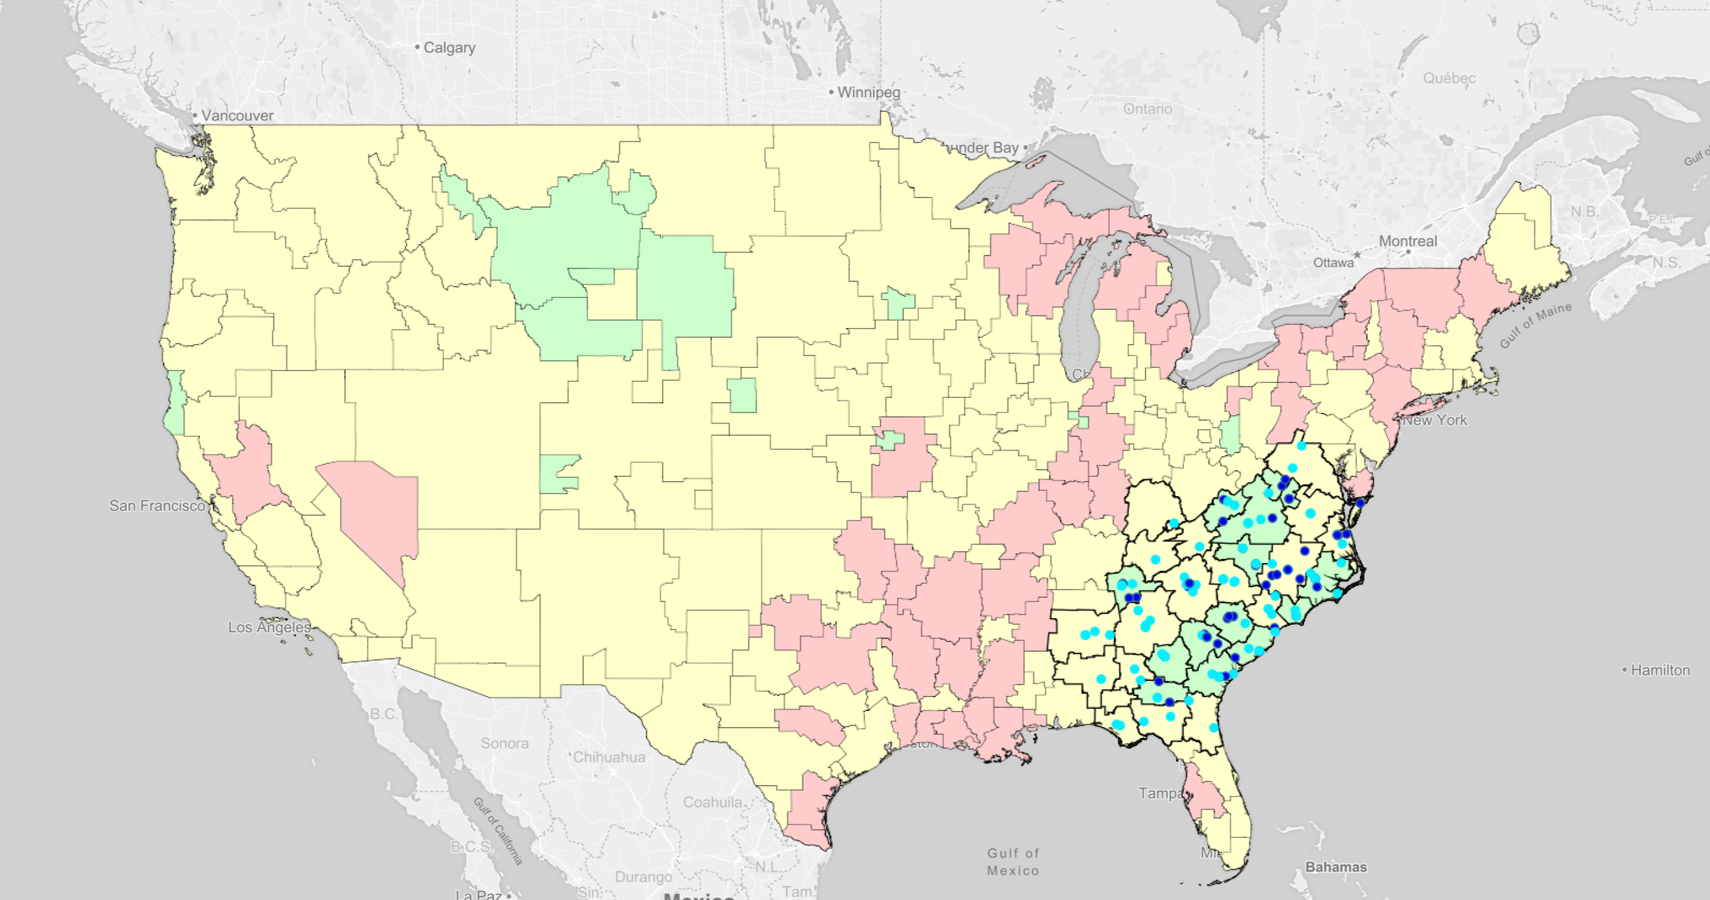
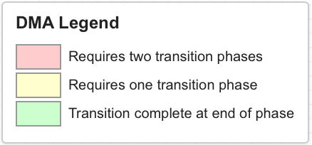
Transitioning Stations at 114 MHz: Phase 1

Slide 40
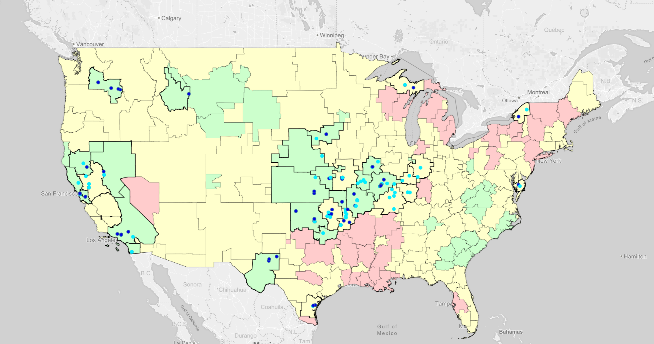
Transitioning Stations at 114 MHz: Phase 2

Slide 41
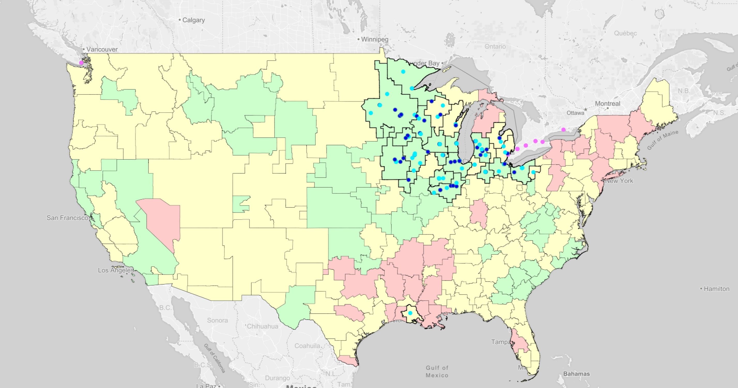
Transitioning Stations at 114 MHz: Phase 3

Slide 42
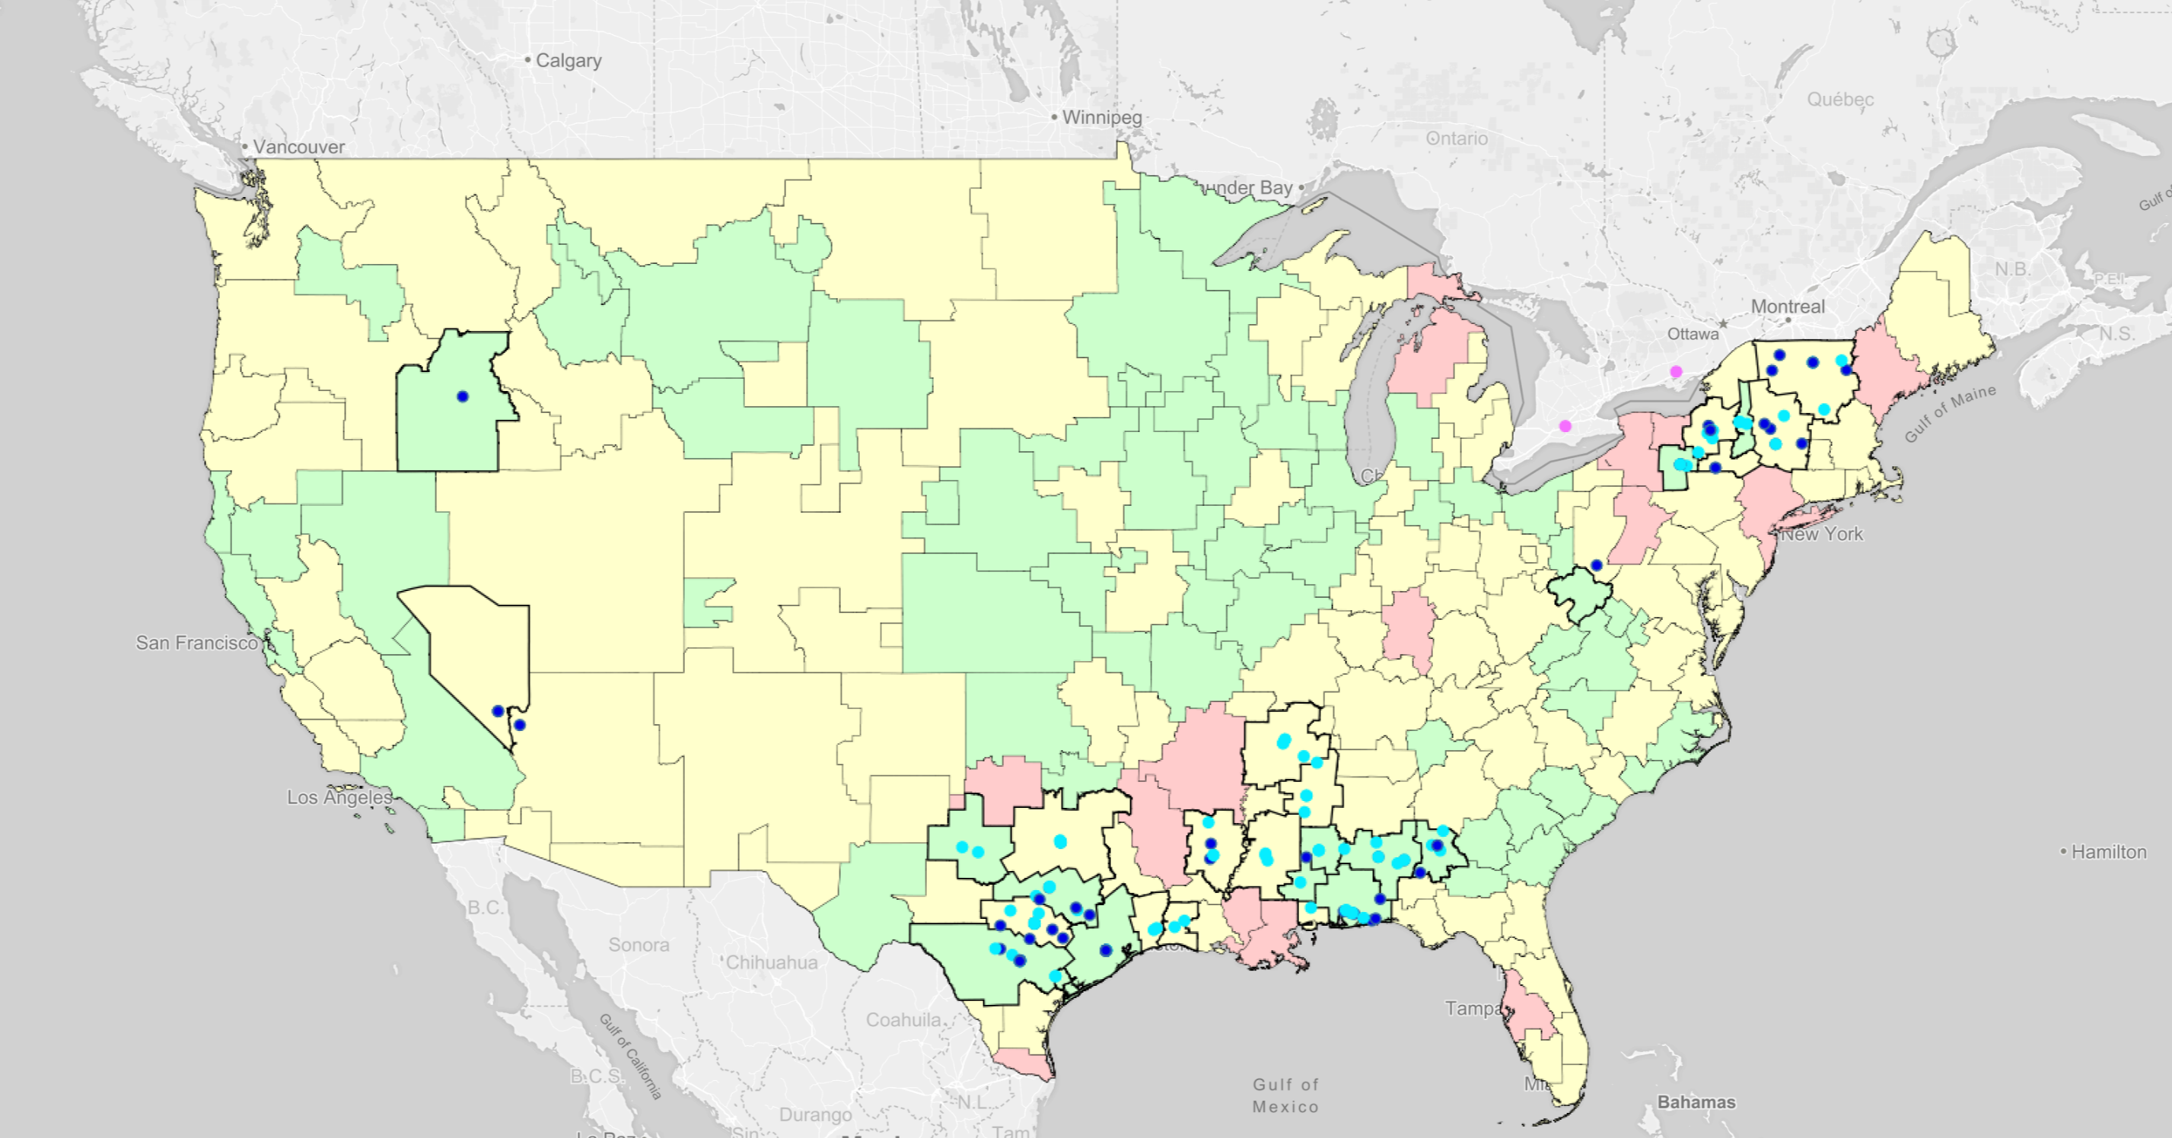
Transitioning Stations at 114 MHz: Phase 4

Slide 43
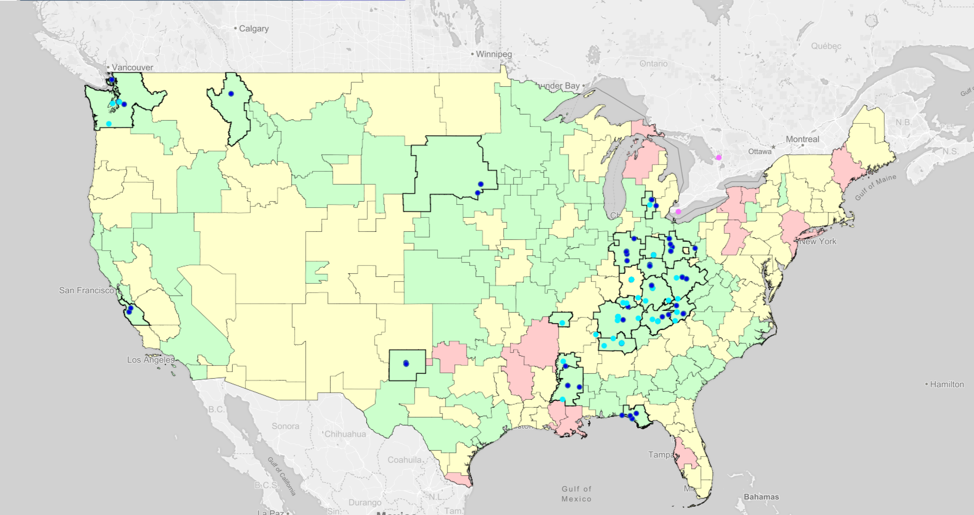
Transitioning Stations at 114 MHz: Phase 5

Slide 44
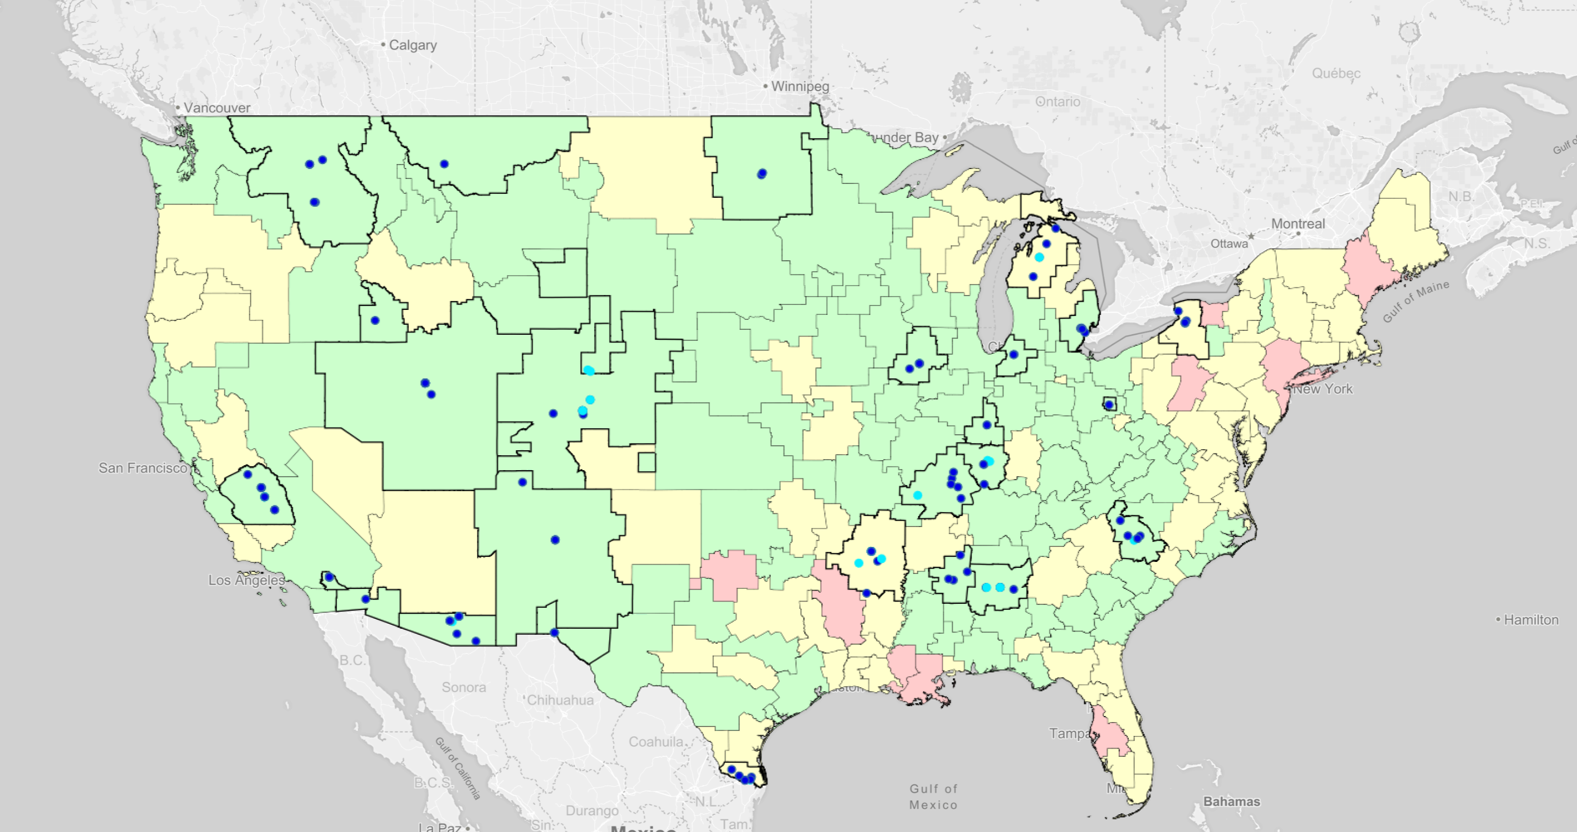
Transitioning Stations at 114 MHz: Phase 6

Slide 45
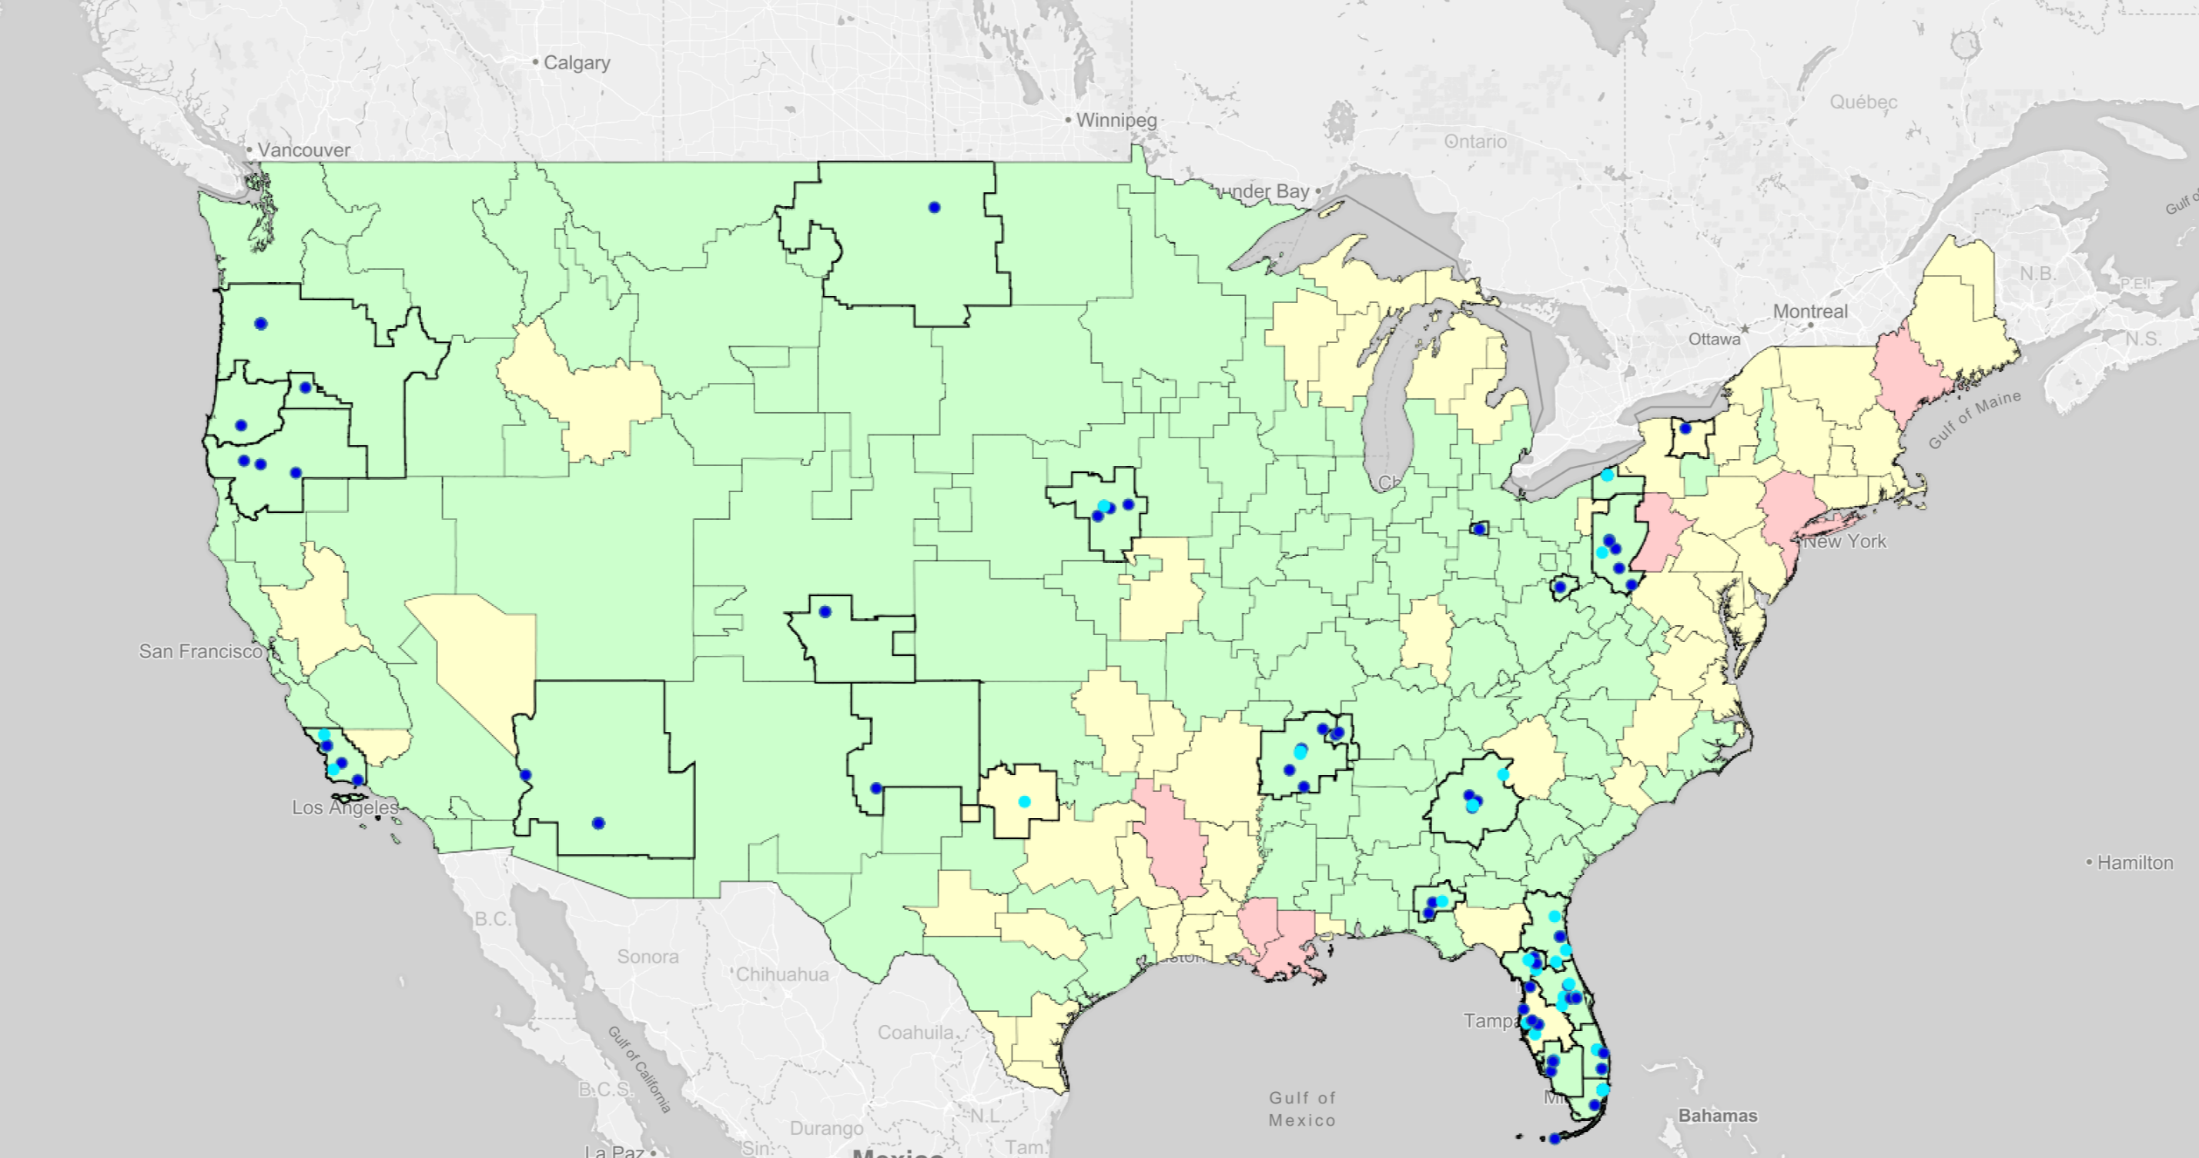
Transitioning Stations at 114 MHz: Phase 7

Slide 46
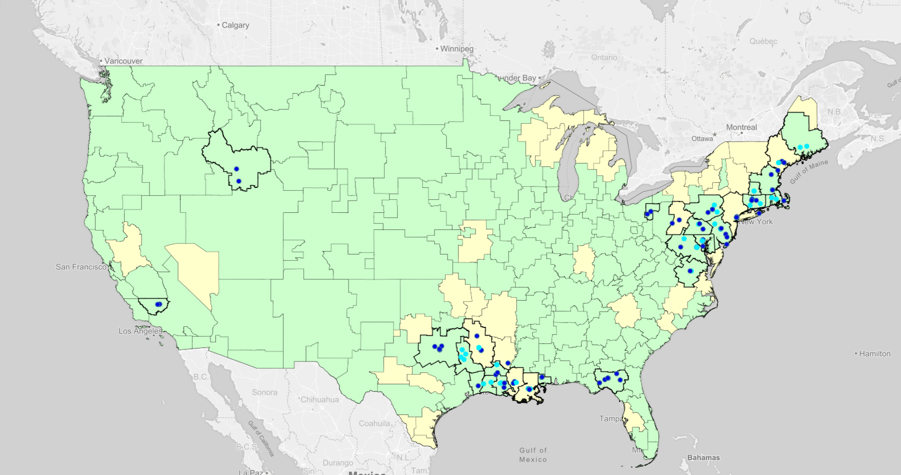
Transitioning Stations at 114 MHz: Phase 8

Slide 47
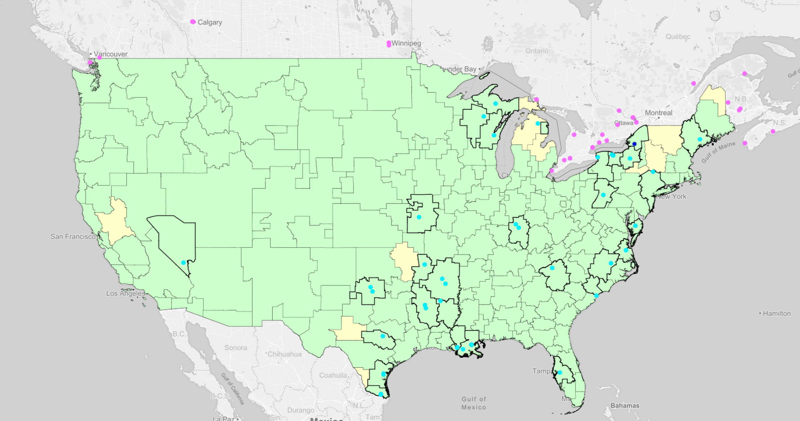
Transitioning Stations at 114 MHz: Phase 9

Slide 48
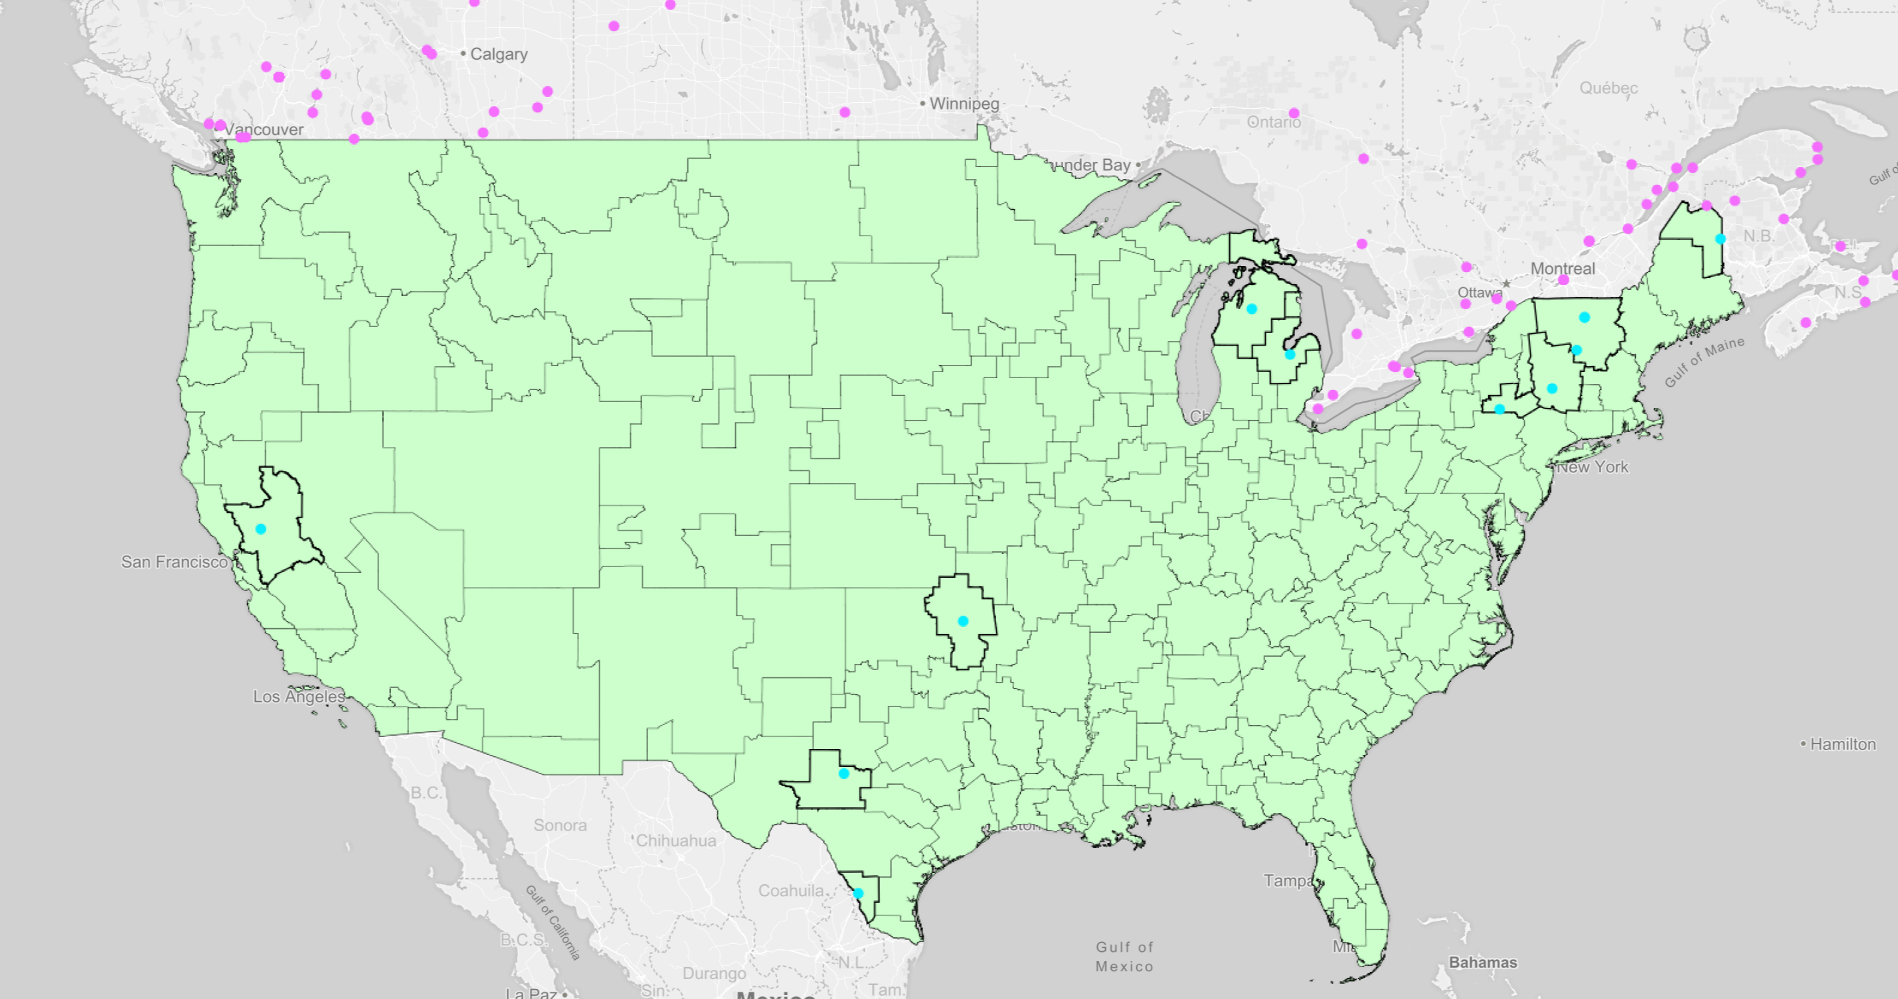
Transitioning Stations at 114 MHz: Phase 10

Slide 49
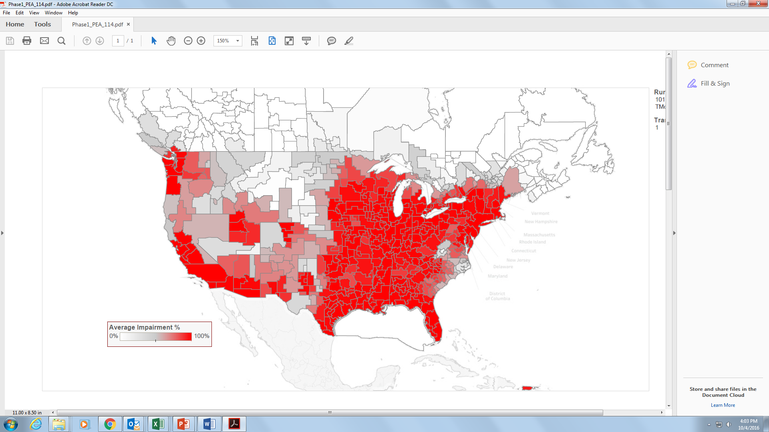
Quick Explanation of Second Set of Maps
The maps in this second set have color-coded PEAs based on the average impairment across all 9 blocks:
The map shows the average impairment across all 9 blocks at the end of each transition phase.
In actuality, each block would have its own level of impairment, but this average gives us the best sense of just how quickly the PEA is clearing overall.

Slide 50
Clearing the 600 MHz Band at 114 MHz: Phase 1

Slide 51
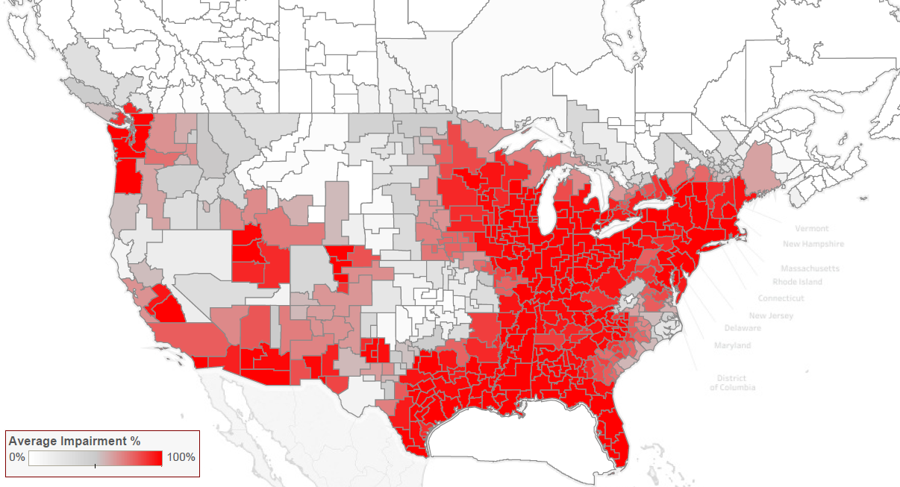
Clearing the 600 MHz Band at 114 MHz: Phase 2

Slide 52
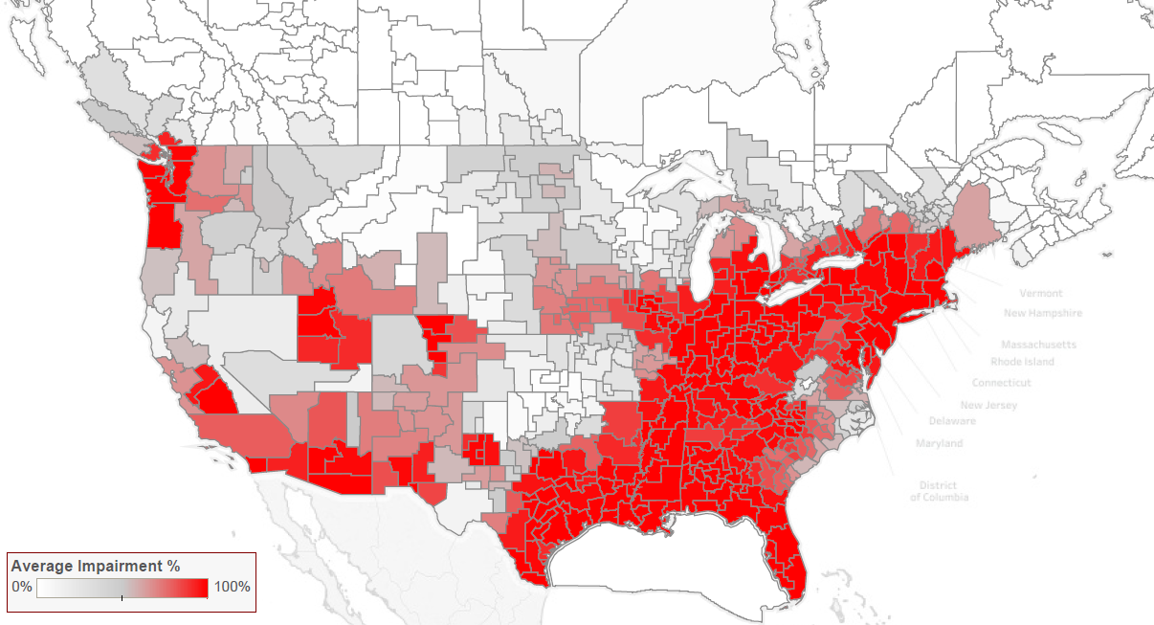
Clearing the 600 MHz Band at 114 MHz: Phase 3

Slide 53
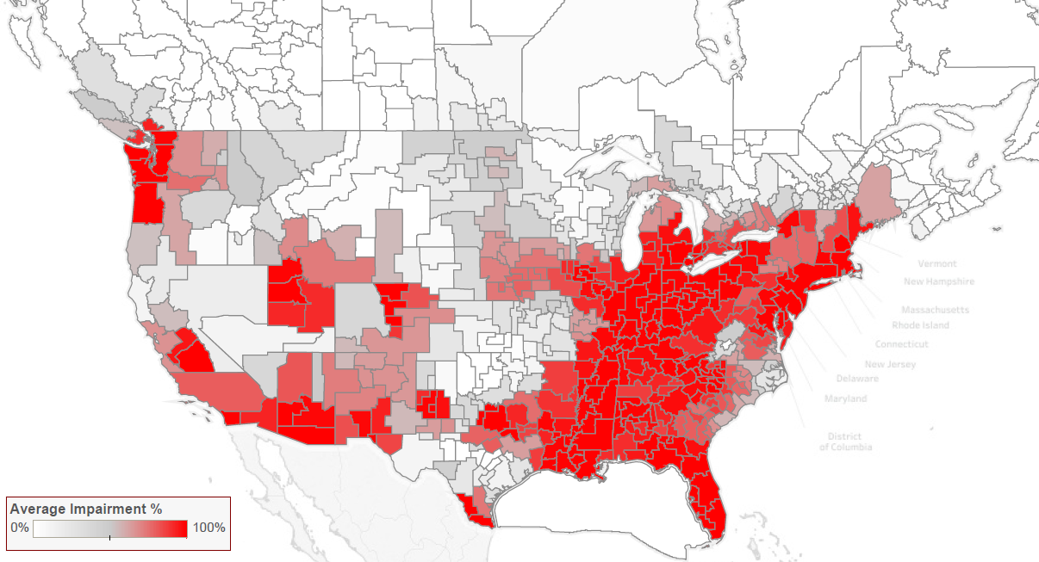
Clearing the 600 MHz Band at 114 MHz: Phase 4

Slide 54
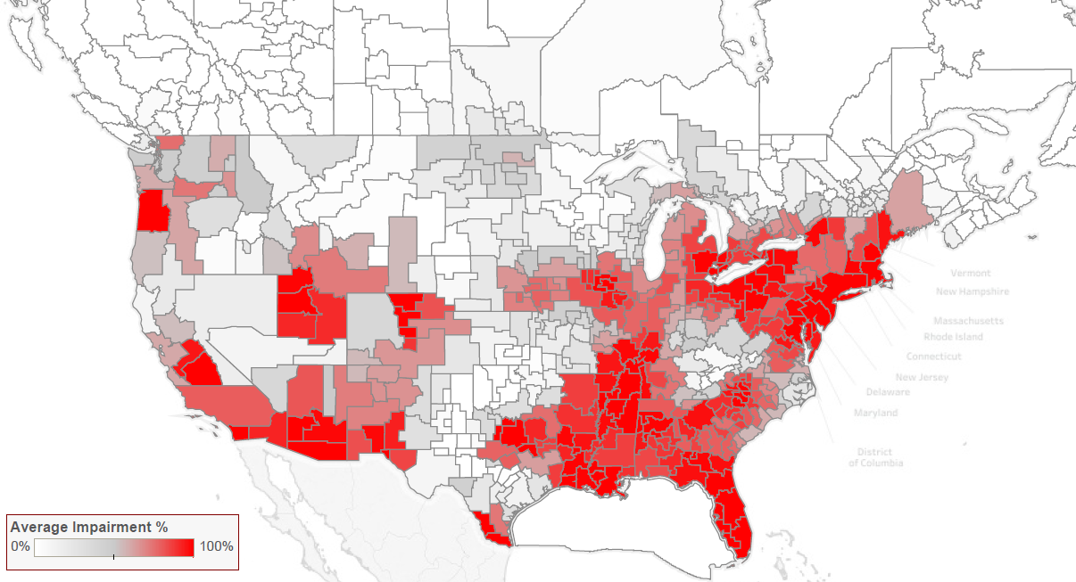
Clearing the 600 MHz Band at 114 MHz: Phase 5

Slide 55
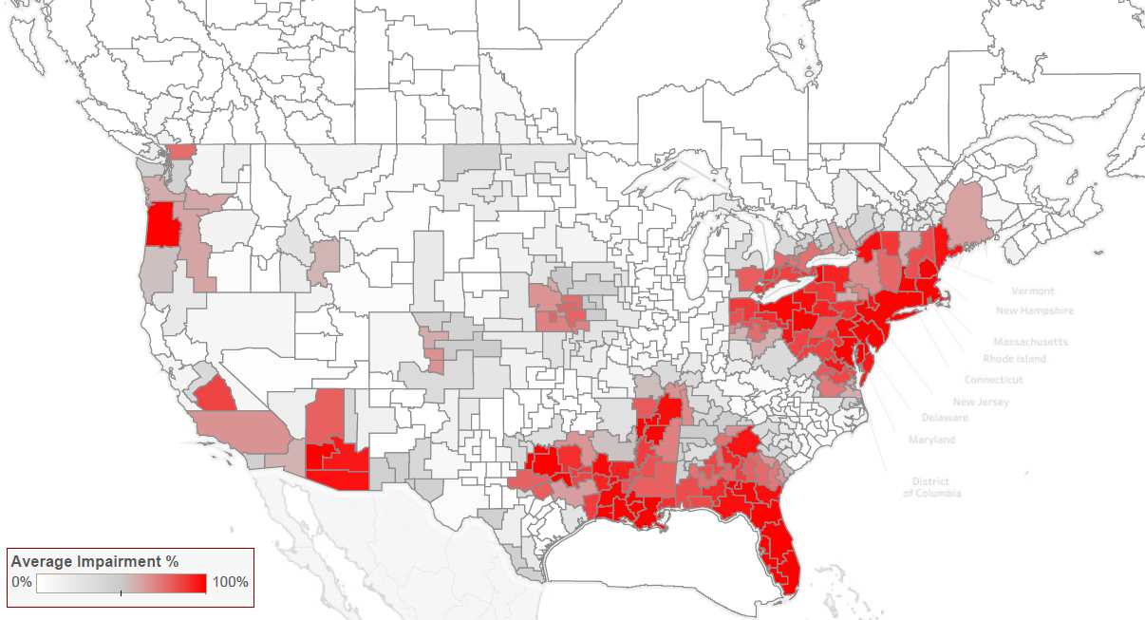
Clearing the 600 MHz Band at 114 MHz: Phase 6

Slide 56
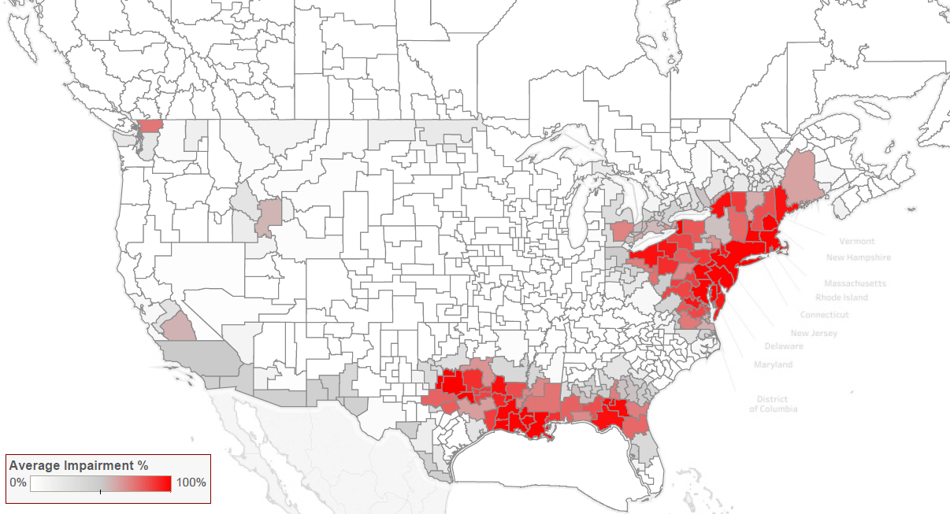
Clearing the 600 MHz Band at 114 MHz: Phase 7

Slide 57
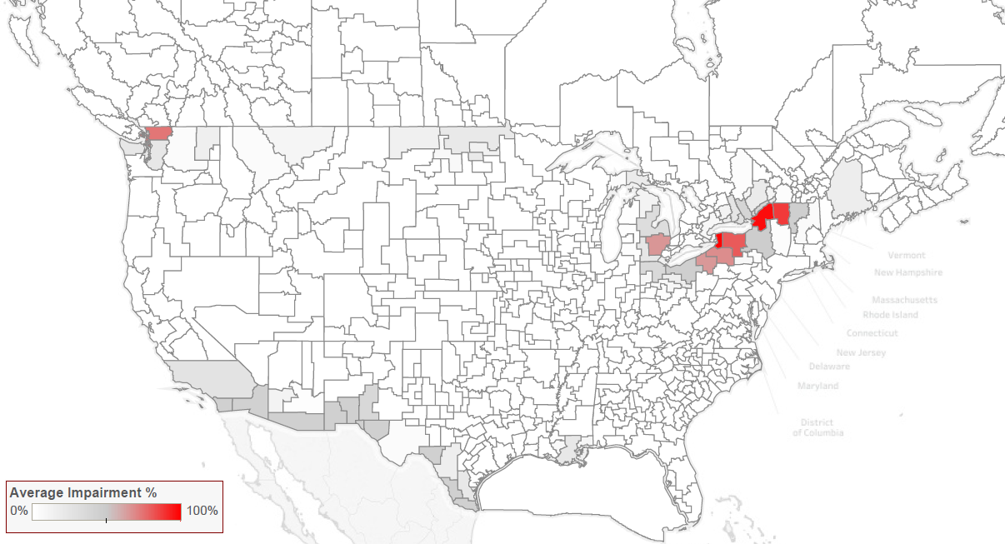
Clearing the 600 MHz Band at 114 MHz: Phase 8

Slide 58
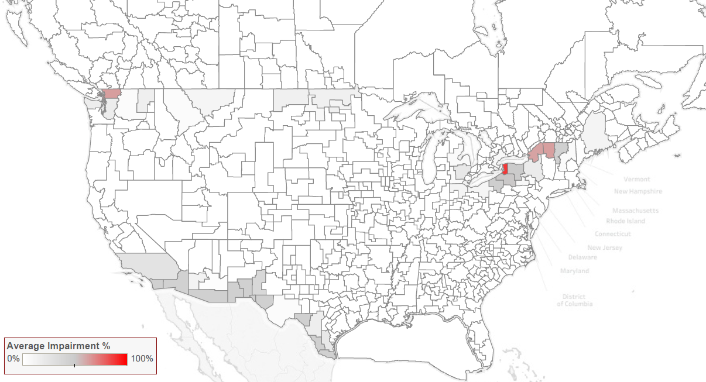
Clearing the 600 MHz Band at 114 MHz: Phase 9

Slide 59
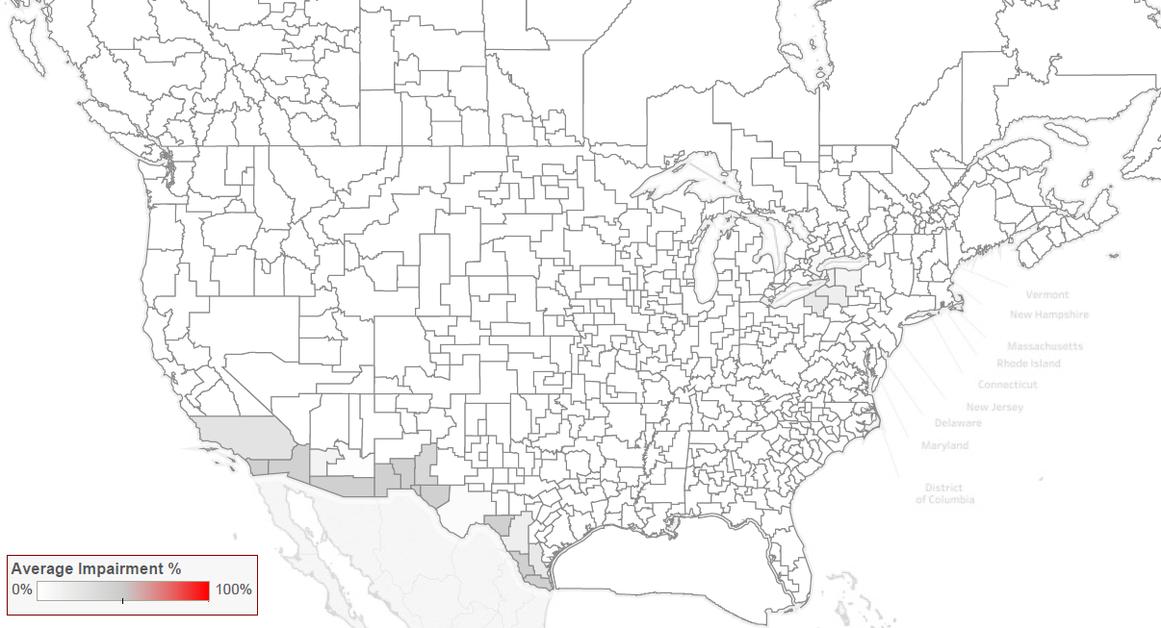
Clearing the 600 MHz Band at 114 MHz: Phase 10

Slide 60
Agenda
Transition Plan Overview
Dependency Graph
Phase Assignment Tool
Phase Scheduling Tool
Questions

Slide 61
Determining the Phase Completion Date
The Phase Scheduling tool estimates the total time necessary for stations within a phase to perform the tasks required to complete the transition process.
Tasks are divided into two sequential stages: the “Pre-Construction Stage” and the “Construction Stage.”
Pre-Construction Stage
Construction Stage
Administration/ Planning
Construction Related Work
Pre-Construction Complete
Transition Complete
Antenna Procurement
Tower Crew Work

Slide 62
Administrative and Planning Tasks:
Administration/planning includes all tasks that must be completed before construction can begin, including: zoning, administration, legal, possible structural tower improvements, equipment modifications, etc.
Resources that are not treated separately (because they are in sufficient supply) include auxiliary antennas manufacturing, transmitter manufacturing, transmission line manufacturing and RF component installation.
All resources necessary to complete these tasks are assumed to be available when needed.
Time estimates for the Admin/Planning task group stations into three categories: “Complicated stations,” DTV, and Class A
All times are conservatively estimated.

Slide 63
Construction-related Work
Construction-related work includes the time to complete all construction work and associated management and coordination activities, including:
  Installing the transmitter components, combiners, RF mask filters and the transmission line to the tower base.
  Installing liquid cooling systems, AC power, and connection to remote control equipment and input signal connections, if required.
  Performing any tower modifications and any final testing of the system.
Similar to Admin/Planning, time estimates for the construction-related work group stations into three categories: “Complicated stations,” DTV, and Class A.
All times are conservatively estimated.
All resources necessary to complete these tasks are assumed to be available when needed.

Slide 64
Modeling Resources in Limited Supply
Antenna Manufacturing and Tower Crews are in limited supply.
If a station needs a constrained resource, and it is unavailable, the station must wait (in a queue) until the required resource is available.
The model assumes that stations assigned to earlier phases will begin their activities before stations assigned to later phases.
The Model assigns an ordering to all stations.
  Stations in earlier phases receive a lower order number than stations in later phases.
  Order is random for stations in the same phase.

Slide 65
Modeling Resources in Limited Supply
Each ordering of stations, called the “simulation order,” provides a single estimate of the time to complete each transition phase.
By repeating this simulation multiple times with stations in the same phase entering the system in a new random simulation order, the Phase Scheduling Tool produces a range of completion times for each phase.
The FCC intends to use this range in determining appropriate phase deadlines given the composition of the individual stations in each phase.

Slide 66
Primary Antenna Manufacturing Is Limited
The time for the manufacture and delivery of an antenna is based on the type of antenna needed but also manufacturing capacity.
Industry can only fulfill limited number of orders per month.
Stations wait in a queue until manufacturing capacity is available.
The queue is prioritized by phase assignment and then by station order within phase.
Queue | Manufacturing | Delivered
S₉
S₇
S₈
S₆
S₅
S₂
S₄
S₁
S₃
Phase 3
Phase 2
Phase 1

Slide 67
Tower Crews Are Limited
Limited number of qualified and equipped crews.
Stations request a crew based on site location and complexity.
  Crews able to work on the most difficult U.S. sites.
  Crews able to work on average difficulty U.S. sites.
  Crews able to work on Canadian sites.
If all crews of the required type are busy on other sites, stations enter queues similar to antenna procurement.
The time to complete the tower work is based on:
  Whether the tower crew is available when needed (if not, the station waits until there is a tower crew available), and
  The time for the tower crew to complete all tasks once begun. These estimates are station specific.

Slide 68
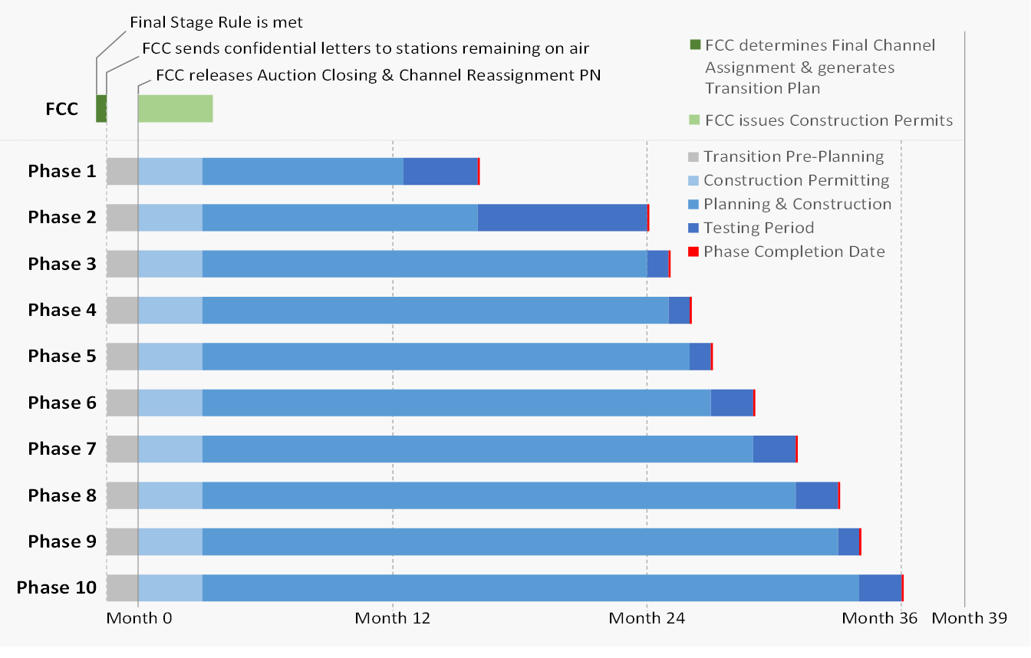
Phase Scheduling Tool and the Post Auction Timeline
Output from model at 114 MHz:
Results used to determine:
Phase # | Ave # of weeks from Phase Start to Phase Completion Date
1 | 70
2 | 104
3 | 108
4 | 112
5 | 116
6 | 123
7 | 131
8 | 138
9 | 143
10 | 149

Slide 69
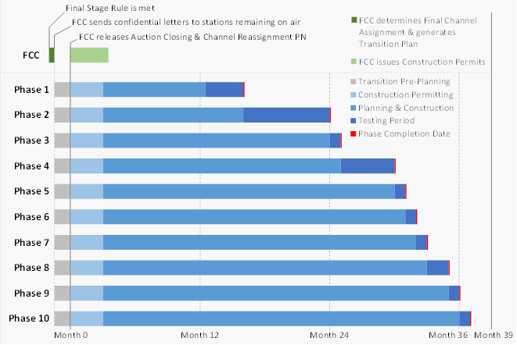
Phase Scheduling Tool and the Post Auction Timeline
Output from model at 84 MHz:
Results used to determine:
Phase # | Ave # of weeks from Phase Start to Phase Completion Date
1 | 69
2 | 104
3 | 108
4 | 129
5 | 133
6 | 137
7 | 143
8 | 151
9 | 156
10 | 160

Slide 70
Questions?
Send questions to IAtransition@fcc.gov

Slide 71
Contact Information
Additional Question or Information: Sasha Javid Email: Sasha.Javid@fcc.gov Telephone: (202) 418-2392 Erin Griffith Email: Erin.Griffith@fcc.gov Telephone: (202) 418-0660 Shaun Maher Shaun.Maher@fcc.gov Telephone: (202) 418-2324 Evan Morris Evan.Morris@fcc.gov Telephone: (202) 418-1656 | Press Contact Charles Meisch Email: Charles.Meisch@fcc.gov Telephone: (202) 418-2943

Slide 72
Additional Slides

Slide 73
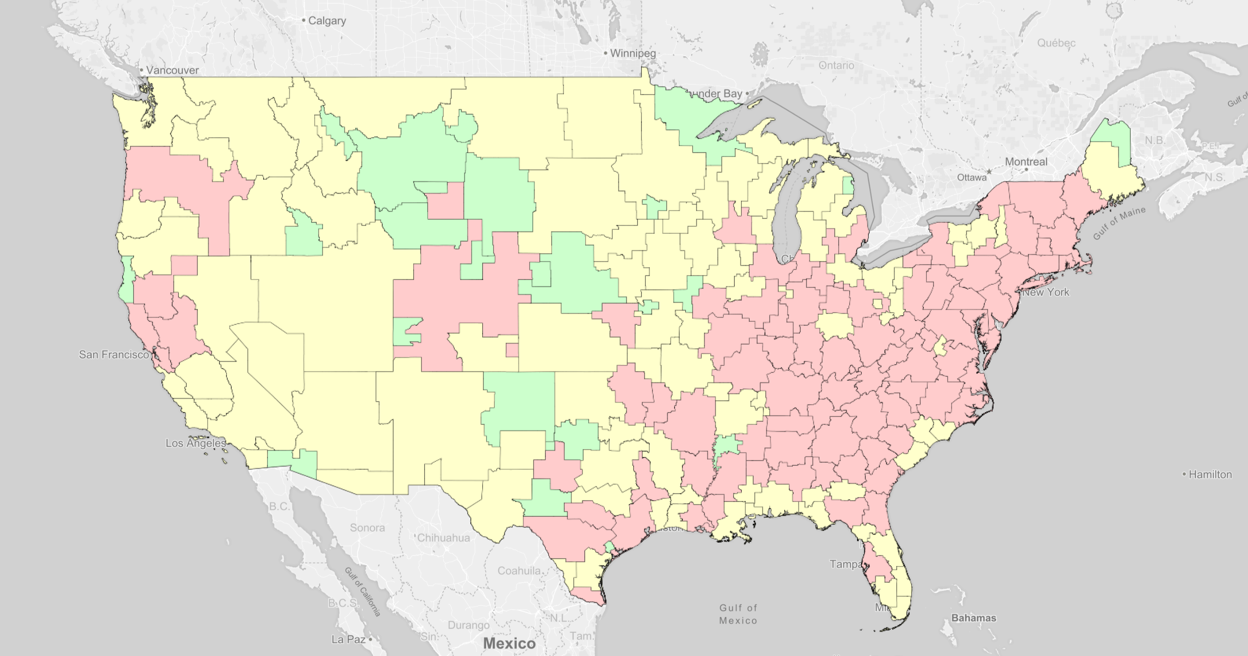
Transitioning Stations at 84 MHz: Start

Slide 74
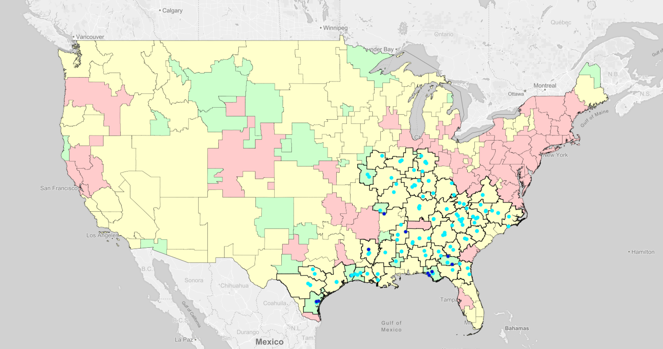
Transitioning Stations at 84 MHz: Phase 1

Slide 75
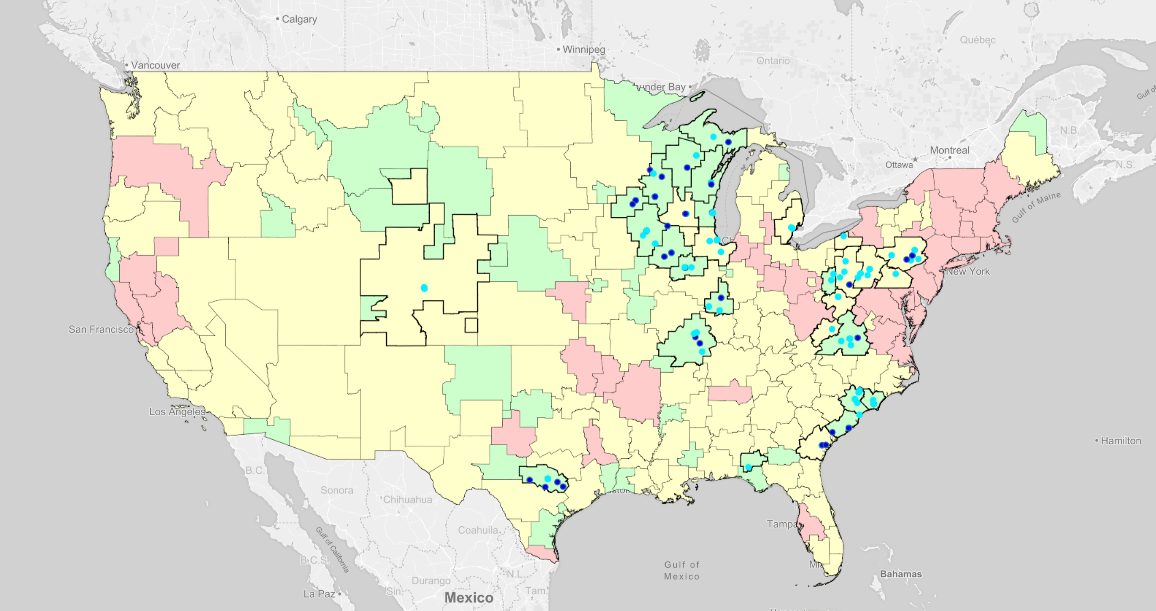
Transitioning Stations at 84 MHz: Phase 2

Slide 76
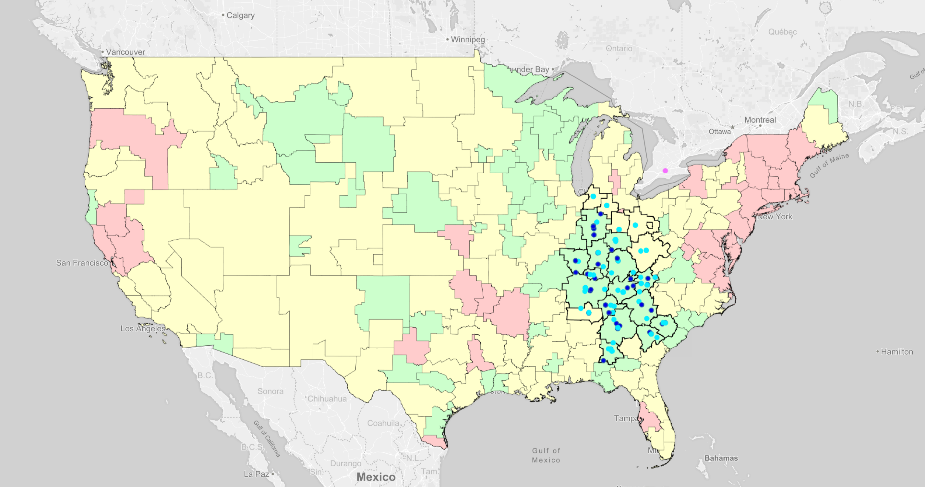
Transitioning Stations at 84 MHz: Phase 3

Slide 77
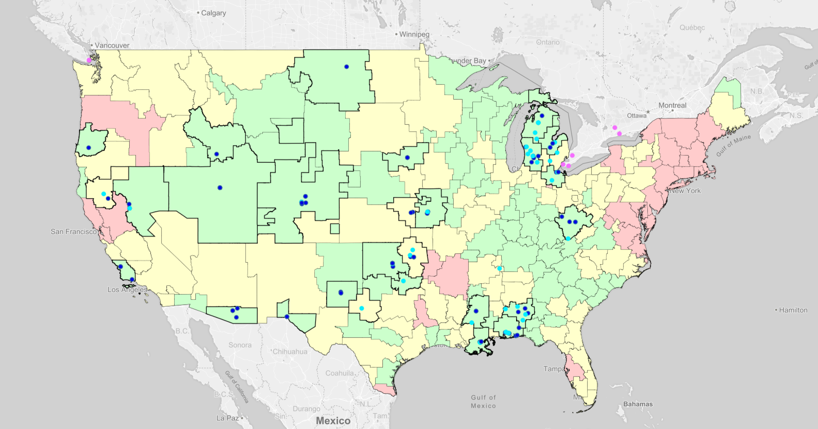
Transitioning Stations at 84 MHz: Phase 4

Slide 78
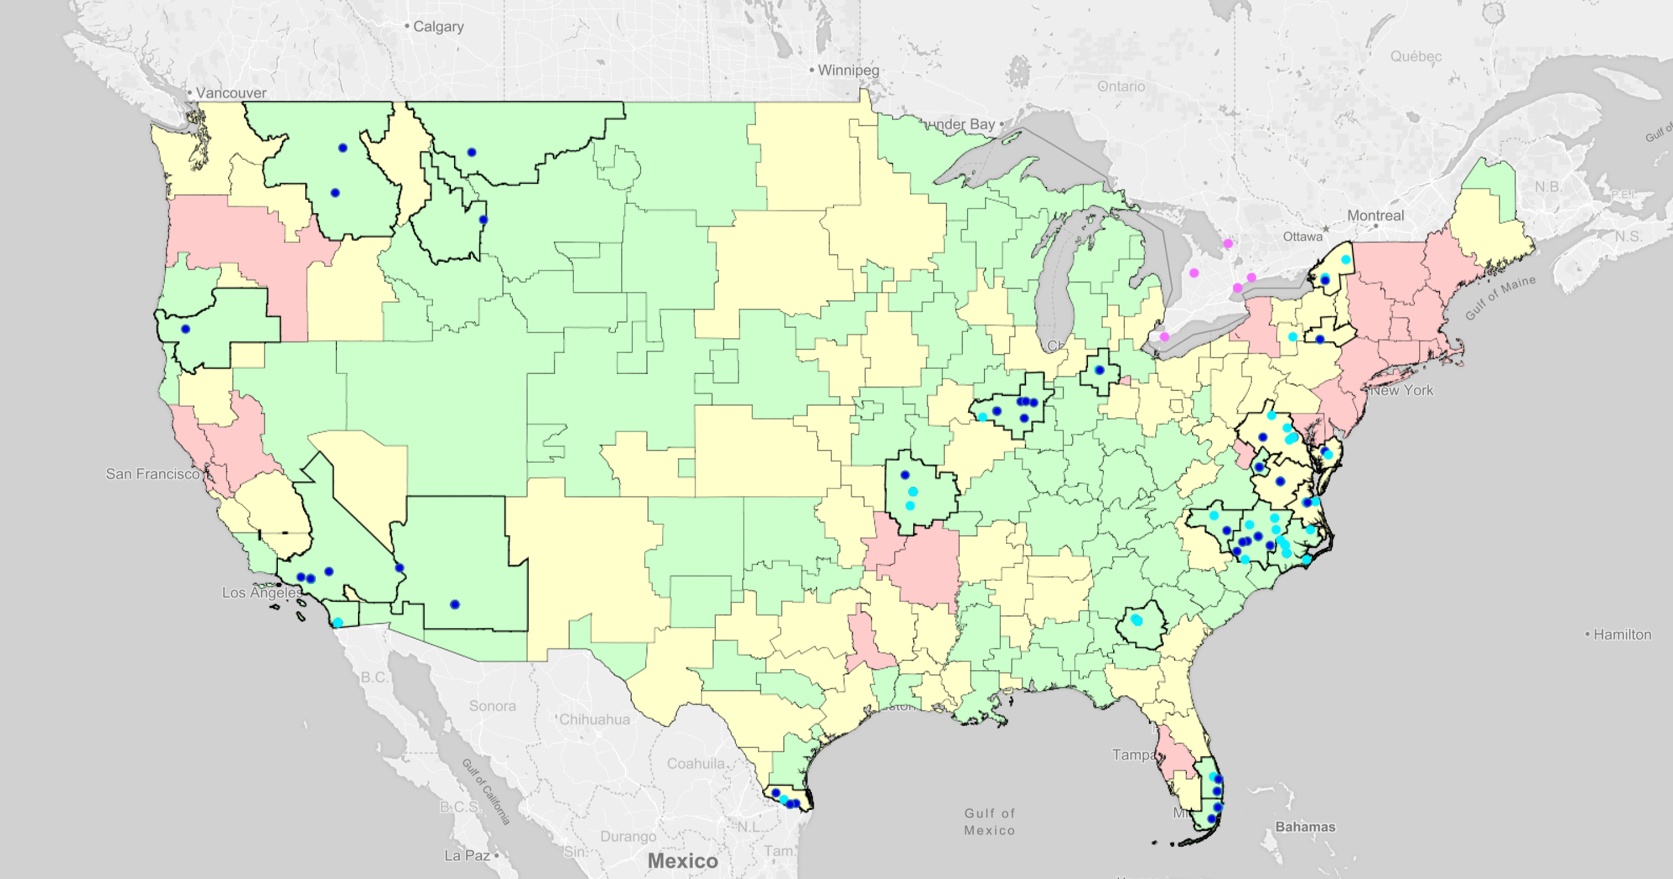
Transitioning Stations at 84 MHz: Phase 5

Slide 79
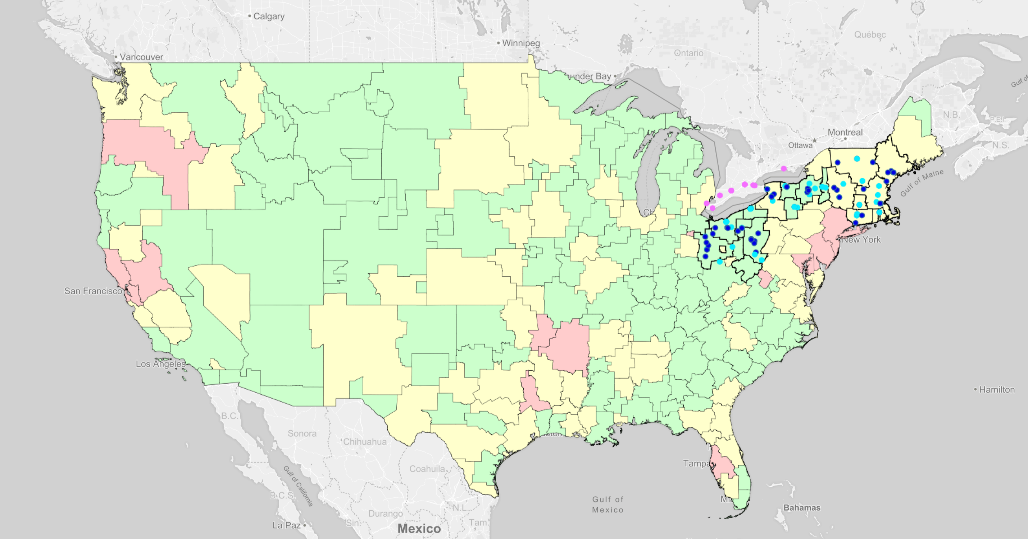
Transitioning Stations at 84 MHz: Phase 6

Slide 80
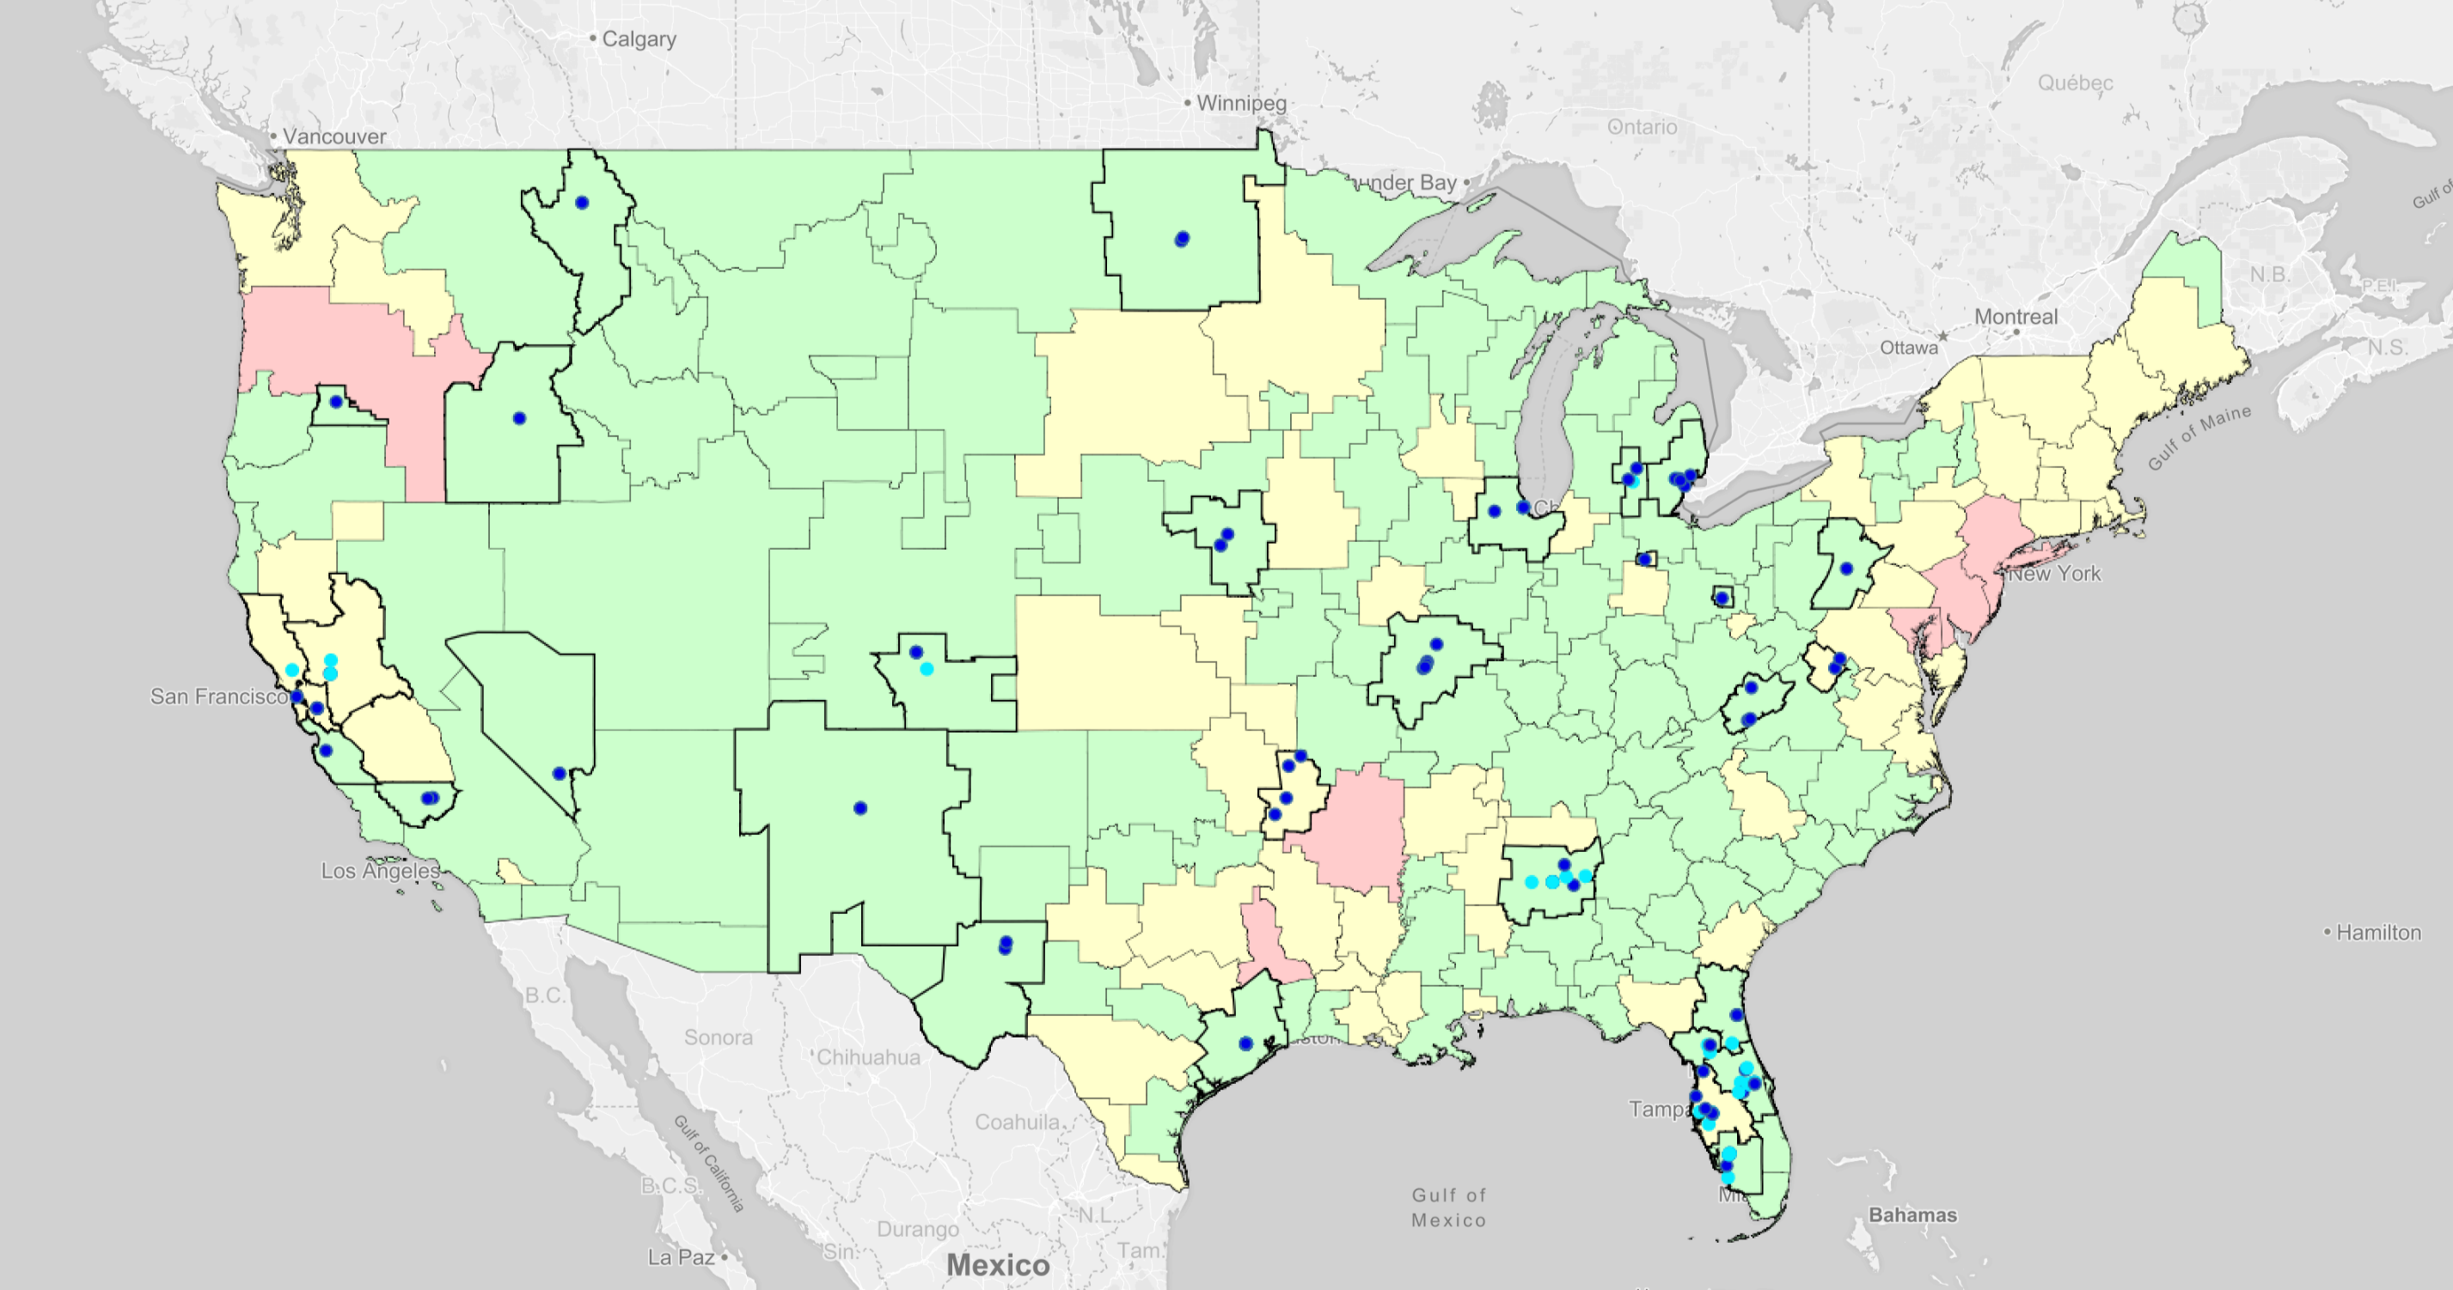
Transitioning Stations at 84 MHz: Phase 7

Slide 81
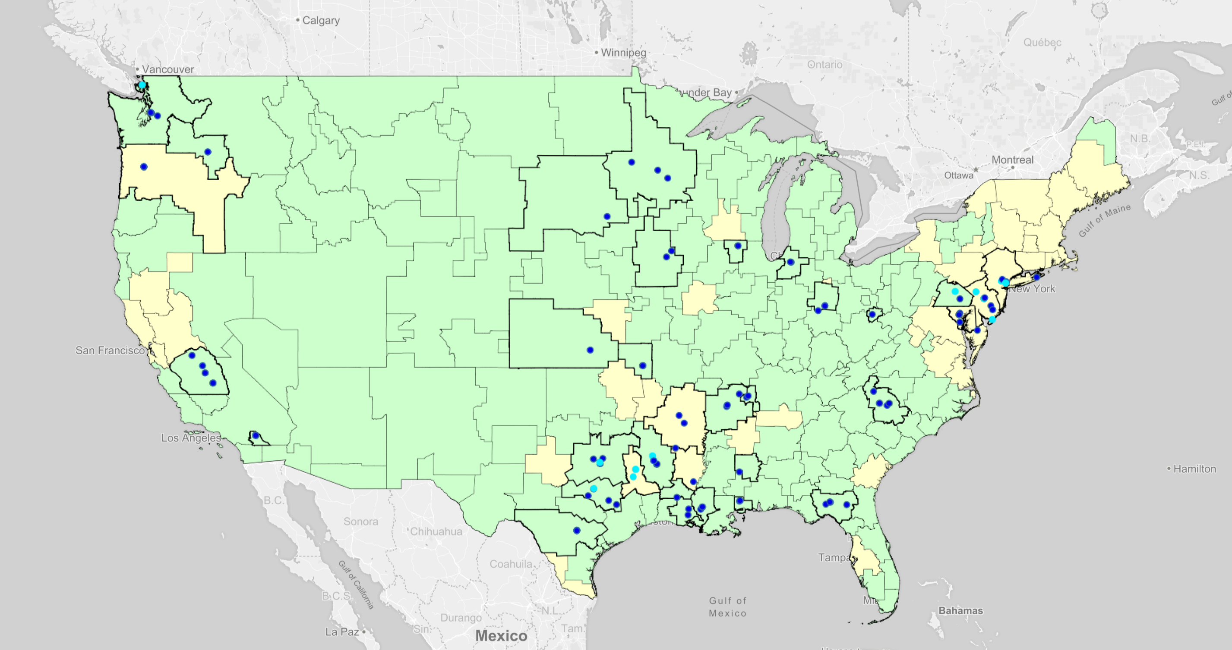
Transitioning Stations at 84 MHz: Phase 8

Slide 82
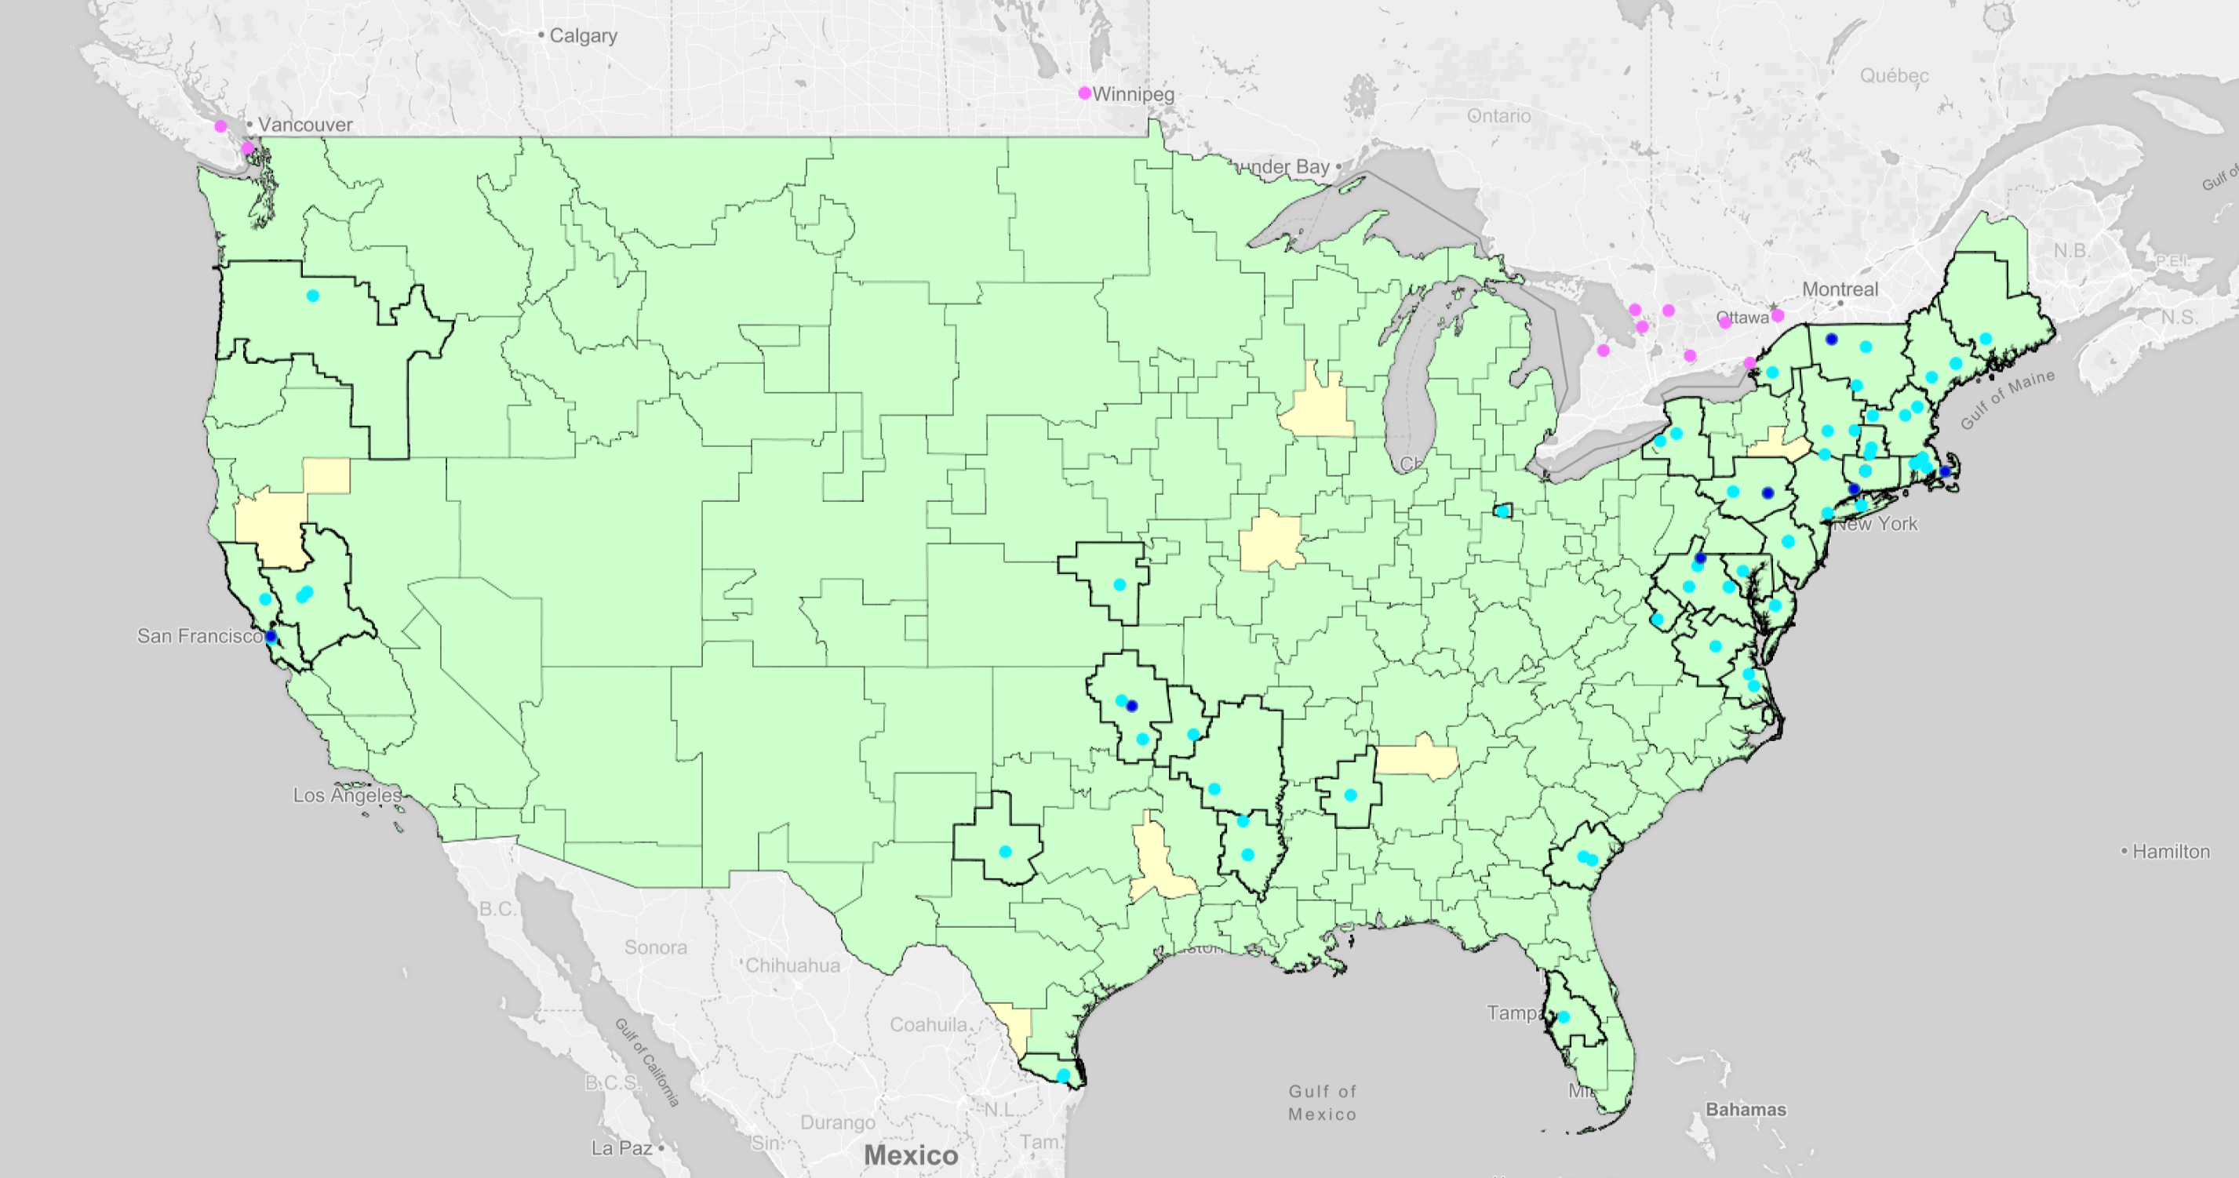
Transitioning Stations at 84 MHz: Phase 9

Slide 83
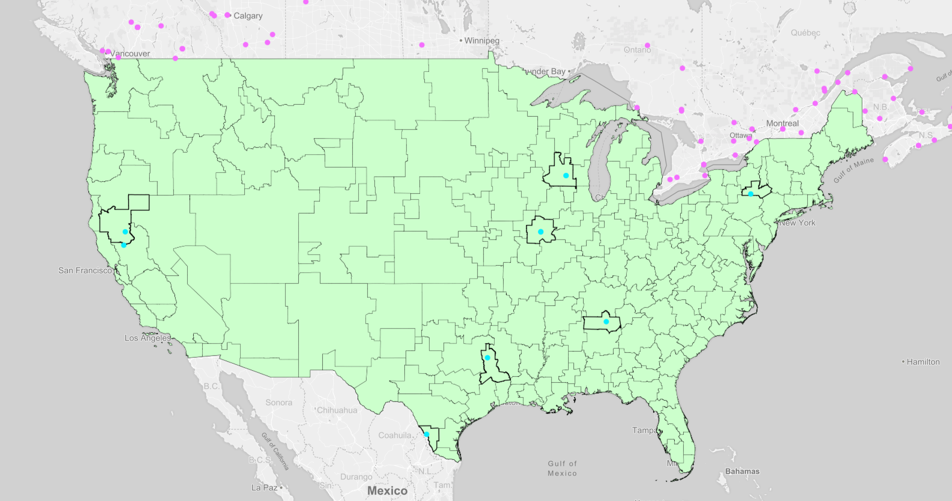
Transitioning Stations at 84 MHz: Phase 10

Slide 84
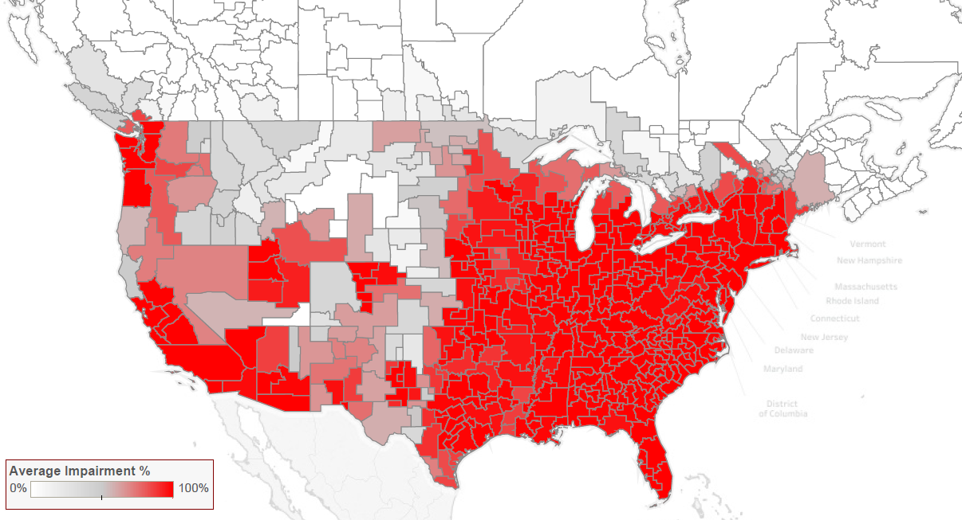
Clearing the 600 MHz Band at 84 MHz: Phase 1

Slide 85
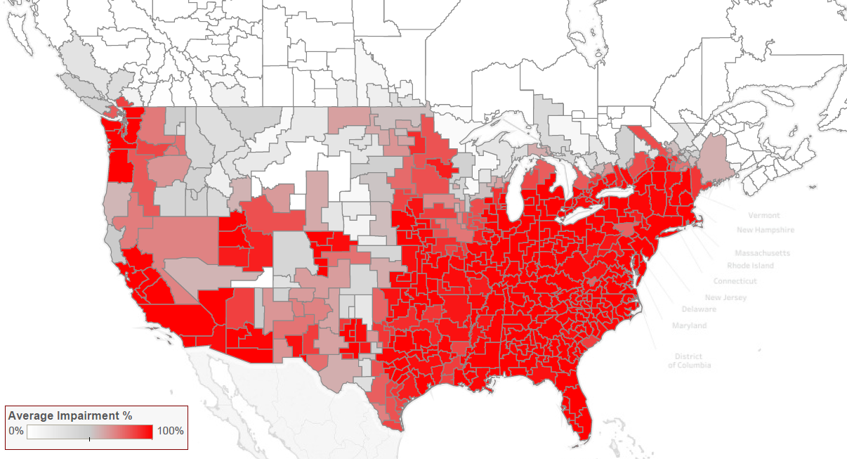
Clearing the 600 MHz Band at 84 MHz: Phase 2

Slide 86

Clearing the 600 MHz Band at 84 MHz: Phase 3

Slide 87
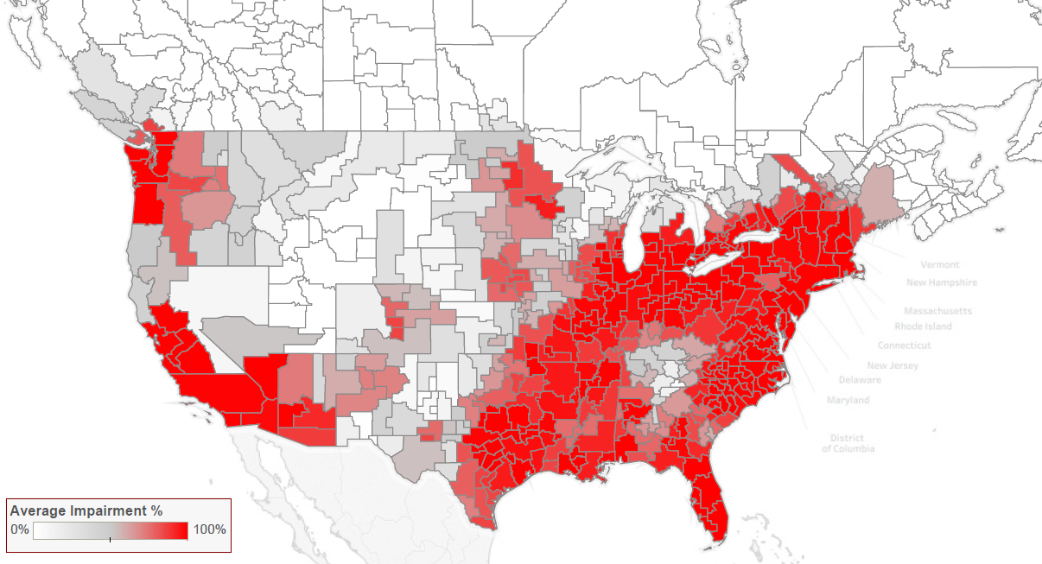
Clearing the 600 MHz Band at 84 MHz: Phase 4

Slide 88
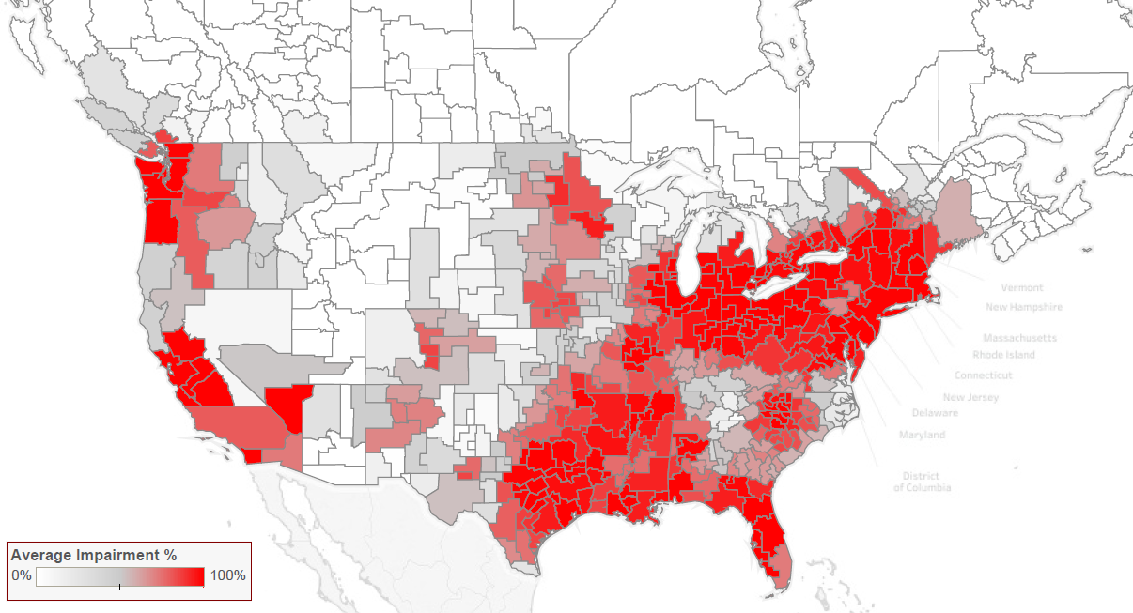
Clearing the 600 MHz Band at 84 MHz: Phase 5

Slide 89
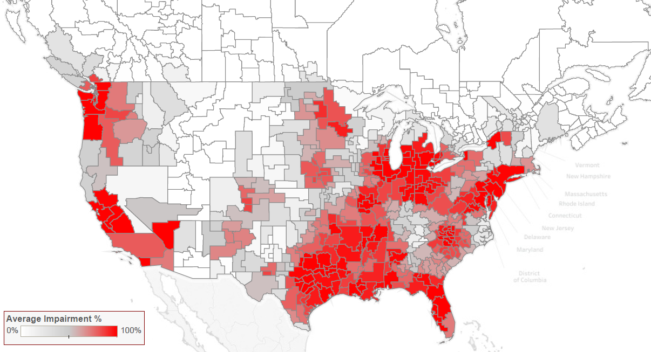
Clearing the 600 MHz Band at 84 MHz: Phase 6

Slide 90
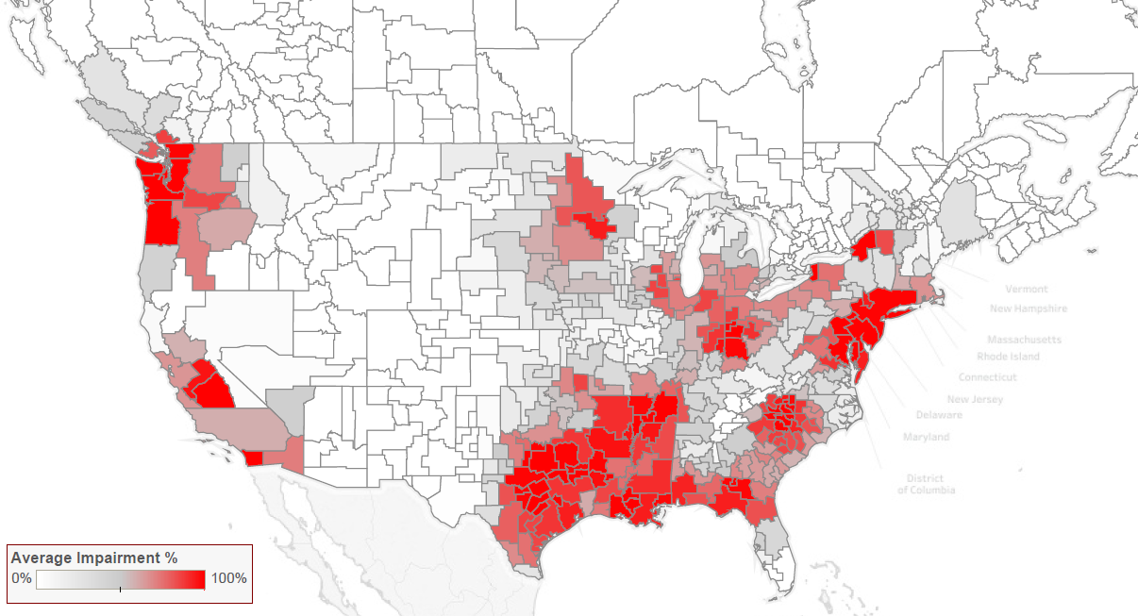
Clearing the 600 MHz Band at 84 MHz: Phase 7

Slide 91
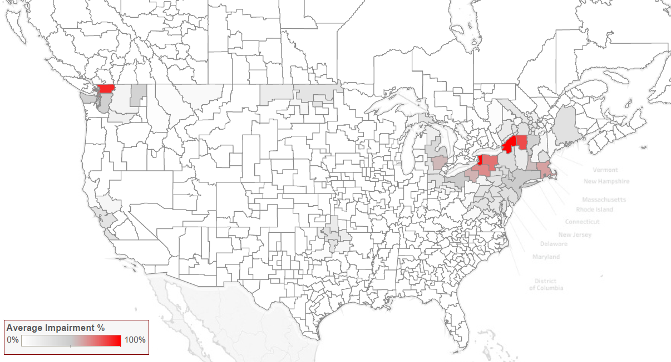
Clearing the 600 MHz Band at 84 MHz: Phase 8

Slide 92

Clearing the 600 MHz Band at 84 MHz: Phase 9

Slide 93

Clearing the 600 MHz Band at 84 MHz: Phase 10

