Slide 1
Mobility Fund II
Introduction to
the MF-II Challenge Process
for State, Local, and Tribal Governments

Slide 2
Today’s Topics
Mobility Fund Phase II Overview
Mobility Fund Phase II Challenge Process High-level
Initial Eligible Areas Map
Challenge Process Step-by-Step
Mobility Fund Phase II Challenge Process Details
Window to File Challenges
Window to File Responses
Adjudication of Challenges
Other Important Resources

Slide 3
MF-II Overview
Universal service funding to be used to advance 4G LTE service
Areas eligible for MF-II support will be where there is no qualifying unsubsidized service
Challenge Process helps determine those areas
$4.53B over ten years
Support awarded through a reverse auction
Bidders submit bids for support to provide service in eligible areas
An auction is an efficient mechanism for determining how much of the fixed budget should be awarded to specific providers in specific areas

Slide 4
Areas Eligible for MF-II Support
Areas without unsubsidized, qualified 4G LTE service are eligible for MF-II support
“Qualified” 4G LTE service is mobile broadband with download speeds of at least 5Mbps at the cell edge with 80 percent cell edge probability and a 30 percent cell loading factor
Determinations of whether a provider that deploys qualified 4G LTE in an area is subsidized or unsubsidized will be based only on whether it receives high-cost support for that area
In other words, eligible areas are those areas:
Where no provider offers qualified 4G LTE service at all; or
Where one or more providers in the area offer qualified 4G LTE service but each provider offering service is subsidized for that area.

Slide 5
Generating Initial Eligible Areas Map
Providers filed for a new, one-time collection of qualified 4G LTE service coverage data
Entities that previously reported mobile LTE coverage on Form 477 and have qualified mobile 4G LTE coverage were required to file
Coverage data was submitted by providers in January 2018
Coverage data was combined with USAC subsidy data to establish initial eligible areas
Any area where a carrier receives frozen high-cost support or received MF-I support is considered to be subsidized
Map of initial eligible areas published on the Commission’s MF-II web page on Feb. 27, 2018 at:
www.fcc.gov/maps/mobility-fund-ii-initial-eligible-areas-map/

Slide 6
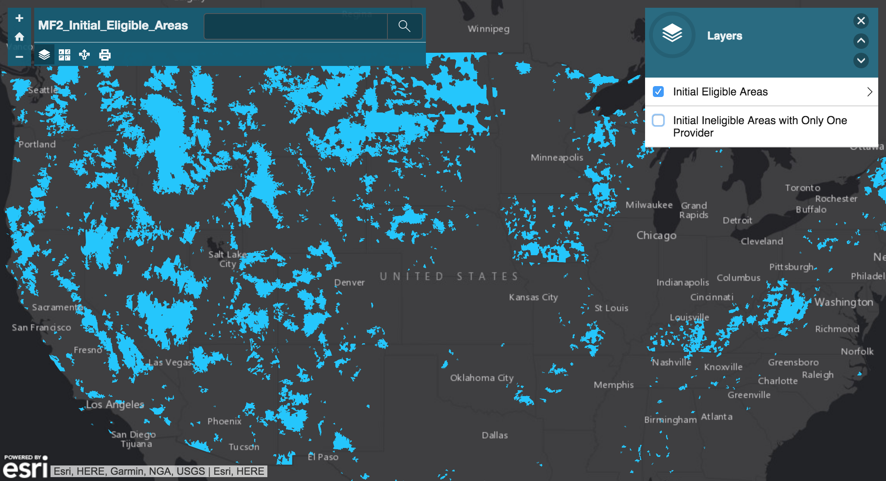
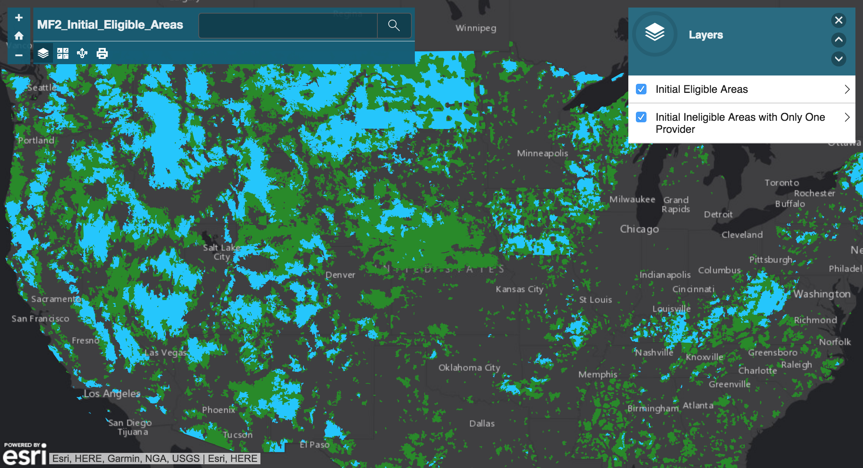
Initial Eligible Areas Map

Slide 7
Why a Challenge Process?
The new, one-time collection of 4G LTE coverage maps established a baseline of where providers predict there is qualified 4G LTE service
Coverage maps are based upon providers’ propagation models, and may or may not necessarily reflect the actual, on-the-ground consumer experience
Challenge Process facilitates interested parties to review confidential coverage maps used to determine the initial map of eligible areas
Allowing parties to dispute maps with actual speed test measurements will improve underlying data
Accurate coverage data ensures that high-cost support in the MF-II auction goes to areas that truly lack unsubsidized, qualified 4G LTE service

Slide 8
Challenge Process Timeline
Jan. 4, 2018: providers submitted one-time collection of 4G LTE coverage data
Feb. 27, 2018: initial map of eligible areas released publicly
Mar. 29, 2018 – Aug. 27, 2018: window to file challenges (“challenge window”)
Sep. 2018: opportunity for challenged parties to view challenge data
Oct. 2018 – Nov. 2018: window to file responses (“response window”)
Adjudication: after the response window closes, staff will adjudicate challenges and determine the final map of eligible areas
Final map of areas eligible in MF-II auction

Slide 9
General Information on Challenges
Who can challenge?
Mobile service providers
State, local, and tribal government entities
Other parties seeking to challenge must submit and be granted a waiver
May challenge areas presumptively ineligible for MF-II support
Eligible areas are not challengeable
Challengers must submit speed tests showing lack of coverage to initiate a challenge
Challenged parties may respond
Challenges will be adjudicated at the end of the process using a preponderance of the evidence standard

Slide 10
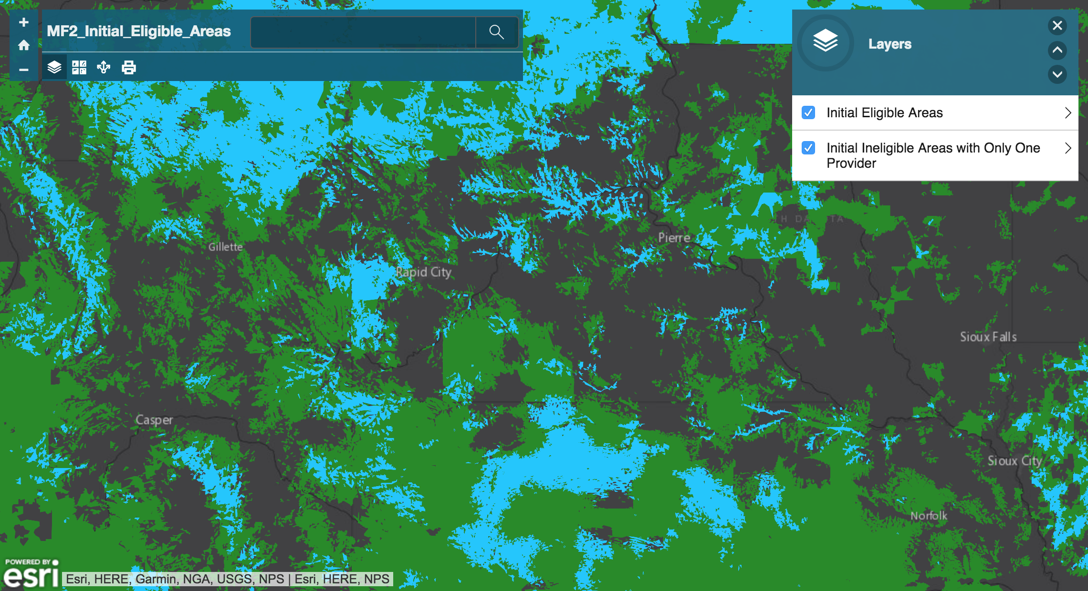
Deciding to Participate

Slide 11
Challenge Process Step-by-Step
Request access to the USAC Challenge Portal via the access request form
Any person affiliated with a state, local, and tribal government entity may request access on behalf of the government entity using this form
Log in to the USAC Challenge Portal and download the confidential, provider-specific coverage data
Analyze the provider-specific coverage data and determine where to challenge
Conduct speed test measurements in these areas
Tests may be conducted using free FCC Speed Test app (iOS / Android)
All tests must be conducted using one of the devices identified by the provider as suitable for testing its coverage
Submit all collected tests via the Challenge Portal

Slide 12
Window to File Challenges
Map of initial eligible areas released on Feb. 27, 2018
The Commission publicly released Shapefiles of eligible areas for use with mapping software such ArcGIS or QGIS
In addition, the Commission publicly released map and Shapefiles showing areas that are ineligible due to coverage by only one unsubsidized provider
Challenge window is open for more than 150 days
Window open from March 29, 2018 through August 27, 2018
Challengers can submit challenges at any point during window
Challengers can download confidential provider-specific maps via USAC Challenge Portal during the window
Challengers submit speed tests by state via the portal

Slide 13
Challenger Speed Tests
Speed test measurements may be drive tests (either hardware- or software-based) or app-based tests
Free “FCC Speed Test” app (for either iOS or Android) may be used to gather measurements
In order to be valid, speed test measurements:
Must use handsets specified by the mobile provider
Must be taken outdoors between 6 AM and midnight
Must be conducted after Feb. 27. 2018
Must be conducted for each unsubsidized provider in an area in order to be counted as proof that the area lacks coverage
All speed test data must be certified by a qualified engineer or, for government entities without an engineer available, by a government official

Slide 14
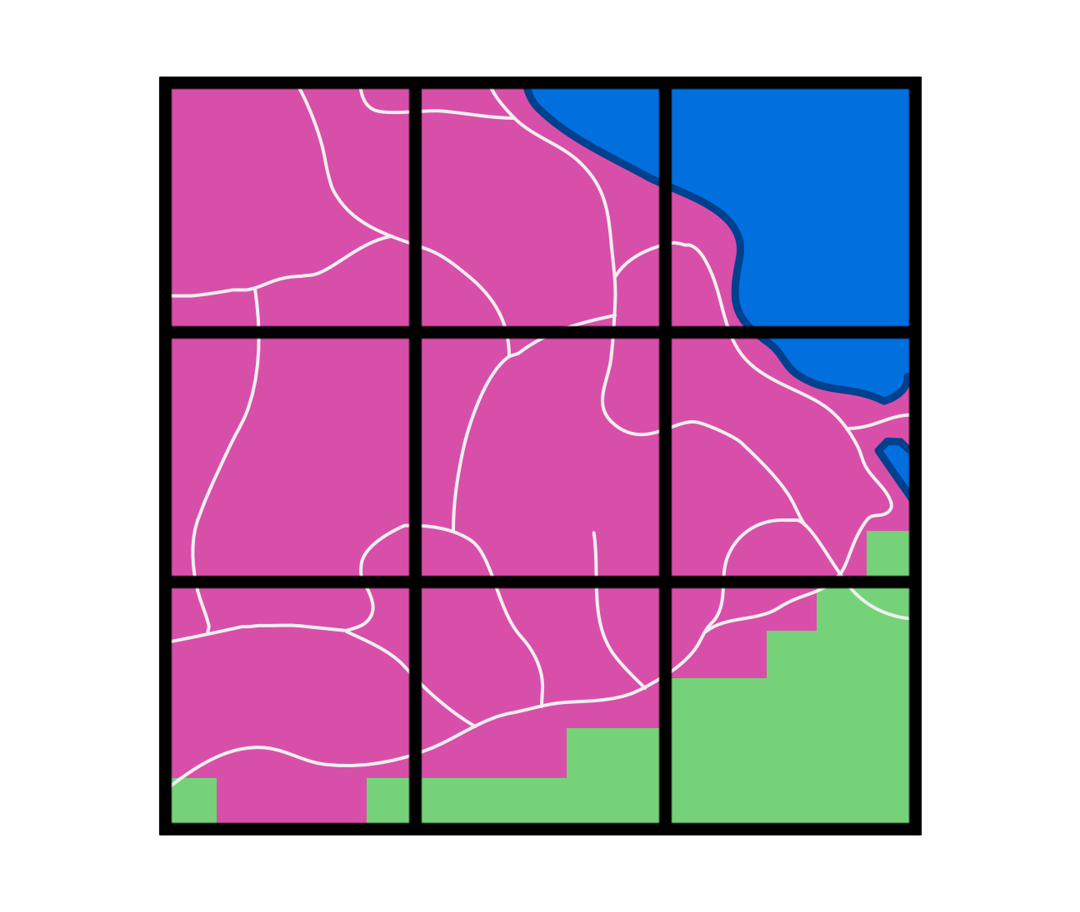
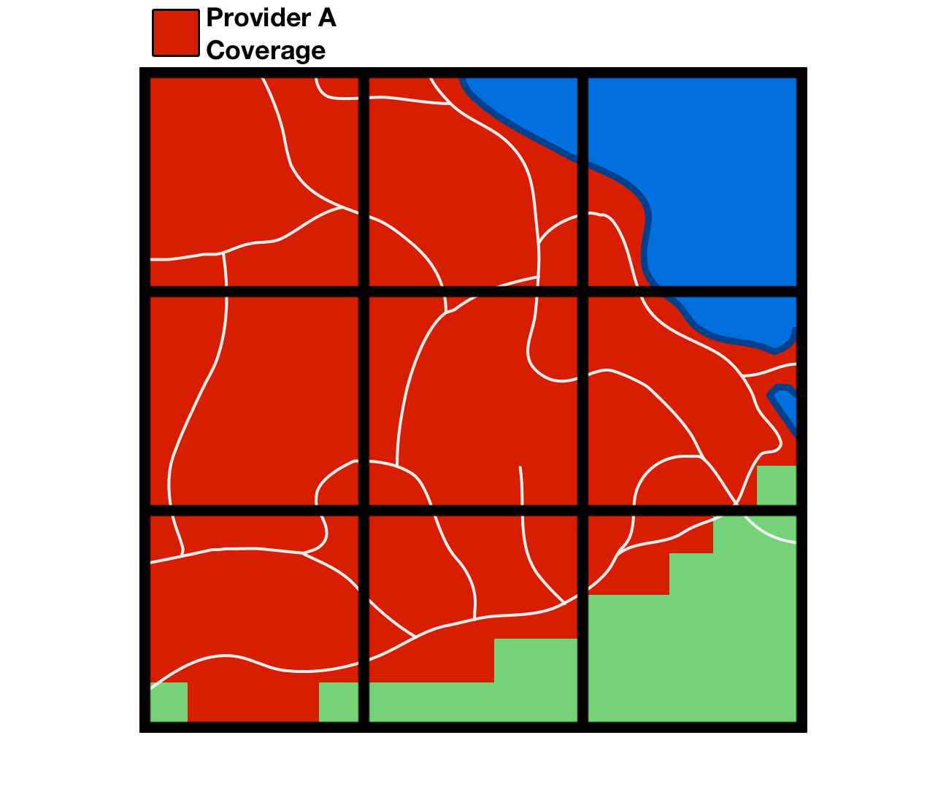
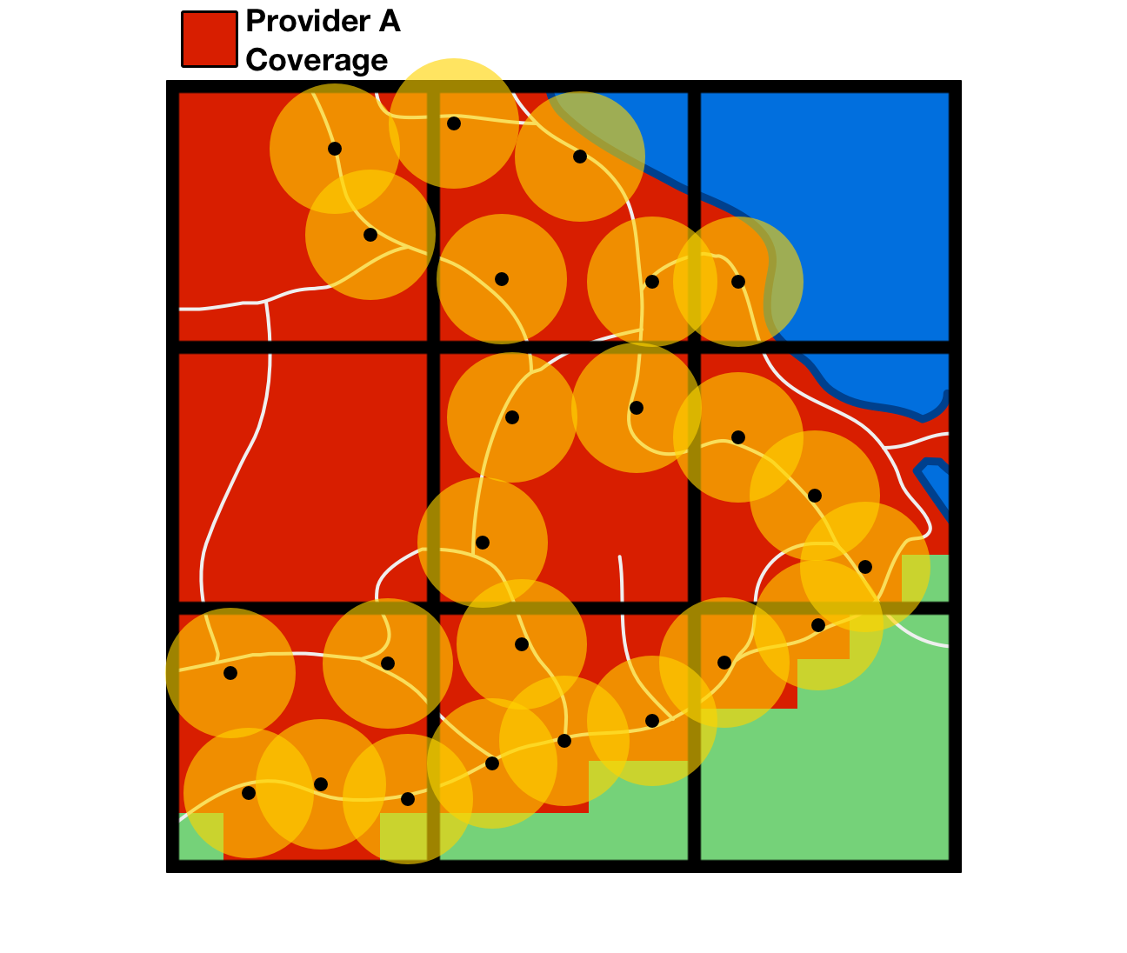
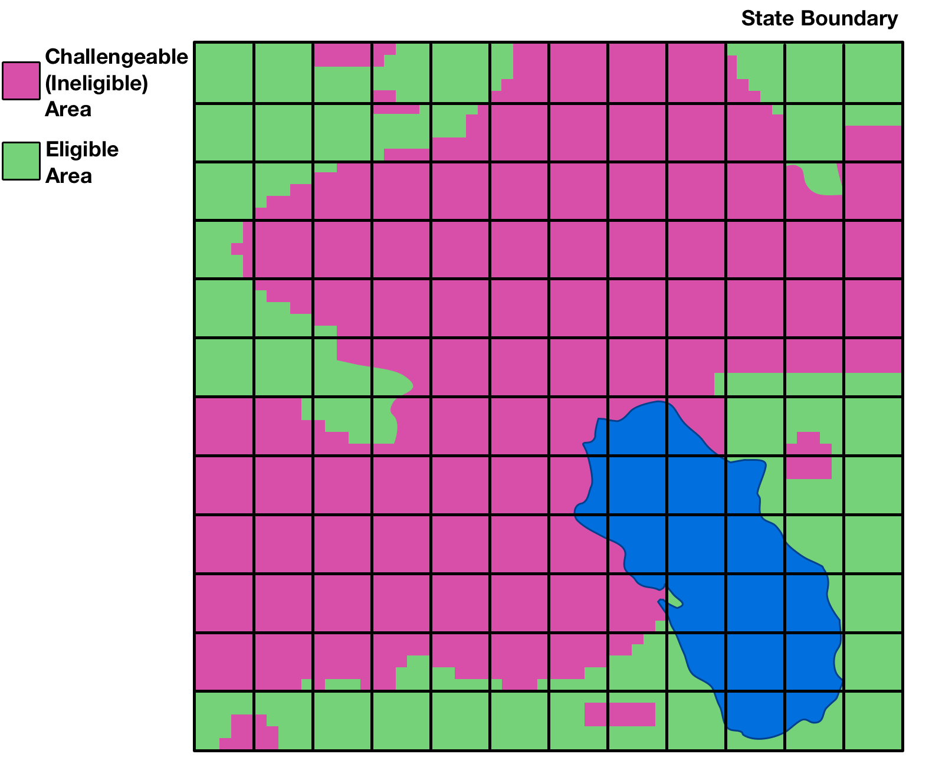
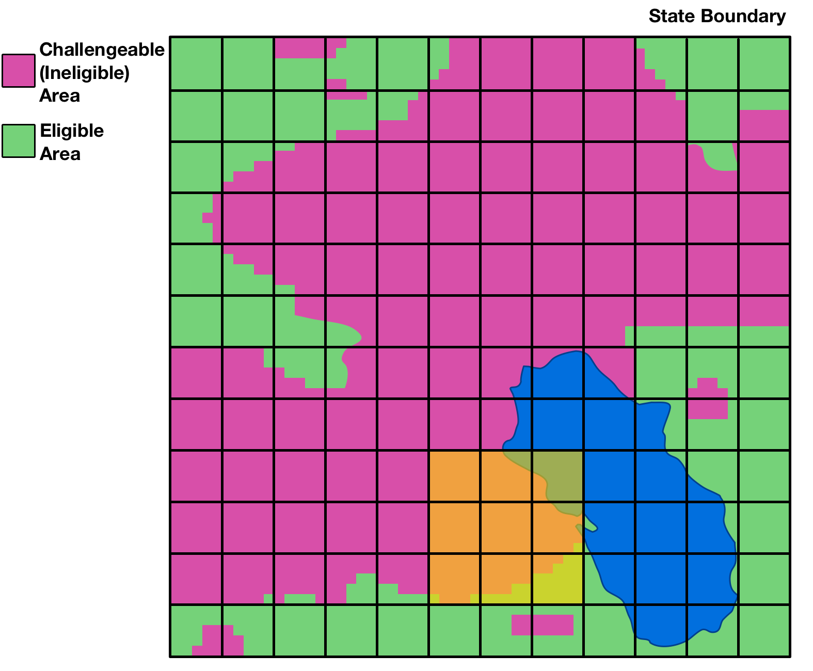
Details on Challenging an Area
How do challengers go about challenging an area?
Review confidential data in the USAC portal
Identify area to challenge
Collect speed tests for each provider in the area
Speed tests must use standard parameters and meet specified requirements in order to be to counted
Each counted speed test is considered evidence for a larger, “buffered” area
Submit all collected evidence in tabular (CSV) format via the USAC portal for automated system processing

Slide 15
Opportunity to Respond to a Challenge
Each challenged party will have an opportunity to view certified challenges to its coverage area before the response window opens
Challenged parties may, but are not required to, respond to a challenge
Challenged parties may submit their own technical evidence during the response window
Response window will be open for 30 days

Slide 16
Adjudicating Challenges
The Commission will use a preponderance of evidence standard to adjudicate disputes over coverage
A challenger must demonstrate that it is more likely than not that the challenged area does not have qualified LTE coverage
Challengers bear the burden of proof

Slide 17
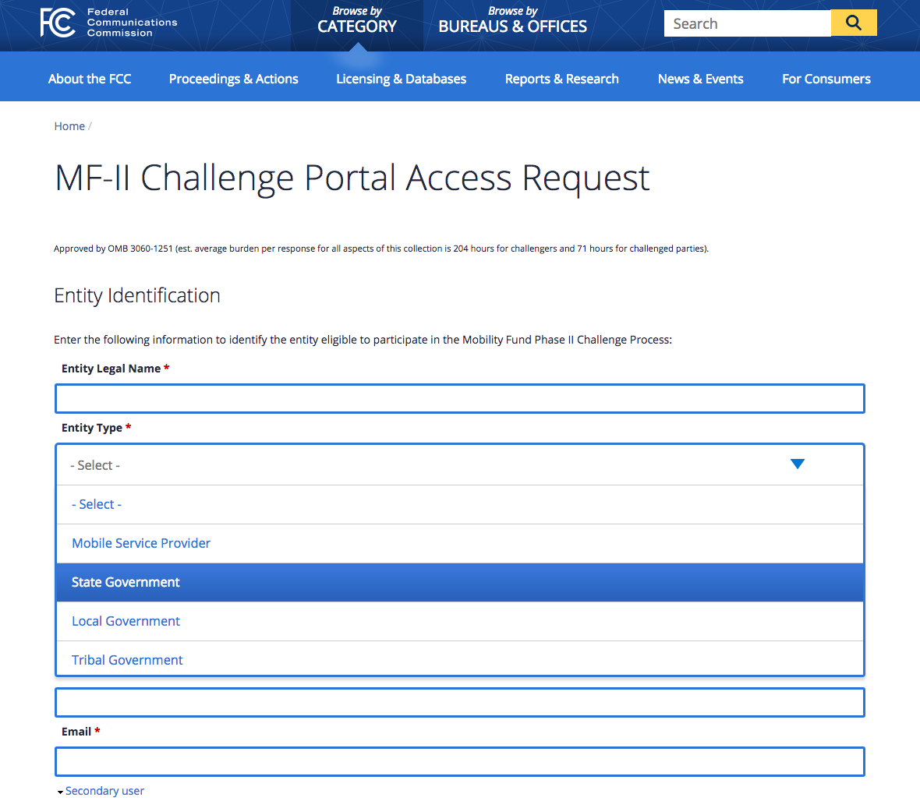
USAC Portal Access Request Form
Mobile service providers and government entities may request access to the USAC Challenge Portal at any point during the Challenge Process
Other parties seeking to participate must first submit and be granted a waiver
USAC Portal Access Request Form: www.fcc.gov/MF2-Challenge-Portal/form

Slide 18
Additional Resources
Important documents and resources, such as the initial eligible areas map and access request form, are available via the MF-II web page:
www.fcc.gov/mobility-fund-phase-2
Specific information on how to use the USAC Challenge Portal to file challenges is available via the USAC High-Cost page:
www.usac.org/hc/MFII-challenge-process.aspx

Slide 19
Questions?
We will take a 10 minute break and then return to answer questions.
Please email any questions to:
mf2challengeprocess@fcc.gov
For further information on Mobility Fund II:
https://www.fcc.gov/mobility-fund-phase-2

