Slide 1
Connect America Fund Phase II Auction (Auction 903) Bidding System Workshop
July 9, 2018
2:00 PM – 4:00 PM

Slide 2
Disclaimer
The examples that appear in this presentation do not reflect any predictions or assumptions about the actual bidding in the auction, what the base clock percentage will be in a particular round, when the budget will clear, the auction schedule, the number of rounds, or the outcome of the auction. The examples do not reflect the Auction 903 final eligible areas. The bidding system shown in the screen shots is not the final version of the bidding system that will be used for Auction 903. Company and bidder names are fictitious. Any similarity to actual company names, PINs, FCC Registration Numbers (FRNs), or other personal information is coincidental.

Slide 3
Please email questions to auction903@fcc.gov
The slides for today’s presentation may be downloaded from the Education tab of the Auction 903 website:
www.fcc.gov/auction/903

Slide 4
Upcoming Events
Registration materials arriving by July 12
Mock Auction
Preview of mock bidding data July 17
Mock auction bidding July 18 and 19
See Mock Auction Information Public Notice
Auction 903 bidding begins July 24

Slide 5
CAF II Auction Educational Materials
On the Education tab of the Auction 903 website:
Online Bidding Tutorial
Reviews bidding rules and procedures
Bidding System User Guide
Describes features of the bidding software
Bidding System File Formats
Details the formats of the bidding and reports files
Support Calculator Spreadsheet
Computes implied support for all T+Ls, bid percentages, and areas
CAF II Technical Guide
Provides supplementary details and examples of bidding and bid processing

Slide 6
High Level Auction Overview
Connect America Fund Phase II Auction

Slide 7
Auction Process
Auction Starts
Round
Before Clearing
Budget Cleared?
No
Yes
Clearing Round Processing
Contested Areas?
No
Auction Concludes
Yes
Round
After Clearing

Slide 8
Multiple Round, Descending Clock Auction
Each round will have a base clock percentage, which implies a level of support for a bid at that percentage
Base clock percentage starts high and is reduced in each bidding round
In each successive round, bidders indicate if they are still willing to accept support amounts corresponding to increasingly lower percentages
Bidding rounds continue as long as there is competition among areas for a share of the budget or among bidders for support to a given area

Slide 9
What is a Bid?
A bid is a request for support:
in a given area
for a given performance tier and latency (T+L)
at a given percentage
A bid corresponds to a support amount
Implied support formula depends on area’s reserve price, the T+L weight, and the bid percentage
If you are a winning bidder:
You are obliged to provide service as indicated in your bid
Your support amount will be at least the amount you agreed to accept by bidding

Slide 10
Budget Clearing
Before the budget clears, aggregate cost* exceeds the budget
Bidders are requesting more money than is available
When aggregate cost* falls within the budget, the budget “clears”
The bidding system can begin to assign winning bids
After the budget clears, rounds continue for support to areas where multiple bidders are still competing
*Aggregate cost includes support for bids at the base clock percentage, counting at most 1 bid per area

Slide 11
Bidding Before the Budget Clears
Activity Rules
Require that you do not bid for more support $ than you did in the prior round
If you do not submit any bids, you will not be able to bid in later rounds!
Limit the extent to which you can switch to bid on different areas
10% (20% in round 2) of prior round’s implied support for bids at base clock %
Intra-round Bids
You can bid at a percentage that is at least the base clock percentage but less than the prior round’s base clock percentage
Proxy Instructions
Tells the bidding system to submit bids on your behalf down to a percentage you specify
Can help you avoid missing a bidding round!
Package Bids
You specify a minimum percent (up to 75%) of the full package support that you will accept if all the package areas cannot be assigned to you; otherwise, none are assigned
Other Rules: Read the Procedures PN!

Slide 12
In the Clearing Round
Once the budget clears, the bidding system considers bids for the round in order of ascending bid percentage, and:
Determines which areas can be assigned, and to which bidders
In general,* the bid for an area at the lowest percentage is assigned
If there is more than one bid for an area at the base clock percentage, bidding rounds will continue for those areas
Calculates the “clearing price point”
The percentage at which the budget is just enough to cover the assigned bids and the areas with more than one bid at the base clock percentage
Bids above the clearing price point are not assigned
Determines the support amount for each assigned bid
In general,* if there is no other bid for the area, support is calculated at the clearing price point
If there are other bids for an area, support is at the percentage of the next lowest bid
*The rules vary slightly for package bids

Slide 13
Rounds After the Budget Clears
There will be additional clock rounds with bidding only for areas with multiple bids at the base clock percentage of the previous round
Same areas, same bidders, same T+L only
As many rounds as needed
Bids at the base clock percentage carry forward to the next round
Bidders can also make lower bids, as in rounds before the budget cleared
For each area, the bid at the lowest percentage wins, but is supported at the percentage at which the next lowest bidder dropped out
Bidding ends when there is no area with more than one bid at the base clock percentage

Slide 14
Introduction to the Bidding system

Slide 15
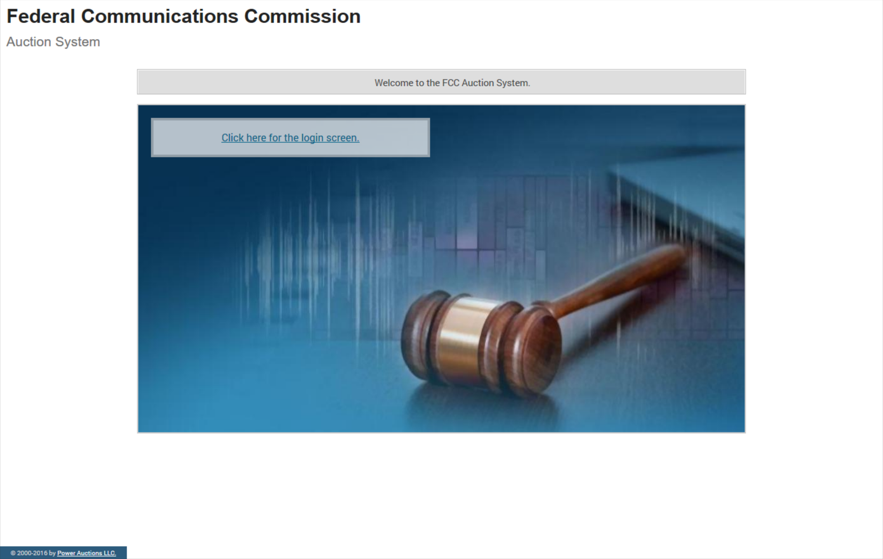
Bidding System Home Page

Slide 16
Logging In

Slide 17
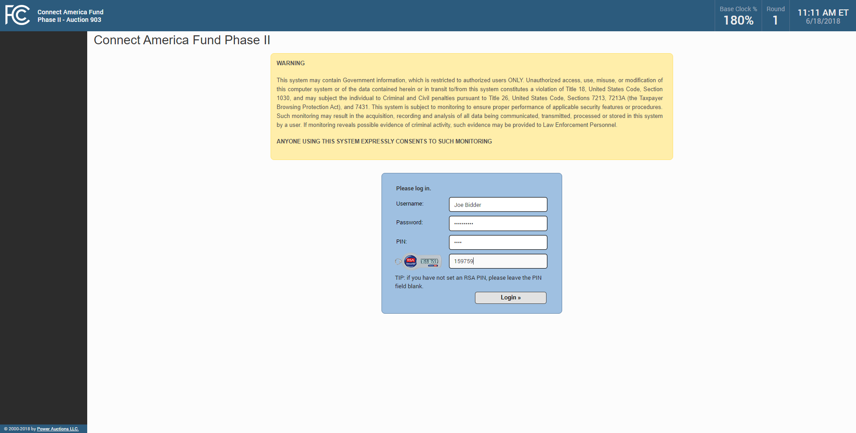
Logging In

Slide 18
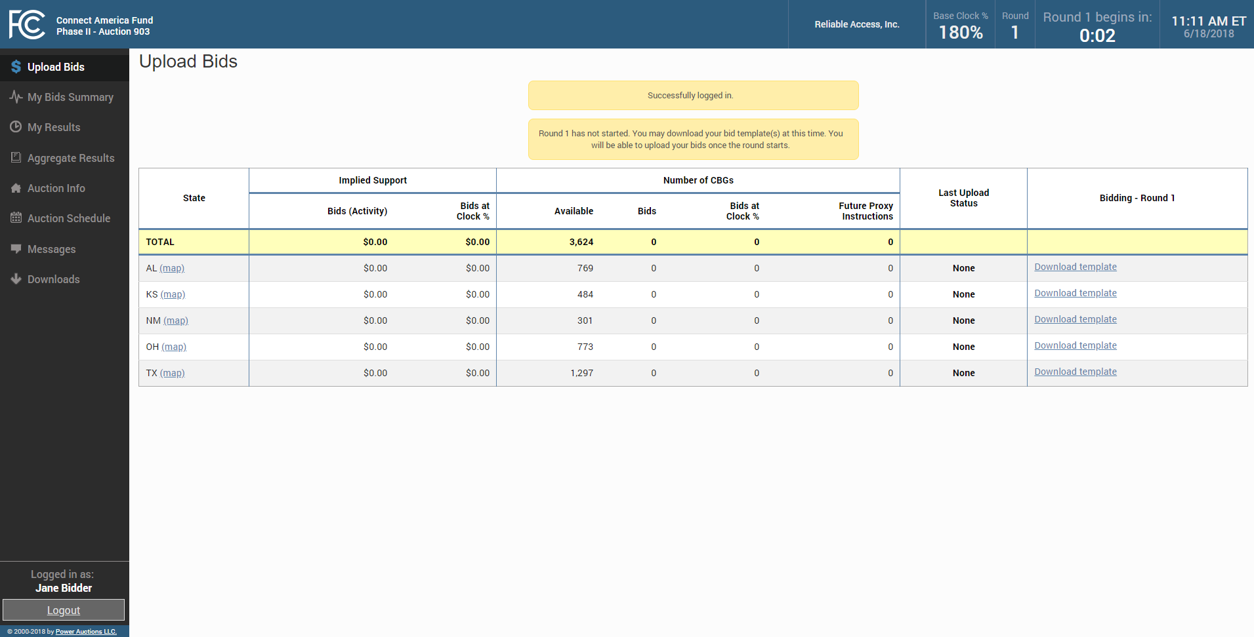
Navigation Bar

Slide 19
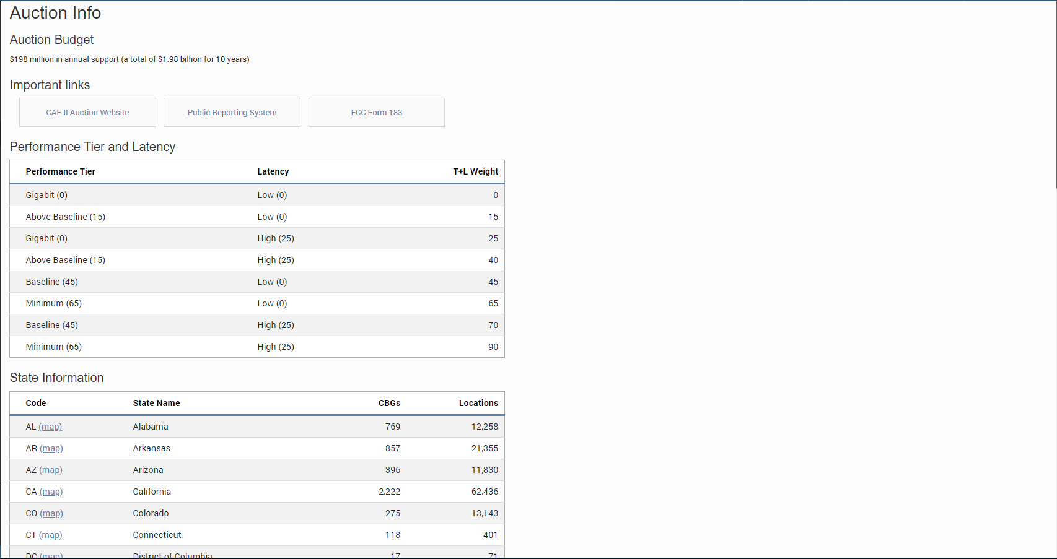
Auction Info

Slide 20
Auction Schedule

Slide 21
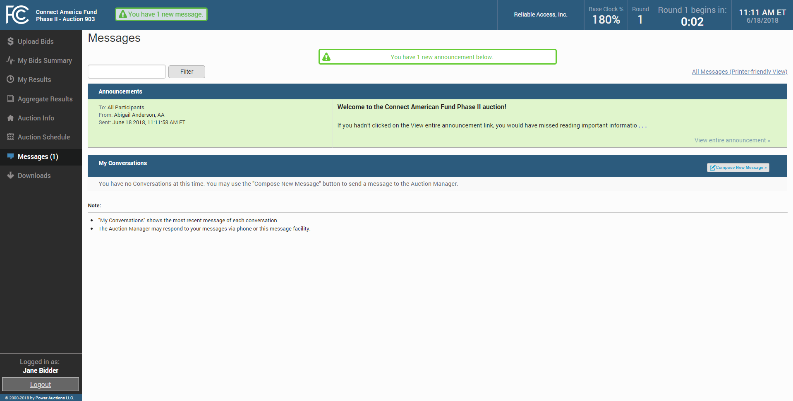
Messages

Slide 22
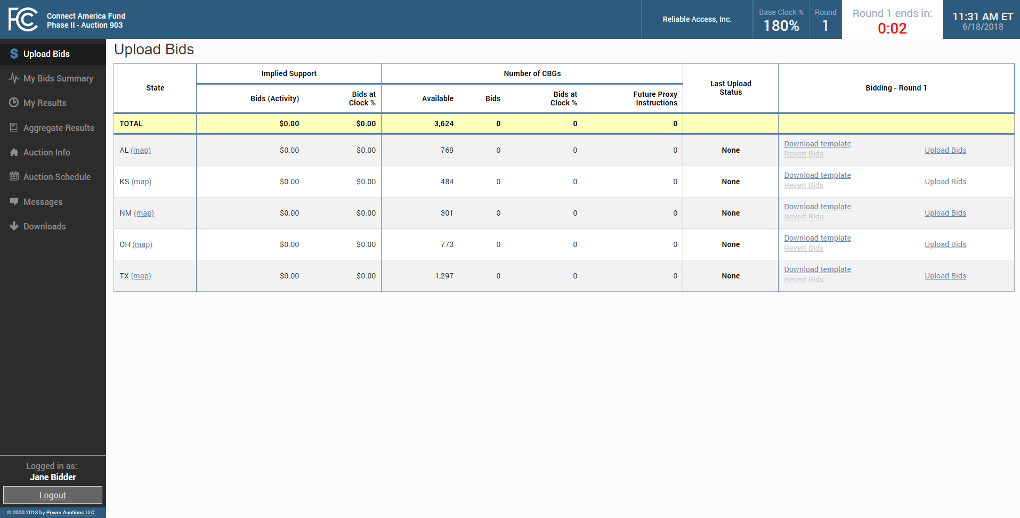
Download Template

Slide 23
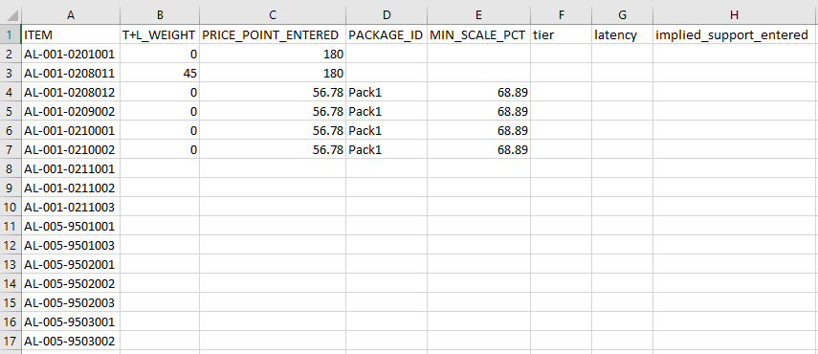
Enter Bids In Template

Slide 24
Upload Bids

Slide 25
Choose File and Upload Bids

Slide 26
Bids Uploaded

Slide 27
Verify Bids on My Bids Summary

Slide 28
Verify Bids on the Map

Slide 29
My Bids Map

Slide 30
Additional Details Box

Slide 31
Download My Bids for AL

Slide 32
Upload Bids

Slide 33
Bid template

Slide 34
Edit Bid Template

Slide 35
Upload Bids Failed

Slide 36
Upload Errors File

Slide 37
My Results

Slide 38
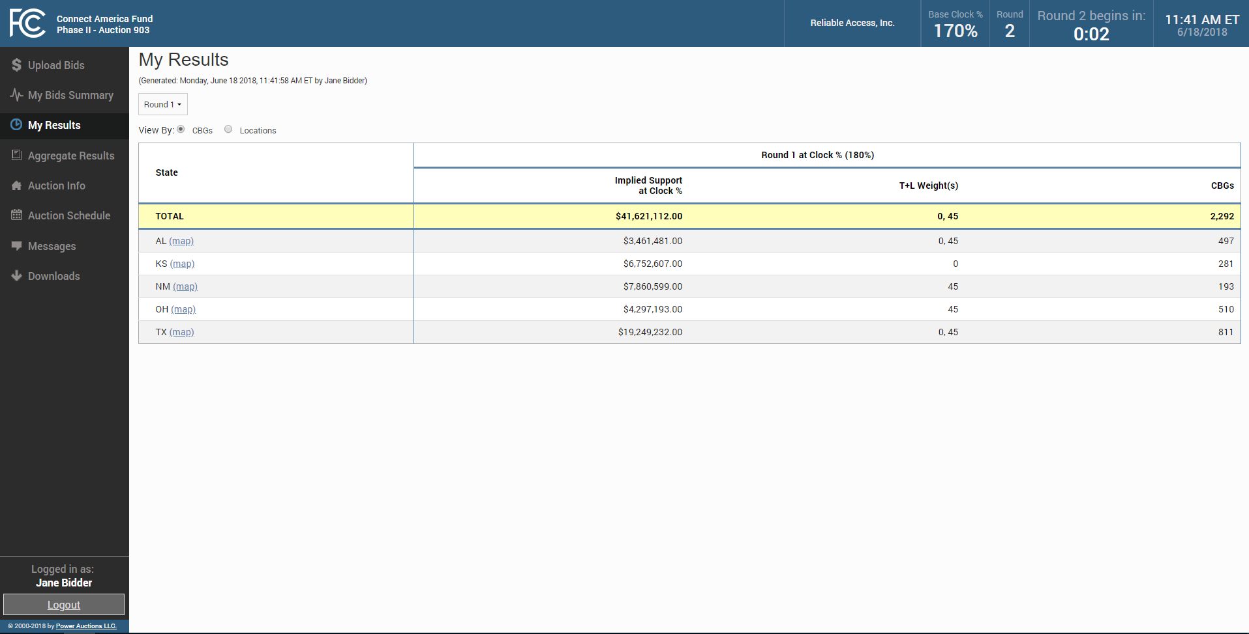
My Results Map

Slide 39
My Results Map

Slide 40
Additional Info on Map

Slide 41
Selecting an Item

Slide 42
Item Detail

Slide 43
Zooming in on an Item

Slide 44
Selecting another Item on the Map

Slide 45
Aggregate Results

Slide 46
Aggregate Results Map

Slide 47
Item Status on Aggregate Results Map

Slide 48
Downloads

Slide 49
My Assignment Tab

Slide 50
Support Calculator

Slide 51
My Results after Budget Cleared

Slide 52
My Results Map after Clearing

Slide 53
Choosing an Assigned Item on Map

Slide 54
Aggregate Results after Clearing

Slide 55
Aggregate Results Map after Clearing

Slide 56
Item Status on Aggregate Results Map

Slide 57
Connect America Fund Phase II Auction (Auction 903) Bidding System Workshop
July 9, 2018
The workshop has concluded. Please email questions to auction903@fcc.gov

