Slide 1

Working Group 3:
Network Reliability and Security Risk Reduction
Report on Best Practices and Recommendations to Mitigate Security Risks to Emerging 5G Wireless Networks
Sept, 2018

Slide 2
CSRIC VI WG3 Description/Timeline
Description: The FCC directs CSRIC to recommend mechanisms to reduce risks to network reliability and security, including: (i) best practices to mitigate the network reliability and security risks associated with the Diameter protocol, an industry standard for connecting and authenticating subscribers on mobile networks, (ii) mechanisms to best design and deploy 5G networks to mitigate risks to network reliability and security posed by the proliferation of Internet of Things devices, vulnerable supply chains, and open-source software platforms used in 5G networks, and (iii) best practices and tools to improve reliability and reduce security risks in IP-based networks and protocols.
The working group will identify and examine the security risks to wireless protocols (e.g., Diameter) impacting network reliability. Once the security risks have been identified and examined for their impact on network reliability, the working group will propose to CSRIC recommendations, including best practices, to mitigate the identified risks.
March 2018 - Report on Best Practices and Recommendations to Mitigate Security Risks to Wireless Protocols.
Sept 2018 - Report on Best Practices and Recommendations to Mitigate Security Risks to Emerging 5G Wireless Networks.
March 2019 - Report Best Practices and Recommendations to Mitigate Security Risks to Current IP-based Protocols.

Slide 3
Focus on 5G
This report focuses on risks and vulnerabilities introduced by:
  The Internet of Things (IoT)
  Network Function Virtualization (NFV) / Software Defined Networks (SDN)
  Open source software
In accomplishing this task, the WG focused specifically on 5G

Slide 4
CSRIC VI WG3 Members
- Chair Travis Russell, Director, Cyber Security | Oracle Communications
Shirley Bloomfield, CEO | NTCA–The Rural Broadband Association
Don Brittingham, VP, Public Safety Policy | Verizon Communications
Charlotte Field, SVP, Application Platform Operations | Charter Communications
Bob Gessner, Chairman | American Cable Association
Michael Iwanoff, SVP and CISO | iconectiv
Mohammad Khaled, Senior Security Specialist | Nokia Bell Labs
Jason Livingood, VP, Technology Policy & Standards | Comcast Cable
Jennifer Manner, VP Regulatory Affairs | EchoStar
Robert Mayer, VP – Industry and State Affairs | USTelecom
Susan Miller, President & CEO | Alliance for Telecom Industry Solutions (ATIS)
Drew Morin, Director, Federal Cyber Security Technology and Engineering Programs | T-Mobile
Sara Mosley, Acting CTO, OCC/NPP* | Department of Homeland Security
Greg Schumacher, Technology Development Strategist | Sprint Corporation
Lee Thibaudeau, CTO & VP of Engineering | Nsight
Tim Walden, SVP of Engineering and Construction | CenturyLink
Jeremy Larson, Network Manager | USConnect
Martin Dolly, Lead Member of Technical Staff | AT&T Services Inc.
John A. Marinho, VP Technology & Cybersecurity | CTIA

Slide 5
Source of WG3 Research
The threat assessment content was initially sourced from a series of subject matter expert (SME) presentations to the CSRIC Working Group members and augmented by additional research information provided by working group members. The SMEs that presented to the CSRIC WG3 members included:
Eric McMurry, Dir., Software Development, Office of the CTO, Oracle Communications
Roger Piqueras Jover, Wireless Engineer, Senior Security Architect, & Security Research Scientist at Bloomberg L.P.
Peter Schneider, Senior Security Researcher, Nokia Bell Labs.
Several of the WG members are also members of 3GPP and actively engaged in defining the 5G standards, bringing first-hand knowledge to this work.

Slide 6
What is 5G?
5G is the commonly used acronym assigned to the 5th generation of wireless technology that has both a fixed and a mobile component.
  It is much broader than previous generations of wireless networks.
  While previous generations of wireless services were focused on a single type of network (i.e., mobile wireless), 5G has been defined as a “network of networks.”

Slide 7
Standards Defining 5G
There are a number of standards organizations that are involved in defining standards that will apply to 5G, although 3GPP has the responsibility of defining the 5G system.
  GSM Association – Global
  Institute of Electrical and Electronics Engineers (IEEE)
  Next Generation Mobile Networks (NGMN)
  Small Cell Forum
  Multi-access Edge Computing (MEC) (ISG in ETSI)
The 3rd Generation Partnership Project (3GPP) unites seven telecommunications standard development organizations
  Association of Radio Industries and Businesses (ARIB) - Japan
  Association for Telecommunications Industry Solutions (ATIS) - US
  China Communications Standards Association (CCSA) - China
  European Telecommunications Standards Institute (ETSI) - Europe
  Telecommunications Standards Development Society, India (TSDSI) - India
  Telecommunications Technology Association (TTA) – Korea
  Telecommunications Technology Committee (TTC) - Japan

Slide 8
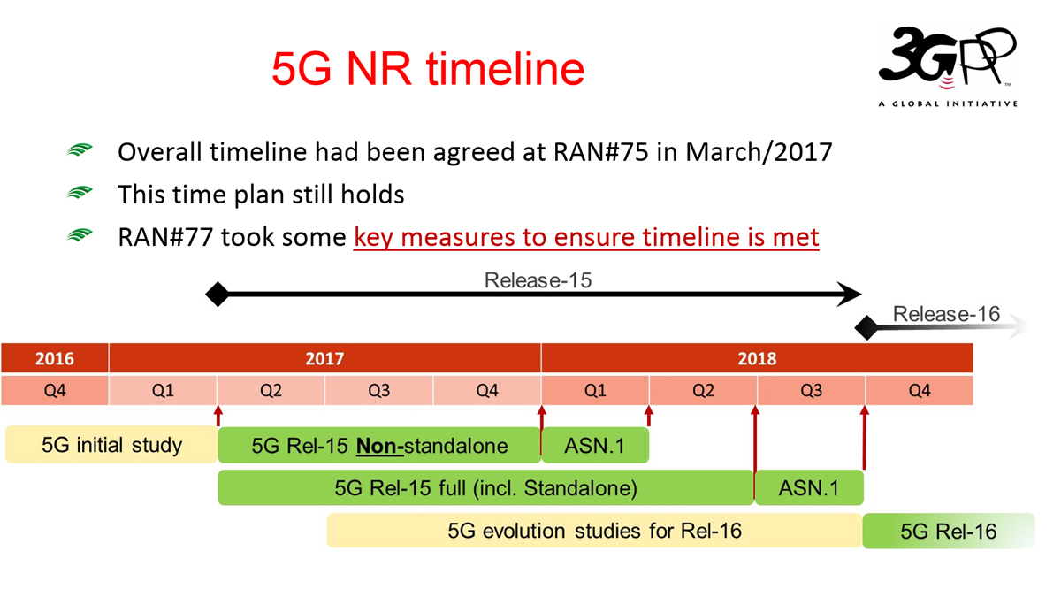
Status of 5G Standards
Figure 3‑2: The 3GPP release timeline for R15

Slide 9
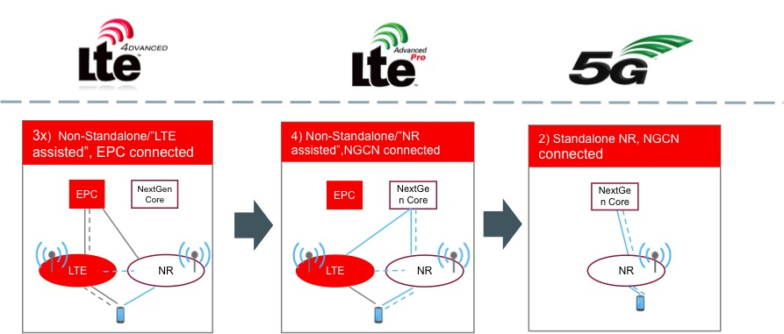
5G Deployment Models
Figure 3‑7: The three phases of 5G implementation. SOURCE: Oracle

Slide 10
Diagram: 5G Network Evolution
Figure 3‑5: The 5G architecture when compared to 4G EPC. SOURCE: Oracle Communications.
Many of the existing functions in wireless still exist, but with new names. Only a few new functions have been defined.

Slide 11
5G Signaling
5G Signaling
REST
JSON
HTTP/2
QUIC
UDP
IP
Representational State Transfer (REST)
JavaScript Object Notation (JSON)
Hypertext Transfer Protocol (HTTP/2)
Quick UDP Internet Connections (QUIC)
User Datagram Protocol (UDP)
Internet Protocol (IP)
Table 3‑2: 5G protocol stack. SOURCE: Oracle Communications

Slide 12
Key Advantages in 5G
5G uses established IT technologies, replacing the traditional telecom technologies we normally see (such as SS7 and Diameter).
Service Based Architecture (SBA)
Reduced latency and high data rates
Massive IoT
Virtualized, cloud-based networks
Multi-access Edge Computing (MEC)
Network Slicing

Slide 13
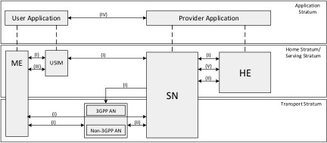
5G Security Architecture
Network Access Security (I)
Network Domain Security (II)
User Domain Security (III)
Application Domain Security (IV)
SBA Domain Security (V)
Visibility and Configurability of Security (VI)
Figure 4‑2: The 3GPP 5G Security Architecture SOURCE: 3GPP

Slide 14
Key Security Features in 5G
Security Edge Protection Proxy (SEPP)
  Protects the network interconnections
Increased Home Control
  The home network can verify the device is actually in the serving network sending messages
Serving Network Authentication
  Binding authentication keys to a serving network prevents network spoofing.
Unified Authentication Framework
  The same authentication methods are used for both 3GPP and non-3GPP access networks, providing one common method of authentication regardless of access type
Security Anchor Function (SEAF) and Authentication Framework
  5G introduces the concept of an anchor key, with the new function of the SEAF. This reduces the signaling load on the home network HSS during various mobility services.
Bidding Down Attack Mitigation
  Prevents an attacker from attempting a bidding down attack

Slide 15
5G Subscriber Identities
Subscriber Permanent Identifier (SUPI)
  Provisioned in the UDM/UDR, and used within the 5G network
  Comprised of the IMSI, to support interworking with 3G/4G networks
  Not disclosed to other networks until they authenticate
Subscription Concealed Identifier (SUCI)
  This is generated by the device and sent when it is registering with a network
  Comprised of the SUPI, MCC/MNC, and other data

Slide 16
The Internet of things (IoT)
Risks and vulnerabilities introduced by:

Slide 17
Security in IoT
The security of the IoT is manifested in a broad ecosystem that is comprised of many participants including:
  network operators,
  manufacturers,
  software developers,
  and service providers
This ecosystem will continue to expand to include much more, including (but not limited to):
  vehicles,
  industrial control systems,
  and sensors driving intelligent municipalities (smart cities)

Slide 18
Previous IoT Work
    CSRIC IV, WG5 Remediation of Server-Based Distributed Denial of Service (DDoS) Attacks
CSRIC III, WG7 Botnet Remediation and the Anti-Botnet Code of Conduct
CSRIC II, WG8 ISP Network Protection Practices
Communications Sector Coordinating Council White Paper
Report to the President on Enhancing the Resilience of the Internet and Communications Ecosystem Against Botnets and Other Automated, Distributed Threats
The WG did not repeat this work, but focused instead on interconnectivity enabled by 5G

Slide 19
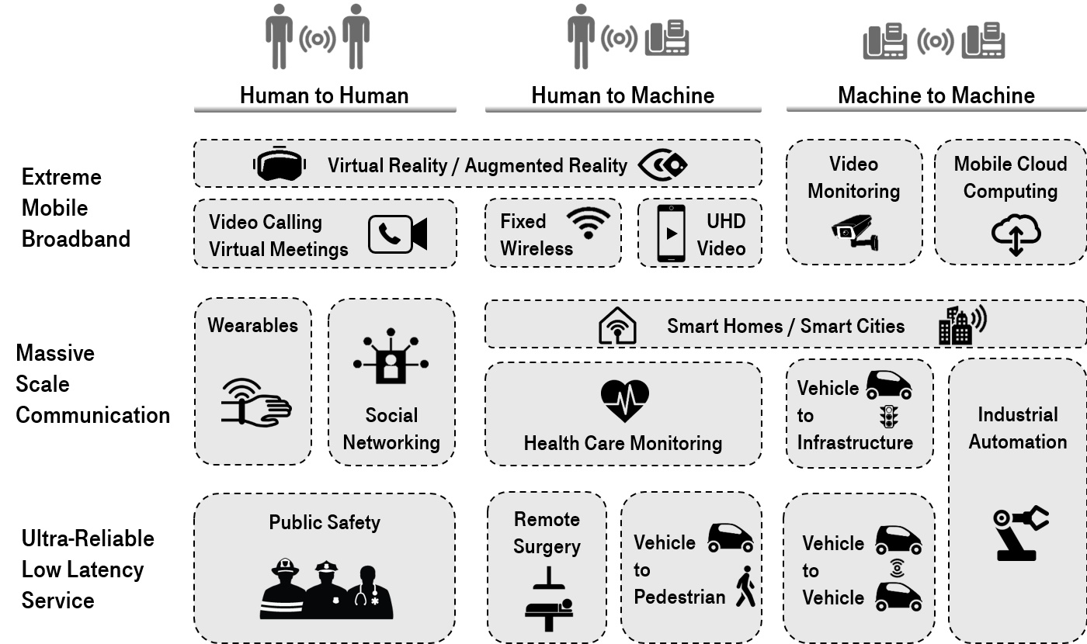
5G Use Cases for IoT
Figure 5‑1: 5G use cases grouped by the type of interaction and the range of performance requirements. SOURCE: page 19 of 5G Americas Services & Use Cases.

Slide 20
5G IoT Use Cases
Many of the use cases associated with Massive Scale Communication in the previous figure will leverage the emerging Low Power Wide Area (LPWA) needs for low cost devices
  extended coverage
  long battery life
The use cases are expected to make up a large part of the new types of services that 5G systems will address by connecting the massive number of devices such as:
  sensors,
  actuators,
  cameras,
  and wearables

Slide 21
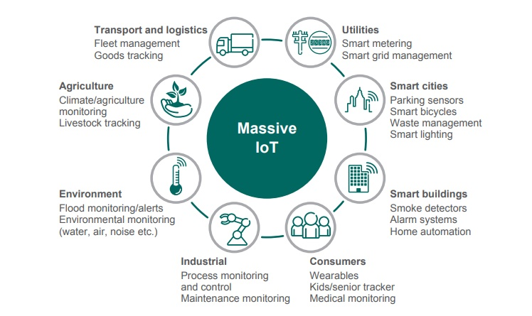
Massive IoT
Figure 5‑2: Several use cases in mMTC category enabled by 5G technologies. SOURCE: 5G Americas Services & Use Cases, page 22.

Slide 22
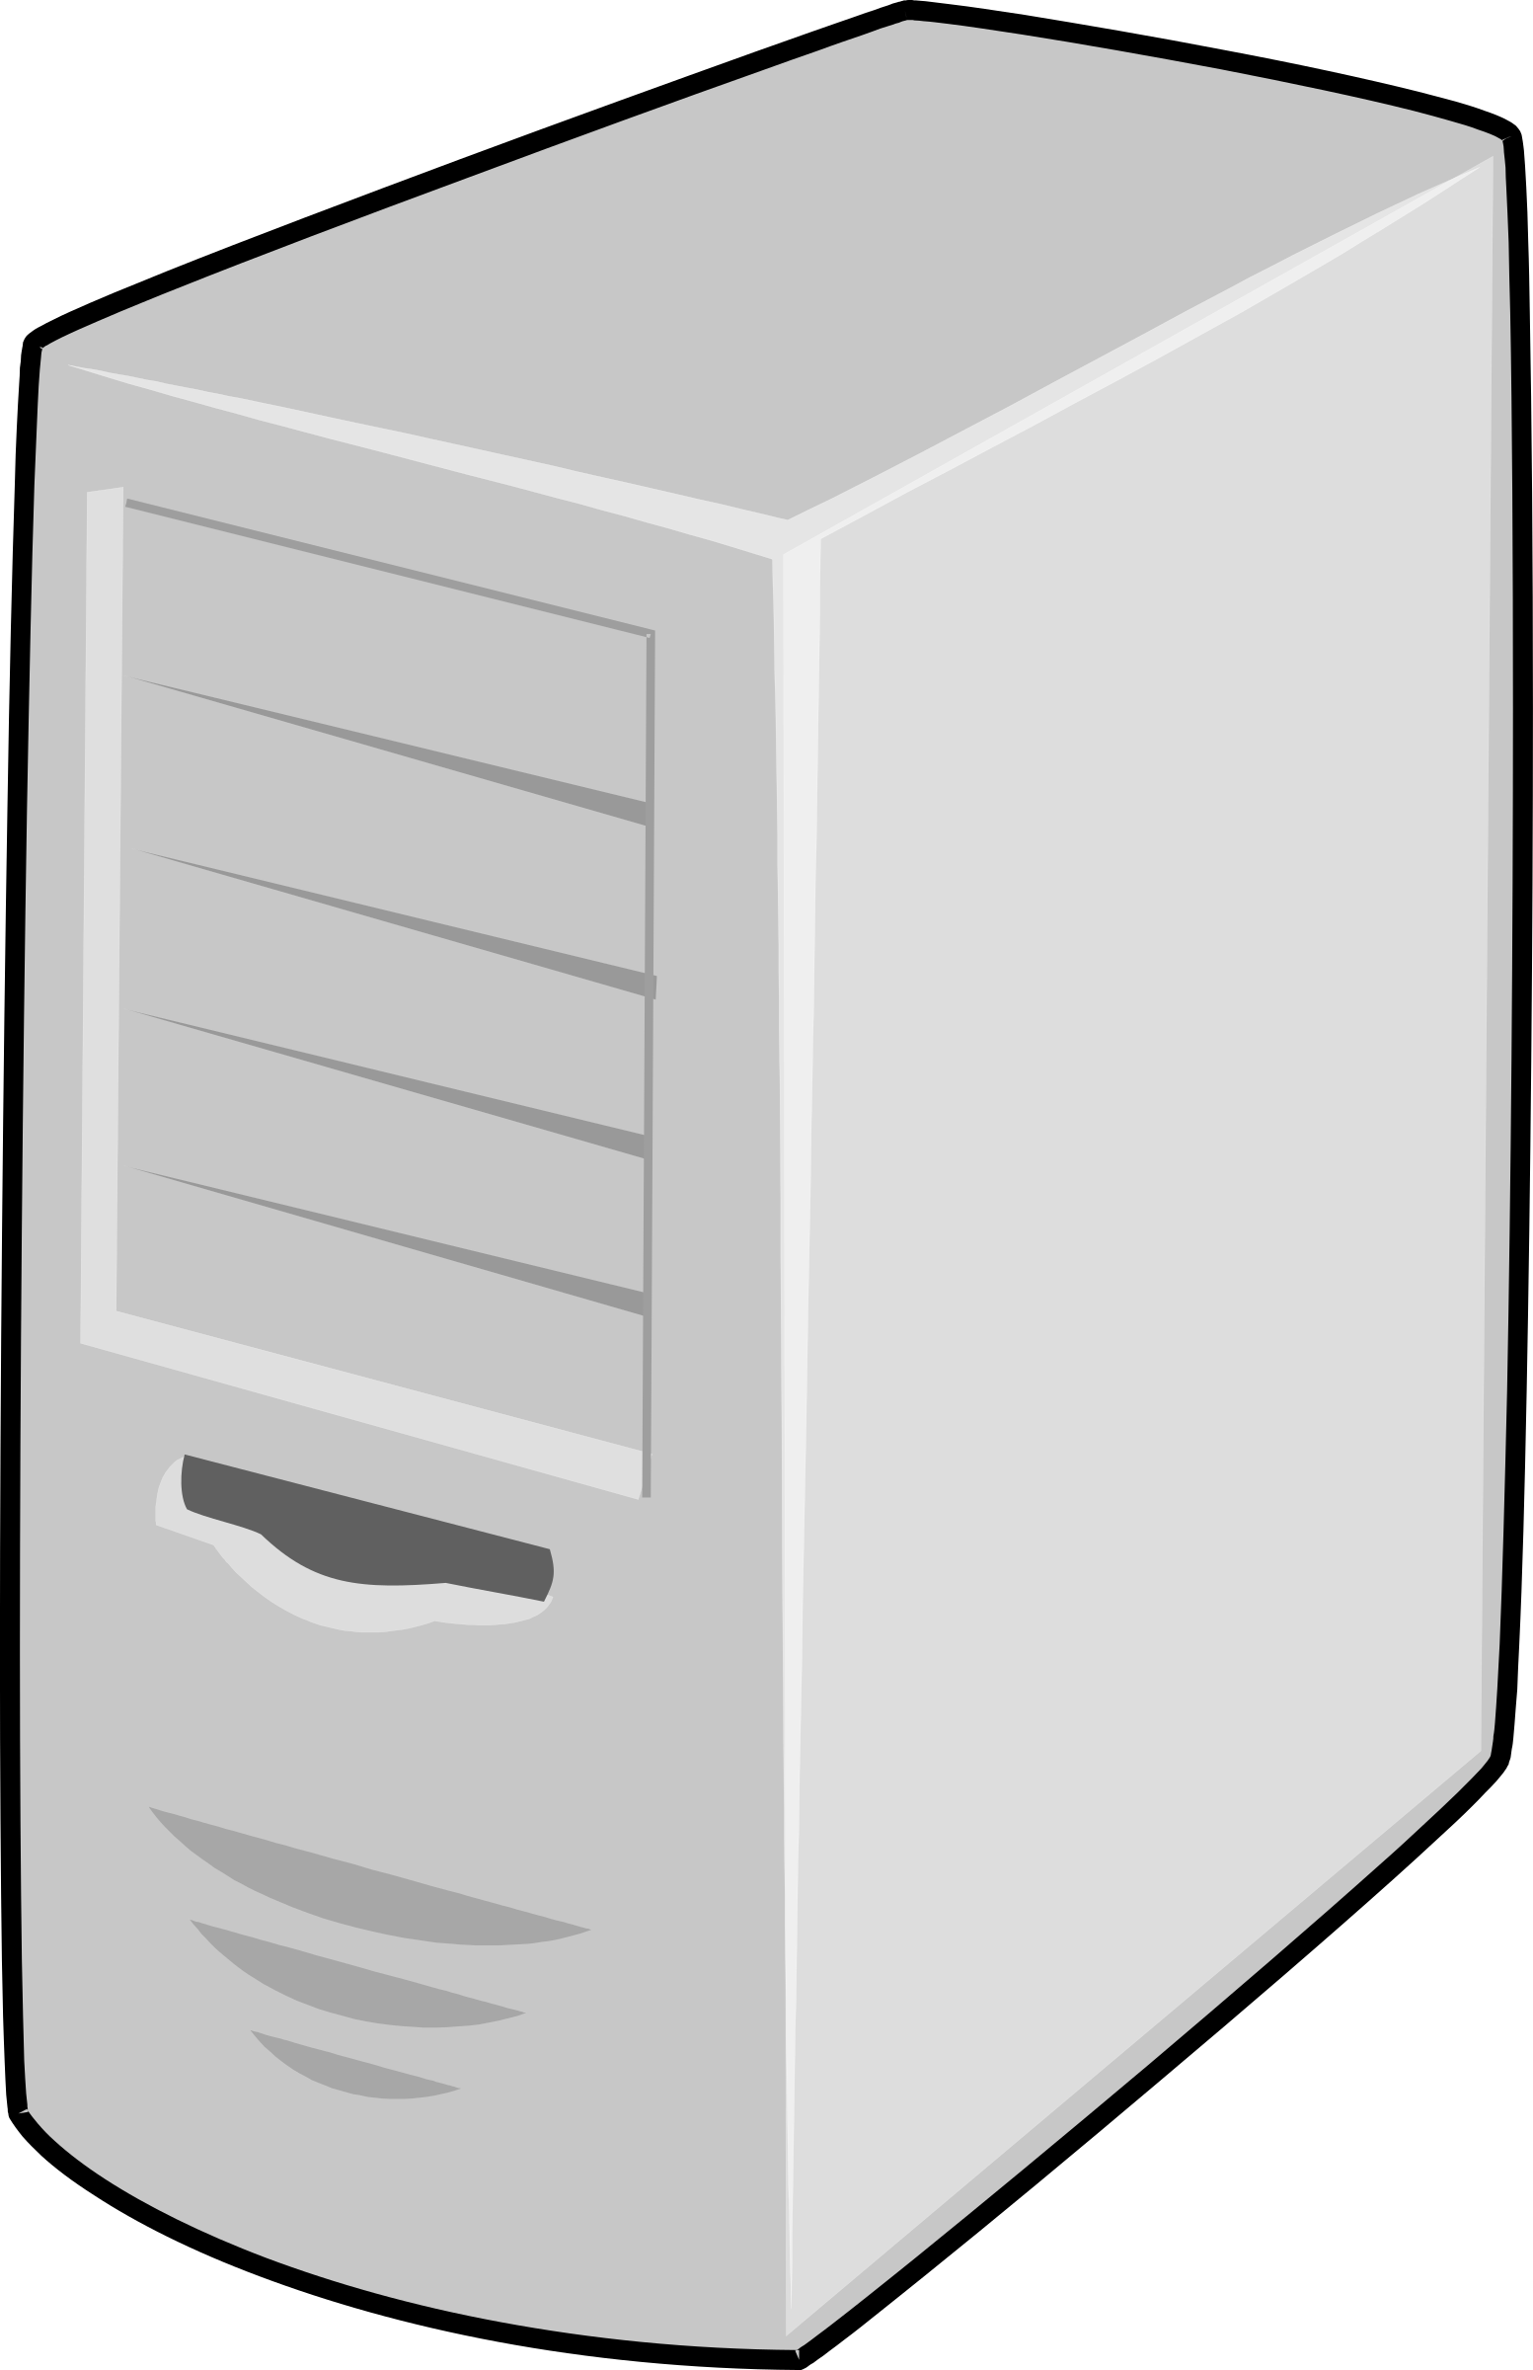




IoT Connectivity
Non IP Data
IP Data
IP and Non IP Data
SCEF
MME
AS
SCS
RAN
SGW/PGW
Figure 5‑5: Role of the SCEF and SCS in 4G networks. SOURCE: T-Mobile
Low power devices will primarily use NarrowBand IoT (NB-IoT)
These devices take a different path in the network then BroadBand IoT (BB-IoT)
The Service Capabilities Exposure Function (SCEF) serves as a proxy gateway for these devices
  The SCEF was designed for 4G, and evolves to the Network Exposure Function (NEF) in 5G

Slide 23
NFV AND SDN
Network Function Virtualization (NFV) and Software Defined Networks (SDN)

Slide 24
NFV and SDN Defined
SDN defines a network architectural approach rather than a specific product and is based on the physical disaggregation of the network control and data forwarding functions.
  This creates a network architecture that is:
    Dynamic, manageable, adaptable, and more cost-effective than traditional architectures,
    making it well-suited for the high-bandwidth, dynamic nature of emerging applications
    SDN was driven by the high-bandwidth, low latency requirements of current applications.
NFV eliminates the need for custom hardware appliances dedicated to each network function
  NFV focuses on three main components of virtualization: compute, storage, and networking.

Slide 25
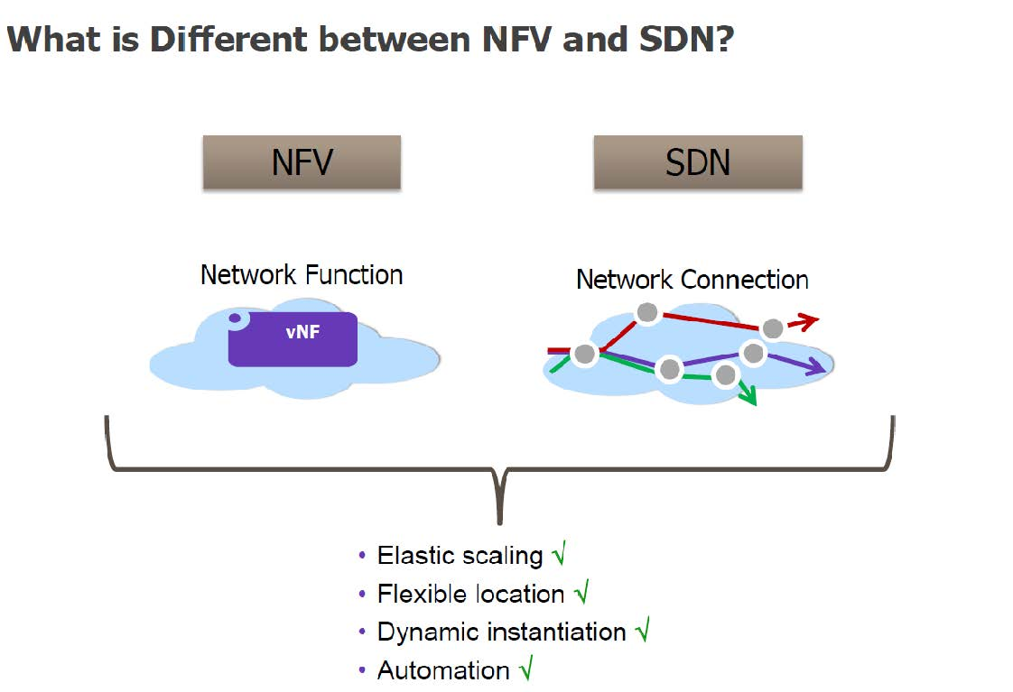
NFV vs. SDN
The 5G architecture is a native NFV/SDN architecture covering aspects ranging from:
devices,
mobile and fixed infrastructure,
network functions,
value-add services,
and the management functions that orchestrate a 5G system
Figure 6‑1: NFV vs. SDN. SOURCE: FCC TAC Cybersecurity Working Group, White Paper: Considerations for Securing SDN/NFV

Slide 26
Advantages of NFV/SDN
The capability to virtualize network functions and define networks within software brings significant advantages to network operators.
5G networks will be built on a virtualized platform taking advantage of NFV, SDN and Containerization along with Open Network Automation Platform (ONAP).
Therefore, the security advantages associated with virtualization, and ONAP will apply to 5G.
  Closed-loop automation based on ONAP along with virtualization’s inherent elasticity feature will be leveraged as a significant 5G security advantage
  Those advantages, however, carry with them risks previously unseen in traditional hardware-defined networks.

Slide 27
Open source software code

Slide 28
Open Source Software
Open source software includes operating systems, applications, and programs in which the source code is published and made available to the public, enabling anyone to copy, modify and redistribute that code without paying royalties or fees.
Open source “products” typically evolve through community cooperation among individual programmers as well as large companies

Slide 29
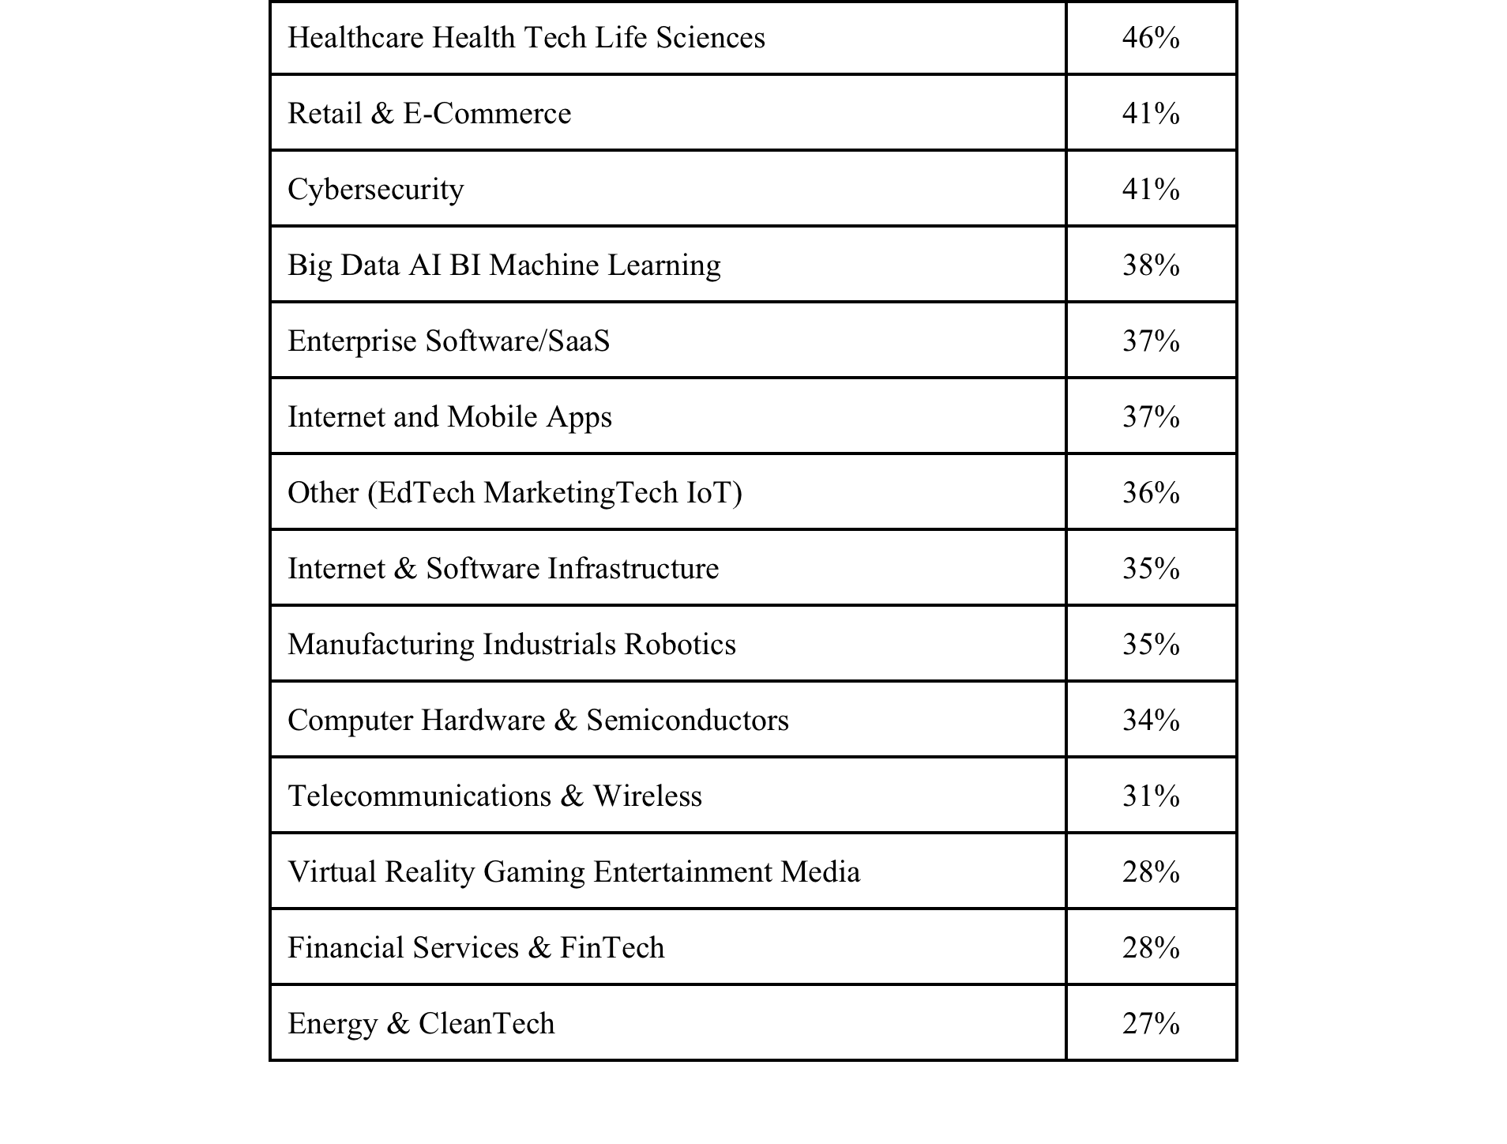
Applications Using Open Source
Table 7‑1: Percentage of open source by industry SOURCE: Black Duck

Slide 30
Open Source Risks
Open source software is incorporated into applications in many ways, and often an operator will not know where open source is used.
Open source software provides attackers with a target-rich environment because of its wide spread use.
  However, because of its wide spread distribution, there are many more eyes reviewing the code (this is one of the major attractions to open source)
  Any vendor that incorporates open source code in their product can also apply any patches to the open source, and provide to the rest of the open source community
This means vendors must ensure they have mechanisms in place to monitor Common Vulnerabilities and Exposures (CVEs) against any open source software components that they may use in their own products.
  Vendors must test and perform security assurance assessments on all open source software and bug fixes.
  Note that many times while there may be a vulnerability in a specific software component, that vulnerability may only exist as a stand-alone component, and may be nullified when incorporated into the vendors’ solution (through middleware where the open source component is isolated, for example).

Slide 31
Mitigating Open Source Risks
In order to address the identification and mitigation challenge requires an intentional effort that includes activities such as code inspection, dynamic security scanning and vulnerability testing.
There are also enterprise specific products that offer a complete end-to-end solution for third party components and supply chain management with features such as licensing, security, inventory, and policy enforcement. Many of these products can be used to automate the release of maintenance patches to address identified CVEs.
  Node Security Project (NSP)
  RetireJS
  OSSIndex
  Dependency-Check
  Bundler-Audit
  Hakiri
  Snyk
  Gemnasium
  SRC:CLR

Slide 32
Supply chain in 5g

Slide 33
Supply Chain
There has been much debate over the risks introduced through the supply chain.
This is especially true in current geo-political climates where there has been additional scrutiny placed on goods from specific nation states.
While much of the debate focuses on Threat, mitigation of risks can be achieved through appropriate application of best practices for supply chain risk management
“A broad, holistic approach to risk management is required rather than a wholesale condemnation of foreign products and services.” - Internet Security Alliance (ISA)

Slide 34
Supply Chain in 5G
Supply chains for wireless telecommunications are complex and the complexity will carry over to 5G
An example of wireless supply chain complexity is that of the modern smartphone.
  It is reported that for the smartphone one can expect that on the order of 700 suppliers from 30 countries may provide components.
  While the device may be designed in the US, component technologies may come from all over the world and assembled in China –
    cameras from Japan,
    displays from Korea,
    wireless chips from the US,
    and computer processors from Taiwan.

Slide 35
Critical Infrastructure
According to Title 42 US Code, Section 5195c(e), critical infrastructure is defined as the
“systems and assets, whether physical or virtual, so vital to the United States that the incapacity or destruction of such systems and assets would have a debilitating impact on security, national economic security, national public health or safety, or any combination of those matters”.

Slide 36
5G Supply Chain
5G is in the early stages of its evolution, as is the corresponding supply chain.
  A comprehensive risk assessment may be premature.
  Some of the risks:
    Inadequate Information Sharing
    SMBs face many challenges
    Lack of visibility to supply chain

Slide 37
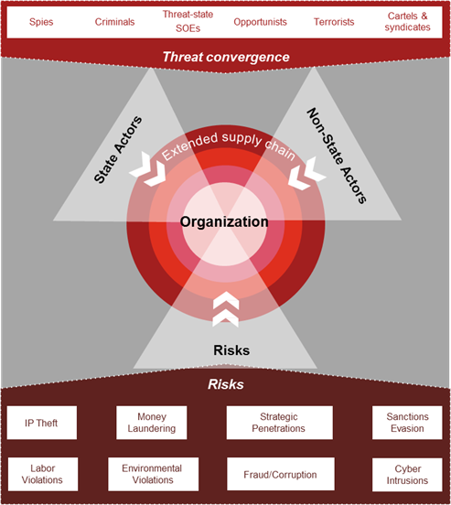
Threat Vectors for 5G
“With this convergence, Industry consistently has more ambiguity to the nature of threat in supply chain due to the complexity and expansiveness of threat actors working to exploit the system.”
“As different threat actors are driven by different motives and with differing access to resources, it is imperative to consistently apply appropriate SCRM procedures across the enterprise supply chain with a focus on the mitigation of risk as opposed to specific actors.”
Figure 8‑2: “Supply Chain Threat Convergence- A New Reality for Supply Chains”. SOURCE: PwC

Slide 38
Supply Chain Risk Management
The Department of Defense has defined SCRM as:
“A systematic process for managing supply chain risk by identifying susceptibilities, vulnerabilities and threats throughout a “supply chain” and developing mitigation strategies to combat those threats whether presented by the supplier, the supplied product and its subcomponents, or the supply chain.”

Slide 39
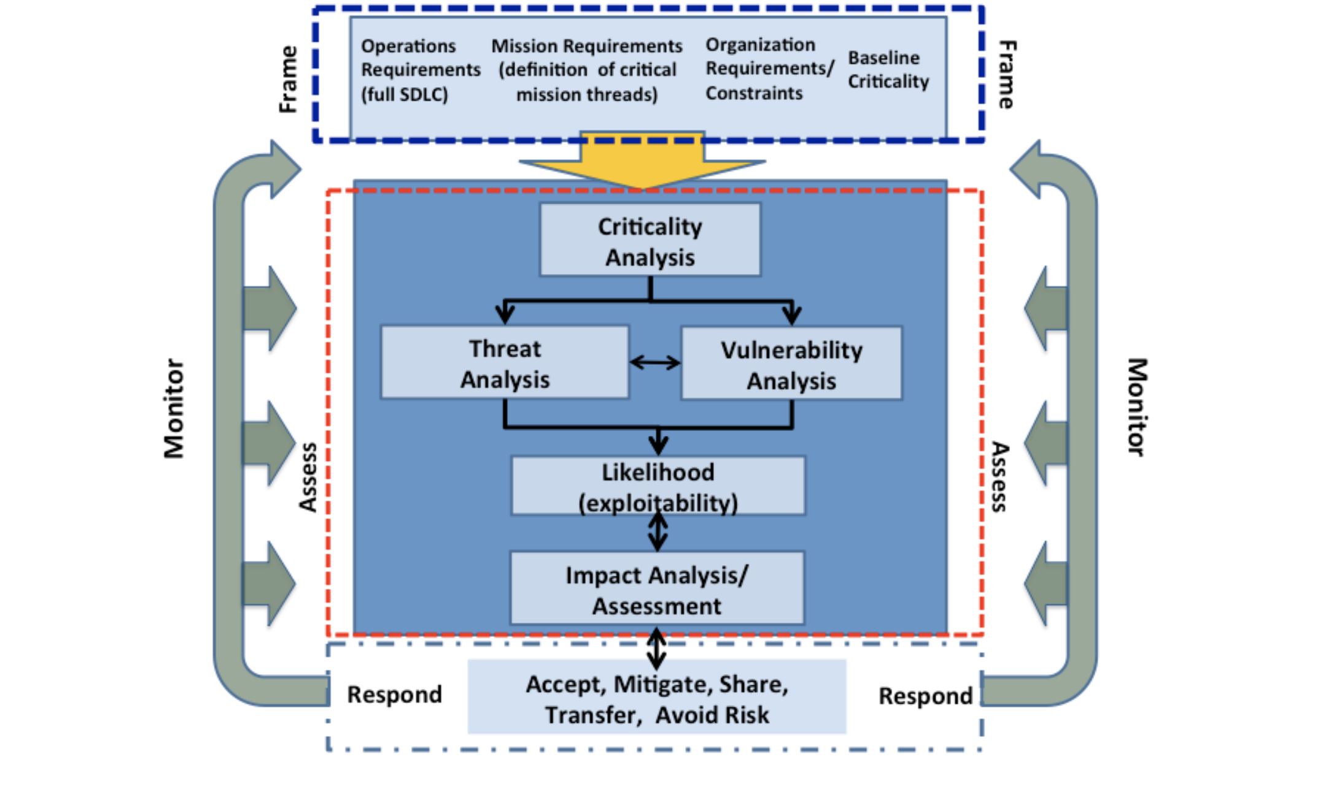
SCRM Activities
Figure 8‑3: SCRM activities. SOURCE: NIST SP 800-161

Slide 40
Recommendations to the fcc

Slide 41
General Recommendations
10.1.1 Extension of CSRIC 5G Study
  Given the current state of the standards and deployment, the working group therefore feels it would be best to revisit 5G in the next CSRIC.
10.1.2 Threat Taxonomy
  FCC should work with industry, DHS and NIST through a future CSRIC or other collaborative process to develop a communications sector-specific taxonomy for communicating threats and evaluating risks to the 5G ecosystem
10.1.3 Participate with DHS in Public/Private Partnership for Threat Assessment
  With the evolution towards a 5G network architecture that combines communications network technology with established information technologies (i.e. a ‘converged’ network), the need to effectively and quickly understand, assess, and mitigate emerging threats to the ecosystem will become more critical because of the wide variety of systems, applications, and users that depend upon the network.

Slide 42
Recommendations for IoT
10.2.1 Regulatory actions
  CSRIC recommends that the FCC avoid IoT regulatory actions
    10.2.2 Public/Private Partnership
      The CSRIC recommends that the FCC should continue to participate with the Departments of Commerce and Homeland Security as they coordinate with industry, civil society, and international partners to develop and execute the roadmap of prioritized actions to increase the resilience of the Internet and communications ecosystem against distributed threats

Slide 43
Recommendations for NFV/SDN
10.3.1 Regulatory Action
  Suppliers and operators are developing and deploying networks that encompass NFV/SDN.
  CSRIC recommends that the FCC avoid NFV/SDN regulatory actions.

Slide 44
Recommendations for Open Source
10.4.1 Regulatory Action
  CSRIC recommends that the FCC avoid open source regulatory actions since operators, suppliers and standards bodies are collaborating on open source software development for platforms that will support 5G

Slide 45
Recommendation to industry

Slide 46
General Recommendations
11.1.1 Protecting the 4G Core
  As many network operators will be launching 5G radio supported by a 4G EPC, it is imperative that network operators take measures to implement the recommendations of CSRIC VI, WG3 Diameter Best Practices.
11.1.2 REST API Authorization
  It is necessary that network operators configure the authorization of the REST APIs correctly for a successful implementation of the end-to-end core network interconnection security solution specified in 3GPP TS 33.501.
11.1.3 REST API Authentication
  The right credentials need to be in place to confirm the authenticity of requests.

Slide 47
General Recommendations (cont)
    11.1.4 Protection of the User Data
      CSRIC recommends adoption of ciphering for the confidentiality of user data, and integrity protection of user data between the UE and the gNB (optional implementation in 3GPP TS 33.501)
    11.1.5 Protecting RRC and NAS Signaling
      CSRIC recommends protection of the RRC-signaling and NAS signaling (optional implementation in 3GPP TS 33.501)

Slide 48
Recommendations for IoT
    11.2.1 Industry Collaboration
      CSRIC recommends that network providers work together to develop best practices or other ways to best minimize threats to IoT.
    11.2.2 NB-IoT Management
      CSRIC recommends that industry implement 3GPP controls for management of NB-IoT traffic to prevent overloading the network.
    11.2.3 IoT Best Practices
      CSRIC recommends that industry evaluate for applicability the GSMA CLP.14, API and SOA security best practices to mitigate IoT threats included in this report for voluntary adoption as applicable and if appropriate.
    11.2.4 CSRIC IV, WG-5 Remediation of Server-Based DDoS Attacks
      The CSRIC recommends that industry follow the recommendations of CSRIC IV, WG5 for the mitigation of DDoS attacks.

Slide 49
Recommendations for IoT (cont)
    11.2.5 CSRIC III, WG-7 Botnet Remediation and the Anti-Botnet Code of Conduct
      The CSRIC recommends industry follow the recommendations of CSRIC III, WG7 for the mitigation of botnets.
    11.2.6 CSRIC II, WG-8 ISP Network Protection Practices
      The CSRIC recommends industry follow the recommendations of CSRIC II, WG8 of best practices for protecting end-users and the network.
    11.2.7 Comm Sector Coordinating Council White Paper
      The CSRIC recommends industry collaborate with other service providers, as well as government agencies such as the FCC and DHS, to help neutralize the threats from botnets, as laid out by the CSCC in its white paper created in response to Executive Order 13800.

Slide 50
Recommendations for NFV/SDN
    11.3.1 Monitor, Monitor and Then Analyze
      CSRIC recommends monitoring and analytics be implemented. Strong analytics with machine learning and AI may be necessary to detect anomalies between network functions.
    11.3.2 Adopt Industry Driven Standards
      CSRIC recommends industry adopt as appropriate the recommendations provided in the ETSI white paper addressing NFV; Ecosystem; Report on SDN Usage in NFV Architectural Framework.
    11.3.3 Future CSRIC Study on NFV/SDN
      CSRIC recommends further study addressing NFV management, forwarding plane architecture, and the control network to mitigate DoS exploits on the network.

Slide 51
Recommendations for Open Source
11.4.1 Inventory Management of Open Source Components
  CSRIC recommends vendors develop procedures for inventory of open source components used in internal development efforts.
  Protection of this information may be critical to prevent system wide vulnerabilities being disclosed.
11.4.2 Code Management Systems
  CSRIC recommends that a code management system must be in place, such as digital signing, to ensure nonrepudiation of the code.
11.4.3 Testing of Open Source Code
  CSRIC recommends that when using open source code for internal development, the code must be rigorously tested in accordance with industry best practices prior to being placed into production.
    11.4.4 Security Frameworks
      A framework should be developed for managing the maintenance cycle of all open source components used within a vendor’s products, or within an operator’s network.

