Slide 1
The Migratory Bird Treaty Act
For Federal Agencies
Eric L. Kershner
October 2018

Slide 2
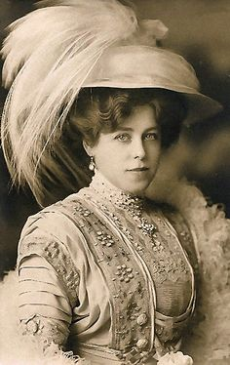
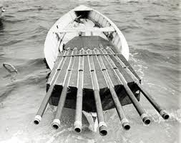
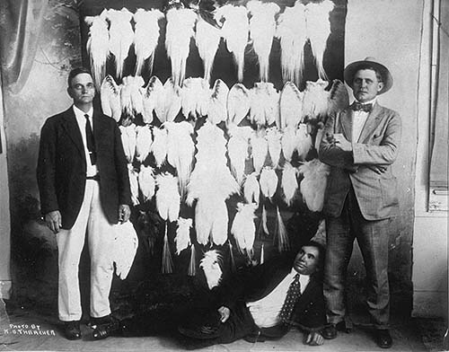
The Need for Bird Conservation
The 19th and 20th Centuries
Market hunting
Plume trade (Millinery)
Abundant species declining
Unregulated killing
Notes:
No seasonal restrictions
No Bag Limits
All species could be hunted

Slide 3
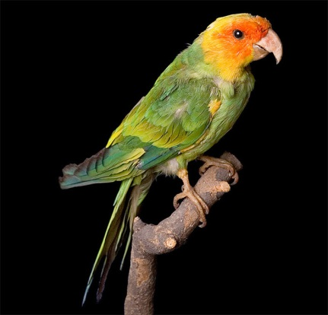
Over-Exploitation Leads to Extinctions
Great Auk (1852)
Labrador Duck (1880)
Carolina Parakeet (1918)

Slide 4
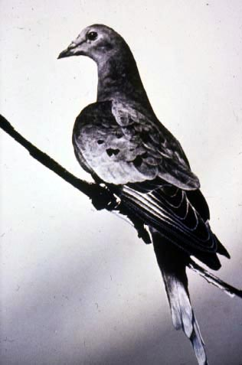
An Unthinkable Extinction
The Passenger Pigeon
A vastly common bird
“…darken the sky for days.”
Economically important
By early 1900s, pigeons are scarce
1914 – last pigeon dies in captivity
Launches an era of bird conservation

Slide 5
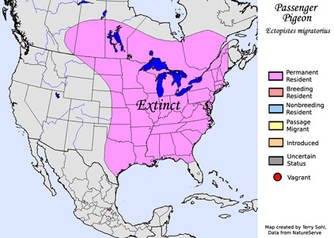
International Implications
A Moment that Changed Bird Conservation
Notes:
(Report of select committee of the Ohio Senate in 1857 on a bill proposed to protect Passenger Pigeons.)
On September 1, 1914, the last passenger pigeon, Martha, died in a zoo. Although the loss of this bird was devastating to bird activists, it once had been very numerous and an economically important migratory bird in both the U.S. and Canada. This unfortunate event stimulated more intense diplomatic negotiations with Canada to work together to protect their shared migratory bird resources. President Woodrow Wilson was far more sympathetic to Federal bird protection than was Taft and directed his Secretary of State, William Jennings Bryan to begin negotiations with Mexico and Great Britain.

Slide 6
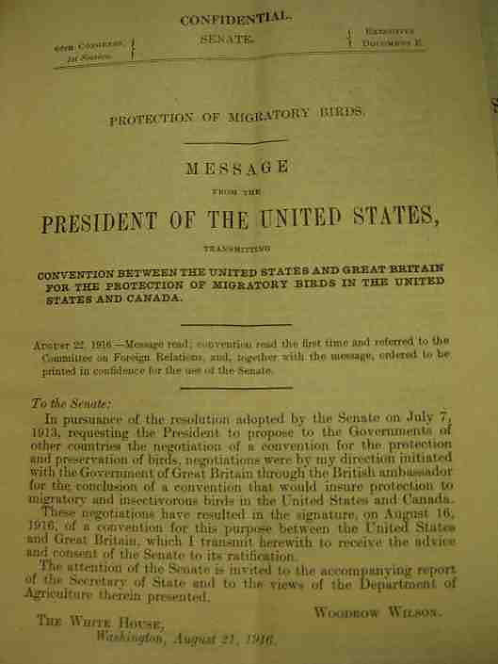
The Migratory Bird Treaty with Canada - 1916
Address the migratory bird conservation crisis
1916 Convention Established:
Which species are protected
Set hunting seasons (game)
Closed hunting (non-game)
System of permits
Scientific collecting
Agricultural pests

Slide 7
International Migratory Bird Treaties
1916 – Great Britain for Canada
1936 – Mexico
1972 – Japan
1976 – Soviet Union (Russia)
Migratory Bird Program – Conserving America’s Birds
Notes:
Recognized that certain birds crossed International boundaries during completion of their life cycles and assigned Federal authority to regulate the take of those birds.

Slide 8
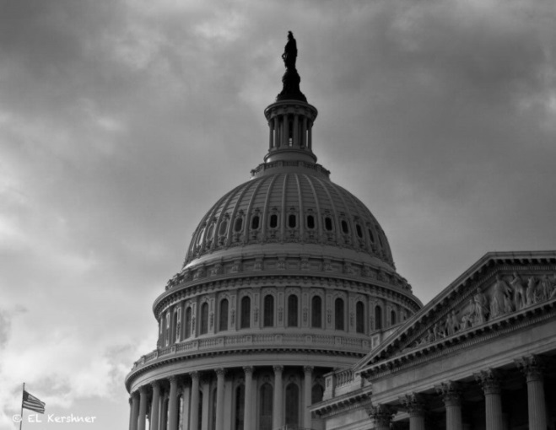
The Migratory Bird Treaty Act - 1918
A Tool for the Conservation of Migratory Birds
U.S. Congress enacted the MBTA using the constitution’s Treaty Power as authorization
Enacted to implement the 1916 treaty with Canada and the three subsequent treaties: Mexico (1936), Japan (1972), and Russia (1976)
Migratory Bird Program – Conserving America’s Birds
Notes:
To reduce the illegal killing of migratory birds in the early 20th centuries, a treaty with Great Britain for Canada (1916) was signed to protect our shared resources. The MBTA was passed two years later to implement the Canadian treaty. The Migratory Bird Treaty Act (MBTA) is one of the nation’s oldest and most important conservation laws. The MBTA is responsible for bringing many of species of migratory birds back from the brink of extinction to the point where tens of millions of American’s can enjoy hunting, bird watching, and bird feeding; contributing billions of dollars to the nation’s economy. Today, the Act also implements 3 additional treaties signed later to continue to increase protections for birds.

Slide 9
The Migratory Bird Treaty Act -1918
What does it say?
Prohibits taking “at any time, by any means or in any manner…any migratory bird, [or] any part, nest, or egg of any such bird” unless authorized by the Secretary of the Interior
Allows permits for the taking of migratory birds that are “compatible with the terms” and “carry out the purposes” of the migratory bird conventions
Migratory Bird Program – Conserving America’s Birds
Notes:
The MBTA was passed to implement the treaty with Canada/UK. The Migratory Bird Treaty Act (MBTA) is one of the nation’s oldest and most important conservation laws. The MBTA is responsible for bringing many of species of migratory birds back from the brink of extinction to the point where millions of American’s can enjoy hunting and bird watching, contributing billions of dollars to the nation’s economy.
50 CFR 10.12

Slide 10
Birds Protected by MBTA
~ 1,026 species (1,088 pending 2018 proposed rule)
Species are protected under MBTA if they are:
Native to some portion of the U.S. and its territories - and
Belong to a family, group, or species named in one of the four international treaties
They are protected regardless of whether the species actually migrates or not – resident species are covered
Migratory Bird Program – Conserving America’s Birds
Notes:
The MBTA was passed to implement the treaty with Canada/UK. The Migratory Bird Treaty Act (MBTA) is one of the nation’s oldest and most important conservation laws. The MBTA is responsible for bringing many of species of migratory birds back from the brink of extinction to the point where millions of American’s can enjoy hunting and bird watching, contributing billions of dollars to the nation’s economy.
50 CFR 10.12

Slide 11
MBTA and Incidental Take
A historical review
Under previous interpretations, the killing of 1 bird is a violation and can be enforced
Enforcement discretion depends on whether a project elected to follow recommended best practices or not
Courts have been split on whether incidental take is prohibited under the MBTA
The courts inconsistently apply the provisions of the MBTA, utilizing different and often contradictory methods
Notes:
Under the MBTA it is illegal to:
…pursue, hunt, shoot, wound, kill, trap, capture, or collect, or attempt to hunt, shoot, wound, kill, trap, capture, or collect…
When the intent of the action is to kill birds, that action can be authorized through a series of permits as long as they are compatible with the purposes of the 4 international treaties. Examples of such authorizations include depredation permits for birds that pose problematic to some agricultural crops or in cases of human health and safety (e.g., airports).
MBTA does not protect inactive nests or nesting substrate - but you cannot possess nests. MBTA does not protect bird habitat.
In December 2017, the Department of Interior released a legal opinion that interprets that the MBTA applies only to purposeful killing or capturing of migratory birds.

Slide 12
2017 Department of Interior M-Opinion
A new interpretation of MBTA and Incidental take
Inconsistent court decisions led to legal uncertainty for lawful actions whose purpose is not to take birds
The December 2017 M-Opinion replaces the January 2017 M-Opinion on the same subject
The M-Opinion concludes MBTA does not prohibit activities that result in the incidental/unintentional take of migratory birds
Notes:
Under the MBTA it is illegal to:
…pursue, hunt, shoot, wound, kill, trap, capture, or collect, or attempt to hunt, shoot, wound, kill, trap, capture, or collect…
When the intent of the action is to kill birds, that action can be authorized through a series of permits as long as they are compatible with the purposes of the 4 international treaties. Examples of such authorizations include depredation permits for birds that pose problematic to some agricultural crops or in cases of human health and safety (e.g., airports).
MBTA does not protect inactive nests or nesting substrate - but you cannot possess nests. MBTA does not protect bird habitat.
In December 2017, the Department of Interior released a legal opinion that interprets that the MBTA applies only to purposeful killing or capturing of migratory birds.

Slide 13
2017 Department of Interior M-Opinion
A new interpretation of MBTA and Incidental take
Clarifies “take” to include pursue, hunt, shoot, wound, kill, trap, capture, or collect or attempt any of these actions, with the intent of taking migratory birds, nests or eggs
There is a distinction between the intent to kill a bird and knowing a bird will die
If killing a bird is NOT the intent of the action – it is not prohibited, regardless of whether you know birds might die as a result
M-Opinion directs the actions of the bureaus within DOI but does not change any statutory or regulatory requirements implemented by federal agencies
Notes:
Under the MBTA it is illegal to:
…pursue, hunt, shoot, wound, kill, trap, capture, or collect, or attempt to hunt, shoot, wound, kill, trap, capture, or collect…
When the intent of the action is to kill birds, that action can be authorized through a series of permits as long as they are compatible with the purposes of the 4 international treaties. Examples of such authorizations include depredation permits for birds that pose problematic to some agricultural crops or in cases of human health and safety (e.g., airports).
MBTA does not protect inactive nests or nesting substrate - but you cannot possess nests. MBTA does not protect bird habitat.
In December 2017, the Department of Interior released a legal opinion that interprets that the MBTA applies only to purposeful killing or capturing of migratory birds.

Slide 14
Current MBTA Prohibitions
Purposeful vs Incidental
Purposeful Take – Prohibited Under MBTA
Take that is the purpose of the action
Generally, permits are available for these actions
Incidental Take – Not Prohibited Under MBTA
Take that directly results from, but is not the purpose of an activity
Notes:
Under the current interpretation of MBTA there are two types of take:
Purposeful take – the intent of the action is to kill or possess a bird, nest, egg, or part. Purposeful take is prohibited under the Act and requires an authorization to conduct these activities.
Incidental take – the intent of the action is not the killing of birds (birds are killed “accidentally” to the otherwise lawful action). The December 2017 M-Opinion interprets that MBTA does not prohibit these activities.

Slide 15
Scenario 1
Do I need a permit?
Action: I need to change a light on my tower
There is a nest on my tower 10 feet above the light that I need to change
Do I need a permit?
NO – you may change the light on the tower without a permit, abandonment of the nest is incidental
Use voluntary best practices to reduce disturbance

Slide 16
Scenario 2
Do I need a permit?
Action: There is a Osprey nest on my tower. The adults are aggressive to people near the tower.
I want to remove the nest for human safety
Do I need a permit?
YES – removing the nest for human safety is a purposeful action
USFWS will issue a permit to remove the nest

Slide 17
Scenario 3
Do I need a permit?
Action: I want to determine whether a nest on my tower is active using a drone
Do I need a permit?
NO – you may use a drone to assess tower components or nest status without a permit
Use voluntary best practices to reduce disturbance

Slide 18
Take and Habitat
MBTA does NOT prohibit impacts to habitat

Slide 19
Implementing the MBTA
Technical Assistance
The Service is mandated to conserve migratory birds
Continue to authorize purposeful take via permits
Depredation permits – BASH, Human Health
Continue to work with all partners that seek to reduce impacts on migratory birds
Develop and recommend voluntary best practices

Slide 20
Nest Destruction Memo
Good Samaritan Policy
Intended to allow conservation outcomes without regulatory burden
Any person/entity can, without a permit:
Temporarily possess and transport any sick, injured, orphaned bird
Temporarily possess any egg or chick in imminent danger of incidental take
Relocate any active nest in imminent danger of incidental take (when species appropriate)
And transport these items to a vet or rehab facility

Slide 21
Additional Considerations
Its not all about the MBTA
Compliance w/ Eagle Act and ESA still required
NEPA still applies to all federal actions
Executive Order 13186 remains in effect

Slide 22
National Environmental Policy Act
Addressing impacts to the human environment
Requires Federal Agencies to evaluate action-related impacts to the human environment, including birds
Questions to consider
How does the action impact migratory birds and their habitats?
Can impacts be reduced with best practices?

Slide 23
Executive Order 13186
Federal Agency responsibilities to protect migratory birds
The M-Opinion does not directly affect how federal agencies manage incidental take
The EO was not designed to implement the MBTA per se
Intended to govern federal efforts to conserve migratory birds more broadly (treaties)
Federal agencies should continue to comply with the EO
Implement MOUs, including applying conservation measures to bird and habitat impacts

Slide 24
Summary
Evaluate all federal actions with NEPA
Reduce impacts to birds and their habitat through voluntary conservation measures
Follow the Executive Order and associated MOUs
When faced with incidental take – use tools such as Good Samaritan policy, when appropriate
Seek authorizing permits for Purposeful Take actions

