Slide 1

TCNS System Changes
Implementing the Infrastructure Second Report and Order
FCC 18-30
Effective July 2, 2018

Slide 2
Applicant / Consultant Login View
Submit a New Filing
  New checkbox to designate a project excluded from SHPO Review
  New Attachment Type: Alternate Submission Packet
  New icon - Project Excluded from SHPO Review
Refer a Notification
  Second Contact Date is no longer required
  Tribes will be available for referral based on their notification preference
    Day 31 when notification preference is email
    Day 36 when notification preference is letter (or both email and letter)
Notification Details Display
  The “Related E106 File Number” will display the file number of the related Form 620/621
  The “Form 620/621 available on:” date will display the date the Tribe was notified of the related 620/621 filing when the project requires SHPO review.
  New icon - Project Excluded from SHPO Review

Slide 3
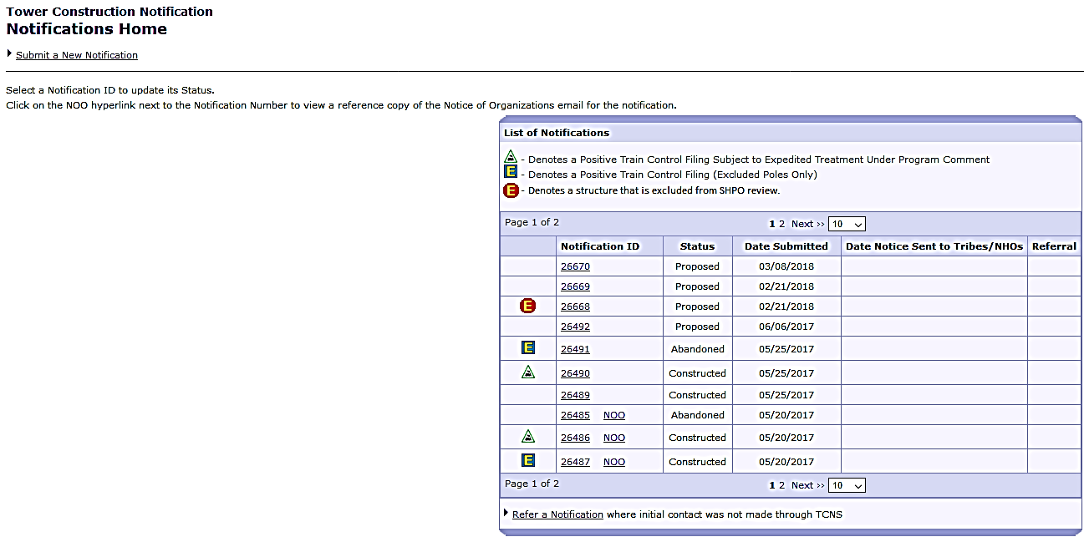
Submit a New Notification

Slide 4
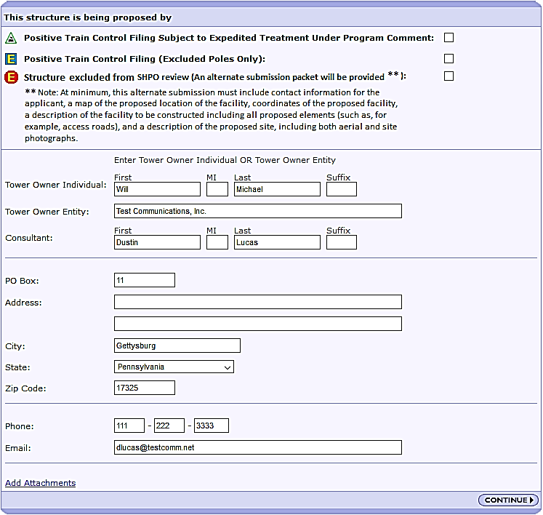
New icon and checkbox to denote a project that is excluded from SHPO review.
Consultants now have an option to indicate a project is “Excluded from SHPO Review”.
When applicable, check the ‘Structure excluded from SHPO review’ box.

Slide 5
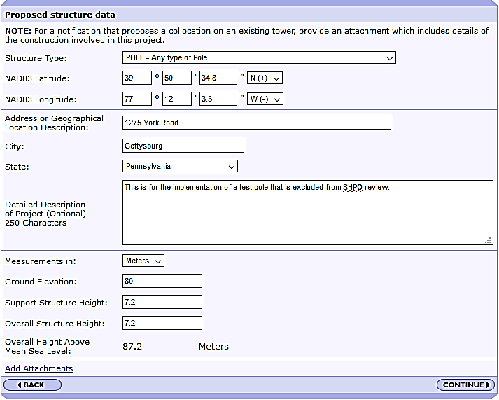
An ‘Alternate Submission Packet’ is required to be uploaded to a project designated as “Excluded from SHPO Review”
  The ‘Alternate Submission Packet’ must include a map of the proposed location of the facility, a description of the facility to be constructed including all proposed elements (such as, for example, access roads), and a description of the proposed site, including both aerial and site photographs.
Click on the ‘Add Attachments’ link to upload the required “Alternate Submission Packet”

Slide 6
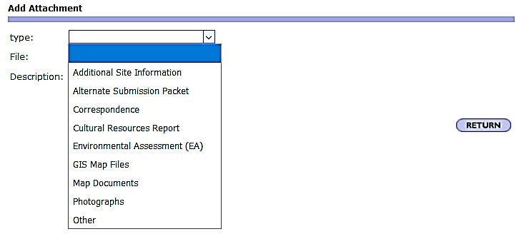
A new Attachment Type, ‘Alternate Submission Packet’, has been added to the dropdown list.
After adding your documents, click Return to go back to the ‘Proposed Structure data’ page.

Slide 7
Click the ‘Continue’ button to proceed to the Summary page

Slide 8
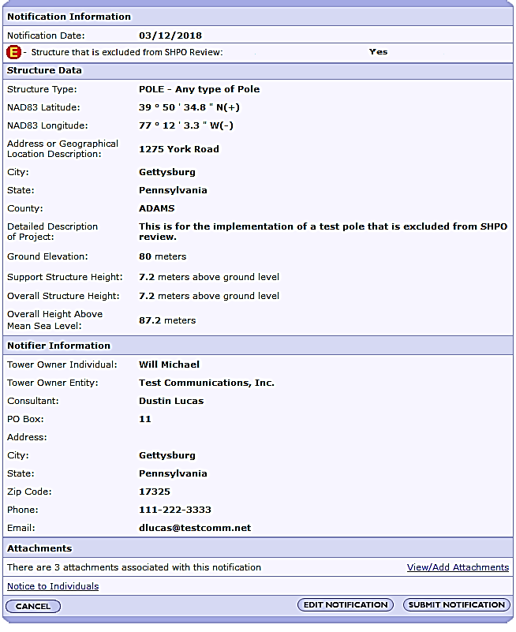
New icon - Structure Excluded from SHPO Review
Click the ‘Submit Notification’ button.

Slide 9
If the required ’Alternate Submission Packet’ Attachment Type hasn’t been added, the following error will display when the ‘Submit Notification’ button is selected.

Slide 10
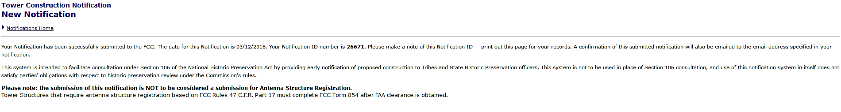
When the notification has been submitted the TCNS number is displayed here on the confirmation page.
TCNS will continue to process on a weekly basis the “Weekly Notice of Tower Construction Notification System Filings” emails and letters to the Tribes every Wednesday and
the “Notice of Organization(s) Which Were Sent Proposed Tower Construction Notification Information” emails to the consultants every Friday.
* The 30/35-day Tribal review period begins for projects excluded from SHPO review the date the “Weekly Notice of Tower Construction Notification System Filings” is sent to the Tribes.

Slide 11
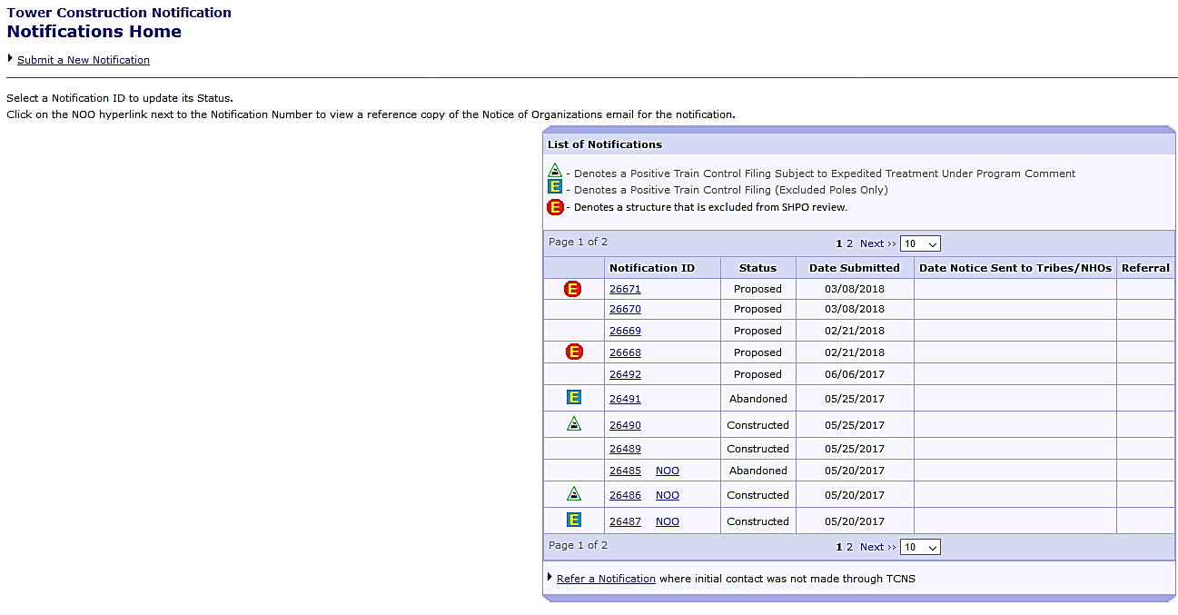
No changes have been made to the Submit a New Notification process for a project that requires SHPO review.

Slide 12

Projects that require SHPO review will be processed on the same weekly basis:
Wednesday - Weekly Notice of Tower Construction Notification System Filings emails/letters
Friday - Notice of Organization(s) Which Were Sent Proposed Tower Construction Notification Information emails
* The 30/35-Day Tribal Review period for projects that require SHPO review starts when the related (FCC Form 620 or FCC Form 621) has been submitted and the E-106 system has sent an email or letter notification to the Tribes.

Slide 13

Revised text in the “Notice of Organization(s) Which Were Sent Proposed Tower Construction Notification Information” email.
FEDERAL COMMUNICATIONS COMMISSION
Washington DC 20554
Notice of Organization(s) Which Were Sent Proposed
Tower Construction Notification Information
Individual Name (First Name, MI, Last Name, Suffix) Date:
Entity Name (Tower Company Name) Reference Number:
PO Box #
Street Address
City, State, ZIP
Dear Applicant:
Thank you for using the Federal Communications Commission's (FCC) Tower Construction Notification System (TCNS). The purpose of this electronic mail message is to inform you that the following authorized persons were sent the notification that you provided through TCNS, which relates to your proposed antenna structure. The information was forwarded by the FCC to authorized TCNS users by electronic mail and/or regular mail (letter). We note that the review period for all parties begins upon receipt of the Submission Packet pursuant to Section VII.A of the NPA and notifications that do not provide this serve as information only.
Persons who have received the notification that you provided include leaders or their designees of federally-recognized American Indian Tribes, including Alaska Native Villages (collectively "Tribal Nations"), Native Hawaiian Organizations (NHOs), and State Historic Preservation Officers (SHPOs). For your convenience in identifying the referenced Tribal Nations and NHOs and in making further contacts, the City and State of the Seat of Government for each Tribal Nation and NHO, as well as the designated contact person, is included in the listing below. We note that Tribal Nations may have Section 106 cultural interests in ancestral homelands or other locations that are far removed from their current Seat of Government. Pursuant to the Commission's rules as set forth in the Nationwide Programmatic Agreement for Review of Effects on Historic Properties for Certain Undertakings Approved by the Federal Communications Commission (NPA), all Tribal Nations and NHOs listed below must be afforded a reasonable opportunity to respond to this notification, consistent with the procedures set forth below, unless the proposed construction falls within an exclusion designated by the Tribal Nation or NHO. (NPA, Section IV.F.4).
The notification that you provided was forwarded to the following Tribal Nations and NHOs. A Tribal Nation or NHO may not respond until a full Submission Packet is provided. If, upon receipt, the Tribal Nation or NHO does not respond within a reasonable time, you should make a reasonable effort at follow-up contact, unless the Tribal Nation or NHO has agreed to different procedures (NPA, Section IV.F.5). In the event a Tribal Nation or NHO does not respond to a follow-up inquiry, or if a substantive or procedural disagreement arises between you
and a Tribal Nation or NHO, you must seek guidance from the Commission (NPA, Section IV.G). These procedures are further set forth in the FCC's Second Report and Order released on March 30, 2018 (FCC 18-30).
1. Title – Contact First & Last Name – Entity Name – Contact City, State - regular mail, email or both
Exclusions:
2. Title – Contact First & Last Name – Entity Name – Contact City, State - regular mail, email or both
Exclusions:
3. Title – Contact First & Last Name – Entity Name – Contact City, State - regular mail, email or both
Exclusions:
The notification that you provided was also forwarded to the following SHPOs in the State in which you propose to construct and neighboring States. The information was provided to these SHPOs as a courtesy for their information and planning. You need make no effort at this time to follow up with any SHPO that does not respond to this notification. Prior to construction, you must provide the SHPO of the State in which you propose to construct (or the Tribal Historic Preservation Officer, if the project will be located on certain Tribal lands), with a Submission Packet pursuant to Section VII.A of the NPA unless the project is excluded from SHPO review under Section III D or E of the NPA.
4. Title – Contact First & Last Name – Entity Name – Contact City, State - regular mail, email or both
TCNS automatically forwards all notifications to all Tribal Nations and SHPOs that have an expressed interest in the geographic area of a proposal. However, if a proposal for PTC wayside poles falls within a designated exclusion, you need not expect any response and need not pursue any additional process with that Tribal Nation or SHPO. In addition, a particular Tribal Nation or SHPO may also set forth policies or procedures within its details box that exclude from review certain facilities (for example, a statement that it does not review collocations with no ground disturbance; or that indicates that no response within 30 days indicates no interest in participating in pre-construction review).
Please be advised that the FCC cannot guarantee that the contact(s) listed above have opened and reviewed an electronic or regular mail notification. If you learn that any of the above contact information is no longer valid, please contact the FCC by emailing tcnshelp@fcc.gov. The following information relating to the proposed tower was forwarded to the person(s) listed above:
Notification Received: mm/dd/yyyy
Notification ID:
Excluded from SHPO Review: Yes
Tower Owner Individual or Entity Name:
Consultant Name:
P.O. Box:
Address Line 1:
Address Line 2:
City:
State:
Zip Code:
Phone:
Email:
Structure Type:
Latitude:
Longitude:
Location Description:
City:
State:
County:
Detailed Description of Project (Optional):
Ground Elevation:
Support Structure:
Overall Structure:
Overall Height AMSL:
If you have any questions or comments regarding this notice, please contact the FCC using the electronic Help Request form located on the FCC's website at:
https://www.fcc.gov/wireless/available-support-services
You may also call the FCC Support Center at (877) 480-3201 (TTY 717-338-2824). Hours are from 8 a.m. to 7:00 p.m. Eastern Time, Monday through Friday (except Federal holidays). To provide quality service and ensure security, all telephone calls are recorded.
Thank you,
Federal Communications Commission

Slide 14
FEDERAL COMMUNICATIONS COMMISSION
Washington DC 20554
Weekly Notice of Tower Construction Notification System Filings
Individual Name (First Name, MI, Last Name, Suffix) Date:
Entity Name (Tower Company Name)
PO Box #
Street Address City, State, ZIP
Dear (Contact Title, First Name MI Last Name Suffix):
The Federal Communications Commission extends its greetings to you. Thank you for using our Tower Construction Notification System (TCNS). This letter is a notice that a telecommunications project is proposed within a geographic area(s) for which you have chosen to receive such notifications.
In order to promote the efficiency of the FCC's process for protecting historic properties, including Tribal traditional cultural properties, we respectfully request that you respond within no more than 30 days from receipt of a complete Submission Packet as to your interest or lack of interest in each of the proposed constructions listed below. You may respond either through the TCNS as described at the end of this Notice, directly to the entity submitting the notification, or by contacting one of the FCC employees listed below. Your prompt response will avoid the need for repetitive follow-up contacts that unnecessarily consume the resources of all parties involved in the process.
The following list indicates the geographic area(s) of interest which you have indicated to receive notifications of proposed communications facilities constructions:
[System inputs a list of Tribe’s geographic areas of interest from TCNS]
The Tower Construction Notification Submissions received during the last week, which match your areas of interest, are listed and detailed below.
[System inputs the notification data as listed below in table formats under each section]
Summary Listing by State, County, City
State County City TCNS ID Tower Owner Structure Type
Exempt from SHPO Review: Yes/No
Lat/Lon
Location description
Detailed Listing by State, County, City
State County City TCNS ID Tower Owner
Revised text in the Weekly Notice of Tower Construction Notification System Filings emails and letters.
Structure Type
Exempt from SHPO Review: Yes/No
Lat/Lon
Location description
Ground Elevation (meters): Contact Name: Telephone Number:
Support Structure (meters above ground level): P. O. Box: E-mail Address:
Overall Structure (meters above ground level): Street Address:
Overall Height (meters above sea level): City: State: Zip Code:
Detailed Description of Project (Optional):
To submit comments and reply electronically to a notification, view attachments to a notification, update your contact information, set your preferences for receiving notifications (e-mail and/or letter), or update the area for which you receive notifications, please go to http://wireless.fcc.gov/outreach/notification. Click on the "LOGIN" button and then log onto the TCNS system by using your FRN and Password. From that point, follow the directions that will appear on the screen.
If you would like us to provide you with your FRN or Password, you desire assistance in using TCNS, or you have any questions relating to this Notice, please contact the TCNS Help team at TCNShelp@fcc.gov or (202) 418-0220.
Thank you,
Federal Communications Commission

Slide 15
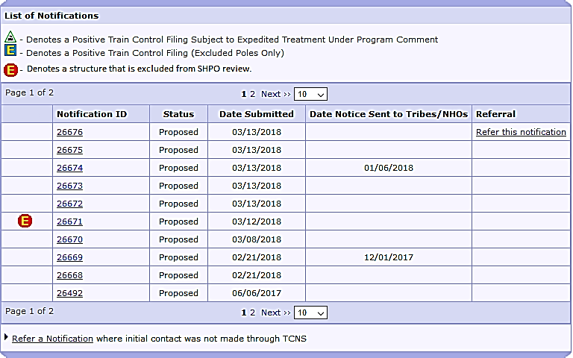
Refer a Notification
Projects excluded from SHPO review
  The ‘Refer this notification’ link will appear on day 31 after the Weekly Notice of Tower Construction Notification System Filings email/letter is sent to the Tribe
Projects that requires SHPO review
  If the Tribe has not responded in the system, the ‘Refer this notification’ link will appear on day 31 after the E-106 system notifies the Tribes that the FCC Form 620 or FCC Form 621 has been submitted.

Slide 16
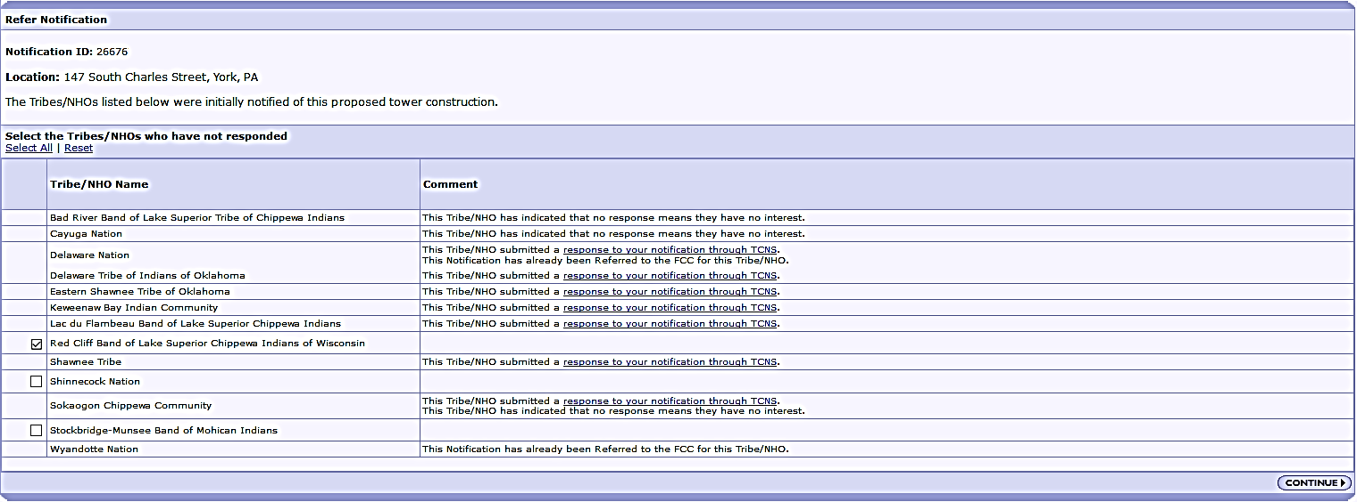
When project requires SHPO Review: Tribes who have not submitted a reply will become available for referral on the 31st day after the related E-106 notification is sent by email or on the 36th day if the related E-106 notification was sent by letter
When project is excluded from SHPO Review: Tribes who have not submitted a reply will become available for referral on the 31st day after the Weekly Notice is sent by email and the 36th day after the Weekly Notice is sent by letter.
A Consultant no longer needs to enter a Second Contact Date

Slide 17
Referrals where initial contact was not made through TCNS

Slide 18
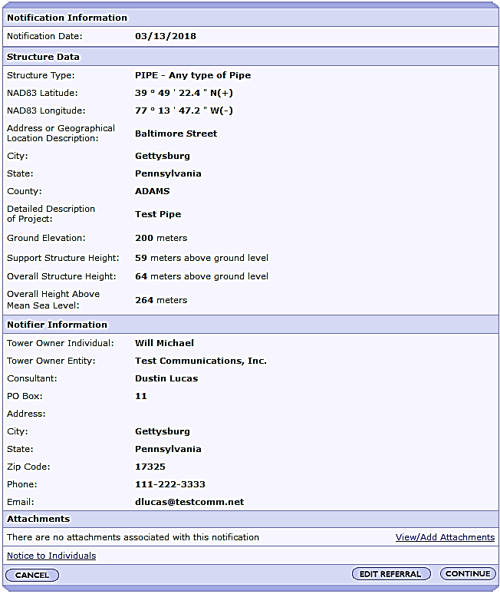
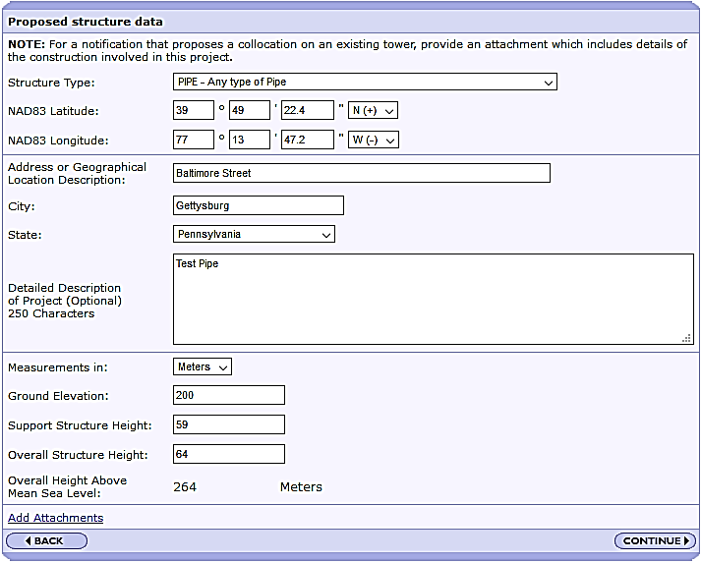
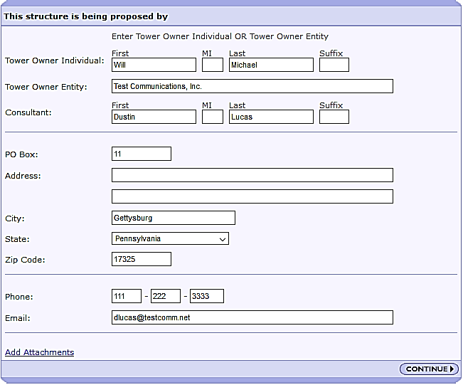
There have been no change to these 3 screens.

Slide 19
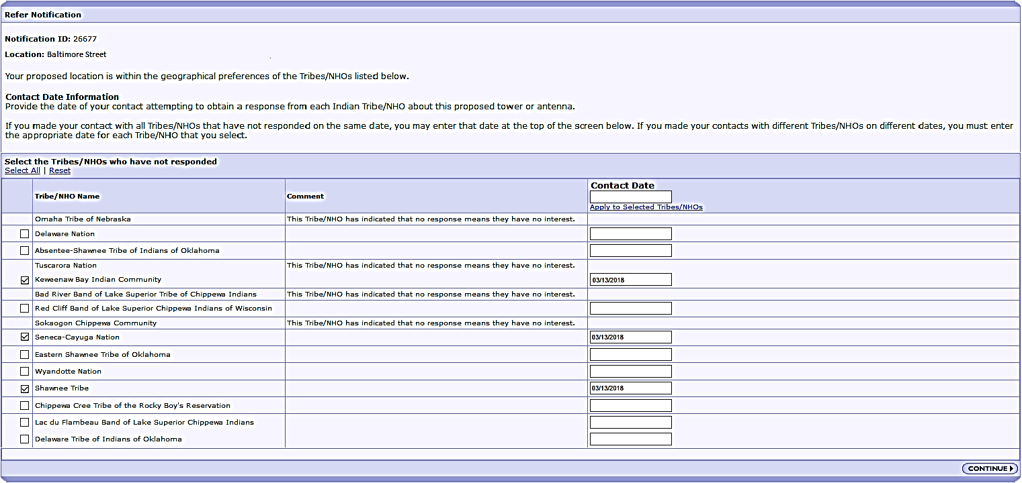
Consultants no longer need to enter a Second Contact Date
Fill in the date that you first contacted the Tribe outside of TCNS

Slide 20
Confirmation page when the referral has been submitted.
TCNS will continue to process referrals on a weekly basis every Thursday.
- Proposed Construction of Communications Facilities Final Request for Indication of Interest emails/letters to Tribes
- Proposed Construction of Communications Facilities Notification of Final Contacts emails to Consultants.

Slide 21
Revised text in the Proposed Construction of Communications Facilities Notification of Final Contacts email.
FEDERAL COMMUNICATIONS COMMISSION
Washington DC 20554
Proposed Construction of Communications Facilities
Notification of Final Contacts
Entity or Individual First Name MI Last Name Suffix Date: [System Date]
Consultant Name
PO Box
Street Address1
Street Address 2
City, State, Zip Code
Dear Applicant:
This letter addresses the proposed communications facilities listed below that you have referred to the Federal Communications Commission (Commission) for purposes of contacting federally recognized Indian Tribes, including Alaska Native Villages (collectively Indian Tribes), and Native Hawaiian Organizations (NHOs), as specified by Section IV.G of the Nationwide Programmatic Agreement (NPA). Consistent with the procedures outlined in the Commission's Wireless Infrastructure Second Report and Order,^{[1]} we have contacted the Indian Tribes or NHOs identified in the attached Table for the projects listed in the attached Table. You referred these projects to us between 05/10/2018 and 05/17/2018. Our contact with these Tribal Nations or NHOs was sent on 05/17/2018.
Thus, as described in the Wireless Infrastructure Second Report and Order,^{[2]} if you or Commission staff do not receive a statement of interest regarding a particular project from any Tribe or NHO within 15 calendar days of 05/17/2018, your obligations under Section IV of the NPA with respect to these Tribal Nations or NHOs are complete. If a Tribal Nation or NHO responds that it has concerns about a historic property of traditional religious and cultural significance that may be affected by the proposed construction within the 15 calendar day period, the Applicant must involve it in the review as set forth in the NPA, and may not begin construction until the process set forth in the NPA is completed.
You are reminded that Section IX of the NPA imposes independent obligations on an Applicant when a previously unidentified site that may be a historic property,
including an archeological property, is discovered during construction or after the completion of review. In such instances, the Applicant must cease construction and promptly notify, among others, any potentially affected Tribal Nation or NHO. A Tribal Nation's or NHO's failure to express interest in participating in pre-construction review of an undertaking does not necessarily mean it is not interested in archeological properties or human remains that may inadvertently be discovered during construction. Hence, an Applicant is still required to notify any potentially affected Tribal Nation or NHO of any such finds pursuant to Section IX or other applicable law.
Sincerely,
Jill Springer
Federal Preservation Officer
Federal Communications Commission
jill.springer@fcc.gov
_______________________________________
LIST OF PROPOSED COMMUNICATIONS TOWERS
[System inputs a section of data like below for each notification and the Tribe names this applicant referred]
TCNS#: [Notification ID#] Referred Date: [MM/DD/YYYY] Location: [Tower location address, city, state]
Tribe Name:
Tribe Name:
LEGEND:
* - Notification numbers are assigned by the Commission staff for sites where initial contact was not made through TCNS.

Slide 22
Revised text in the Proposed Construction of Communications Facilities Final Request for Indication of Interest emails and letters.
FEDERAL COMMUNICATIONS COMMISSION
Washington DC 20554
Proposed Construction of Communications Facilities
Final Request for Indication of Interest
Tribe Contact Title, First Name MI Last Name Suffix Date: [System Date]
Tribe Name
PO Box
Street Address1
Street Address 2
City, State, Zip Code
Dear (Contact Title, First Name MI Last Name Suffix):
By this communication, we respectfully submit the Federal Communications Commission's (Commission) final request for you, as the designated representative of the [Tribe Name] for purposes of the Tower Construction Notification System (TCNS), to let us know whether your Tribal Nation or Native Hawaiian Organization (NHO) has an interest in participating in pre-construction Section 106 review of the proposed communications facilities listed in the table below. In particular, we request that you inform us and each party listed below (Applicant) within 15 calendar days from the date of this communication whether historic properties of religious and cultural significance to your Tribal Nation or NHO may be affected by construction of the proposed communications facilities. In addition, we respectfully inform you that we are also notifying each Applicant that proposes to construct these facilities that, if neither we nor the Applicant hears from you within 15 calendar days, then both we and the Applicant will consider that our respective pre-construction notification and consultation obligations with respect to your Tribal Nation or NHO are now complete with regard to these listed facilities. In order to ensure that your response is timely received, we ask that you respond using one of the methods specified on page 3 of this letter.
According to information provided to us by the Applicants, each Applicant listed below (or the Commission through TCNS) has contacted you regarding construction of the proposed communications facilities. If you have not received such communications, please let us know. Nonetheless, our records do not indicate that you or your Tribal Nation or NHO has provided us with a statement either of "interest" or of "no interest" regarding the proposed undertaking(s), and we are informed that the Applicant has received no such response. Our records further indicate that neither you nor your Tribal Nation has expressed a desire to engage in government-to-government consultation regarding the undertaking(s). (In the event that you have already responded either to an Applicant or to the Commission, you do not need to respond again, and we apologize for the misunderstanding.)
If you have not responded because you have had difficulty using TCNS for any reason, please contact the Tower Construction Notification System Help Team at TCNShelp@fcc.gov or (202) 418-0220 for assistance. We appreciate any suggestions you may have to improve TCNS so that it may better serve your needs.
Background
In order to fulfill our obligations under the NHPA, the Commission has instituted rules and procedures to ensure that we consult with any federally recognized Indian Tribes, including Alaska Native Villages (collectively Tribal Nations), and Native Hawaiian Organizations (NHOs), that may attach religious and cultural significance to a historic property that may be affected by an undertaking. These procedures, as memorialized in the Nationwide Programmatic Agreement (NPA), initially require Applicants to identify and ensure that early contact is made with Tribal Nations and NHOs that may attach religious and cultural significance to affected historic properties (Sections IV.B and IV.C). As you know, your Tribal Nation or NHO has voluntarily entered information into TCNS regarding the geographic areas where such properties may exist.
The NPA requires Applicants to make initial contact with Tribal Nations or NHOs that may attach religious and cultural significance to a historic property that may be affected by an undertaking through TCNS or otherwise, in accordance with each Tribal Nation's or NHO's wishes (Section IV.C). The NPA further requires Applicants to afford these Tribal Nations a reasonable period of time to respond, ordinarily 30 days (Section IV.F.4) from receipt of a full Submission Packet, and it advises Applicants to follow up in case a Tribal Nation or NHO does not respond to a single attempt at communication (Section IV.F.5). As explained in Section IV.G of the NPA, the purposes of this initial communication are: (1) to ascertain whether historic properties of religious and cultural significance to the Tribal Nation or NHO may be affected by the undertaking and consultation is therefore necessary; and (2) where possible, with the concurrence of the Tribal Nation, to reach an agreement on the presence or absence of effects that may obviate the need for consultation.
In the event a Tribal Nation requests government-to-government consultation, the Applicant must refer the matter to the Commission (Section IV.G). The Commission then carries out government-to-government consultation. If a Tribal Nation or NHO does not respond to an Applicant's inquires, the Applicant must seek guidance from the Commission (Section IV.G). Under our procedures, in the event that a Tribal Nation or NHO does not respond to an Applicant's inquiries, the Commission staff will contact the Tribal Nation's or NHO's designated cultural resources representative by letter and/or e-mail to respectfully request that the Tribal Nation or NHO inform the Commission and the Applicant within 15 calendar days as to its interest or lack of interest in participating in the Section 106 review. Staff will inform the Applicant when this letter or e-mail is sent, either by copying it on the correspondence or by other effective means. If the Tribal Nation or NHO does not respond within 15 calendar days of the date of this letter or e-mail, the Commission will conclude that the Tribal Nation's or NHO's non-response to communications from the Applicant, TCNS, and the Commission staff means the Tribal Nation or NHO does not wish to participate in the Section 106 review for that particular project. If the Tribal Nation or NHO responds that it is interested in participating within the 15 calendar day period, the Applicant must involve it in the review as set forth in the NPA.
Contacts Regarding the Sites Listed In this Communication
As already noted above, according to our records, your Tribal Nation or NHO has not indicated whether it is interested in participating in review for the sites listed below nor expressed a desire to engage in government-to-government consultation. Specifically, our records indicate that you have been initially notified either through TCNS or directly by the Applicant of each of the projects listed below. These earlier efforts and this letter together comprise reasonable and good faith efforts to contact you and obtain your participation, in accordance with our procedures. Accordingly, we determine that if your response is not received within 15 calendar days of the date of this communication, as specified above, we will have discharged our pre-construction notification and consultation obligations to you under the NHPA, and the Applicant will have fulfilled its related duties under the NPA and the Commission's Rules. If you did not receive the initial contact as indicated by the Applicant, please let us know and we will look into the situation.

Slide 23
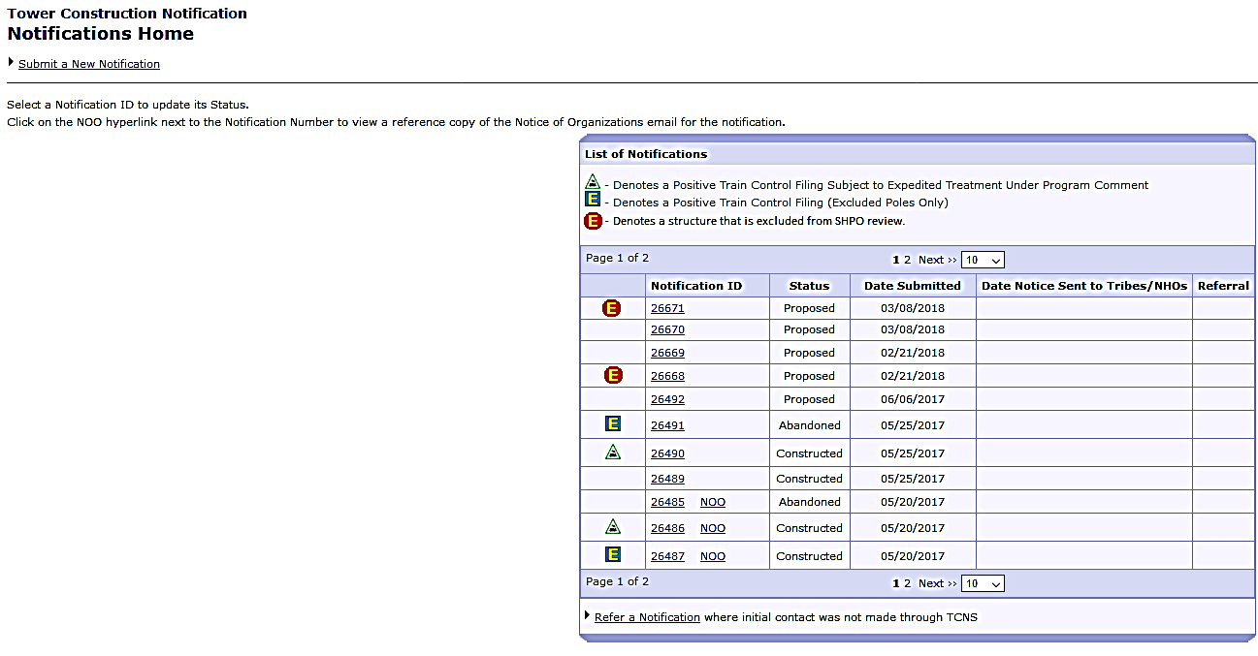
View of the Notification Details on the Update Status screen

Slide 24

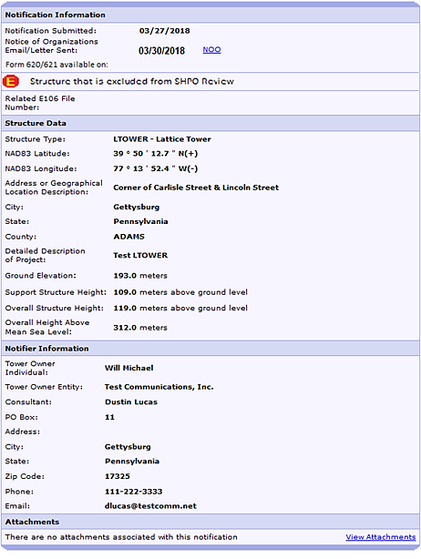
View of the Notification Details on the Update Status screen
When the project requires SHPO review:
  The “Related E106 File Number” will display the file number of the related Form 620/621
  The “Form 620/621 available on:” date will display the date the Tribe was notified of the related 620/621 filing was submitted

Slide 25
View of the Notification Details on the Update Status screen
When the project is Excluded from SHPO review you will see the icon displayed

Slide 26
Tribes / THPOs / NHOs Login View
‘Section 106 New Filing Submitted’ email and ‘Informational Notice of Section 106 Filings’ letter
  Added the Form 621 question “Has the Communications Tower or Non-Tower Structure been the subject of a SHPO/THPO review?” and the “yes” or “no” answer
  Added “Tribal Review Period End Date“
Reply to a Notification and Search (Notification Details)
  New icon - Project Excluded from SHPO Review
  The “Related E106 File Number”
  The “Form 620/621 available on:” date
  “Tribal Review Period End Date“
Additional Details
  FCC approval process

Slide 27

‘E-106 System Notifications: Section 106 New Filing Submitted’ email and ‘Informational Notice of Section 106 Filings’ letter
Form 621 question “Has the Communications Tower or Non-Tower Structure been the subject of a SHPO/THPO review?” and the “yes” or “no” answer
“Tribal Review Period End Date:” will be the last date that a Tribe can reply before they are considered eligible for referral and the date is determined based on Tribe's TCNS Notification Preference.
Informational Notice of Section 106 Filings
Date: MM/DD/YYYY
Reference Number: 9999999
Kathleen Kilpatrick, State Historic Preservation Officer
Virginia State Historical Society
2801 Kensington Avenue
Richmond, Virginia 23221
The following new Section 106 filing has been submitted:
FILE NUMBER: XXXXXXXXXX
Purpose: New Tower Submission Packet
Notification Date: 7AM EST MM/DD/YYYY
Tribal Review Period End Date: MM/DD/YYYY (Date should change based on Tribal Notification Preference)
Applicant: Land Mark Center
Federal Communications Commission
Washington, DC 20554
To: joeclarkTribe@gmail.com
From: ulsbatch@fcc.gov
Subject: Section 106 New Filing Submitted
The following new Section 106 filing has been submitted:
File Number: XXXXXXXXXX
Purpose: Collocation Submission Packet
Has the Communications Tower or Non-Tower Structure been the subject of SHPO/THPO review? Yes
Notification Date: 7AM EST MM/DD/YYYY
Tribal Review Period End Date: MM/DD/YYYY
Applicant: Land Mark Center
Consultant: Archaeological Resource Services
Site Name: Land Mark Center

Slide 28
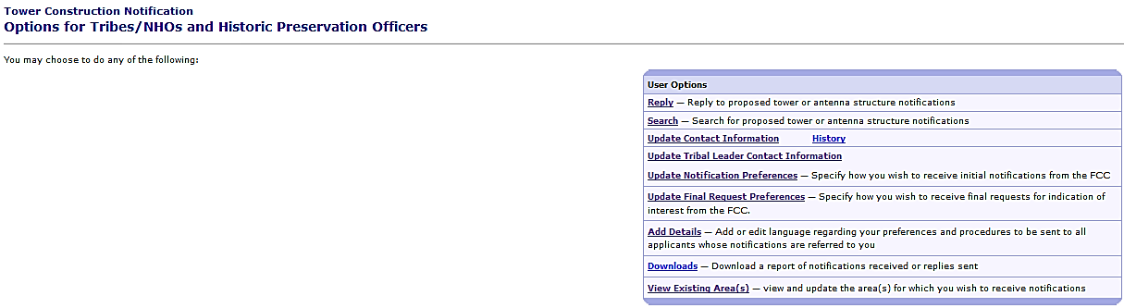
Reply to a notification

Slide 29
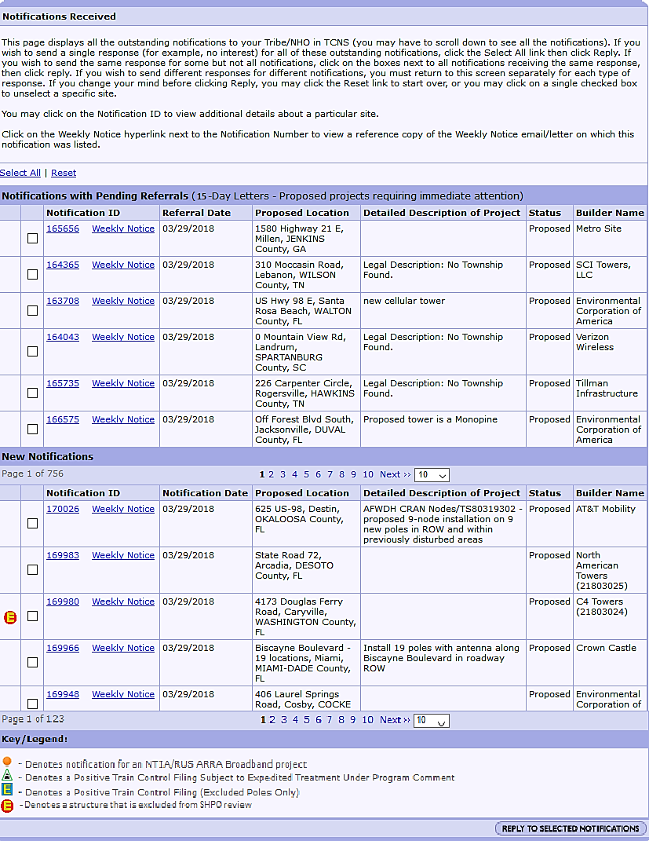
“20-Day Letters” has been changed to “15-Day Letters”
A new icon will display next to notifications that are ‘Excluded from SHPO review’
Click on the number of the TCNS Notification to view the notification details

Slide 30
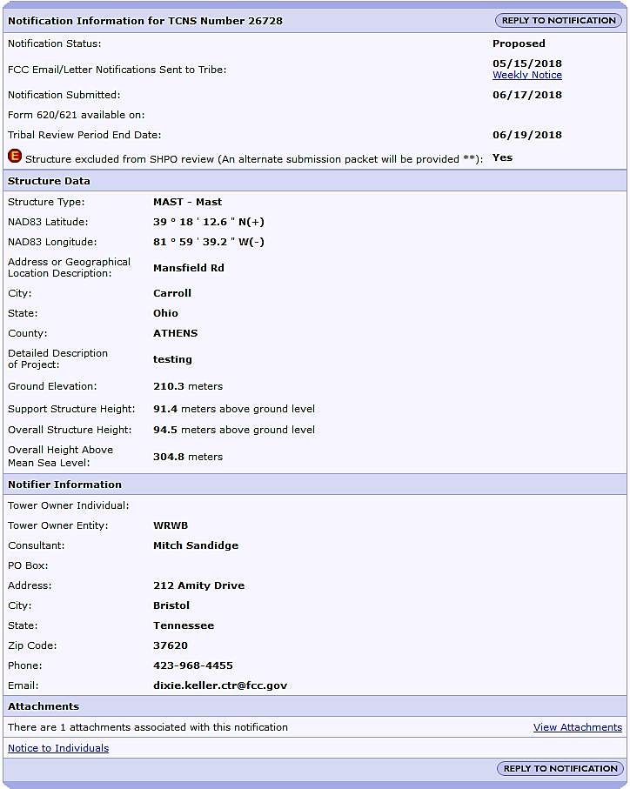
Notification Details
Project Excluded from SHPO Review
The new icon is displayed
The “Tribal Review Period End Date" will be the last date that a Tribe can reply before they are eligible for referral and the date is determined based on Tribe's TCNS Notification Preference.

Slide 31
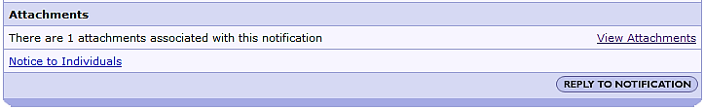
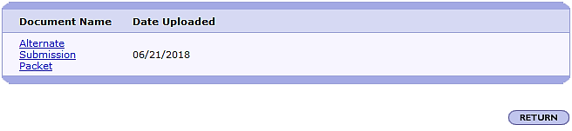
All notifications that are ‘Excluded from SHPO review’ are required to attach an ‘Alternate Submission Packet’
The ‘Alternate Submission Packet’ must include a map of the proposed location of the facility, a description of the facility to be constructed including all proposed elements (such as, for example, access roads), and a description of the proposed site, including both aerial and site photographs.
Click on the ‘View Attachments” link
Click on the Document Name link to view the attachment.

Slide 32
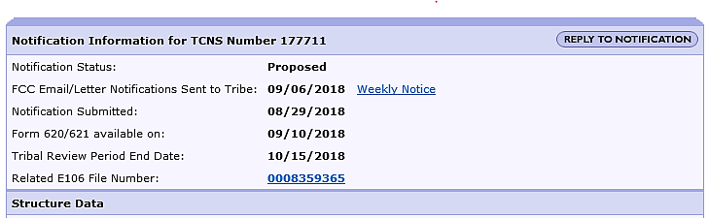
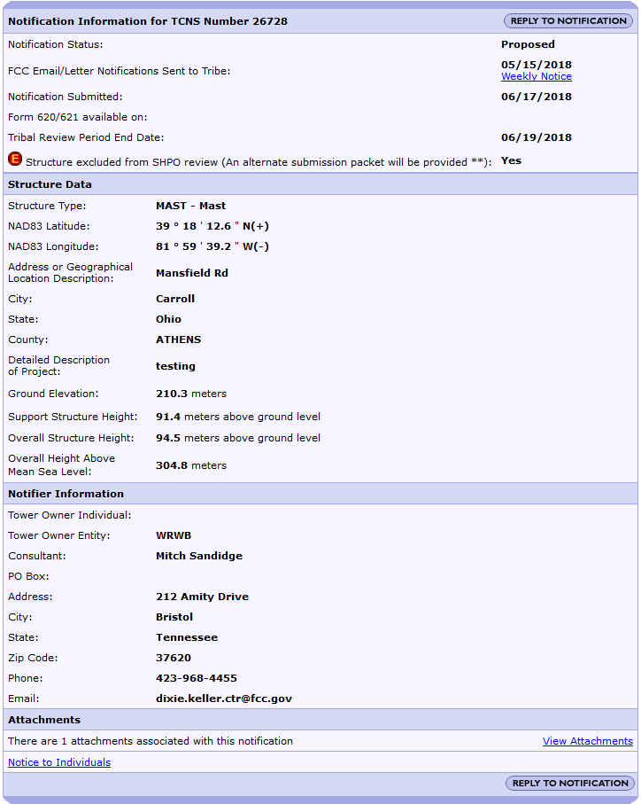
Notification Details
Project that Requires SHPO Review
  The “Related E106 File Number” will display the file number of the related Form 620/621
  The “Form 620/621 available on:” date will display the date the Tribe was notified of the related 620/621 filing when the structure isn’t excluded from SHPO review.
  The “Tribal Review Period End Date" will be the last date that a Tribe can reply before they are eligible for referral and the date is determined based on Tribe's TCNS Notification Preference.

Slide 33
Search for a TCNS notification

Slide 34
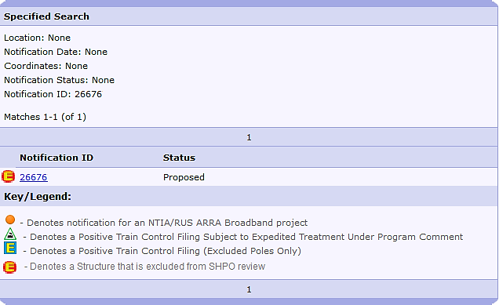
Search Results
The new icon is displayed when the project is excluded from SHPO review.
Click on the TCNS number to view the Notification Details

Slide 35
Notification Details
Project Excluded from SHPO Review
The new icon is displayed
The “Tribal Review Period End Date" will be the last date that a Tribe can reply before they are eligible for referral and the date is determined based on Tribe's TCNS Notification Preference.

Slide 36
Notification Details
Project that Requires SHPO Review
  The “Related E106 File Number” will display the file number of the related Form 620/621
  The “Form 620/621 available on:” date will display the date the Tribe was notified of the related 620/621 filing when the structure isn’t excluded from SHPO review.
  The “Tribal Review Period End Date" will be the last date that a Tribe can reply before they are eligible for referral and the date is determined based on Tribe's TCNS Notification Preference.

Slide 37
Additional Details

Slide 38
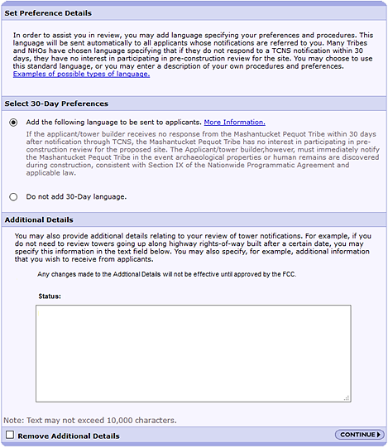
On July 2, 2018 all Additional Details text was deleted from the system
Tribes are required to enter new Additional Details for FCC approval before they are used in the system notifications to the Consultants.
Click in the field and enter text
* The Status will update to ‘Pending FCC Approval’
Click on the ‘Continue’ button to go to the Confirmation Page.

Slide 39
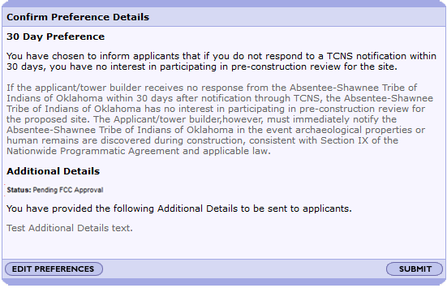
Review the text changes
To confirm the Additional Details text, click the ‘Submit’ button
To edit the text, click the ‘Edit Preferences’ button

Slide 40
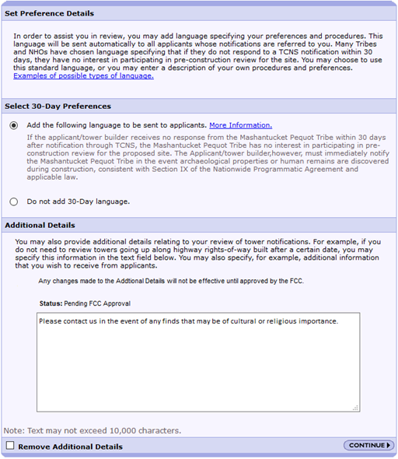
FCC staff review and approval Additional Details on a daily basis.
FCC staff may reach out to discuss the content of the Additional Details text before approving the new language.

Slide 41
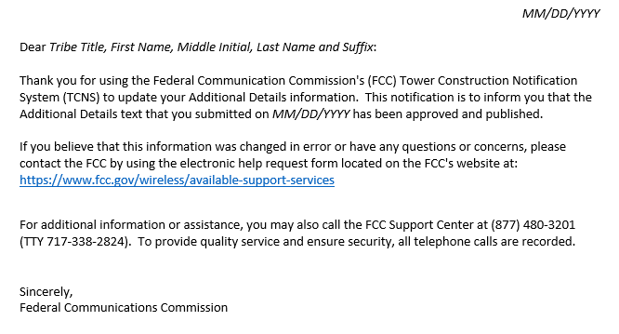
The Tribe will receive an email notification when the FCC has approved their new or modified Additional Details.

Slide 42
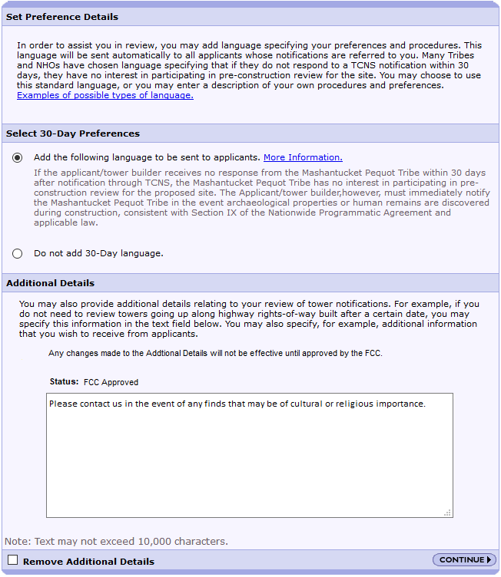
Once approved by the FCC, the Additional Details text will be included in the ‘NOTICE OF ORGANIZATION(S) WHICH WERE SENT PROPOSED TOWER CONSTRUCTION NOTIFICATION INFORMATION’ emails to the Consultants

Slide 43
Questions
TCNSHelp@fcc.gov
1-877-480-3201, option 2

