Slide 1

Hot Topics in Section 106 Compliance
Jill A. Springer, Federal Preservation Officer
Paul D’Ari, Senior Legal Counsel
Saurbh Chhabra, Senior Electronics Engineer

Slide 2
RECENT TIMELINE
APRIL 2017: Notice of Proposed Rulemaking, Notice of Inquiry Released by the Wireless Telecommunications Bureau : Accelerating Wireless Broadband Deployment
by Removing Barriers to Infrastructure Investment (Docket 17‐79)
-Opened a review of the regulatory barriers to wireless network infrastructure investment and deployment to examine how the Commission could act to remove
or reduce these barriers consistent with the law and the public interest
JUNE/JULY 2017: Comments
NOVEMBER 2017: 1st Report and Order (Pole Replacement Order)
MARCH 2018: 2ND Wireless Infrastructure Report and Order
SEPTEMBER 2018: 3RD Wireless Infrastructure Report and Order

Slide 3
NOVEMBER 2018 POLE REPLACEMENT ORDER
Why Necessary?
NPA Section III B excludes replacement of existing communications towers and any associated excavation that does not substantially increase the size of the existing tower nor expand the boundaries of the leased or owned property surrounding the tower.
NPA Section III E excludes construction of a Facility in or within 50 feet of the outer boundary of a right‐of‐way designated by a Federal, State, local, or Tribal government for the location of communications towers or above‐ground utility transmission or distribution lines and associated structures and equipment provided they are not substantially larger than other structures in the r‐o‐w and are not within the boundaries of a historic property.
Under the Collocation NPA, an antenna may be mounted on an existing tower or a non‐tower structure less than 45 years old without such collocation being reviewed in most cases.
No provision addressing the replacement of utility poles to accommodate a wireless antenna when the poles were not built for the sole or primary purpose of supporting Commission‐licensed or authorized Antennas.
The 2nd Wireless Infrastructure Report and Order subsequently expanded this exclusion by establishing that new poles are not considered Commission undertakings when below 50’ and if other conditions are met. No S106 review is required if a tower is not an undertaking.

Slide 4
NOVEMBER 2018 POLE REPLACEMENT ORDER
Exempts additional pole replacements from NHPA review if they meet certain criteria:
  Not a Tower: The pole being replaced can hold utility, communications, or related transmission lines but was not originally constructed for the sole or primary purpose of supporting communications antenna.
  Proximity to Original Pole: The replacement pole must be located no more than ten feet away from the original pole.
  No New Disturbances: The replacement pole must not cause any new “ground disturbance,” although the item recognizes that most rights‐of‐way will have been disturbed previously by the construction of the original pole or other infrastructure.
  Restricting Extensions: The replacement pole may exceed the height of the original pole by no more than five feet or ten percent of the original pole’s height, whichever is greater.
  Preserving Aesthetics: The replacement pole must be “consistent” with the quality and appearance of the original pole. Allows a change in material (e.g., replacing a wooden pole with a metal pole) so long as the replacement does not result in a significant aesthetic change. The exemption also does not apply when the original pole is itself a historic property.
  Inadvertent Discovery Clause: Parties to immediately halt construction if they uncover any burial remains or other historic sites during the replacement, even if they uncover such sites on previously disturbed land.

Slide 5
MARCH 2018: 2ND Wireless Infrastructure Report & Order
CHANGES TO S106 TREATMENT OF “SMALL WIRELESS FACILITIES”
SAURBH CHHABRA, Sr. Electronics Engineer Competition and Infrastructure Policy Division Wireless Telecommunications Bureau
Federal Communications Commission

Slide 6

AGENDA
What are Small Facilities?
Types & Features
Examples of Deployments
Definition of Infrastructure Excluded from Review under the R&O
2

Slide 7
WHAT ARE SMALL FACILITIES?
Deployments such as Distributed Antenna Systems (DAS) and small cells use components that are a fraction of the size of traditional cell tower deployments and can often be installed on utility poles, buildings, and other existing structures.
Types
  Distributed Antenna Systems (DAS) – Indoor/Outdoor
  Small Cells – Indoor/Outdoor
Commission decided in March order that “Small Wireless Facilities” meeting specified criteria need not undergo section 106 review.
3

Slide 8
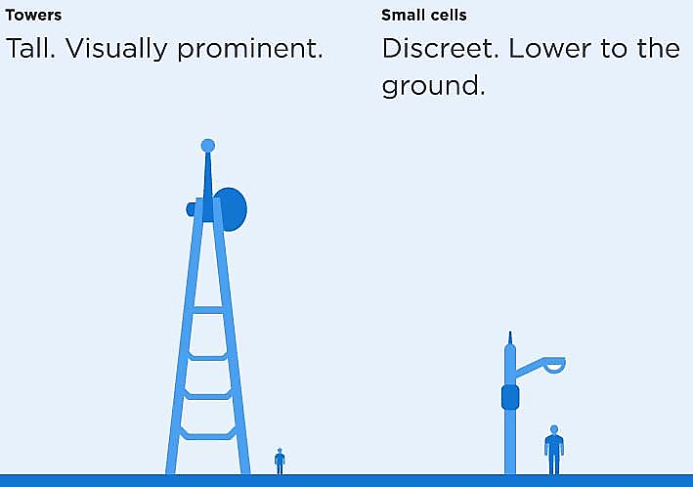
MACROCELL VERSUS SMALL CELL
4
Source: http://www.crowncastle.com/communities/small-cell-solutions.aspx

Slide 9
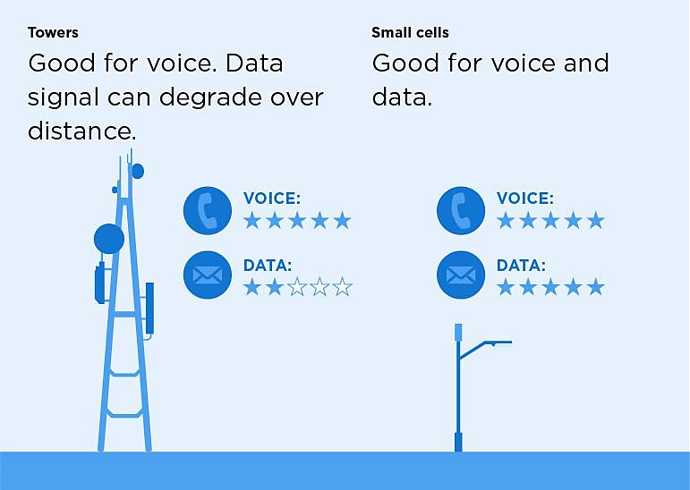
MACROCELL VS SMALL CELL
5
Source: http://www.crowncastle.com/communities/small-cell-solutions.aspx

Slide 10
MACROCELL VS SMALL CELLS
Macrocell sites are effective for covering large geographic areas (8-30 km in radius) with relatively high capacity, because the antennas are typically mounted on tall towers or the rooftops of tall buildings and transmit radiofrequency (RF) signals at high power levels.
On the other hand, facilities such as small cells and DAS can be deployed to provide coverage in targeted locations (0.01 to 2 km in radius) by moving radios closer to the users, and to provide additional capacity in areas with higher demands for wireless voice and data services. Essentially, improving the quality of service and experience.
6
Source: http://www.hetnetforum.com/resources/send/2-resources/24-das-and-small-cell-technologies-distinguished

Slide 11
NEED FOR SMALL FACILITIES
Continuous increase in mobile traffic and required user data rates create need for increased network capacity, which can be achieved by:
  Making more spectrum available,
  Using spectrum more efficiently, and
  “Densifying” the network (i.e., adding more cell sites to increase the amount of available capacity, or adding equipment to augment existing mobile networks and provide additional capacity in areas of high usage)
Densification technologies include Distributed Antenna Systems (DAS) and small cells
Source: http://www.rcrwireless.com/20161109/fundamentals/network-densification-5g-tag31-tag99 Bridging the Gap Report, at http://www.jointventure.org/initiatives/civic-technology/wireless-communications
7

Slide 12
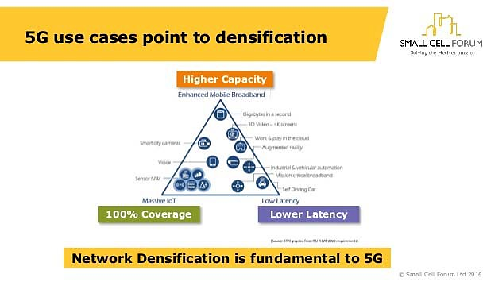
8

Slide 13
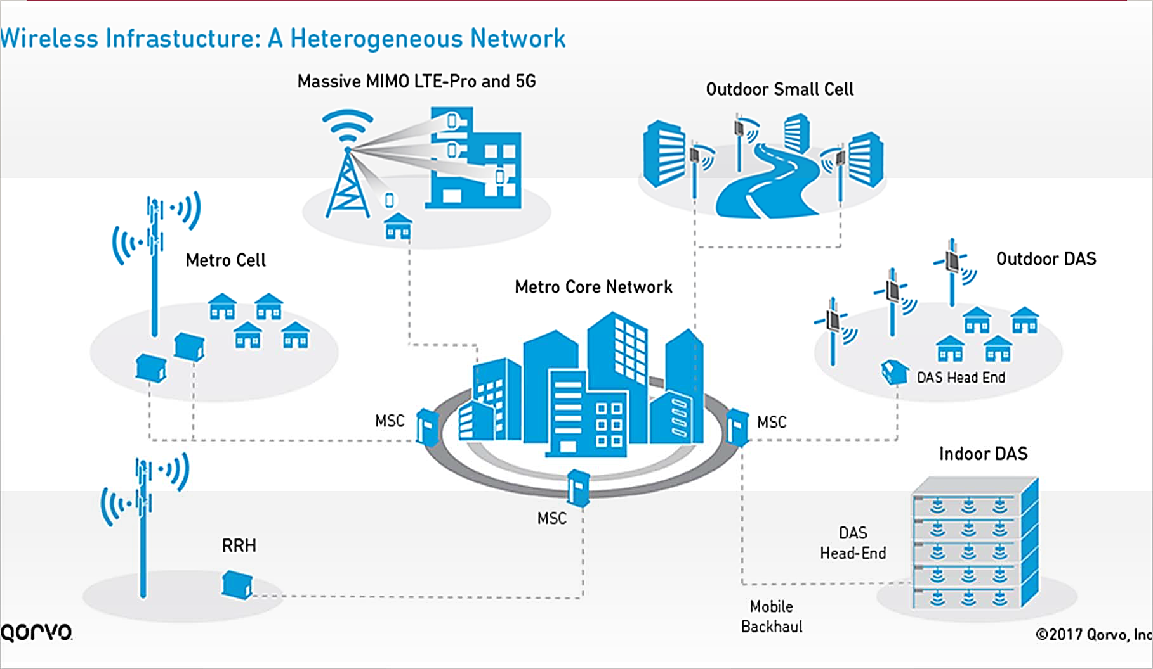
SMALL FACILITIES + MACRO = HETNET
9
Source: http://www.qorvo.com/design-hub/blog/small-cell-networks-and-the-evolution-of-5g

Slide 14
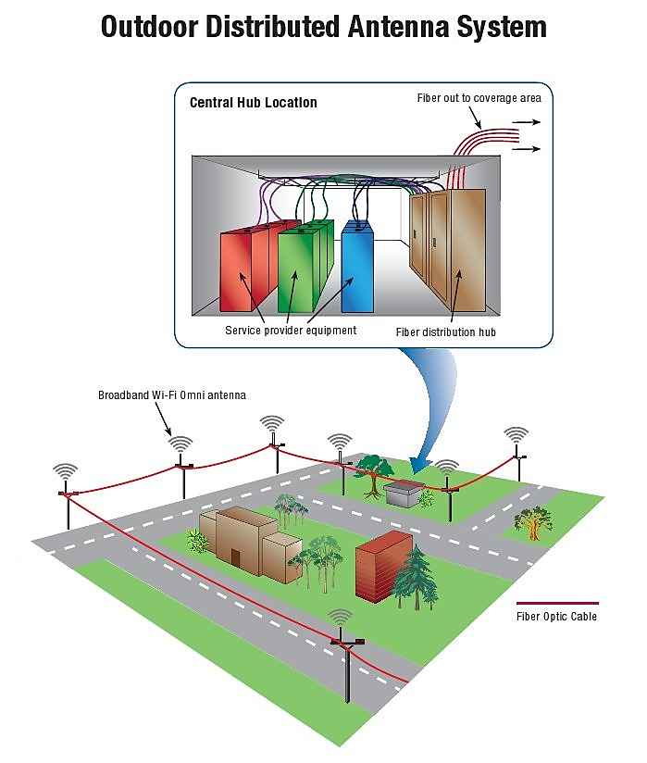
DISTRIBUTED ANTENNA SYSTEM (DAS)
DAS is a network of spatially separated antenna nodes connected to a common source via a transport medium that provides wireless service within a geographic area or structure.
Source: http://www.sbasite.com/OperationsServices_das.aspx http://www.l-com.com/what-is-a-distributed-antenna-system-das
10

Slide 15
SMALL CELLS
‘Small cells’ is an umbrella term for operator-controlled, low-powered radio access nodes, including those that operate in licensed spectrum and unlicensed carrier-grade Wi-Fi.
Types of small cells include femtocells, picocells and microcells – broadly increasing in size from femtocells (the smallest) to microcells (the largest).
Each small cell installation is similar to a single DAS Node installation.
11
Source: http://www.smallcellforum.org/about/about-small-cells/small-cell-definition/ http://www.hetnetforum.com/resources/send/2-resources/24-das-and-small-cell-technologies-distinguished

Slide 16
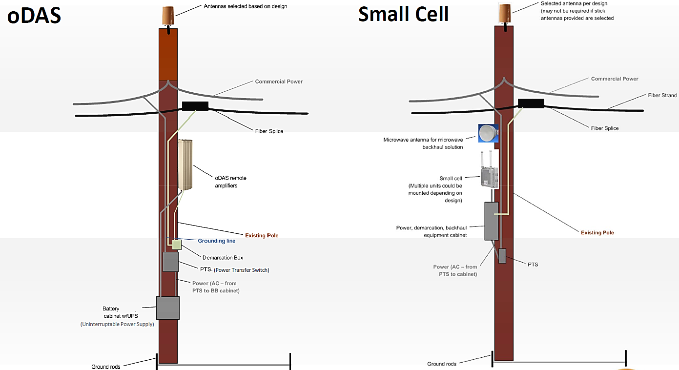
POLE-MOUNTED DAS AND SMALL CELL
12
Source: Letter from Colleen Thompson,AT&T, to Marlene Dortch, Secretary, Federal Communications Commission,WC Docket No. 11-59 (filed June 17, 2013)

Slide 17
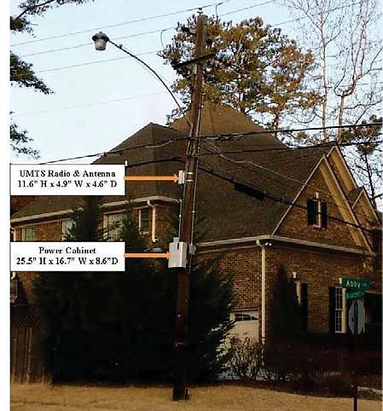
AT&T SMALL CELL DEPLOYMENT ON A UTILITY POLE
Source: Comments of PCIA - Attachment,WT Docket No. 15- 180, at 21 (filed September 28,
2015)
14

Slide 18
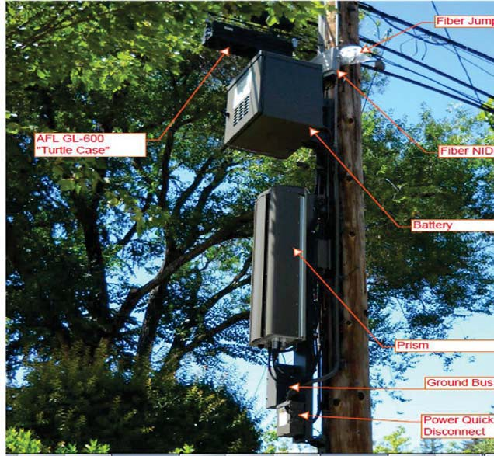
OUTDOOR DAS DEPLOYMENT IN PALO ALTO, CA
Source: Comments of PCIA - Attachment,WT Docket No. 15-180 at 7 (filed September
28, 2015)
15

Slide 19
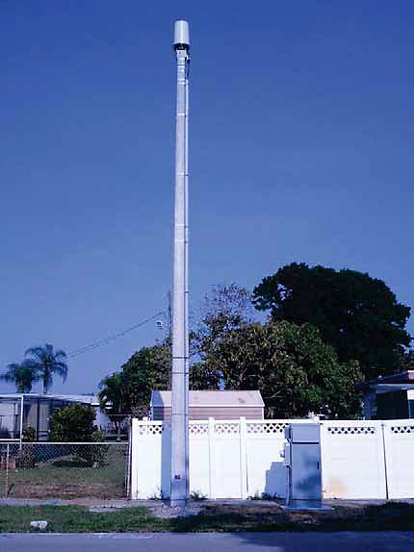
SMALL FACILITY IN BROWARD COUNTY, FL
Source: Comments of Crown Castle - Attachment,WT Docket No. 13-238, at 5 (filed September
10, 2014)
16

Slide 20
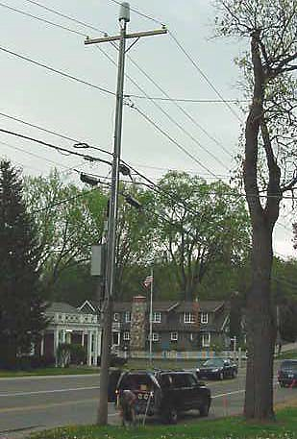
SMALL FACILITY IN HISTORIC DISTRICT IN FRANKLIN VILLAGE, MI
Source: Comments of PCIA - Attachment,WT Docket No. 15- 180, at 30 (filed September 28,
2015)
17

Slide 21
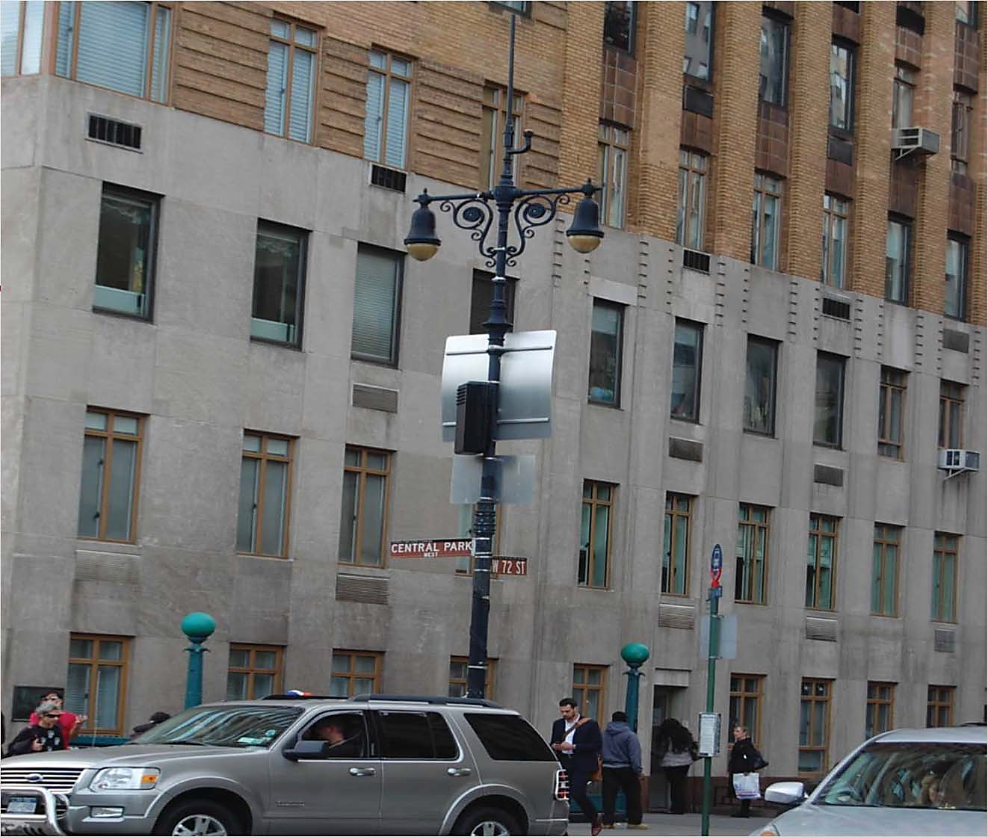
SMALL FACILITY IN HISTORIC CENTRAL PARK, NY
Source: Comments of Crown Castle,WT Docket No. 15-180, at 14
(filed September 28,
2015)
18

Slide 22

SMALL FACILITY IN HISTORIC CENTRAL PARK, NY
Source: Comments of PCIA - Attachment,WT Docket No. 15-180, at 25
(filed September 28,
2015)
19

Slide 23
DEFINITION OF “SMALL WIRELESS FACILITIES” THAT DO NOT REQUIRE SECTION 106 (OR NEPA) REVIEW
Structure Height Limit
  New/existing structures that are either no taller than the greater of 50 feet (including their antennas) or no more than 10 percent taller than other structures in the area
Antenna Volume Limit
  The antenna associated with the deployment, excluding the associated equipment, must be no more than 3 cubic feet in volume.
Equipment Volume Limit
  The wireless equipment associated with the antenna (and any pre-existing associated equipment on the structure) must be no larger than 28 cubic feet in volume.
20
Source: Infrastructure Second Report and Order,WT Docket No. 17-79, paras. 74-76,Appendix B (Final Rules) (2018)

Slide 24
MARCH 2018: 2ND Wireless Infrastructure Report & Order
BRIEF RECAP OF CHANGES TO TRIBAL PARTICIPATION REQUIREMENTS
Information Requirements.
Response Timelines.
Fees.
Consultant Services.

Slide 25
MARCH 2018: 2ND Wireless Infrastructure Report & Order
SACRED SITES IDENTIFICATION VIDEO
https://www.justice.gov/tribal/video/sacred‐sites‐training‐video
This training video for federal employees and contractors was developed [by the USDOJ] in coordination with subject matter experts from across the Federal Government, Indian Country, Academia and Tribal Advocacy Groups. This training was finalized in Fall 2016 with assistance from the Department of Justice’s National Indian Country Training Initiative.

Slide 26
Memorandum of Agreement (MOA) Process
Paul, D’Ari
Competition and Infrastructure Policy Division Wireless Telecommunications Bureau
Federal Communications Commission

Slide 27
OVERVIEW
Applicants are authorized to act on behalf of the FCC for much of the Section 106 process
FCC gets involved when communications facility deployments may have an adverse effect on a historic property.
If there is a finding adverse effects on a historic property, a Memorandum of Agreement (MOA) is required before the project can proceed.
Following the execution of the MOA, the applicant must file an Environmental Assessment.
Early engagement and consistent involvement of FCC staff increases the efficiency of these processes

Slide 28
NOTIFICATION OF ADVERSE EFFECT
The E‐106 system notifies the FCC when a project has an Adverse Effect, however, not all SHPOs use E‐106
Applicants should email notifications of Findings of Adverse Effect to S106.MOA@fcc.gov
Emails should include the project name, tower proponent, location, TCNS/E‐ 106 numbers, a list of all consulting parties, and a brief issue summary
FCC staff monitor this box and route the notices to the assigned preservation officer and attorney

Slide 29
FCC INITIAL CONTACT
FCC staff sends an email to all parties, which includes the following:
Names and contact information of assigned FCC staff
MOA template
Link to the ACHP website with instructions for inviting ACHP to participate
The email also requests:
A written description of the adverse effect(s) and any mitigation under discussion
Confirmation that alternatives have been considered
Uploading of Form 620/621 and all attachments and relevant correspondence into the E‐106 system
Verification that the Tribal engagement process has been completed

Slide 30
MOA DRAFT
MOA drafts must follow the FCC template
Once consulting parties have provided comments, consultant should submit draft final MOA to FCC for review
FCC staff will review the draft MOA and provide comments
Once all parties have agreed to the text, the MOA should be signed by all other parties before returning to the FCC for signature
A signed original MOA should be sent to assigned FCC staff and copies distributed to all signatories

Slide 31
POST EXECUTION
Applicant must ensure completion and filing of Environmental Assessment
Construction cannot begin until a FONSI has been issued
FCC notifies SHPO, ACHP and consulting parties when MOA is effective
Licensee/applicant is responsible for completion of all required mitigation
Licensee/applicant or designee must comply with any stipulated reporting requirements
Any proposed amendments must be coordinated with FCC staff

Slide 32
FCC MOA REVIEW TEAM
Paul D’Ari, Senior Legal Counsel
Jill Springer, Federal Preservation Officer
Michael Smith, Program Analyst (s106.moa@fcc.gov Administrator) MOA Review Attorneys:
Don Johnson
Jennifer Flynn Darrel Pae

Slide 33
QUESTIONS

