Slide 1
NATE
National Association of Tower Erectors

Slide 2
Elevated Equipment Waveland, Ms

Slide 3
Elevated Equipment, Waveland Ms older site required less height

Slide 4
Multiple Carrier Equipment Cabinets

Slide 5
Biloxi Ms Post Katrina

Slide 6
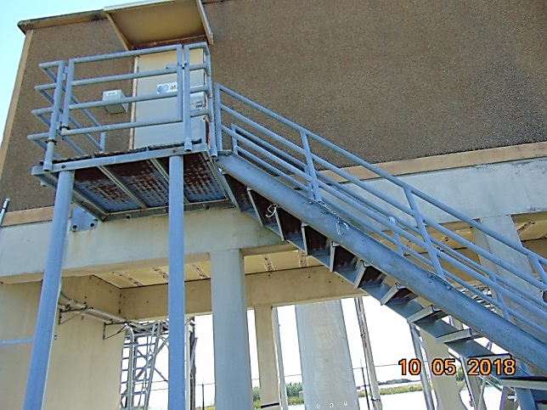
Lousiana Bayou

Slide 7
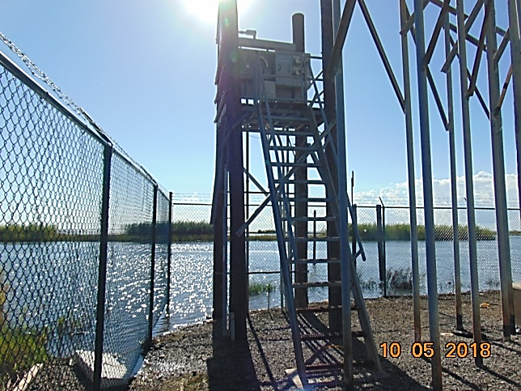
South Louisiana

Slide 8
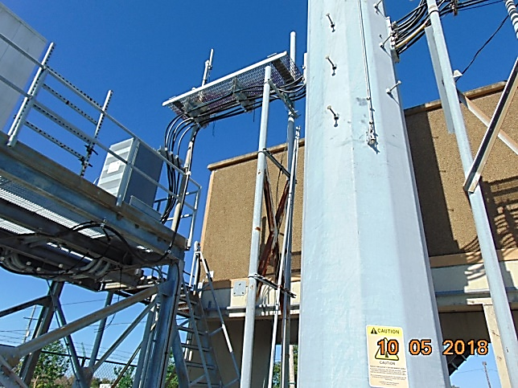

Slide 9
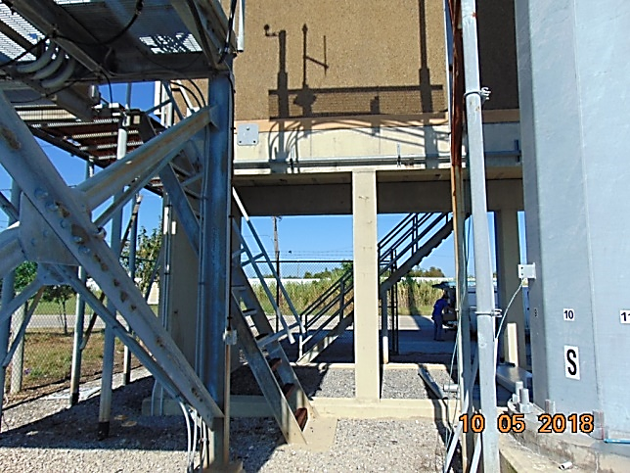

Slide 10
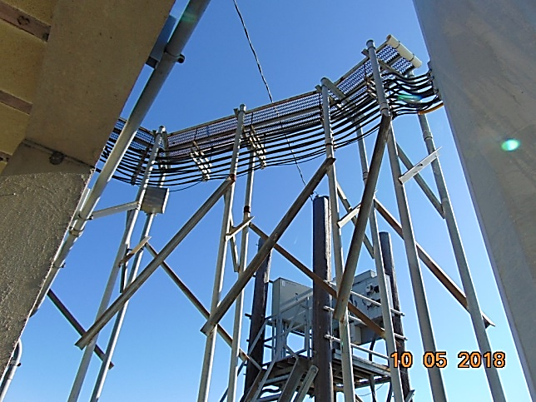

Slide 11
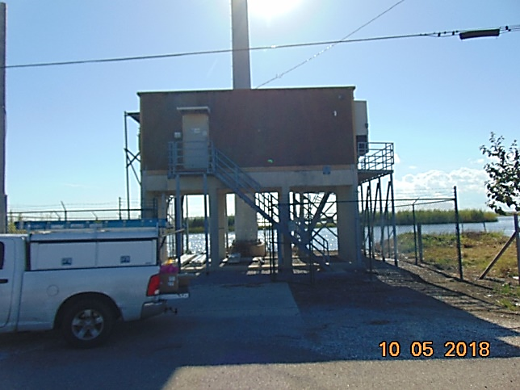

Slide 12
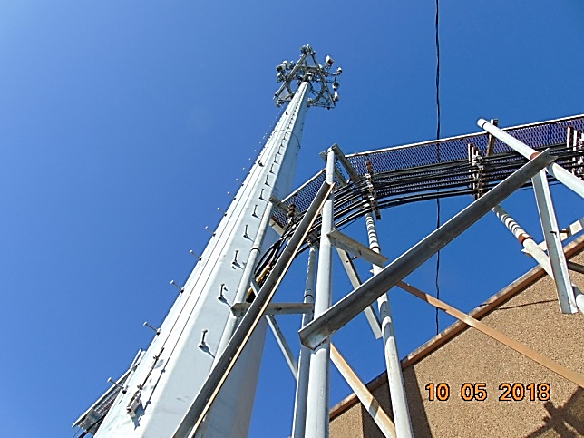

Slide 13
Best Practices for Elevated Sites
Key Components
Electrical Service Entrance
Carrier Equipment and Backhaul
Backup power source
Backup power fuel
FAA Lighting System
Minimal elevation determined by local jurisdiction (FEMA MAPS)

