Slide 1
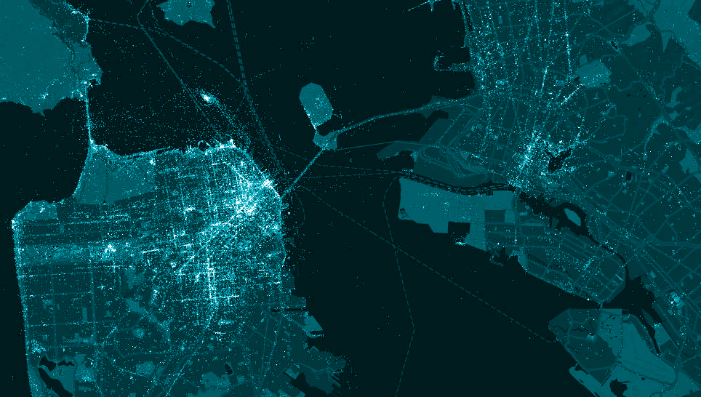
City & County of San Francisco
Miguel A. Gamiño Jr.
City Chief Information Officer
Executive Director, Department of Technology
@SFCityCIO
Omar Masry, AICP
Senior Analyst
Office of Short Term Rentals
FCC/NATOA
May 3, 2016

Slide 2
San Francisco | Department of Technology
WHO WE ARE
The City and County of San Francisco has $9B budget and 30,000 employees, serving nearly 1.5M daytime citizens, commuting workforce and visitors.
Department of Technology has $97M annual dollars with over 220 employees and is an enterprise information and technology services organization that delivers mission critical technology infrastructure and services.
The Department’s vision is to improve government services, the community, and the lives of the City and County of San Francisco customers through proactive leadership in the use of technology and information solutions.

Slide 3
San Francisco | Department of Technology
CONNECTIVITY PHASES
Phase 1
Phase 2
Phase 3
1
2
3
4
Fiber to City Buildings
Dig Once Ordinance
#SFWiFi
Increase Broadband Choices at Home
5
Digital Inclusion Program Recommendations

Slide 4
San Francisco | Department of Technology
CONNECTIVITY
“Wi-Fi in our City’s parks is another step toward a larger vision of connectivity for our City as a whole, bridging the digital divide and ensuring that our diverse communities have access to innovation. This project is a top priority for my administration because of the endless benefits that free Wi-Fi will bring to the residents and visitors of San Francisco.”
~ Mayor Edwin M. Lee
Press Release - Oct. 1, 2014
#SFWIFI in the Parks
Expansion in City Buildings + Public Spaces
Leverage Existing Assets & Projects

Slide 5
San Francisco | Department of Technology
#SFWIFI STATS
197,809
0:10:43
Unique Clients
Avg. Duration
9,158,901
29.6 TB
Total Sessions
Total Throughput
uploads | downloads
*January 2016

Slide 6
San Francisco | Department of Technology
CONNECTIVITY + COMMERCIAL WIRELESS (LTE)
Commercial wireless - Complimentary to Connectivity Plan
Connectivity Plan seeks to increase wireless and wired access, capacity, and choice
Plan is focused on expanding the City’s #SFWiFi service, but we view this as complementary to commercial wireless
Existing pilot offloading agreement with one commercial carrier we hope to expand
Super Bowl 50 served as forcing function - new infrastructure a lasting benefit to public

Slide 7
San Francisco | Department of Technology
CONNECTIVITY + COMMERCIAL WIRELESS
Commercial wireless has a critical role to play in meeting connectivity needs
Immediate driver for allowing small cell deployment was to accommodate visitors in our tourist centers
Infrastructure will be key to meeting residents connectivity needs
Mobile-only households have increased from 10% in 2013 to 20% in 2015, according to a recent article by the NTIA.
For low income households, reliance on LTE is even greater, with 29% of households with an income of less than $25,000 being mobile only.

Slide 8
San Francisco | Department of Technology
CONNECTIVITY + COMMERCIAL WIRELESS
San Francisco has agreements with carriers to use key assets for small cell deployment
San Francisco owns two sets of poles
Steel street light poles owned by Public Utilities Commission (SFPUC)
Support poles for the electric bus system owned by Municipal Transportation Agency (SFMTA)
Verizon and Extenet have installed 320 small cells in the North East & SOMA
The SFPUC and SFMTA have master license agreements with other carriers:
AT&T, T-Mobile, and Mobilitie (Sprint) will be installing small cells soon

Slide 9
Open Captions would appear in this area
Key Challenges for Wireless in The City
Designs (whether on poles or rooftops) that are contextually appropriate. Especially on historic buildings & in historic districts
Noise from cooling fans & generators
Avoiding business or residential tenant displacement (equipment areas for macro sites or cable trays across windows)
There are over 750 rooftop Micro/Macro (mostly rooftop) sites and 750 oDAS/Small Cells in San Francisco (46 square miles)
Notes:
9

Slide 10
Open Captions would appear in this area
Preferences for Wireless in The City
Scale and location appropriate rooftop-mounted Micro/Macro Wireless Facilities that are well designed (noise, displacement, resiliency, safety). Small Cells that are truly Small | Contend with the challenges (current and post-6409) with “oDAS XL” with large bulky cabinets and noisy cooling fans on wooden utility-owned poles a few feet from a residential window
Establishing good quality design standards that are adaptive to future challenges, consistent among wireless carriers, and respectful of current and future streetscapes.
Ensuring sites are appropriately built & maintained in a manner consistent with approvals & building/electrical codes
Notes:
10

Slide 11
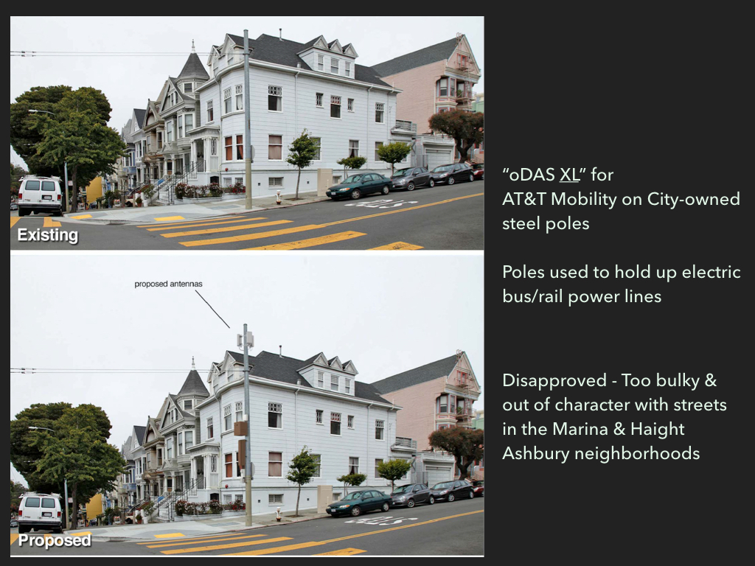
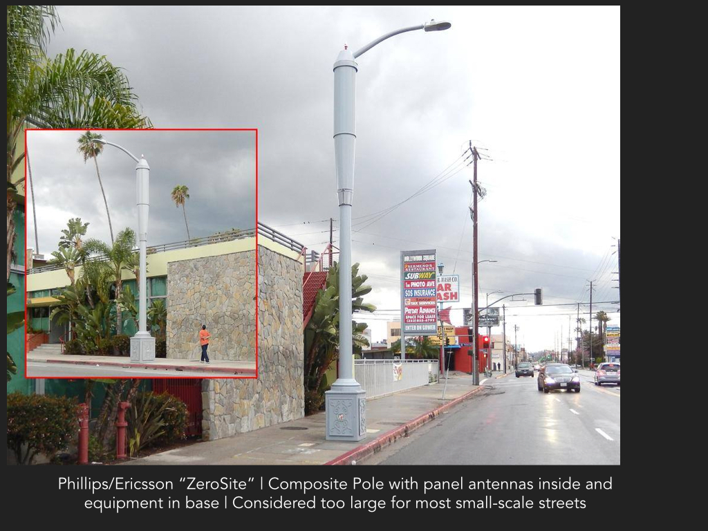
Open Captions would appear in this area
Background.
Prior challenges with incompatible designs – circa 2013
Notes:
11

Slide 12
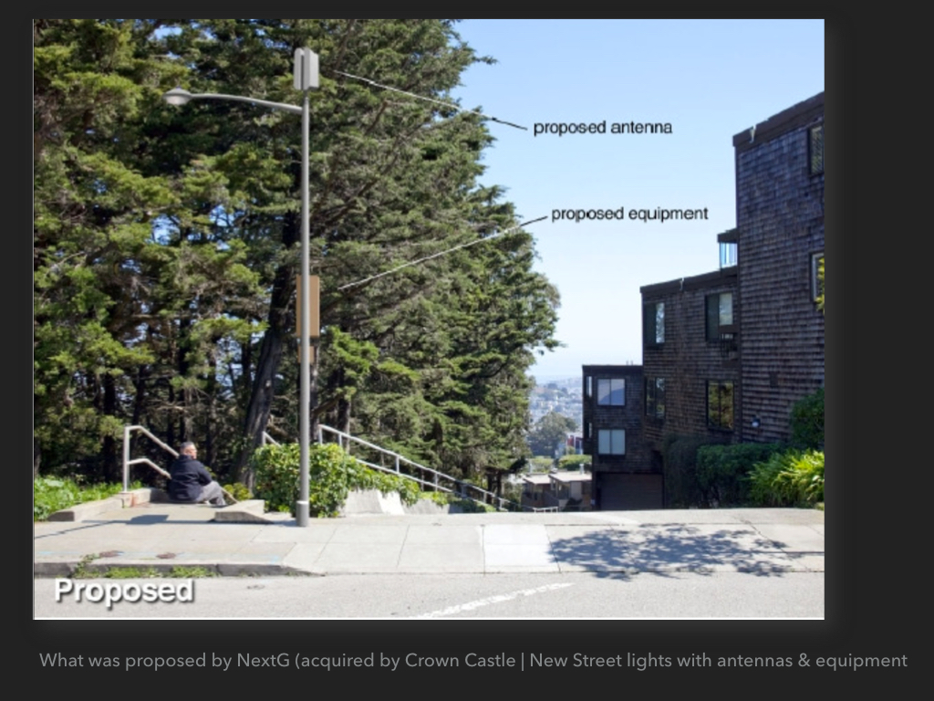
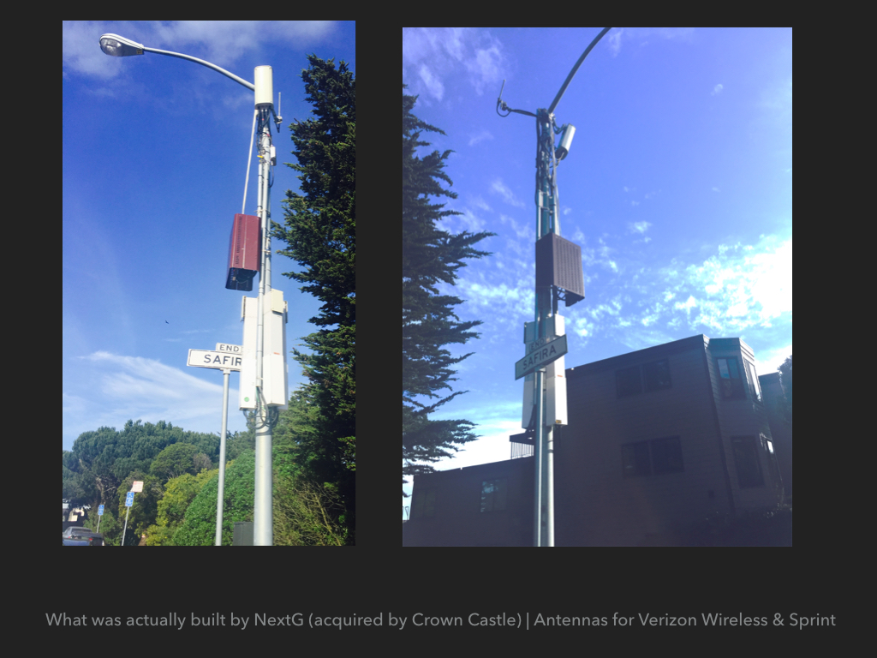
Open Captions would appear in this area
Prior challenge with new pole + small cell by Crown Castle, for Verizon & Sprint
Notes:
12

Slide 13
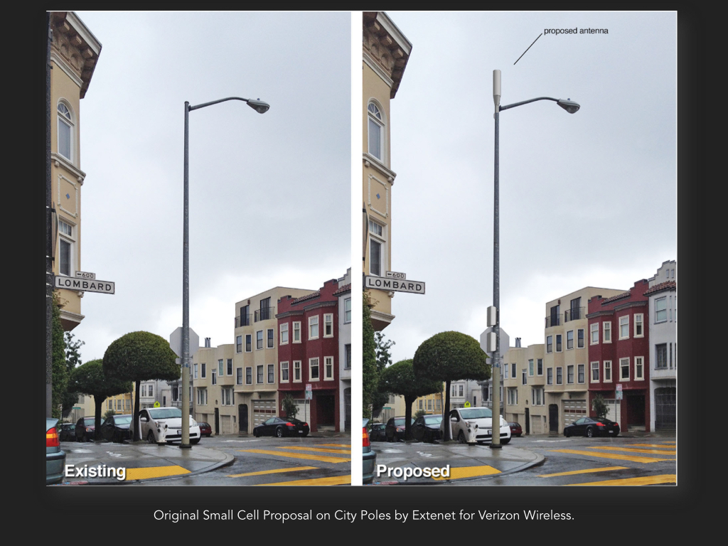
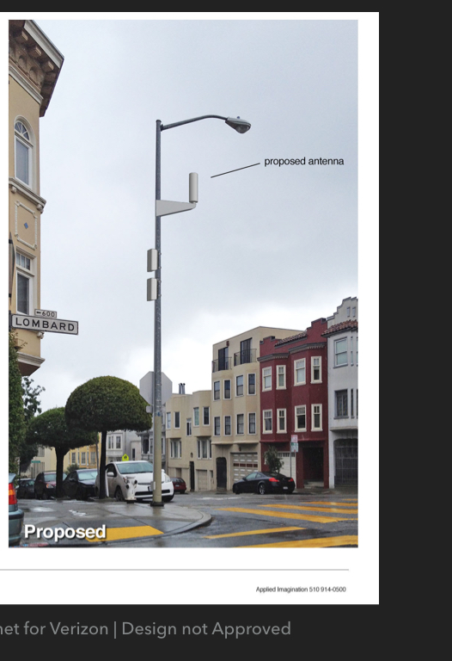
Open Captions would appear in this area
Original Extenet/Verizon Proposal Appeared viable
Notes:
13

Slide 14
Open Captions would appear in this area
Challenge:
Initial submittals left out known required elements (combiner boxes and cabling)
Design rejected
Staff requested mockup to flesh out concerns
Notes:
14

Slide 15
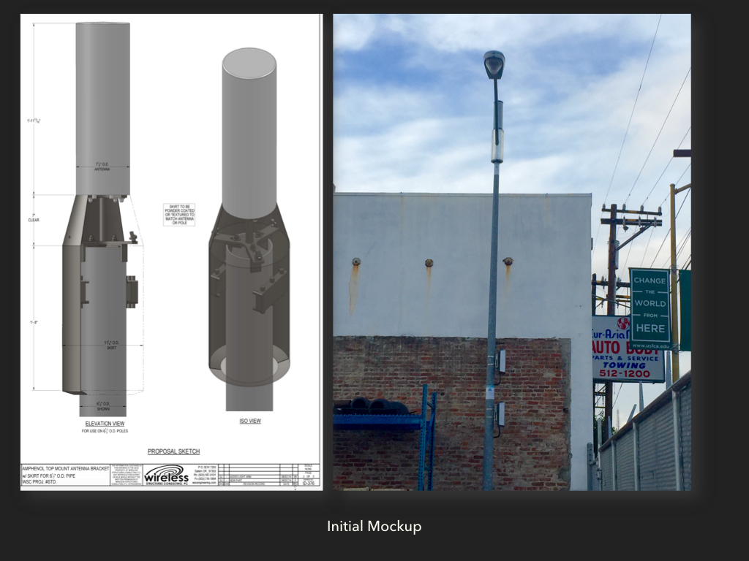
Open Captions would appear in this area
Actual mockup
Challenge:
The shroud used to screen cabling combiners below the antenna appeared too industrial
Notes:
15

Slide 16
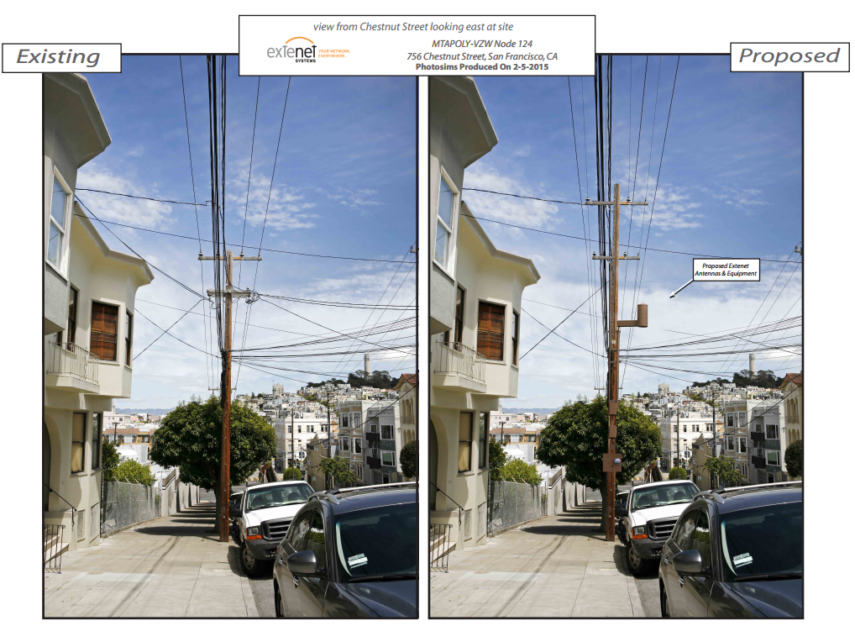
Open Captions would appear in this area
Background.
Challenge with large/noisy “oDAS XL” on some wood poles
Notes:
16

Slide 17
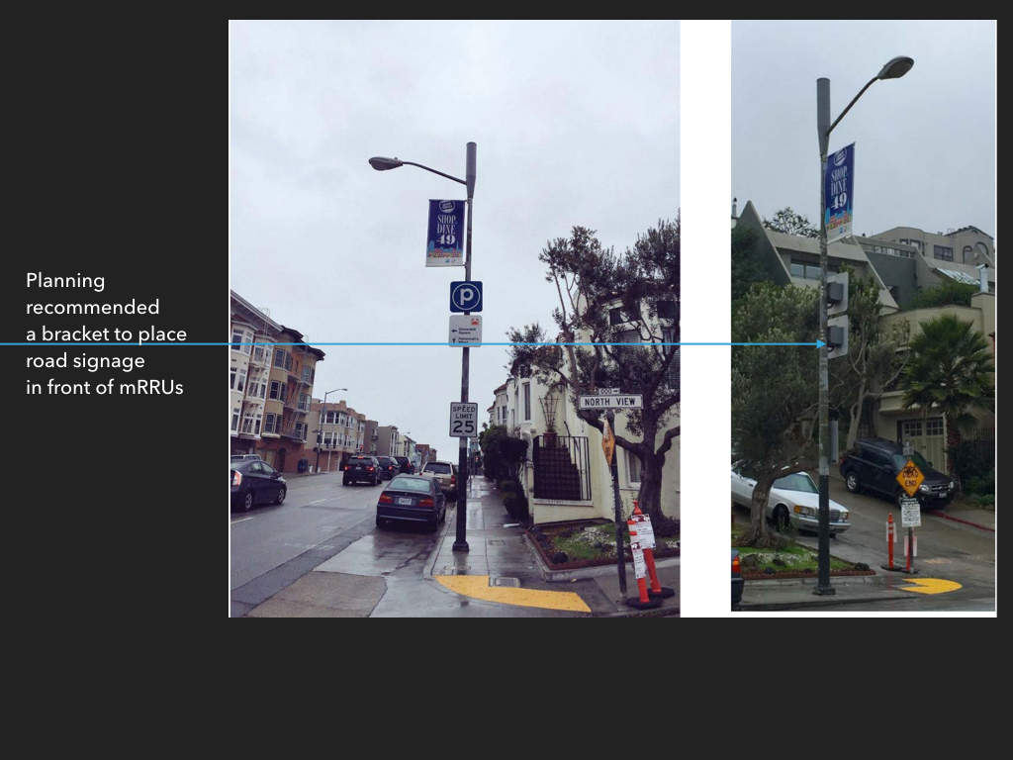
Open Captions would appear in this area
End Product: Citywide Approval
Screen mRRUs (equipment boxes) and reduce visiblity
Carrier required to remove logos
Carrier worked with City to place street signage (if present) in front of equipment (mRRUs)
AT&T may emulate this design
T-Mobile approved for similar (smaller) design
Notes:
17

Slide 18
Thank you!
Miguel A. Gamiño Jr.
City Chief Information Officer
@SFCityCIO
City & County of San Francisco
Office of the CIO
Department of Technology
Omar Masry, AICP
Senior Analyst
Office of Short Term Rentals

