Slide 1
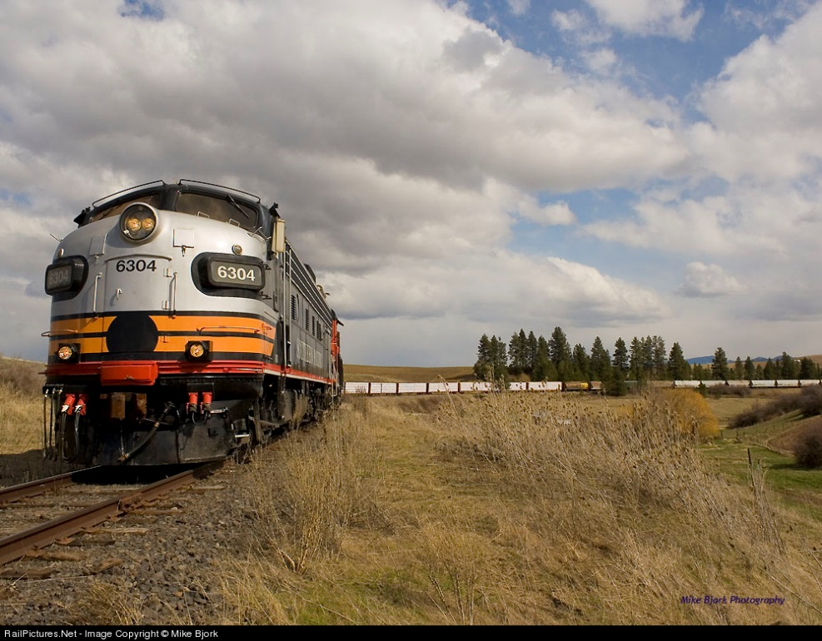
Railroad Towers
Issues and updates for towers proposed in railroad rights of way

Slide 2
POSITIVE TRAIN CONTROL
Implementation deadline extended to 2018 (further extensions possible)
Railroads report that they still aim to complete environmental clearances in 2016 so they can proceed with deployment and testing ASAP
As written, the Program Comment is in effect until May 16, 2021 so no extension was required
Program Comment efficiencies:
Certain exclusions from Section 106 review
APE limited to ¼ mile
Concurrent SHPO/Tribal 30-day review
No response= referred to FCC for resolution (10 days)
Adverse Effect Agreements can require monitoring, other provisions

Slide 3
POSITIVE TRAIN CONTROL REVIEWS

Slide 4
POSITIVE TRAIN CONTROL - EFFECTS
Vast majority have been cleared with no effects (or no adverse effects)
If an Adverse Effect is identified
Explore alternative sites
If not possible, advise FCC (email to jill.springer@fcc.gov)
Work with SHPO and/or Tribe to determine avoidance, mitigation, or monitoring requirements
Adverse Effect Agreement
ACHP notification
Environmental Assessment may be required

Slide 5
POSITIVE TRAIN CONTROL - REMINDERS
If the project was approved more than a year ago, railroads should:
Check State (SHPO) guidelines on approval expiration
Confirm that the project to be constructed is the same as that approved
If the project changes prior to construction, advise FCC
New review may be required
Withdrawn or Revised Projects
E-106 and TCNS
No construction until all environmental reviews (106 and EA, if required) for actual proposed project are completed

Slide 6
NON-PTC POLES = REGULAR NPA REVIEWS
Non-PTC poles, or PTC poles more than 75’ tall, require Section 106 review under the regular process established in the NPA.
These include, but are not limited to:
Advanced Train Control System Poles (ATCS): fixed digital radio link between multiple base stations along railroad tracks to communicate, monitor and control trackside or wayside equipment
PTC Base Station Poles
WiFi Poles
Other (RR Police Radio, etc.)

Slide 7
GENERAL CONSIDERATIONS
Most other (non-FCC regulated) construction in railroad rights of way (e.g. double tracking, expansion, etc.) is exempted from environmental, historic preservation, and sometimes even local, reviews
The direct APE for FCC undertakings includes all (but only) work associated with the tower or pole:
Trenching
Staging
Associated infrastructure (cabinets, power source, etc.)
If any recent non-FCC related construction is evident (double-tracking, signals, etc.) in photographs in the report, explain!

Slide 8
LESSONS LEARNED
Railroads may know about cultural resources in their right of way from past experience; PTC (or other infrastructure) requires special care
Turn of century RR construction clipped a mound site
APE not sufficiently defined in PTC consultation
Artifacts identified during utility trenching
Work stopped, mitigation required (MOA)

Slide 9
LESSONS LEARNED
When projects are delayed or modified, special care is required to ensure all parties receive notification and full information
Project submitted as excluded PTC, then withdrawn
New E-106 notification, but same TCNS number (no updates to TCNS)
SHPO identified concerns and required monitoring, Tribes not adequately notified of project revisions or SHPO concerns
Once monitoring was agreed, project should not be considered excluded
Monitor contacted FCC to ask status of Tribal consultation
Work stopped, adequate Tribal notification required before project proceeded

Slide 10
RESUBMITTING OR REVISING PROJECTS
Updating an E-106 filing (using the same number) automatically generates an email notification to the Tribes who have expressed interest in the project.
If a NEW E-106 filing (new number) is instead made, one of the following is necessary:
Submit a NEW TCNS notification with a statement in the Project Details box that references the original TCNS number; or
Submit an eSupport request (https://esupport.fcc.gov/request.htm) asking the FCC to reinstate the original TCNS Number to a Proposed status and list the project changes.
The FCC will then update the notification with the project changes and reset the notification to go back out to the Tribes.
In either case, the contractor is required to then update the related E-106 filing to remove the initial TCNS number and recopy the new or updated TCNS notification number into the E-106 filing.

Slide 11
LESSONS LEARNED
Expedited, streamlined PTC process still requires flexibility to protect resources
RR proposed 65’ PTC pole in highly sensitive (and scenic) area associated with the creation story of several Tribes, considered a traditional cultural property
Tribe requested viewshed analysis as necessary to determine effect
Consultant referred request as not sufficiently justified
Commission agreed with Tribe, requested railroad to review proposal
Railroad reviewed and redesigned, moved pole out of TCP

Slide 12
“View towards proposed pole.”

Slide 13
WIRELESS RAILROAD INFRASTRUCTURE
QUESTIONS?

