Slide 1
FCC Compliance: Archaeology Topics
May 4, 2016
© Copyright 2015 by ERM Worldwide Limited and/or its affiliates (‘ERM’). All Rights Reserved. No part of this work may be reproduced or transmitted in any form or by any means, without prior written permission of ERM.
The world’s leading sustainability consultancy

Slide 2
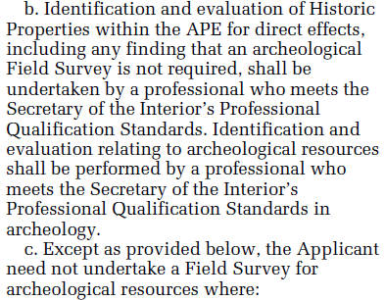
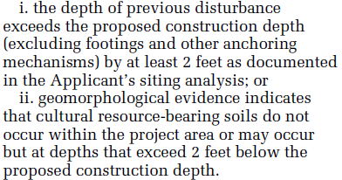
NPA, Appendix C, Section VI, D(2)

Slide 3
“Standard” Archaeological Field Methods
While specific practices are considered standard in some regions, settings, or states, there is no single accepted standard for appropriate field methods
Some SHPOs, THPOs, and land-managing agencies require permits or pre-screening of qualifications
The Principal Investigator is responsible for assuring that all parties consulting under Section 106 (including SHPO and tribes) are satisfied with the testing strategy in advance of field survey—or they risk having to redo survey to satisfy all parties

Slide 4
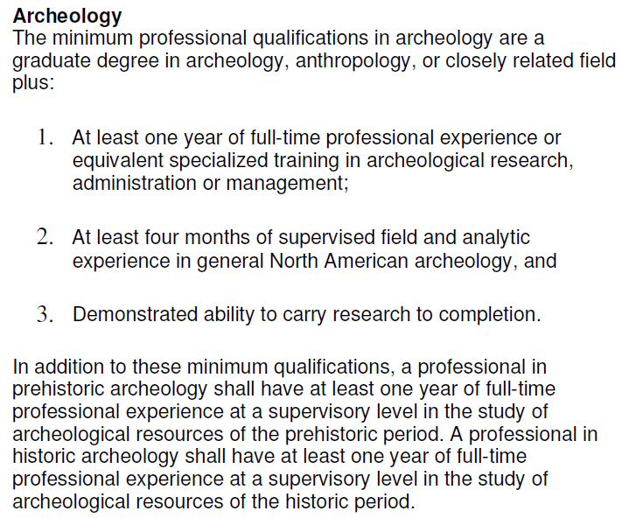
SOI Quals—Archaeology (NPS--36 CFR Part 61)

Slide 5
Case History—The Black Hills of South Dakota
Situation:
A cellular carrier proposed multiple sites within the Black Hills Region of South Dakota
Tribes either replied with no interest, or “timed out” according to FCC Declaratory Ruling process
Shortly after the consultant completed documentation that FCC requirements had been met, a THPO called the consultant and said that she had missed where the projects were, and there were actually big issues

Slide 6
Case History—The Black Hills of South Dakota
Consultation at work:
The consultant contacted the carrier, and explained the situation
The carrier understood the importance of the THPO concerns, and notified FCC of the situation, and their willingness to reopen consultation
Meanwhile, the THPO had contacted several other THPOs, all of whom were concerned and interested in further consultation when they realized the location of the project

Slide 7
Case History—The Black Hills of South Dakota
Strategy:
The carrier recognized that several proposed projects would have similar issues, and decided to meet with the interested tribes about the entire group of sites
Several THPOs and tribal elders were concerned that geographic clues to tribally significant items had been missed during the archaeological surveys
The carrier organized a road trip to visit each of the Black Hills projects with the interested tribes, to re-examine the locations from a tribal perspective

Slide 8
Case History—The Black Hills of South Dakota
Outcome:
Several meetings and a week of field trips led to an agreement about which locations were acceptable and which needed to be moved slightly or significantly
A tribal liaison was identified to assist with all of the projects to be relocated, to work in cooperation with the consultant
The carrier was able to build out needed sites in the Black Hills, limiting cultural impacts, and providing needed service for the community—including the tribes

