Slide 1
Reverse Auction
(Auction 1001)
Clock Phase Workshop
May 24, 2016

Slide 2
Disclaimer
Nothing herein is intended to supersede any provision of the Commission's rules or public notices. These slides should not be used as a substitute for a prospective applicant's review of the Commission's relevant orders, rules, and public notices. Applicants must familiarize themselves thoroughly and remain current with the Commission's rules relating to the Incentive Auction, application and auction procedures, and the procedures, terms and conditions contained in auction public notices. All examples use fictional information, are for illustrative purposes only, and are not predictions or advice.

Slide 3
Questions?
Send questions to auction1001@fcc.gov

Slide 4
Getting to the Start of the Clock Phase
Preview Period
Mock Auction
Bidding Schedule

Slide 5
Preview Period
Preview period closes May 24 at 6 p.m. Eastern Time
  If you had at least one station qualified to participate in the clock phase, make sure to log in to view the results of the initial commitment, which includes information pertinent to Round 1 of the clock phase
    The link to the Auction System was provided in the Final Confidential Status Letter
    The login process is the same as it was for making an initial commitment
  Once the preview period closes, you will not be able to access the results of the initial commitment until the Auction System opens for bidding on May 31

Slide 6
Mock Auction
Qualified bidders should familiarize themselves with the bidding software and may use the mock auction
The station(s) assigned to a bidder in the mock auction will be hypothetical and the price offers that bidders see in the mock auction will not be the same as the actual price offers they see in the reverse auction itself
  The number and variety of stations assigned to a bidder for the mock auction will be similar to what the bidder will have during the actual clock phase of the reverse auction
The mock auction will simulate the start of the auction, and each bidder will be allowed to submit bids for the stations shown in the Auction System
  If a bidder does not place a bid for a station, just as in the actual auction, the Auction System will treat the missing bid as a bid to drop out of the auction

Slide 7
Mock Auction
Mock auction schedule:
May 25, 2016 | Mock Bidding Round 1 | 10:00 a.m. – 12:00 p.m. ET
 | Mock Bidding Round 2 | 3:00 p.m. – 5:00 p.m. ET
May 26, 2016 | Mock Bidding Round 3 | 10:00 a.m. – 11:00 a.m. ET
 | Mock Bidding Round 4 | 1:00 p.m. – 2:00 p.m. ET
 | Mock Bidding Round 5 | 4:00 p.m. – 5:00 p.m. ET
Instructions for how to access the mock auction were provided in the Final Confidential Status Letter
      The login process is the same as it was for making an initial commitment
    Access to the Auction System begins at 9:00 a.m. ET on May 25, 2016
    Bidders may bid telephonically or electronically

Slide 8
Clock Phase Begins on Tuesday, May 31
Auction schedule:
May 31, 2016 | Bidding Round 1 | 10:00 a.m. – 4:00 p.m. ET
June 1, 2016 | Bidding Round 2 | 10:00 a.m. – 2:00 p.m. ET
June 2, 2016* | Bidding Round 3 | 10:00 a.m. – 12:00 a.m. ET
 | Bidding Round 4 | 3:00 p.m. – 5:00 p.m. ET
*This schedule will continue each weekday that is not a federal holiday until further notice
The FCC may adjust the number and length of bidding rounds based upon its monitoring of the bidding and assessment of the reverse auction’s progress
Announcement of any changes will be made in the Auction System during the course of the auction

Slide 9
Bidding Procedures Highlights
Reverse Auction Clock Phase Workshop

Slide 10
Bidding Procedures Highlights
The bidding procedures are discussed in detail in the Bidding Procedures Public Notice (FCC 17-58), Appendix D to the Application Procedures Public Notice (DA 15-1183), and in the Reverse Auction Clock Phase Tutorial
This portion of the presentation is meant to reinforce information about the following topics, but it is not all-inclusive of the bidding procedures
Bidding Statuses
Currently Held Option
Vacancy Index
Price Offers
Proxy Bidding

Slide 11
Stage 1 Bidding Statuses
Status |  | Description | Reason for Status | Can Become Unfrozen | Can place a proxy bid?
BIDDING |  | A bid for the station must be placed in the next round at a lower price offer | The station is currently feasible in its pre-auction band | N/A | ✓
FROZEN | Provisionally Winning | The station’s currently held option and associated price is provisionally winning | The station will never be feasible in its pre-auction band in this stage | In a later stage
 | Currently Infeasible (VHF stations only) | The station’s currently held option and associated price is currently frozen but not provisionally winning | The station is not currently feasible in its pre-auction band but could be later | In the current stage | ✓
EXITED | Voluntarily | The station has exited the auction and will be repacked in its pre-auction band | A bid was placed to drop it out of the auction and the station was feasible in its pre-auction band | N/A
 | Not Needed |  | The station will always be feasible in its pre-auction band

Slide 12
Bidding Statuses
You must place a bid every round for a station that has the status “BIDDING” if you wish to keep the station in the auction
  The Auction System will treat a missing bid as a bid to drop out of the auction
If a station’s status is “FROZEN – Provisionally Winning,” you do not need to place any more bids for that station during the current stage of the auction
  If there is a subsequent stage, your station could unfreeze and you would need to resume bidding for that station if you wish to keep the station in the auction
It is possible that a VHF station could freeze and unfreeze within the same stage (UHF stations, once frozen will never unfreeze during the same stage)
  If your VHF station has the status, “FROZEN – Currently Infeasible,” you should check the status of the station each round to make sure that you do not accidentally miss submitting a bid if the station’s status changes from “FROZEN” to “BIDDING”

Slide 13
Currently Held Option
For each round, the currently held relinquishment option is the option a station is assigned to after bids from the previous round are processed
The Auction System will always be able to accommodate a station in its currently held option
  Go off-air = has unlimited capacity
  Move to Low-VHF = since the option has been assigned to the station, the Auction System has already determined that a feasible channel in Low-VHF exists for that station
  Move to High-VHF = since the option has been assigned to the station, the Auction System has already determined that a feasible channel in High-VHF exists for that station

Slide 14

Currently Held Option
Once a station holds an option, it will continue to be assigned to that relinquishment option each round until
  you bid to switch to a new relinquishment option and it is processed by the Auction System,
  you bid to drop out of bidding and it is processed by the Auction System,
  or during bid processing the Auction System determines that your station is no longer needed in the auction
My Option

Slide 15
Vacancy Index
For a given band and a given station, the vacancy index is an average number of weighted channels available (weighted by station volume) in the station’s neighborhood, given the currently held options of all stations
  A station’s neighborhood includes stations that could interfere with that station in that band, and thus potentially limit assigning that station to an available channel in that band
The minimum possible value of the vacancy index is 0.5
The maximum possible value of the vacancy index is the number of channels in the band
  5 for Low-VHF; 7 for High-VHF; and at a clearing target of 126 MHz,
  16 for UHF
The system does not display the vacancy index, but instead displays a range between which the vacancy index falls

Slide 16
For which Bands is a Vacancy Range Provided?
Vacancy ranges for a station are displayed for the following bands
  Its pre-auction band, and
  Each band associated with an available relinquishment option for the next round, excluding the station’s currently held option
A vacancy range is not displayed for the station’s currently held option because the Auction System has already determined that the station can be accommodated in its currently held option and it will continue to ensure that the station will remain accommodated in that option

Slide 17
Interpreting Vacancy Ranges
The vacancy range gives bidders an indication of how “free” the band is for a station as of the time of the calculation
The lower the values in the range, the fewer the number of available channels in the band
  Lower values for the station’s pre-auction band indicate that there are fewer available channels remaining in the band so there is a higher potential the station may become frozen
  Lower values in bands other than a station’s pre-auction band also indicate that there are fewer available channels in that band
    If a bidder wants to bid to switch from its currently held option to a different band, lower values in that band’s vacancy range indicate a lower likelihood that the station will be able to switch into that band in the next round

Slide 18



Vacancy Ranges for Specific Bands
The FCC defined specific ranges for a station’s pre-auction band
Vacancy ranges for the other relevant bands are not pre-defined and get calculated during bid processing of a round
  These calculations may results in decimal values for the vacancy ranges
UHF station in UHF band:
0.5 - 3
3 - 6
6 - 16*
* Assuming 126 MHz clearing target
High-VHF station in High-VHF band:
0.5 - 2
2 - 4
4 - 7
Low-VHF station in Low-VHF band:
0.5 - 2
2 - 4
4 - 5
Low
Medium
High

Slide 19
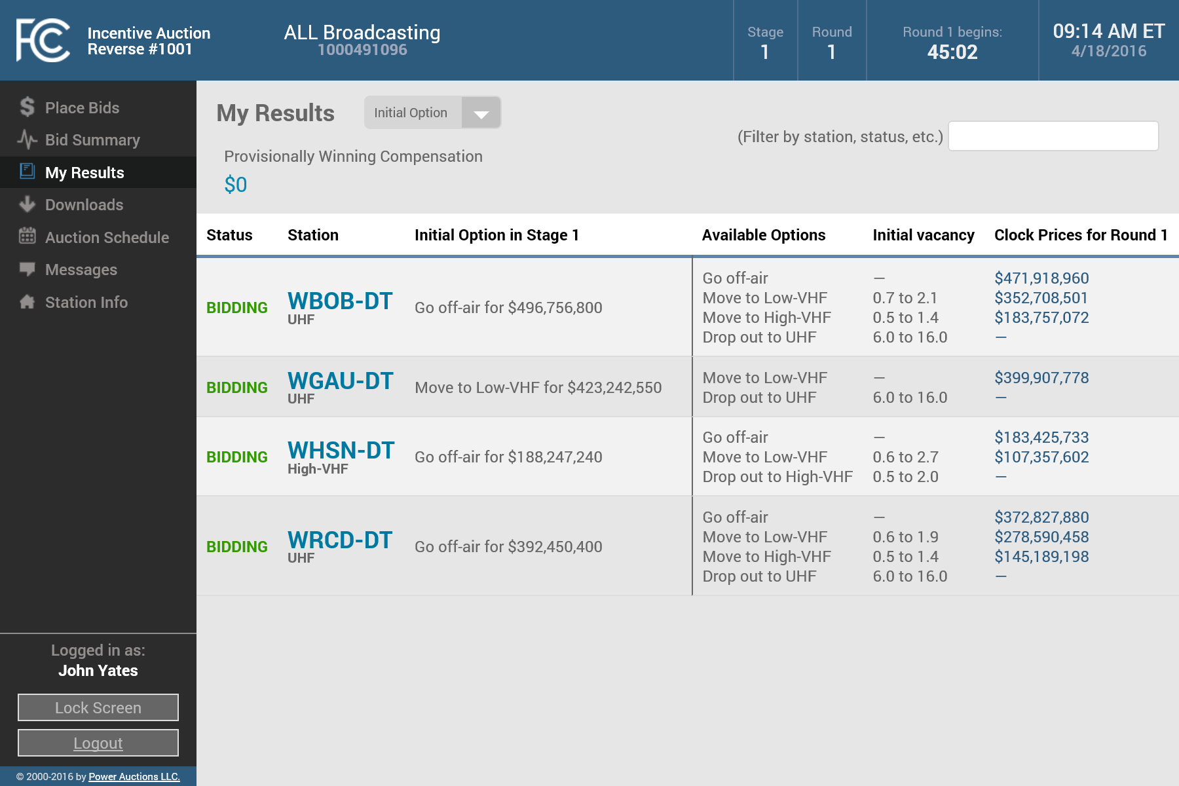
Vacancy Range Example
In this example a UHF station has an initial vacancy range for “Drop out to UHF” of 6.0 to 16.0
This means that after the initial commitments were processed, this station’s vacancy range is the highest of the three ranges for a UHF station’s pre-auction band

Slide 20
Vacancy Range Example
The station’s vacancy range for the “Move to High-VHF” option is 0.5 to 1.4
This means that after the initial commitments were processed, the vacancy in the station's High-VHF neighborhood is low
The station’s vacancy range for the “Move to Low-VHF” option is 0.7 to 2.1 which indicates a relatively low vacancy in the station's Low-VHF neighborhood

Slide 21
Price Offers
Base clock price = $900
  Each round, the base clock price is reduced by the larger of:
    5% of the current base clock price
    1% of the $900 opening base clock price ($9)*
The price offers for UHF stations bidding to Go off-air will be (Base Clock Price) x (Station Volume)
  Price offers for all other options, and for VHF stations, depend on the relative availability of channels in each band in the station’s neighborhood (vacancy)
    The decrement percentage may vary greatly from round to round depending on vacancy; therefore, price offers in these cases will not be predictable
*The FCC has the discretion to change the 5% and 1% decrement percentages during the auction

Slide 22
Proxy Instructions
A proxy instruction tells the Auction System to submit bids on behalf of the bidder in all rounds in which the price offer is greater than or equal to the amount entered by the bidder in the proxy instruction
  Proxy instructions can only be submitted for a station’s currently held option
  Proxy instructions can be changed or deleted at any time during a round
  Bids submitted by the Auction System according to proxy instructions can be manually changed during a round
Users should check regularly that their proxy instruction remains in effect if the bidder wishes to continue bidding for a station after the price offers for the station drop below the proxy amount
  As soon as the price offer for a station’s currently held option drops below the proxy amount, the proxy instruction is no longer in effect and the system will no longer submit bids for the station

Slide 23
High-Level Take Away Points
Pay attention to the bidding schedule and the bidding status for your stations—a missing bid is a bid to drop out
  Proxy instructions are a useful tool, but you still need to pay attention to price offers and bidding statuses
  While the decrement percentage for the base clock price is predictable, the decrement percentage for price offers for anything other than a UHF station bidding to Go off-air will vary from round-to-round based on vacancy
Whether or not the Auction System freezes a station depends solely on if it can find a feasible channel for that station in its pre-auction band
  If a feasible channel exists in the pre-auction band, the Auction System will offer a station lower price offers, as long as the station may be still be needed
Vacancy ranges provide a “snapshot” of the vacancy of a band as of the time they are calculated; while useful, they do not predict what will happen in the future

Slide 24
Reverse Auction Bidding System
Reverse Clock Auction Workshop

Slide 25
Reverse Auction Bidding System Resources
On the Auction 1001 website under the “Education” tab
  Reverse Auction Bidding System User Guide
    Complete guide to using the bidding system during the clock phase
  Reverse Auction Clock Phase Tutorial
    Overview of the bidding system and a review of the bidding procedures that bidders should understand in order to participate in the auction
  Reverse Auction Clock Phase Workshop
    Video recording of today’s workshop will be available on the website soon after the workshop concludes

Slide 26

Accessing the Auction System
The Preview Period will close at 6:00 p.m. ET on May 24, 2016
Once the Preview Period ends the system will not be available again until 9:00 AM on May 31st when the clock phase begins
Bidders can access the system by clicking on the link on the home page once it becomes available

Slide 27
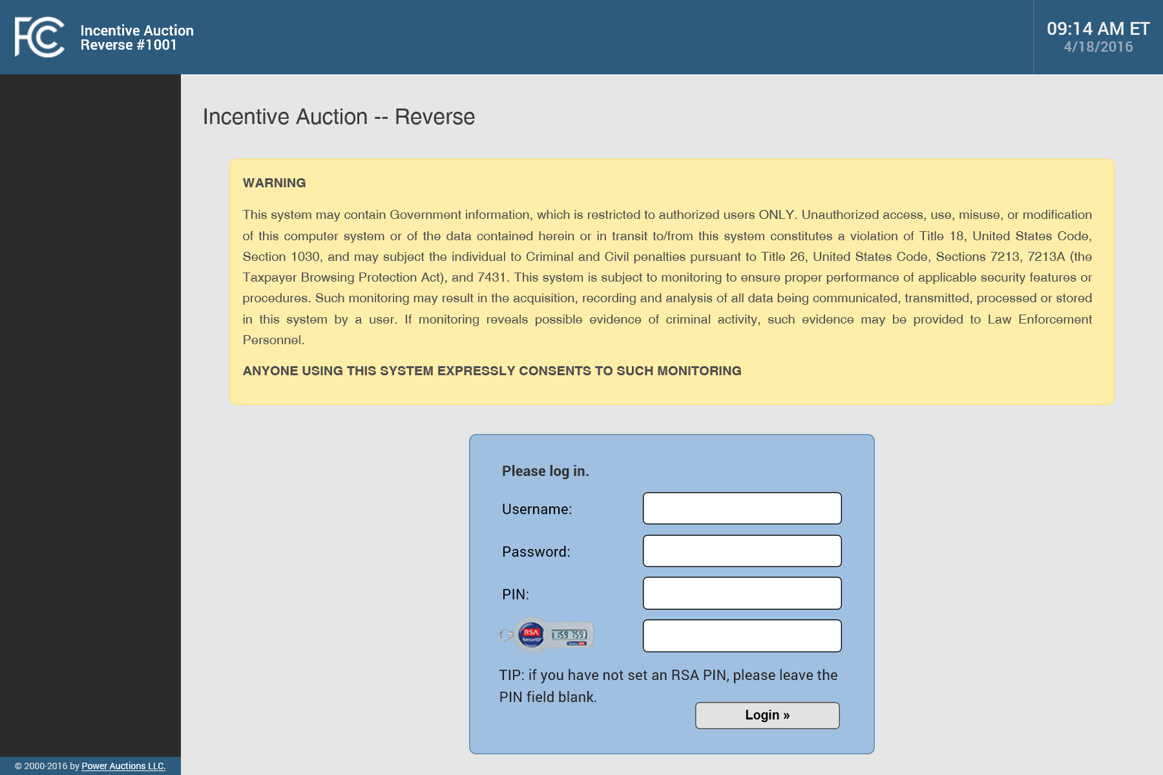
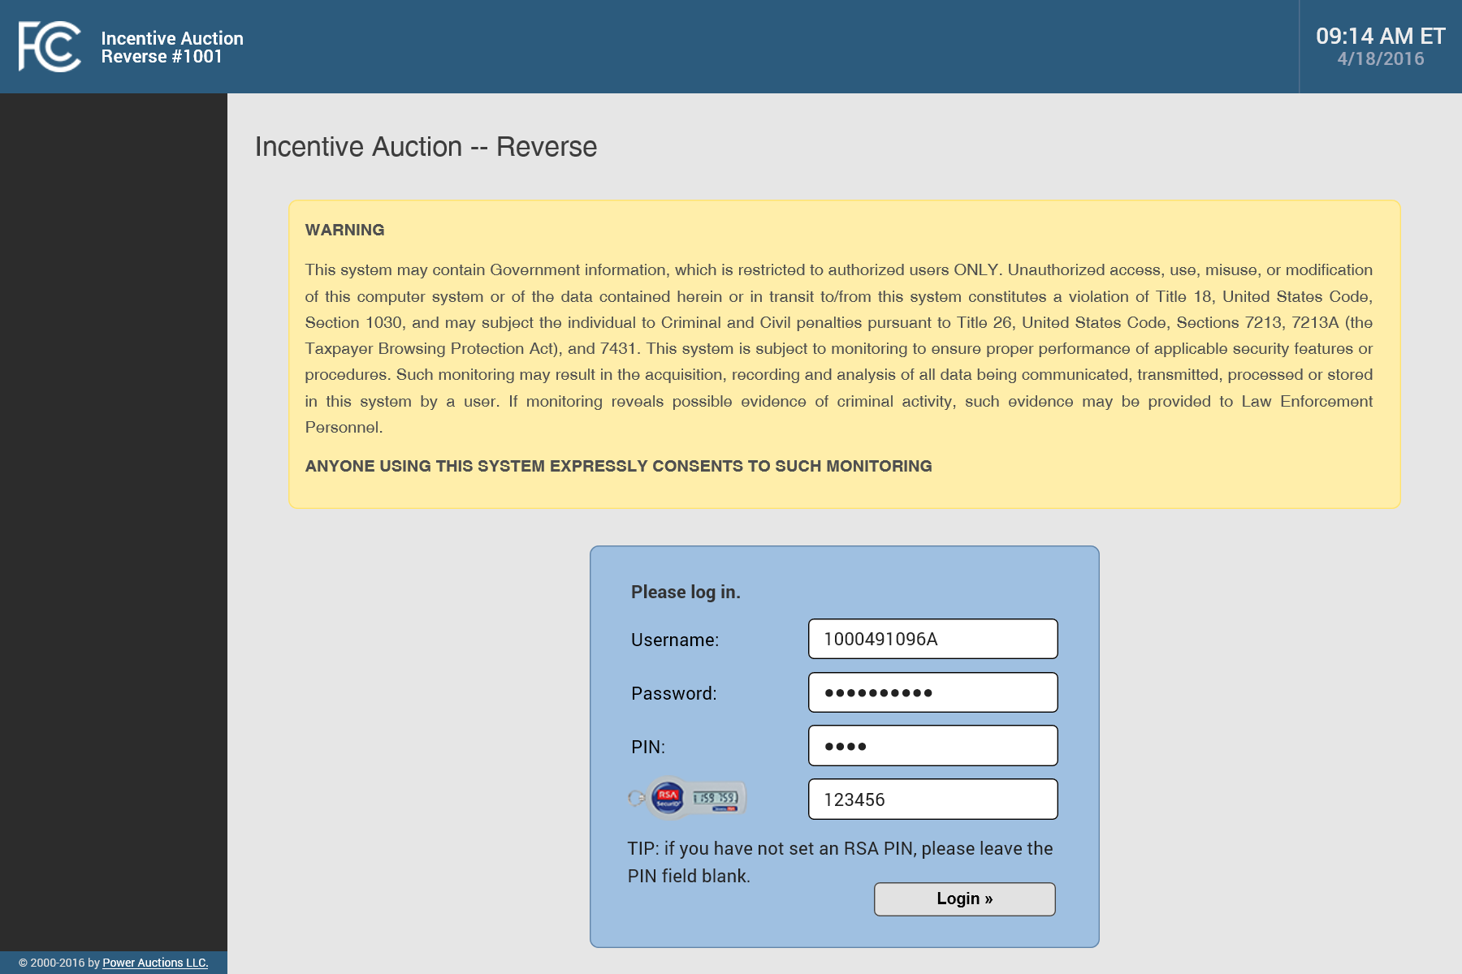
Logging in to the Auction System
Authorized bidders log in to the system using the same username, password, and PIN used during the initial commitment and the preview period
If you have not yet logged in to the system, you must first set a PIN for your RSA token (see User Guide)
You should contact Technical Support if you encounter issues logging in to the system

Slide 28
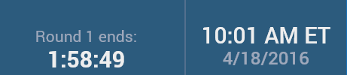
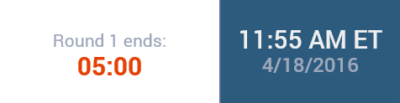
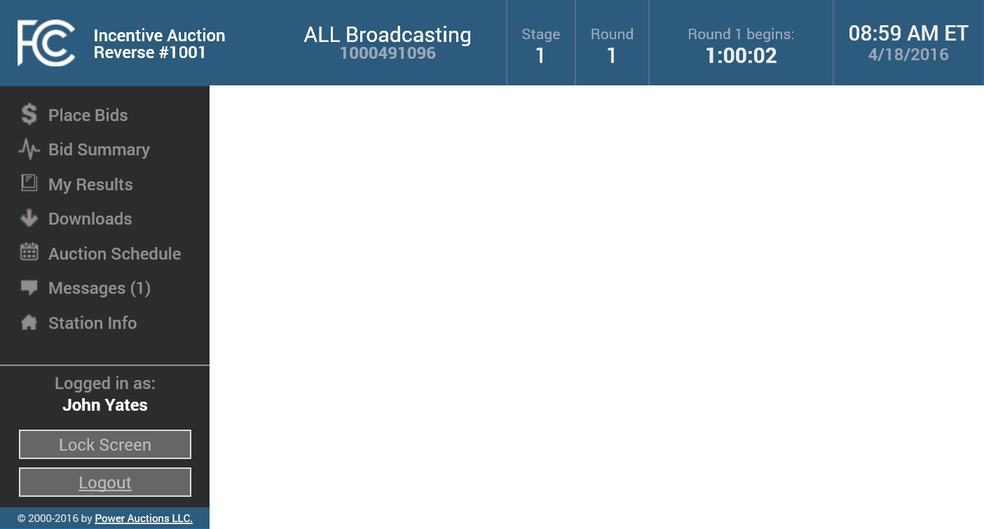







Navigating the Auction System
You navigate to different screens in the system by clicking on links in the left-hand navigation bar
There are seven screens available:
  Place Bids
  Bid Summary
  My Results
  Downloads
  Auction Schedule
  Messages
  Station Info
At any time, you can lock your screen or log out
On every screen, the system will also display:
  Name and FRN of the qualified bidder;
  Current stage and round;
  Current time (ET) and date; and
  Countdown timer.
Before a round opens, the timer will show the time until the round opens
During the round, the timer will show the time until the round closes
The timer will turn red with a white background in the last 5 minutes of a round

Slide 29
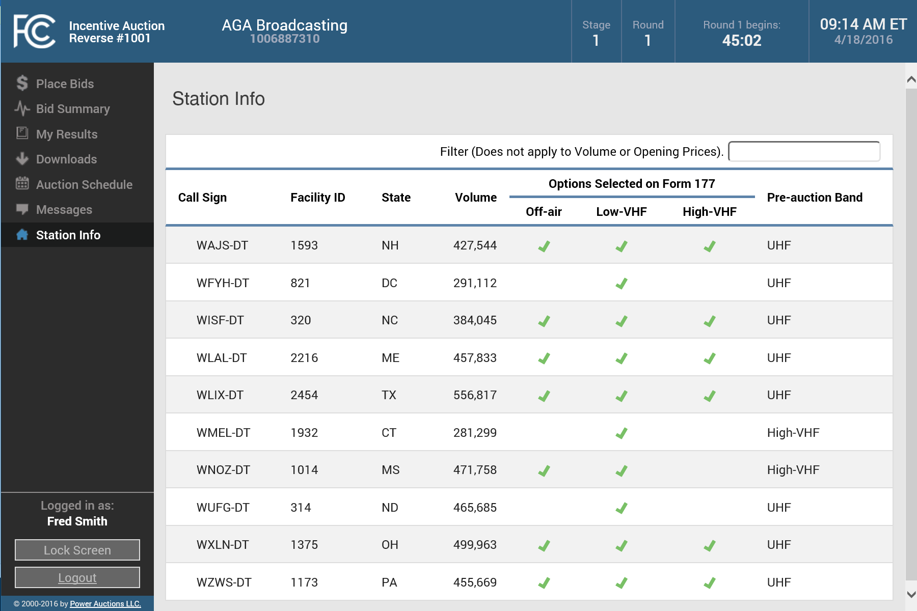
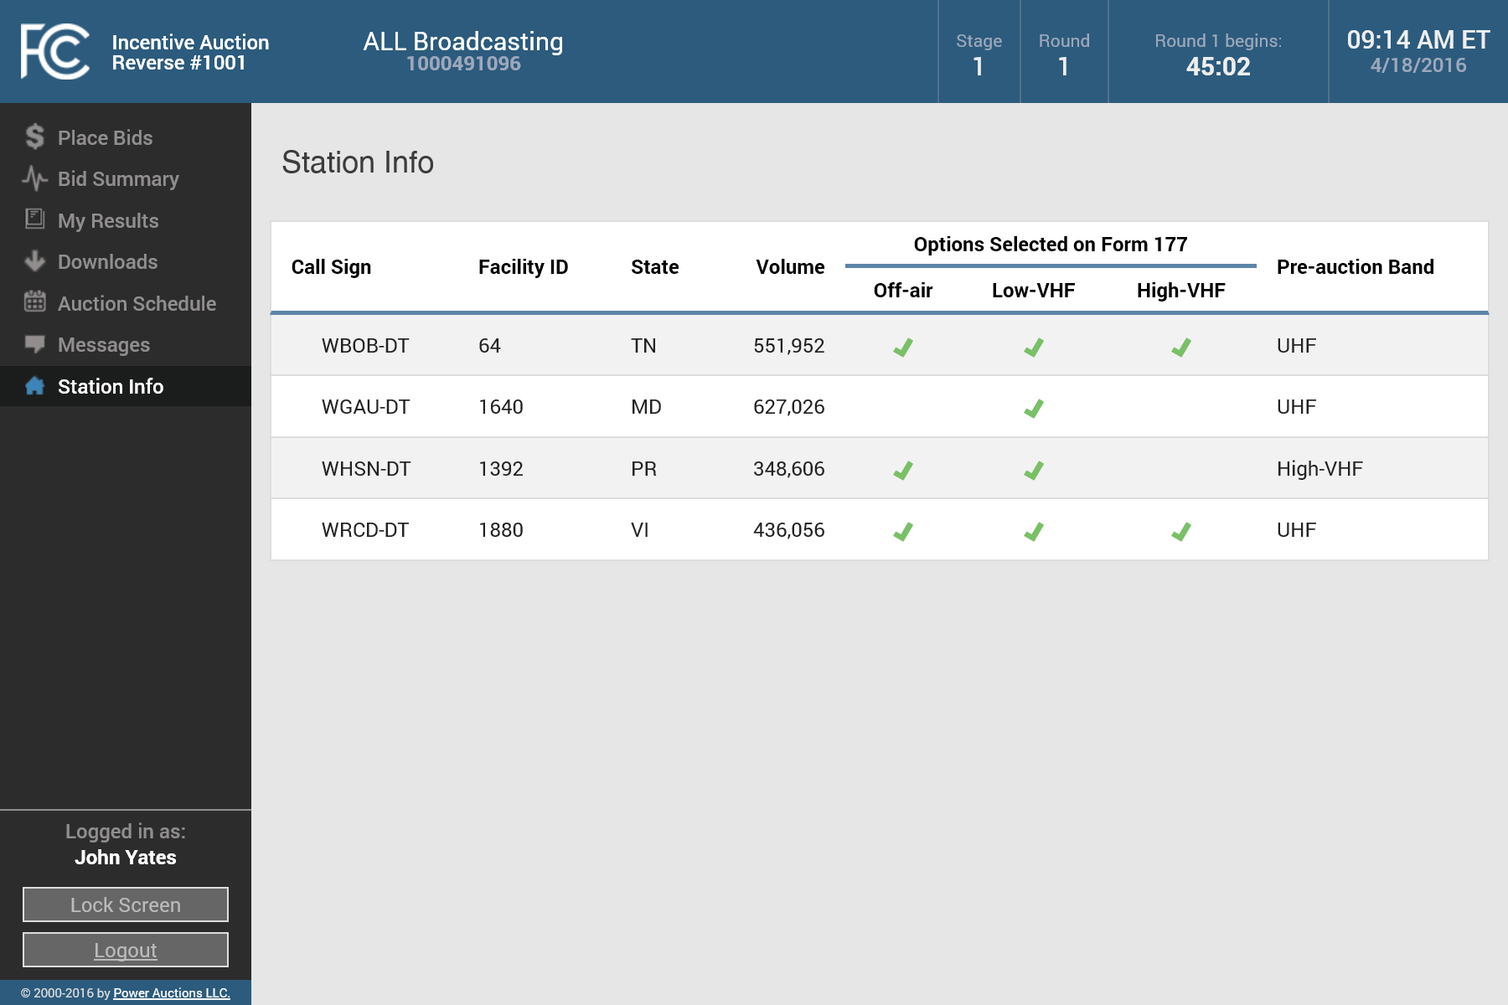
Viewing Station Information
The Station Info screen displays information about all your qualified stations
The information on this screen does not change throughout the reverse auction
The relinquishment options selected on FCC Form 177 are displayed for each station
If you have many stations, you will be able to filter the list

Slide 30
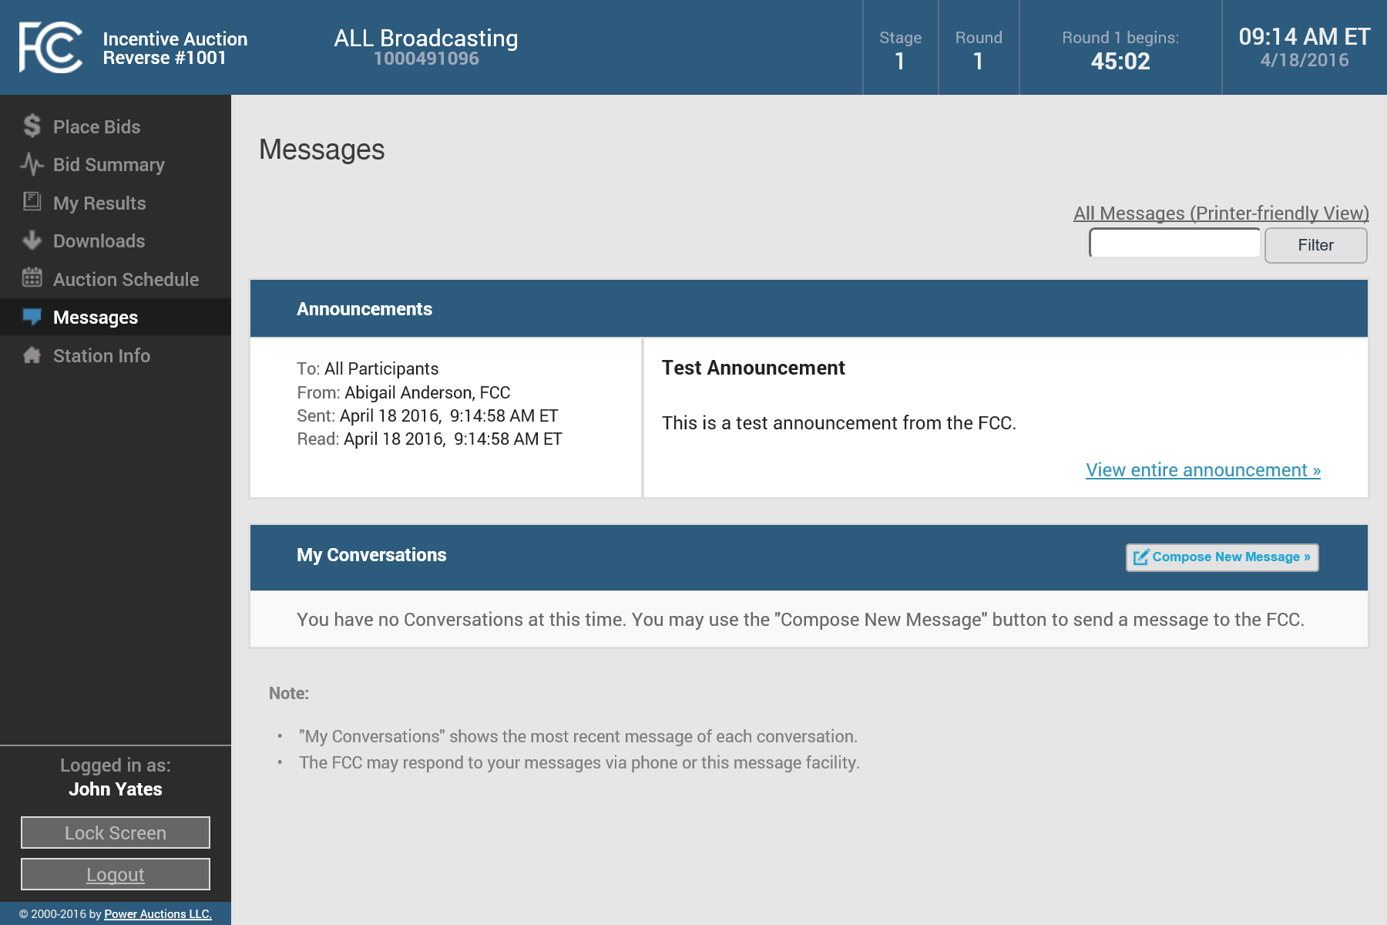
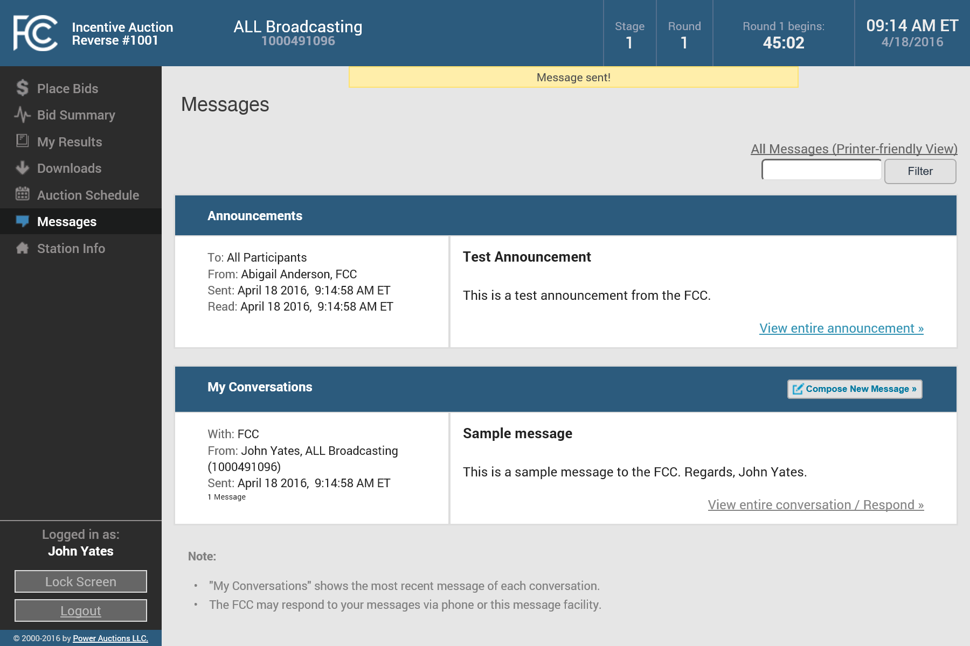
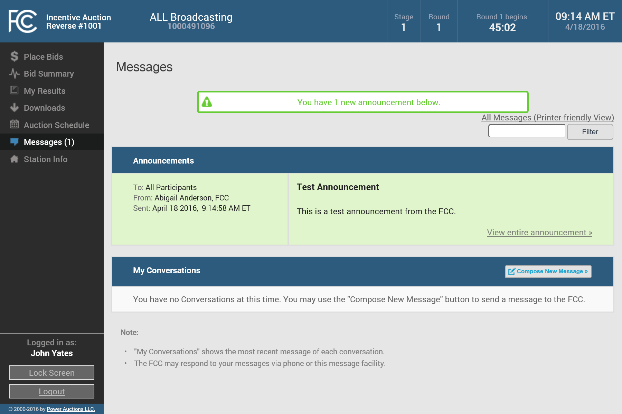
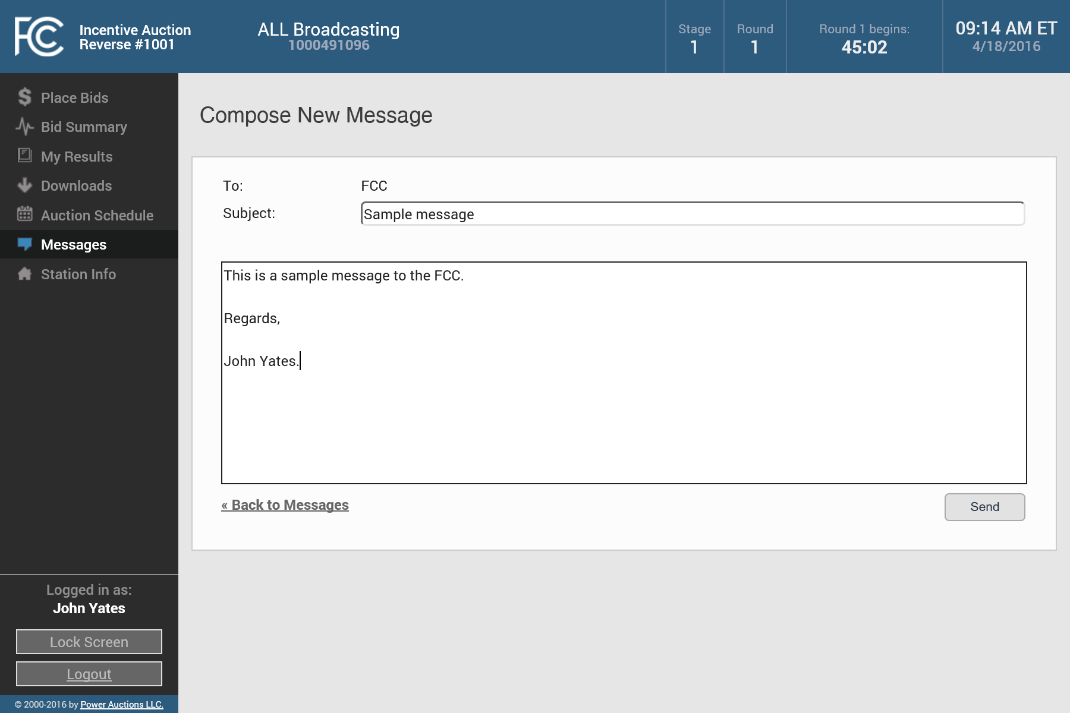
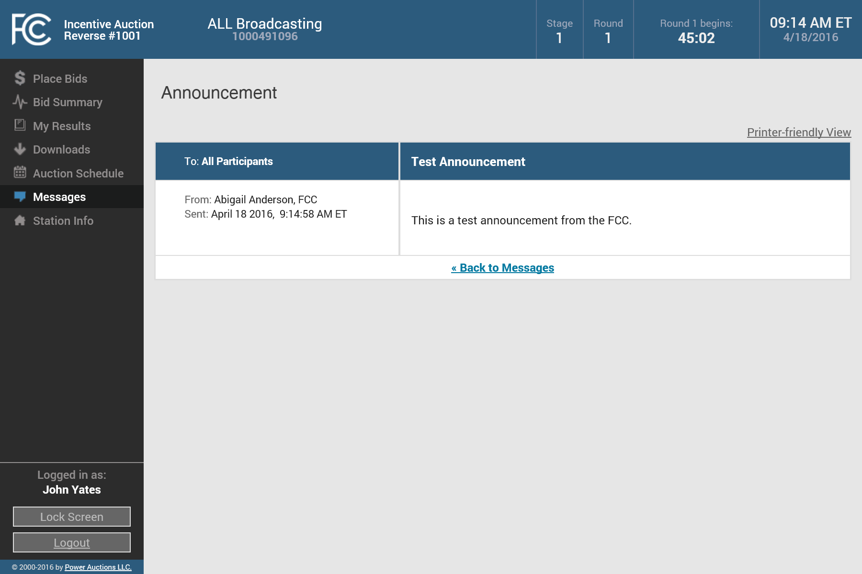
Viewing Announcements & Sending Messages
On the Messages screen, you may view announcements and send messages to the FCC
You will see an unread message count notification next to the Messages navigation link
In the Announcements section, unread announcements are highlighted in green
In the My Conversations section you can send a message by clicking on the “Compose New Message” button

Slide 31
Viewing Initial Relinquishment Option & Bidding Status
Before Round 1, the My Results screen displays for each of your stations
  its bidding status;
  its initial relinquishment option;
  the available options in Round 1;
  the initial vacancy of options other than the currently held option; and
  the Round 1 clock prices for the available relinquishment options

Slide 32
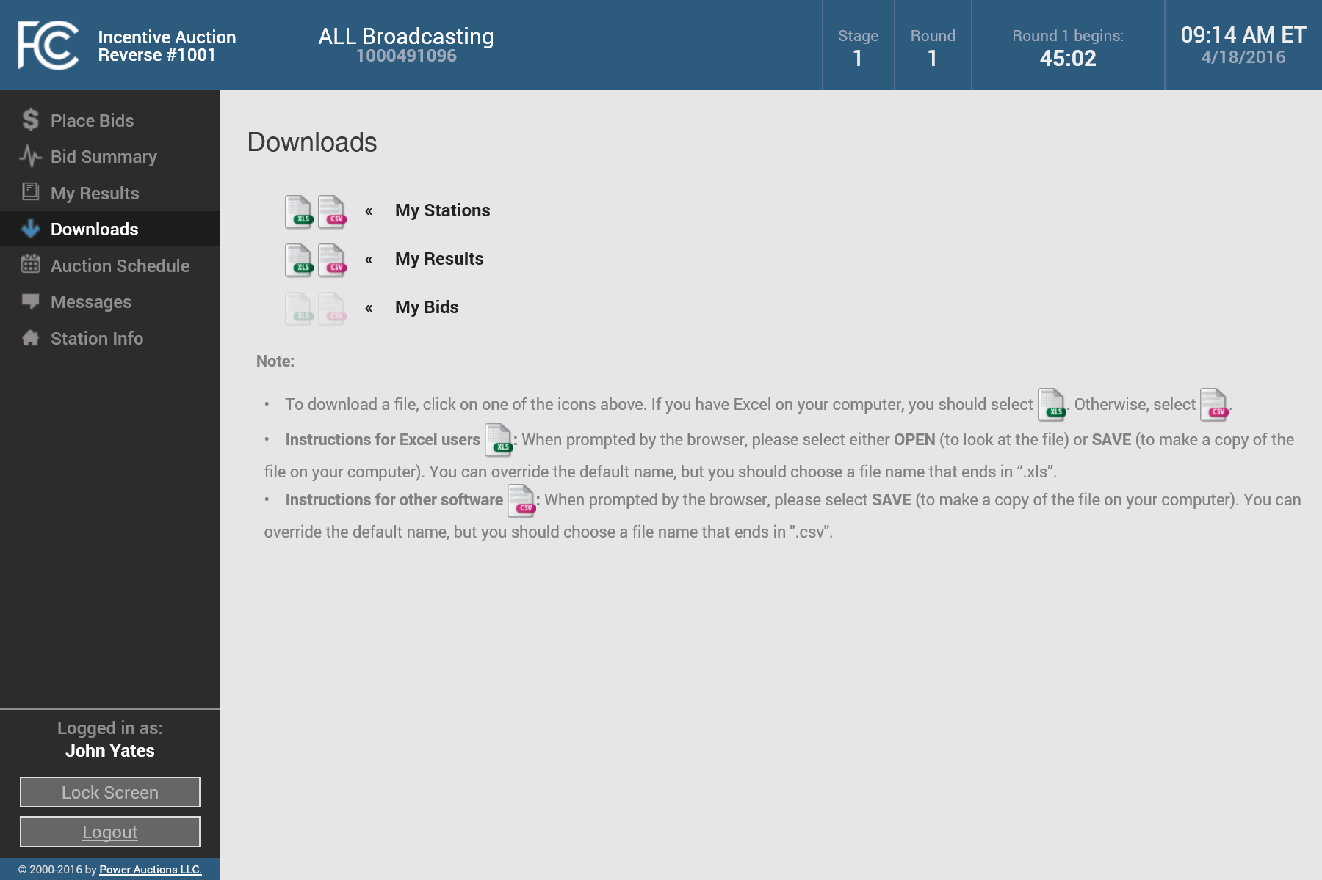
Downloading Station Info and My Results
On the Downloads screen you can download information from the system
The My Stations download includes the information shown on the Station Info screen
The My Results download includes cumulative information from the My Results screen
The My Bids download is not available until Round 1 begins

Slide 33
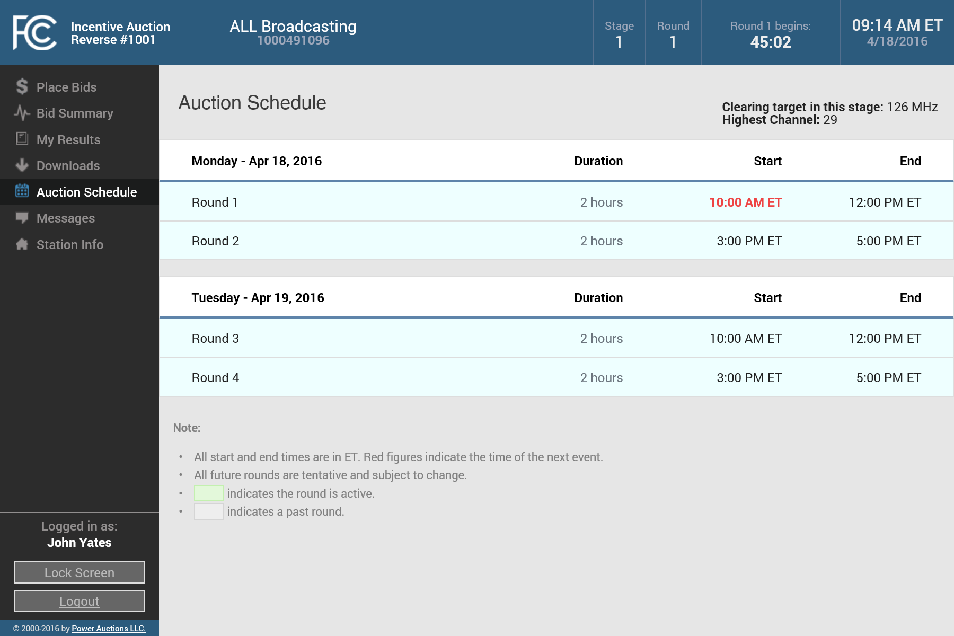
Viewing the Auction Schedule
You can view the schedule for upcoming bidding rounds on the Auction Schedule screen
The screen displays the duration, start, and end time for scheduled rounds
The next event is highlighted in red
This screen also shows the clearing target and highest channel for the current stage

Slide 34

Navigating the Auction System – Round Not Open
During the Preview Period, and any time that a round is not open, you will not be able to place bids
Bids can only be placed when a round is open

Slide 35
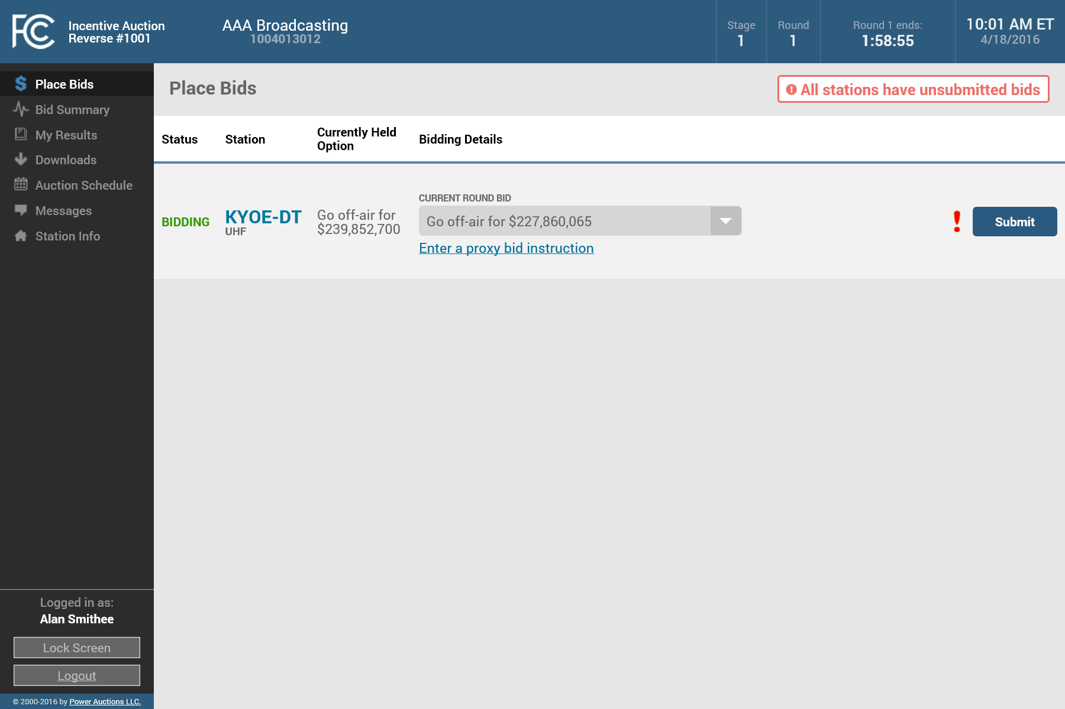
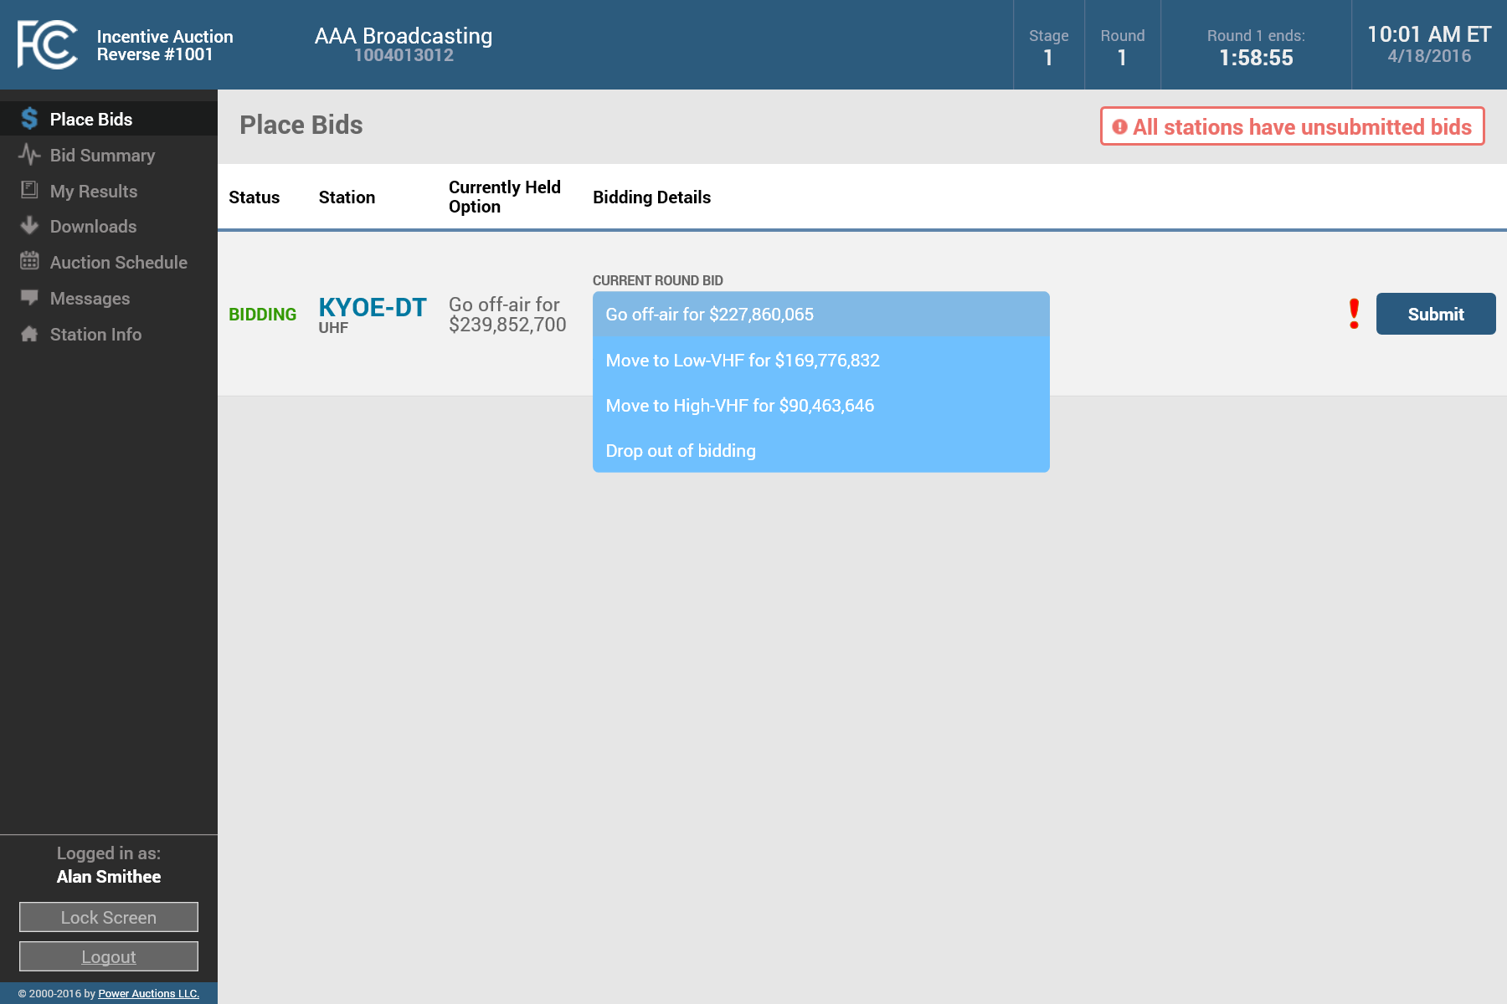
Bidding for a Single Station
Using the Place Bids screen, you can submit bids for stations with the status “BIDDING”
This example shows a bidder with a single station
There is a red warning message to indicate that you have not submitted bids for all your stations
By default the current round bid dropdown displays the station’s currently held option
You can select a different bid option by clicking on the dropdown menu

Slide 36
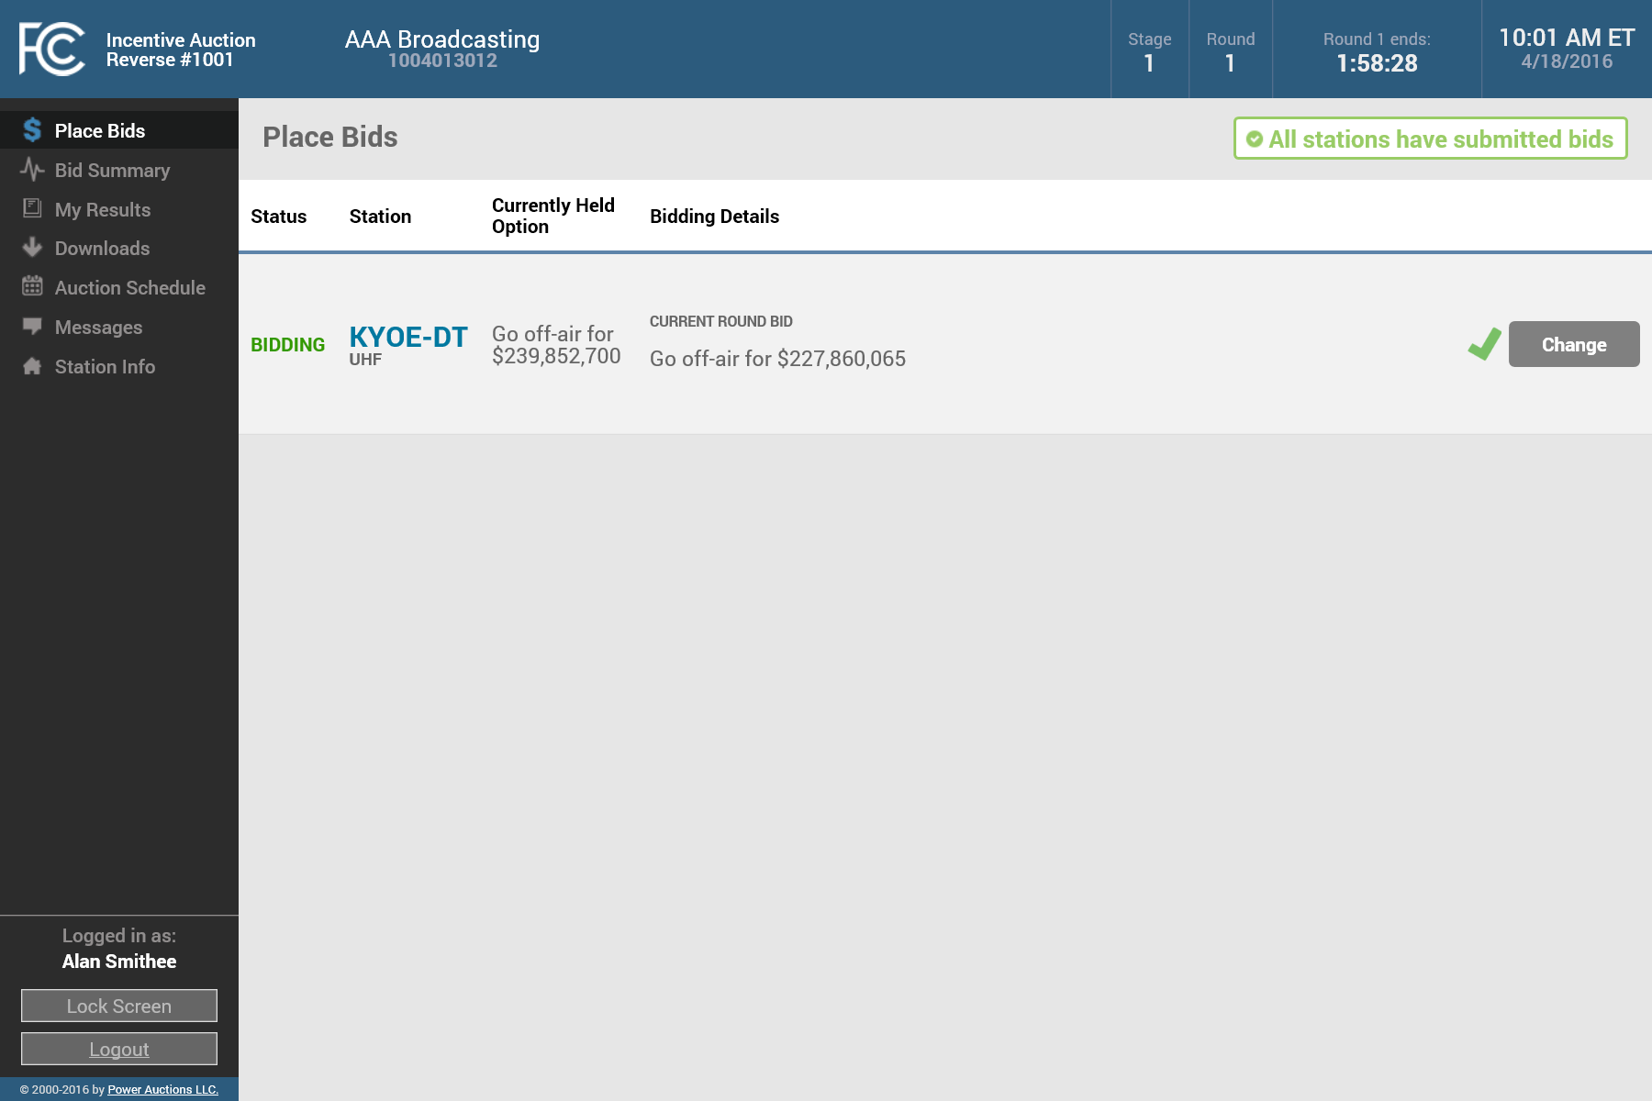
Bidding for a Single Station
Once you have selected your current round bid for a station, you must click the “Submit” button to submit the bid
The red exclamation indicates that the bid has not been submitted
Once a bid has been submitted, the Auction System will display a green check mark indicating that the bid has been submitted

Slide 37
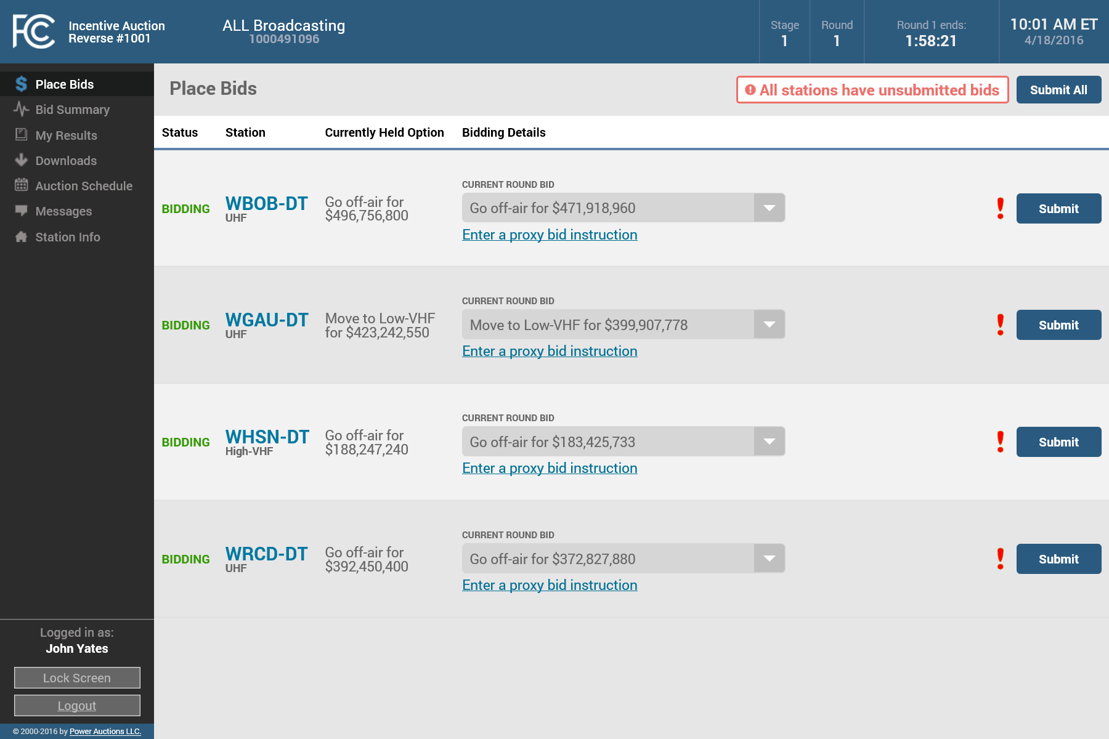
Bidding for Multiple Stations
When bidding for multiple stations—
You can select and submit a bid for each station one at a time
Or, you can also select the bids for all stations…
…and then click “Submit All” to submit all your bid selections at once
Clicking the “Submit All” button will submit the currently held option for each station if you do not first select a different option

Slide 38
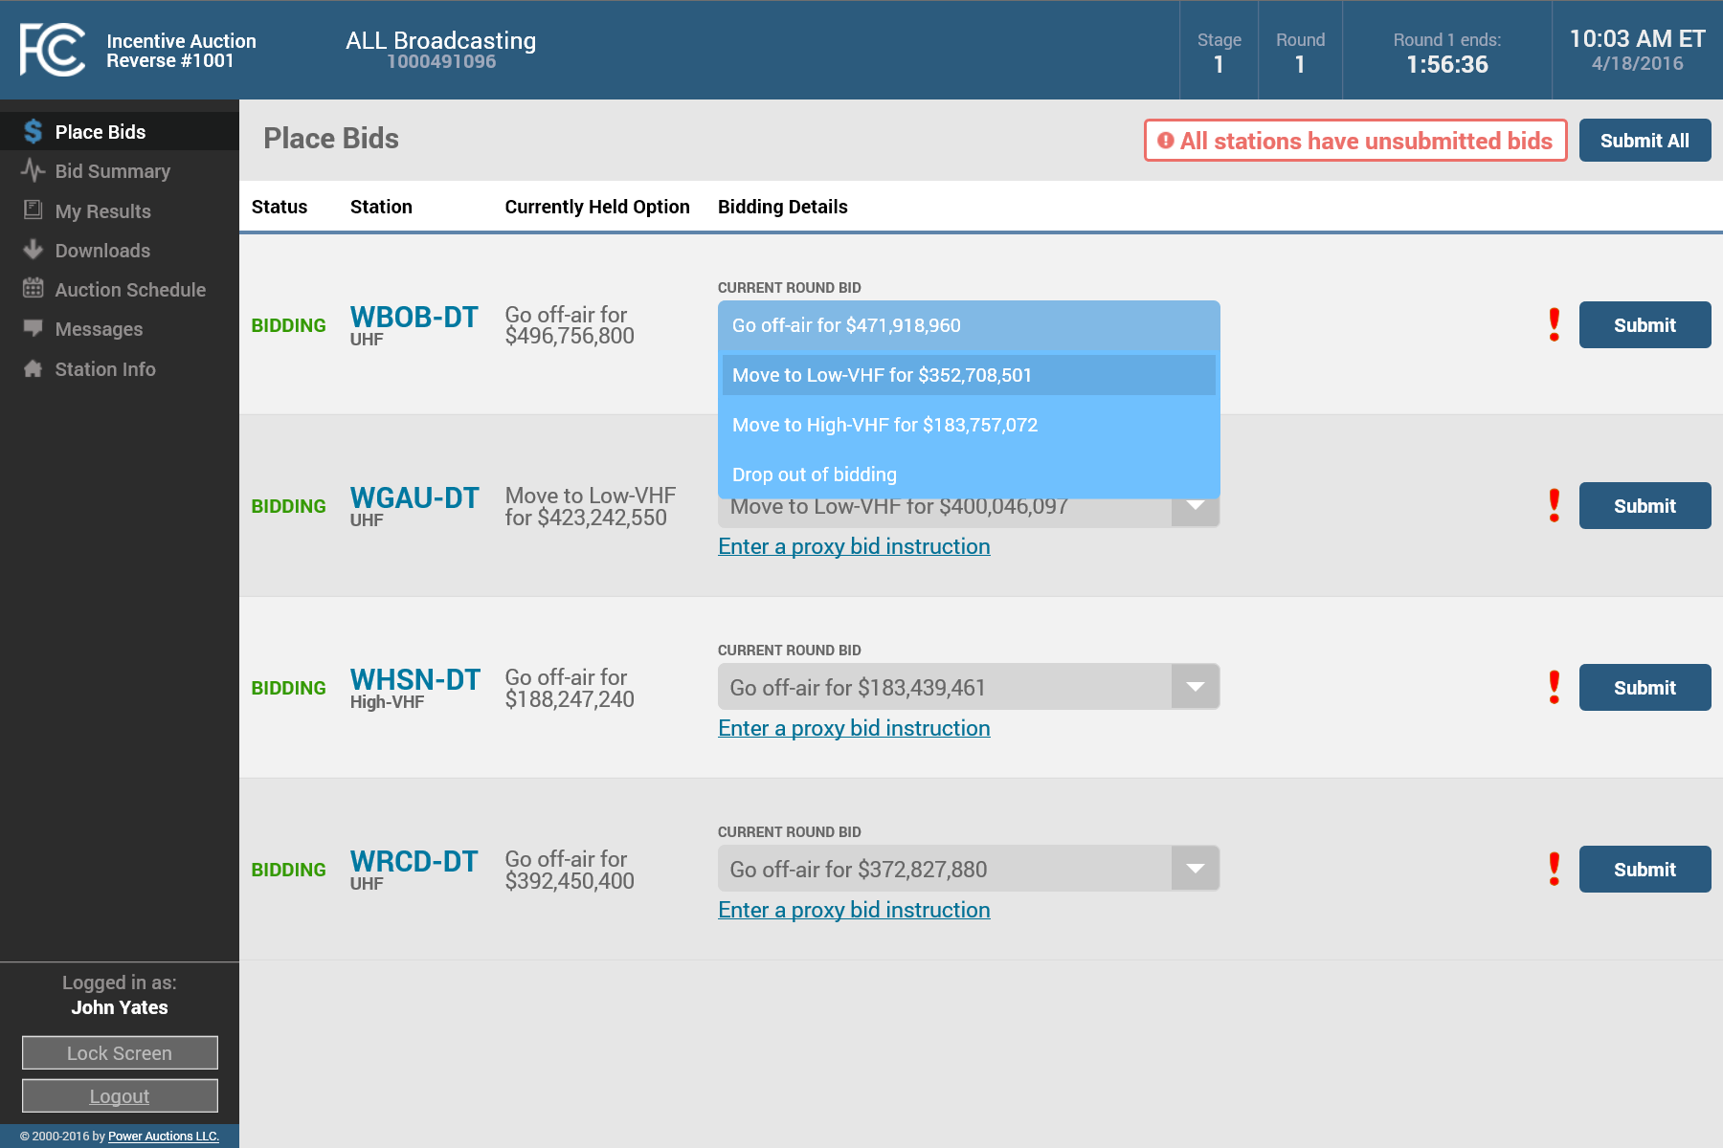
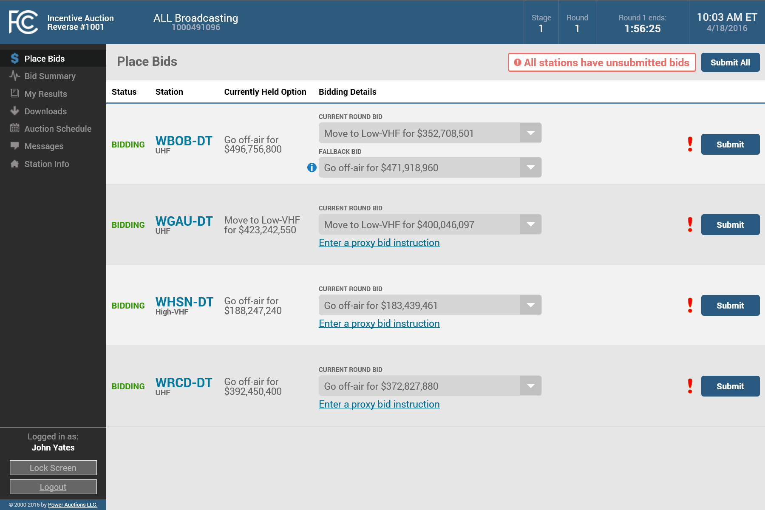
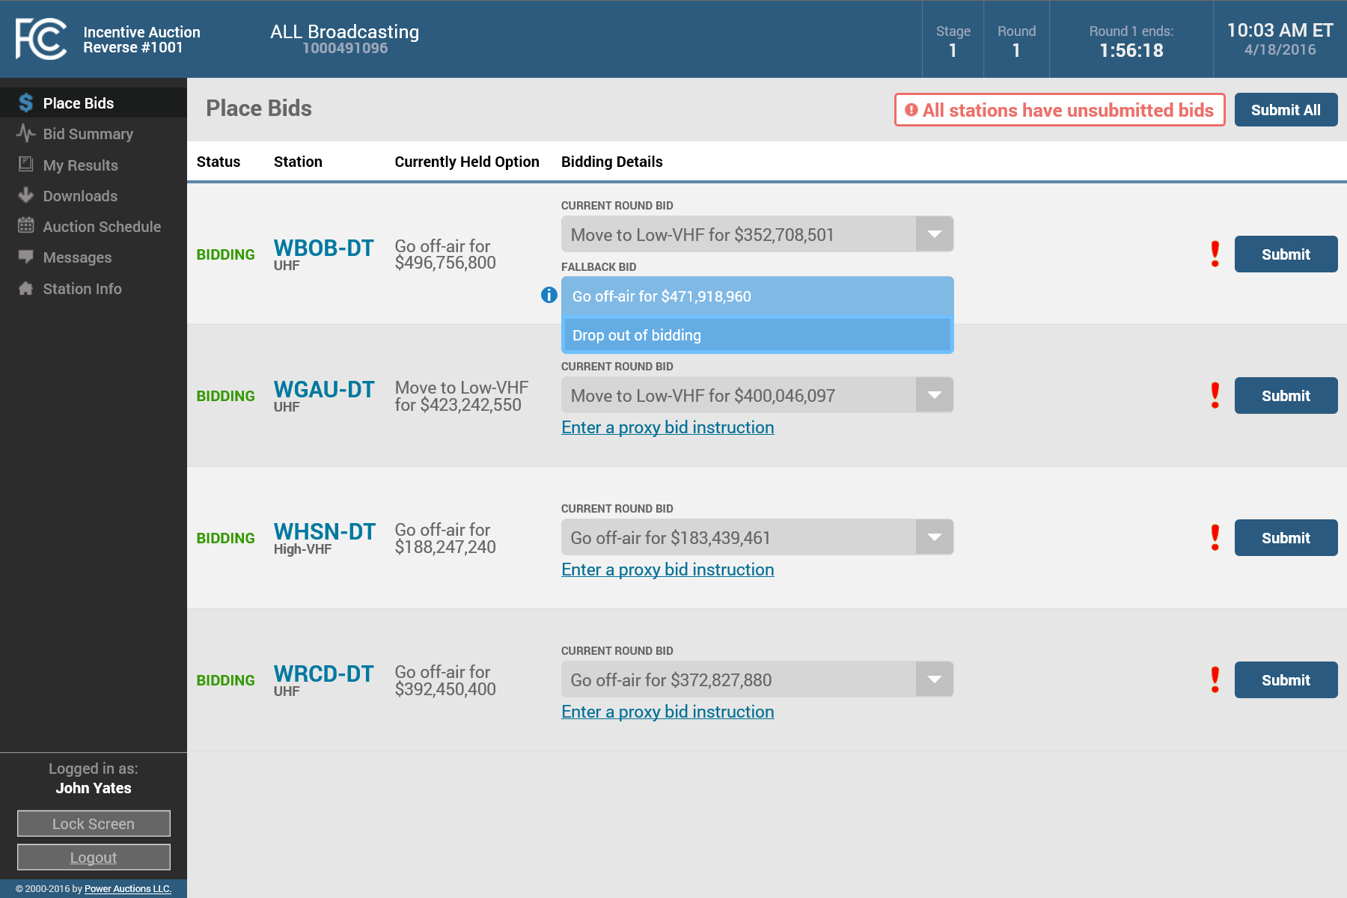


Entering a Fallback Option
If you want to switch from your currently held option and bid to move to one of the VHF bands…
….the system will prompt you to select a fallback bid
You must select either to stay in your currently held option at this round’s price offer or drop out of bidding
Click “Submit” after you have made your selections

Slide 39
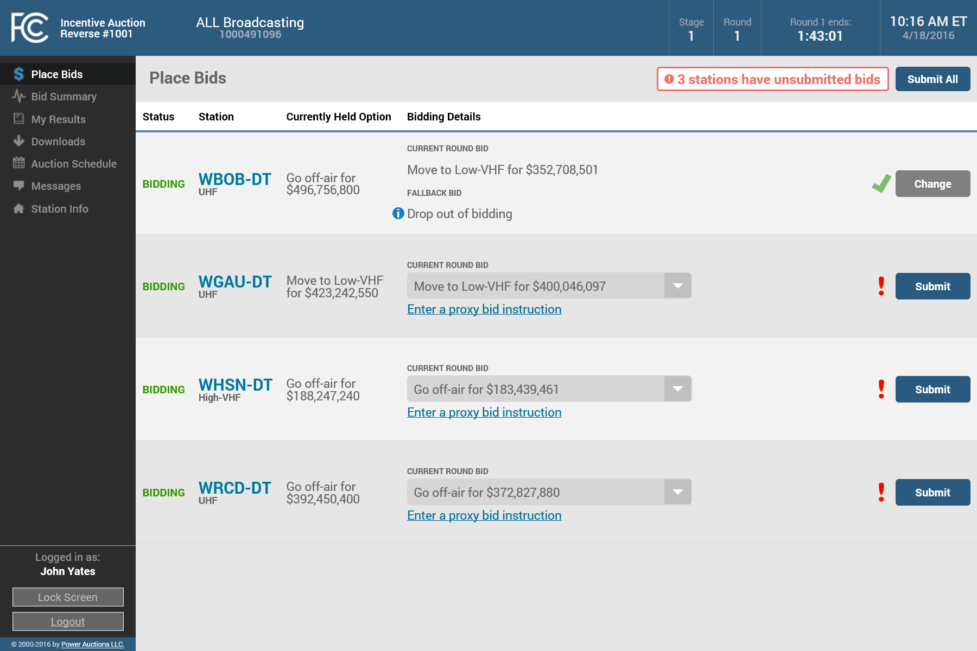
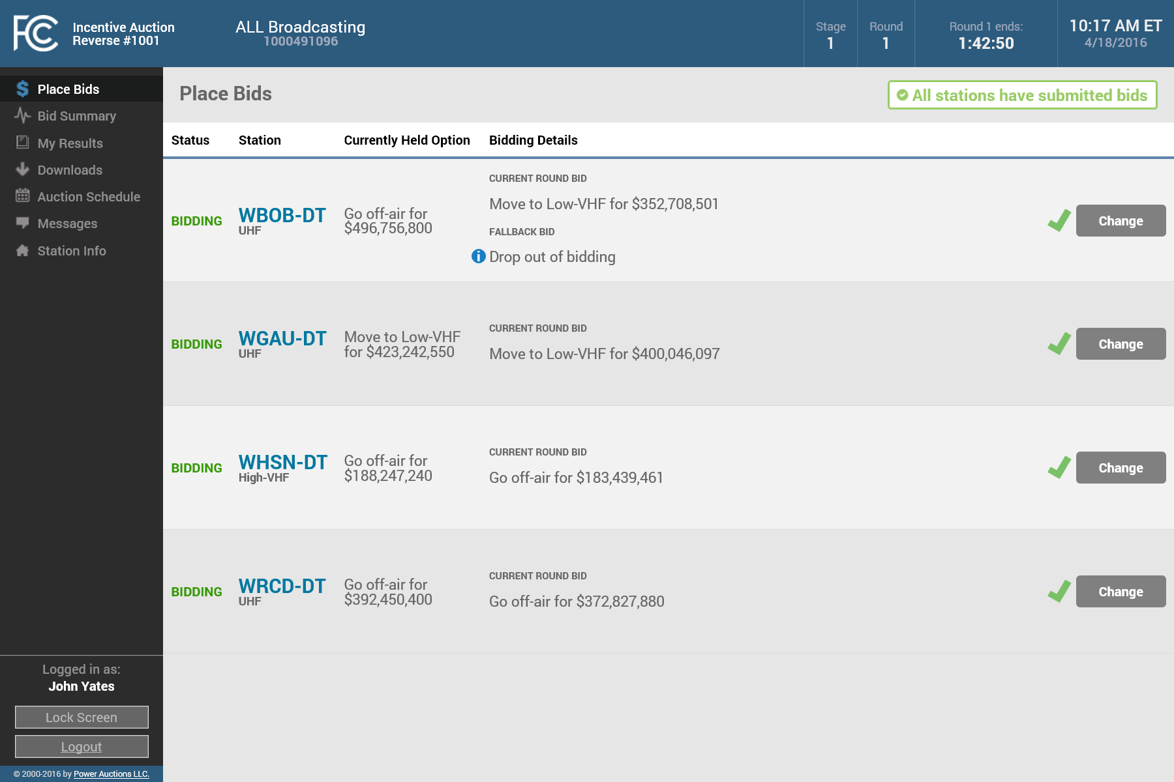
Bid Warning and Confirmation
The system warns you if you have not submitted bids for some or all of your stations
The “Submit All” button submits the selected current round bid for all stations with unsubmitted bids
The system indicates when bids have been submitted for all stations

Slide 40
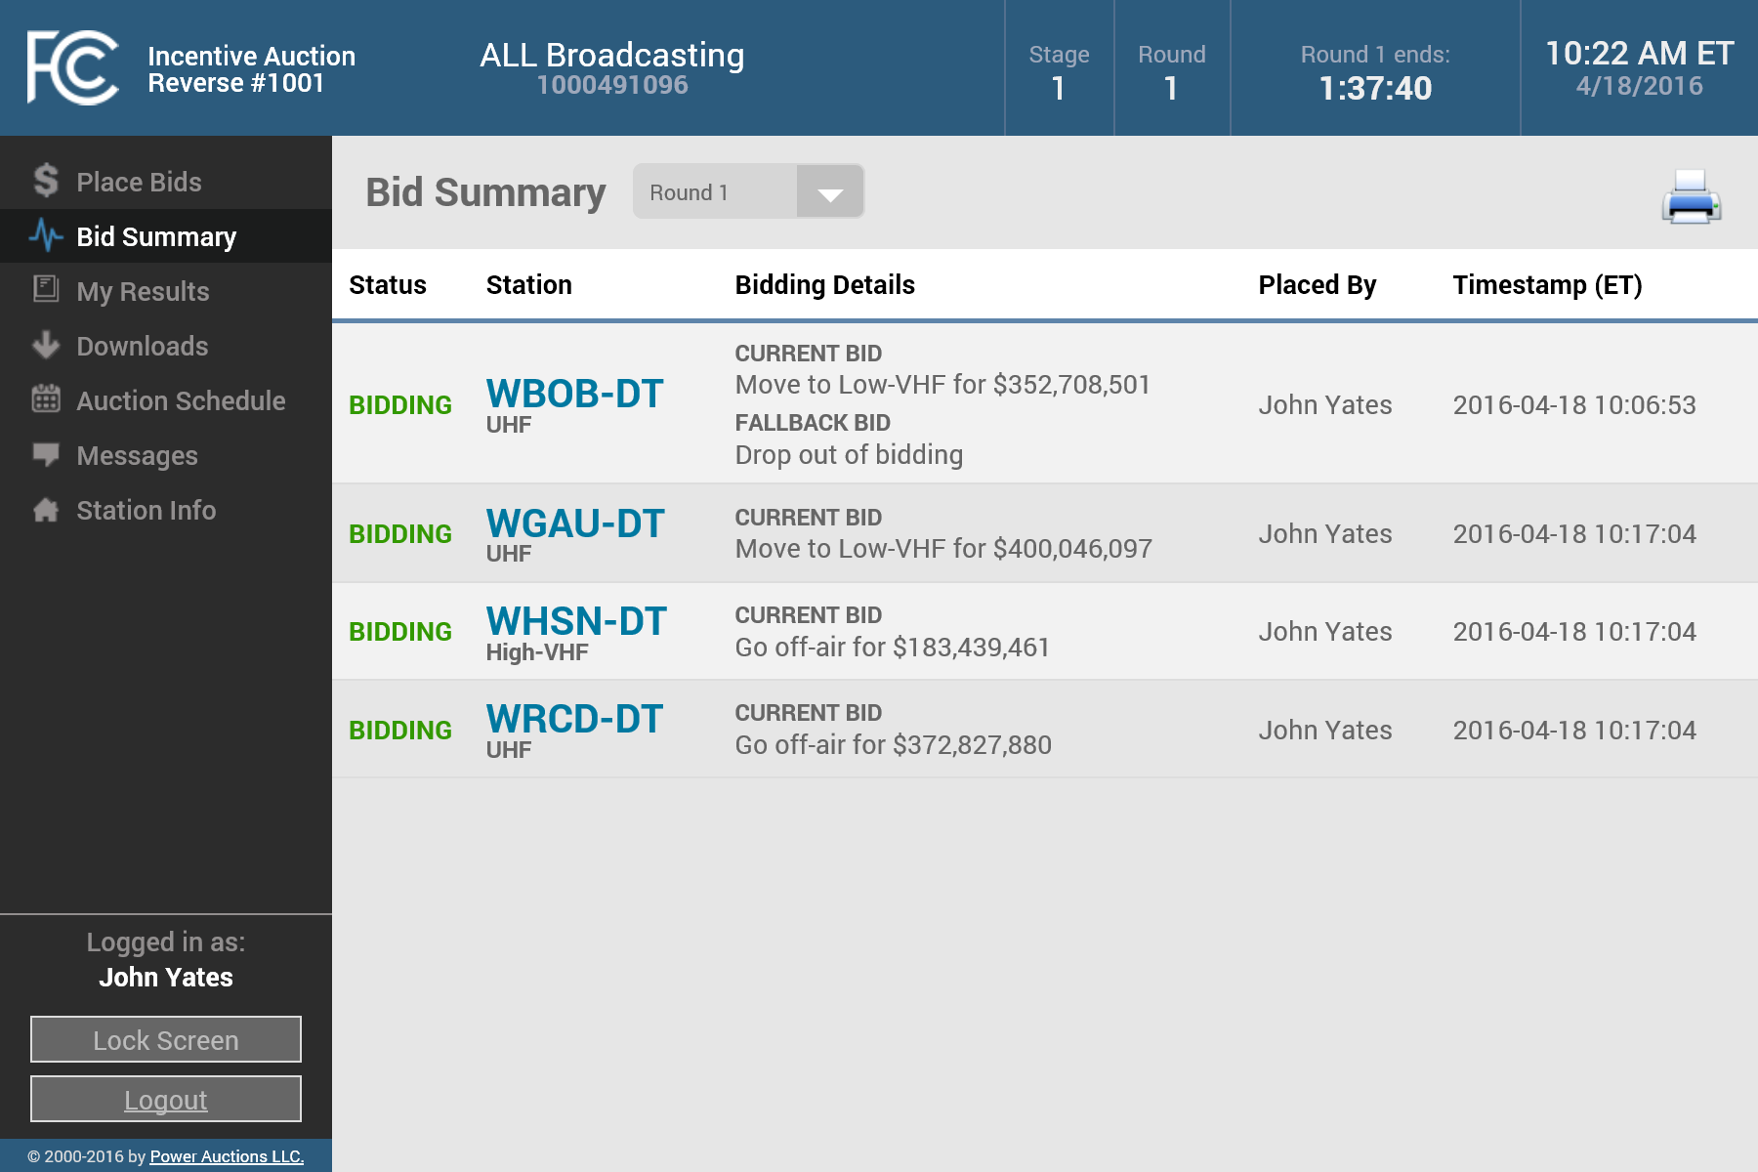
Viewing your Submitted Bids
You can view your submitted bids using the Bid Summary screen
It displays all bids (and fallback options) submitted in the round
It also indicates who placed the bids and when
You can use the print icon to print the page
You can also view the bid summary for previous rounds by clicking on the dropdown list

Slide 41

Downloading your Submitted Bids
Once Round 1 has started, you can also download bids for the current and past rounds using the “My Bids” download on the Downloads screen

Slide 42

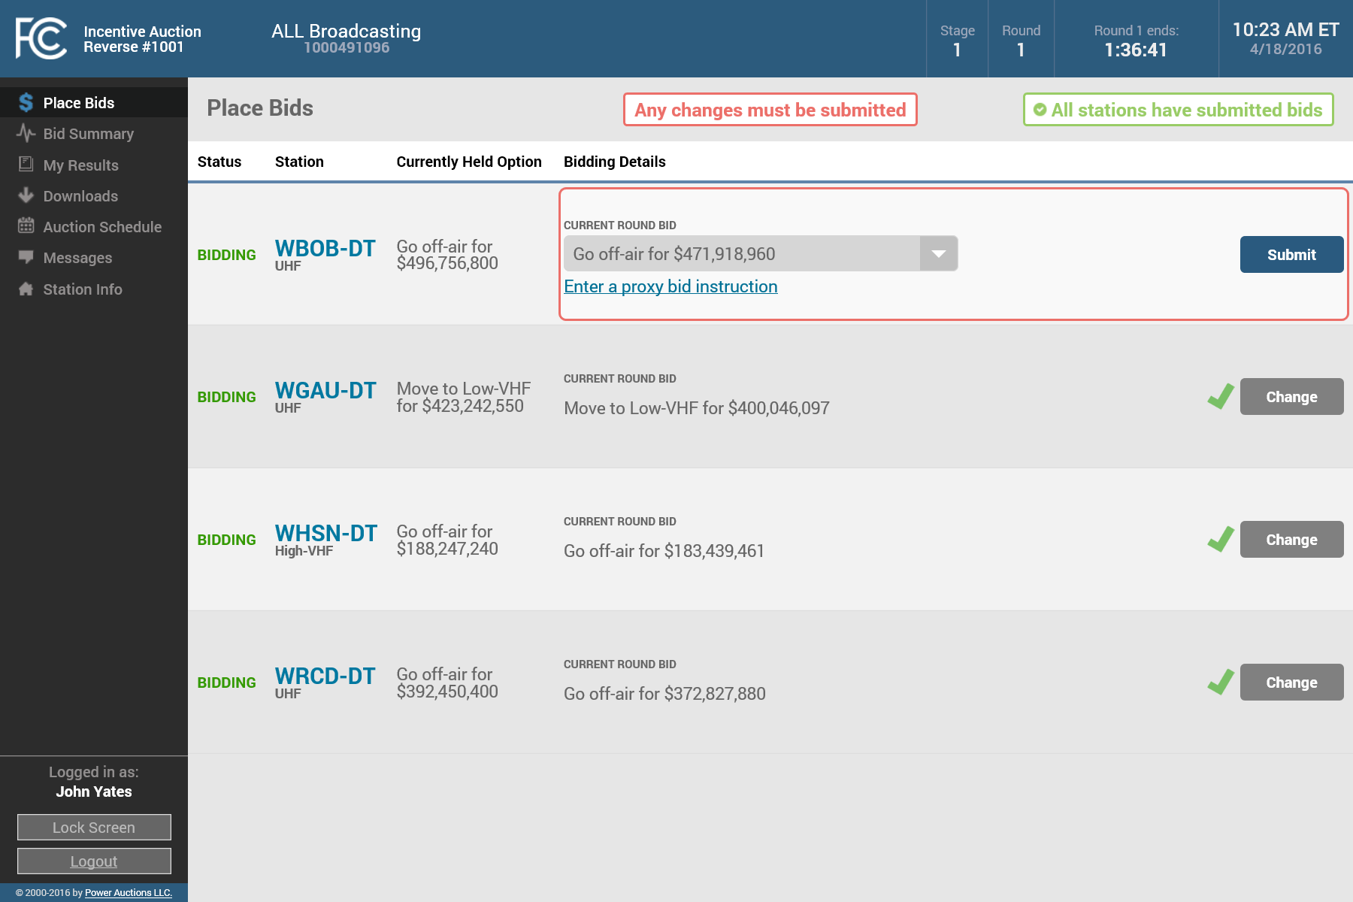

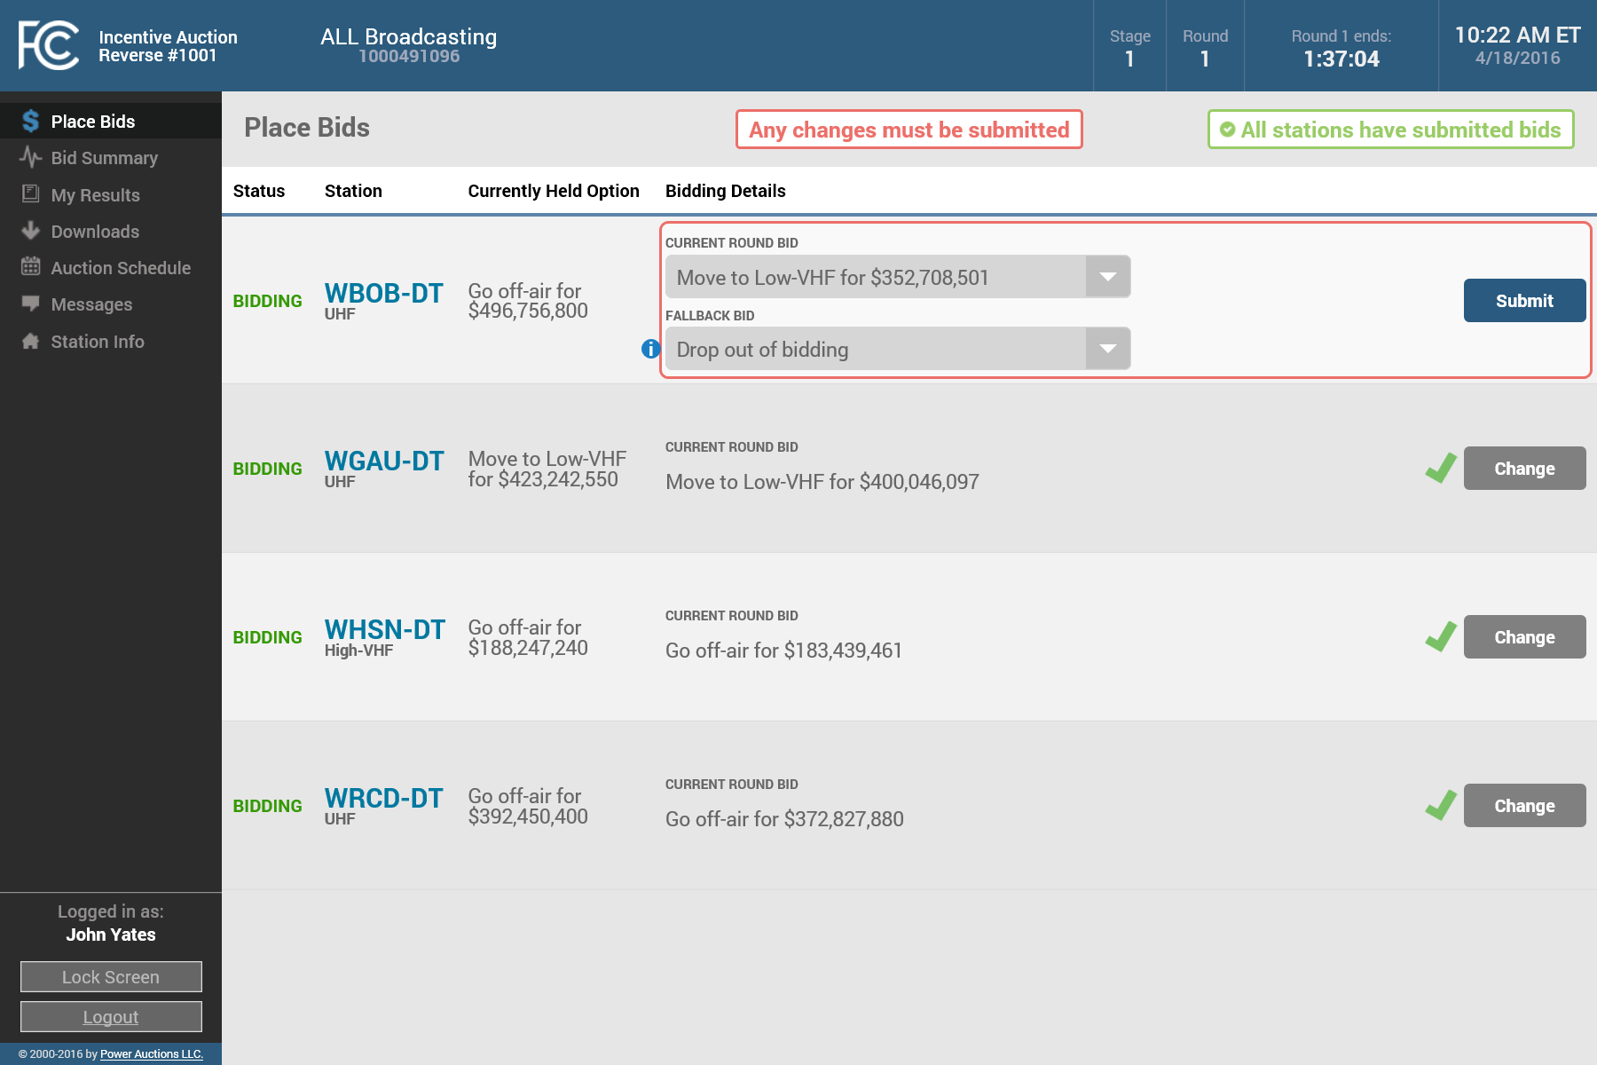
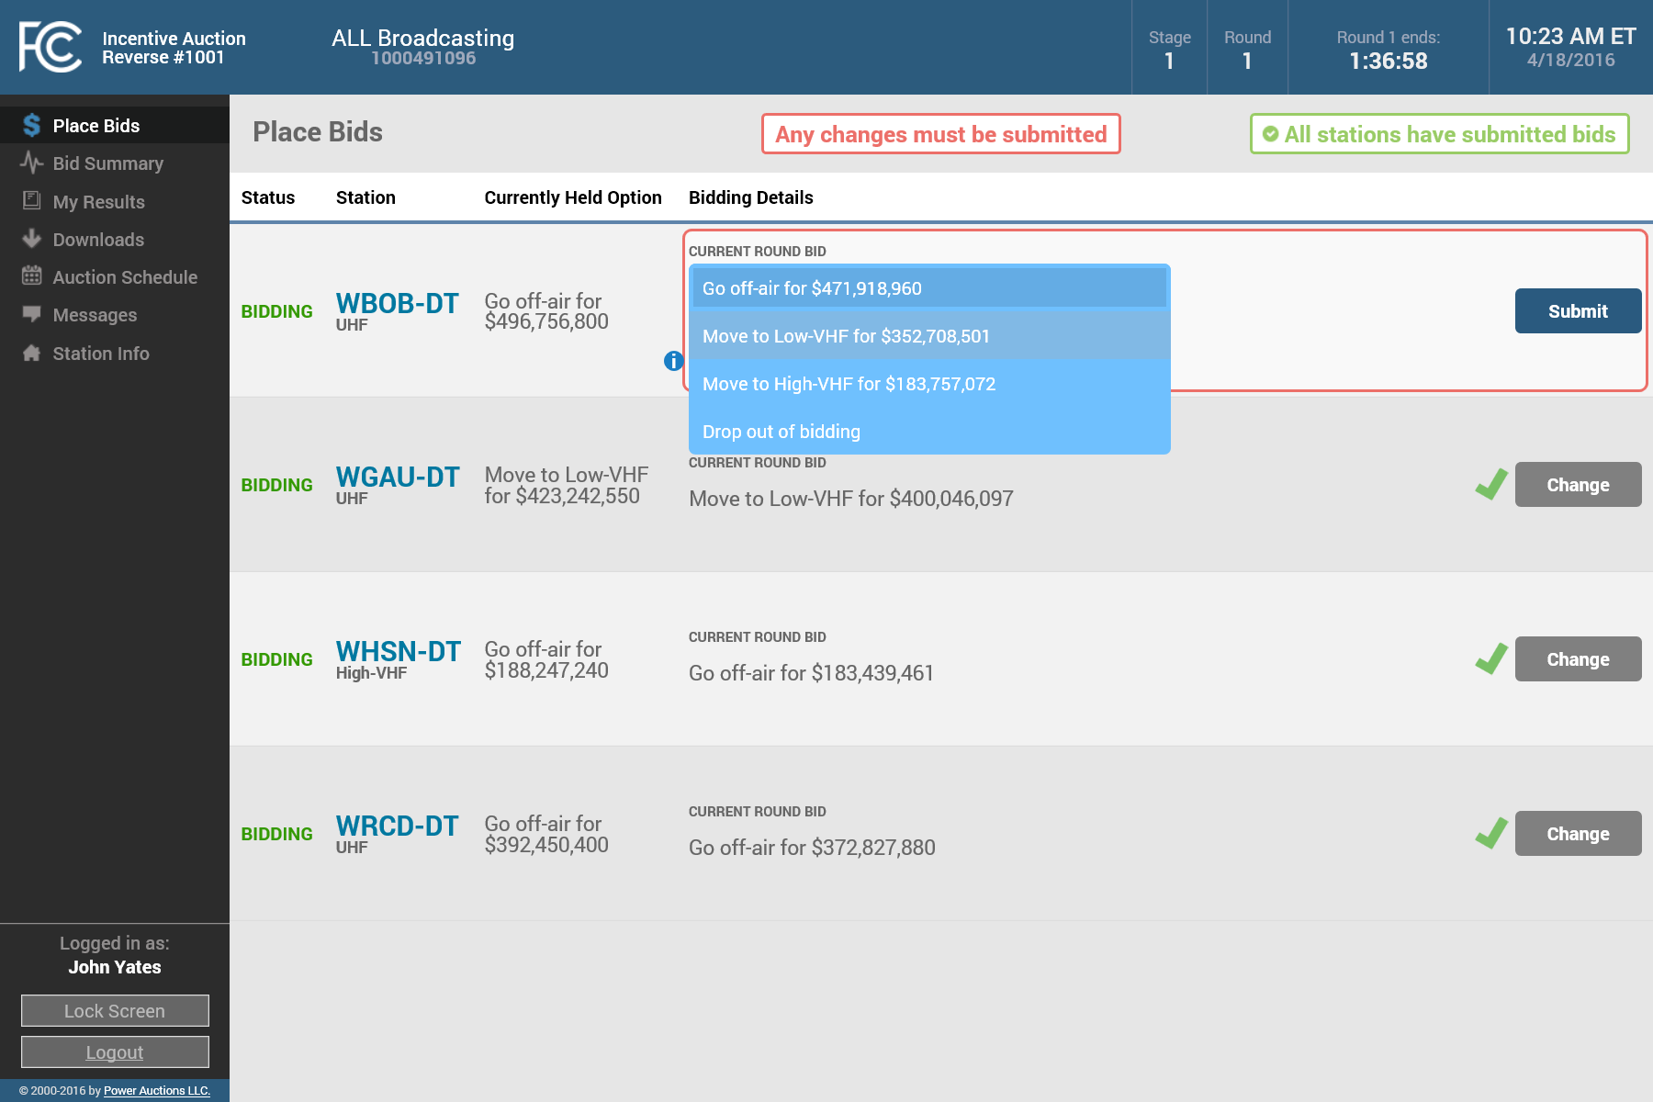
Changing a Submitted Bid
While a round is open, you can change your bid for a station by clicking on the “Change” button for that station
To change your bid, select a different option from the dropdown menu
After changing your current round bid, you must submit your changes by clicking on the “Submit” button
Bids must be submitted before the round ends

Slide 43
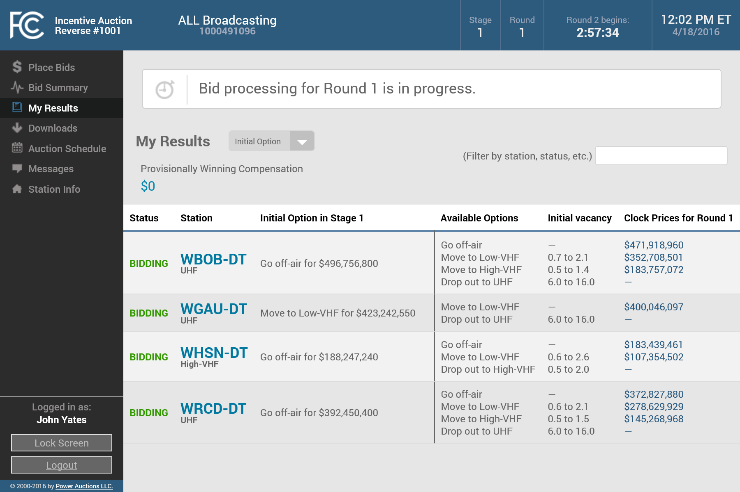
Waiting for the Results to be Posted
After a round is closed, the system will process the bids
A message on the top of the My Results screen will indicate that the bids are currently being processed
Until bid processing is complete, the results displayed on the screen will be for the previous round

Slide 44
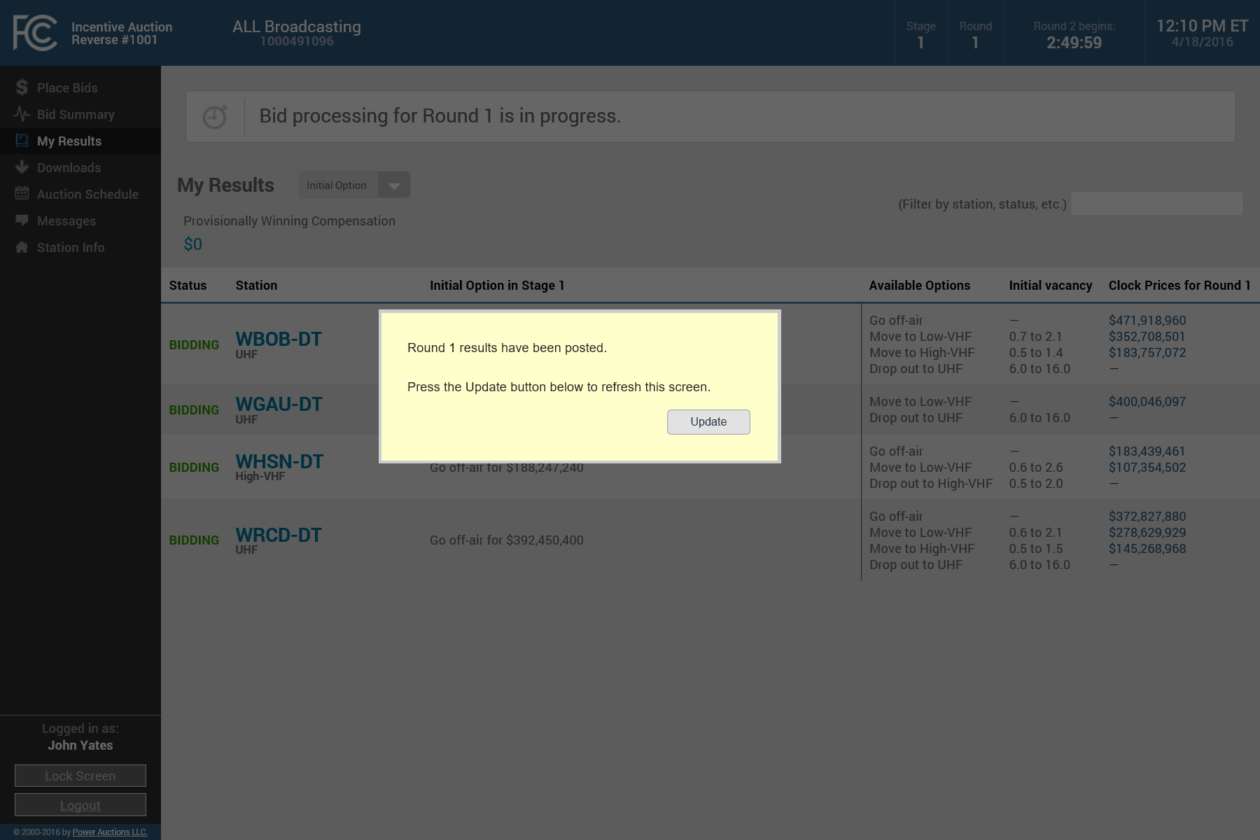
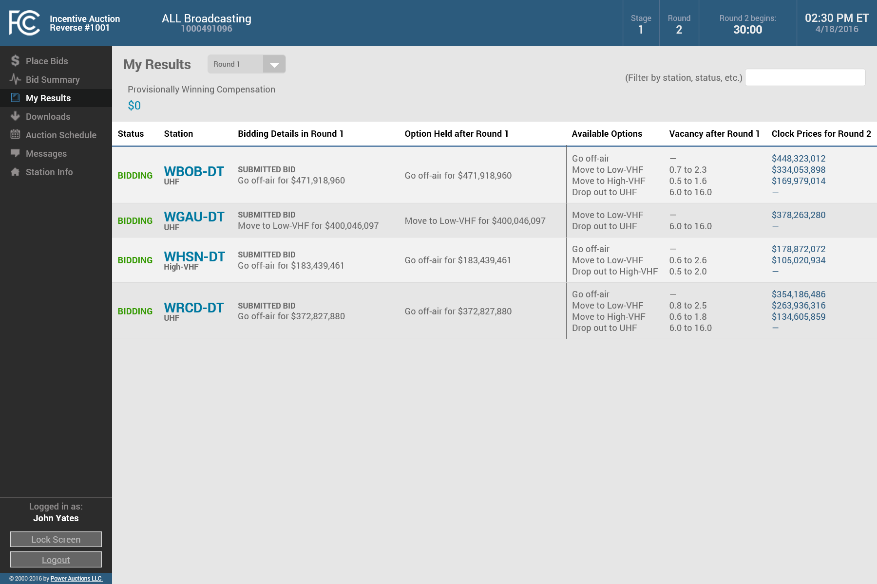
Viewing your Results
When the results are ready, a pop-up message will ask you to update the screen
As applicable, the My Results screen shows the
  bidding status;
  bid in the previous round;
  option held after processing the bids;
  available options for the next round;
  associated vacancy ranges; and
  clock prices for the next round
You can use the dropdown to see your results from a previous round or the initial option

Slide 45
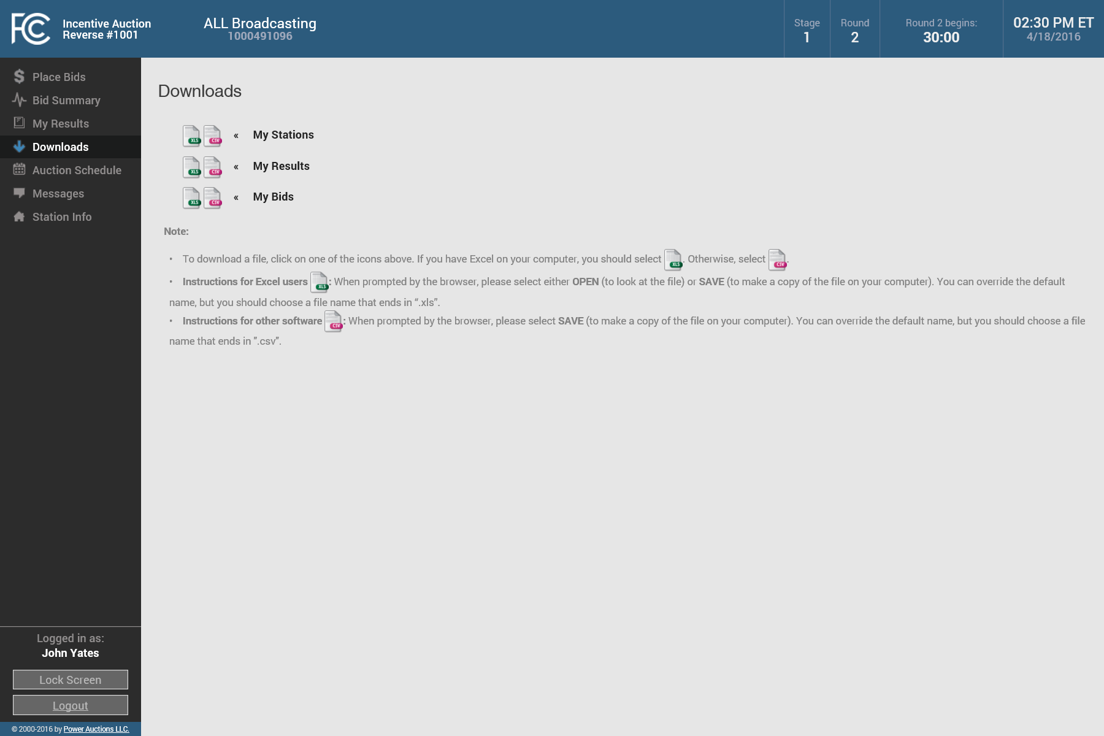
Downloading your Results
You can also download your results for the round using the Downloads screen
Note that the download includes data for all past rounds as well as the current round

Slide 46
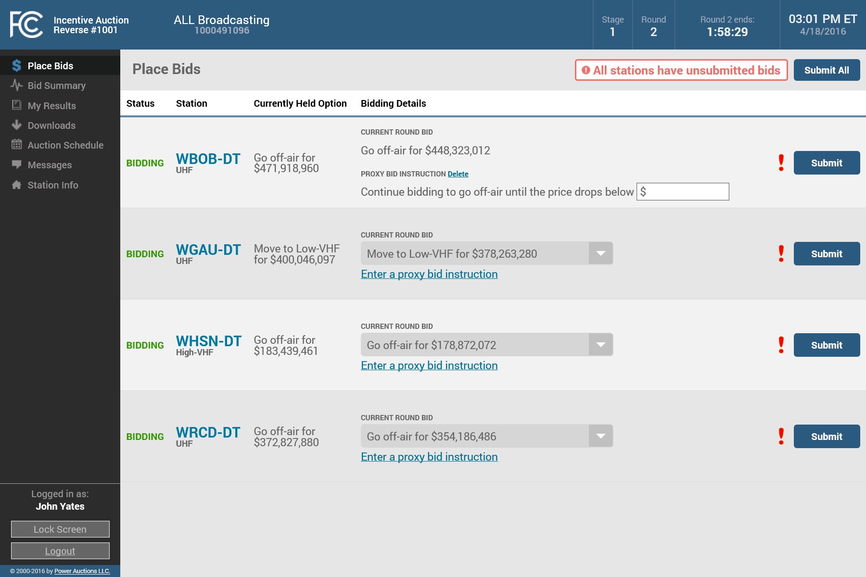
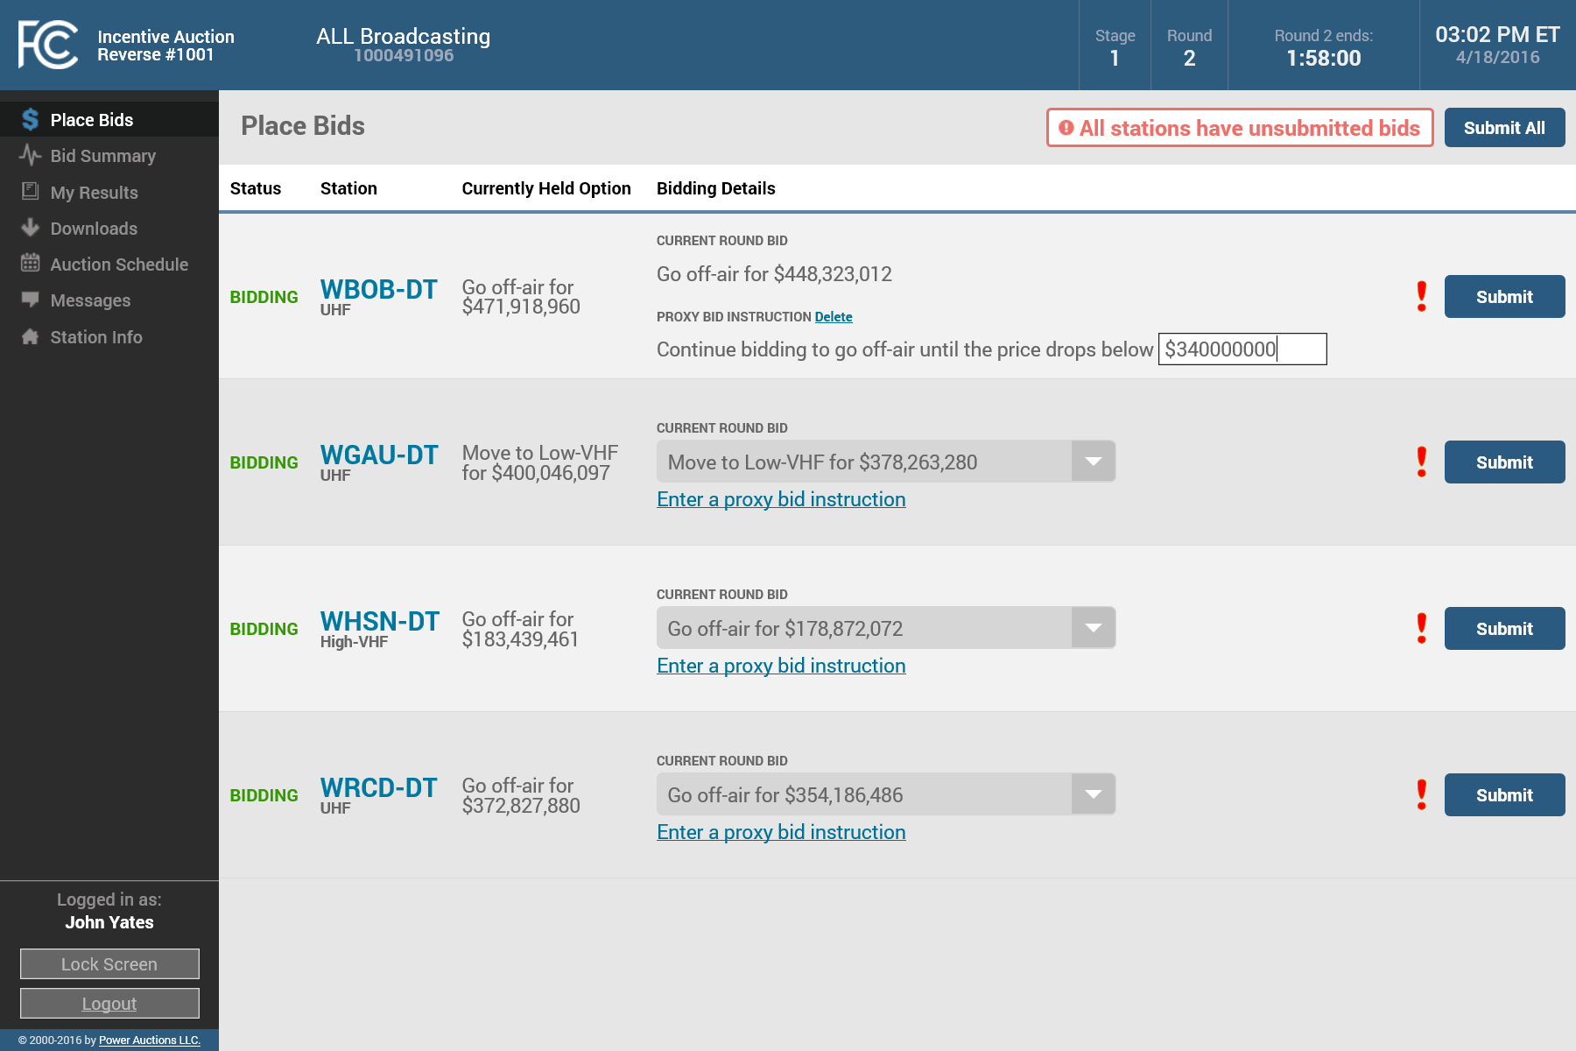


Submitting a Proxy Instruction
If you are bidding to stay in your currently held option, you can also enter a proxy instruction by clicking on the link below the bid dropdown
Enter your proxy amount in the box
And then click on “Submit” to submit the bid and the proxy instruction
You can change or delete the proxy instruction button by clicking on “Change”

Slide 47
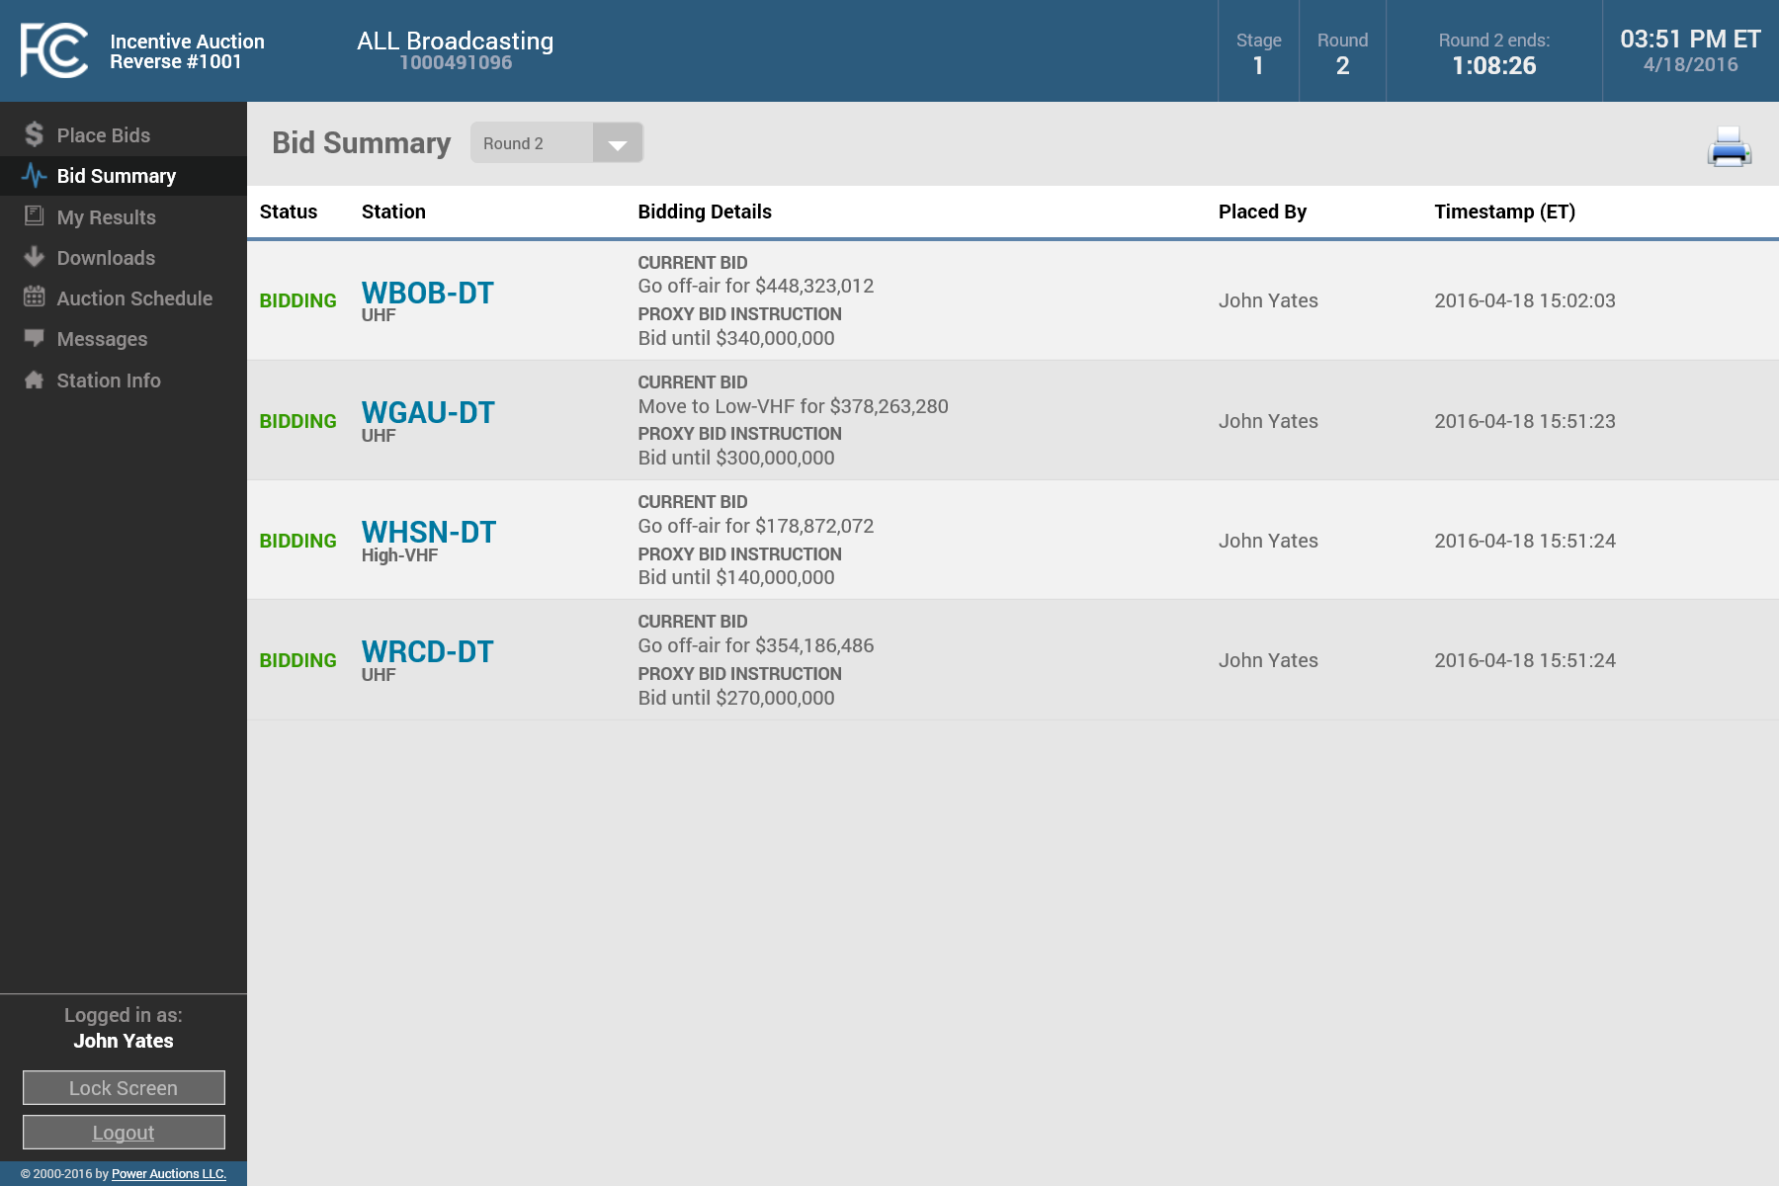
Viewing Proxy Instructions in Bid Summary
Your proxy instructions are displayed on the Bid Summary screen along with your bids
In this example, proxy instructions have been placed for all of the bidder’s stations, but you can submit proxy instructions for just some of your stations if you want (or none at all)

Slide 48
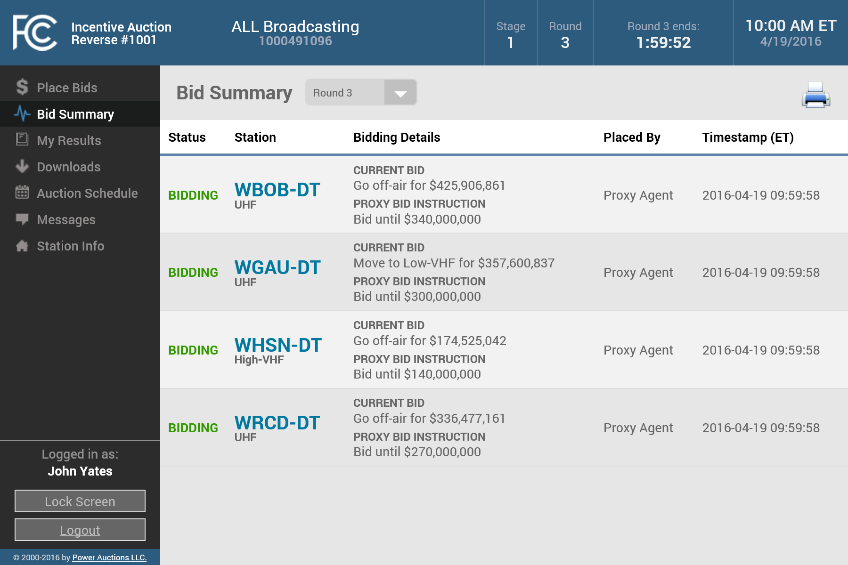
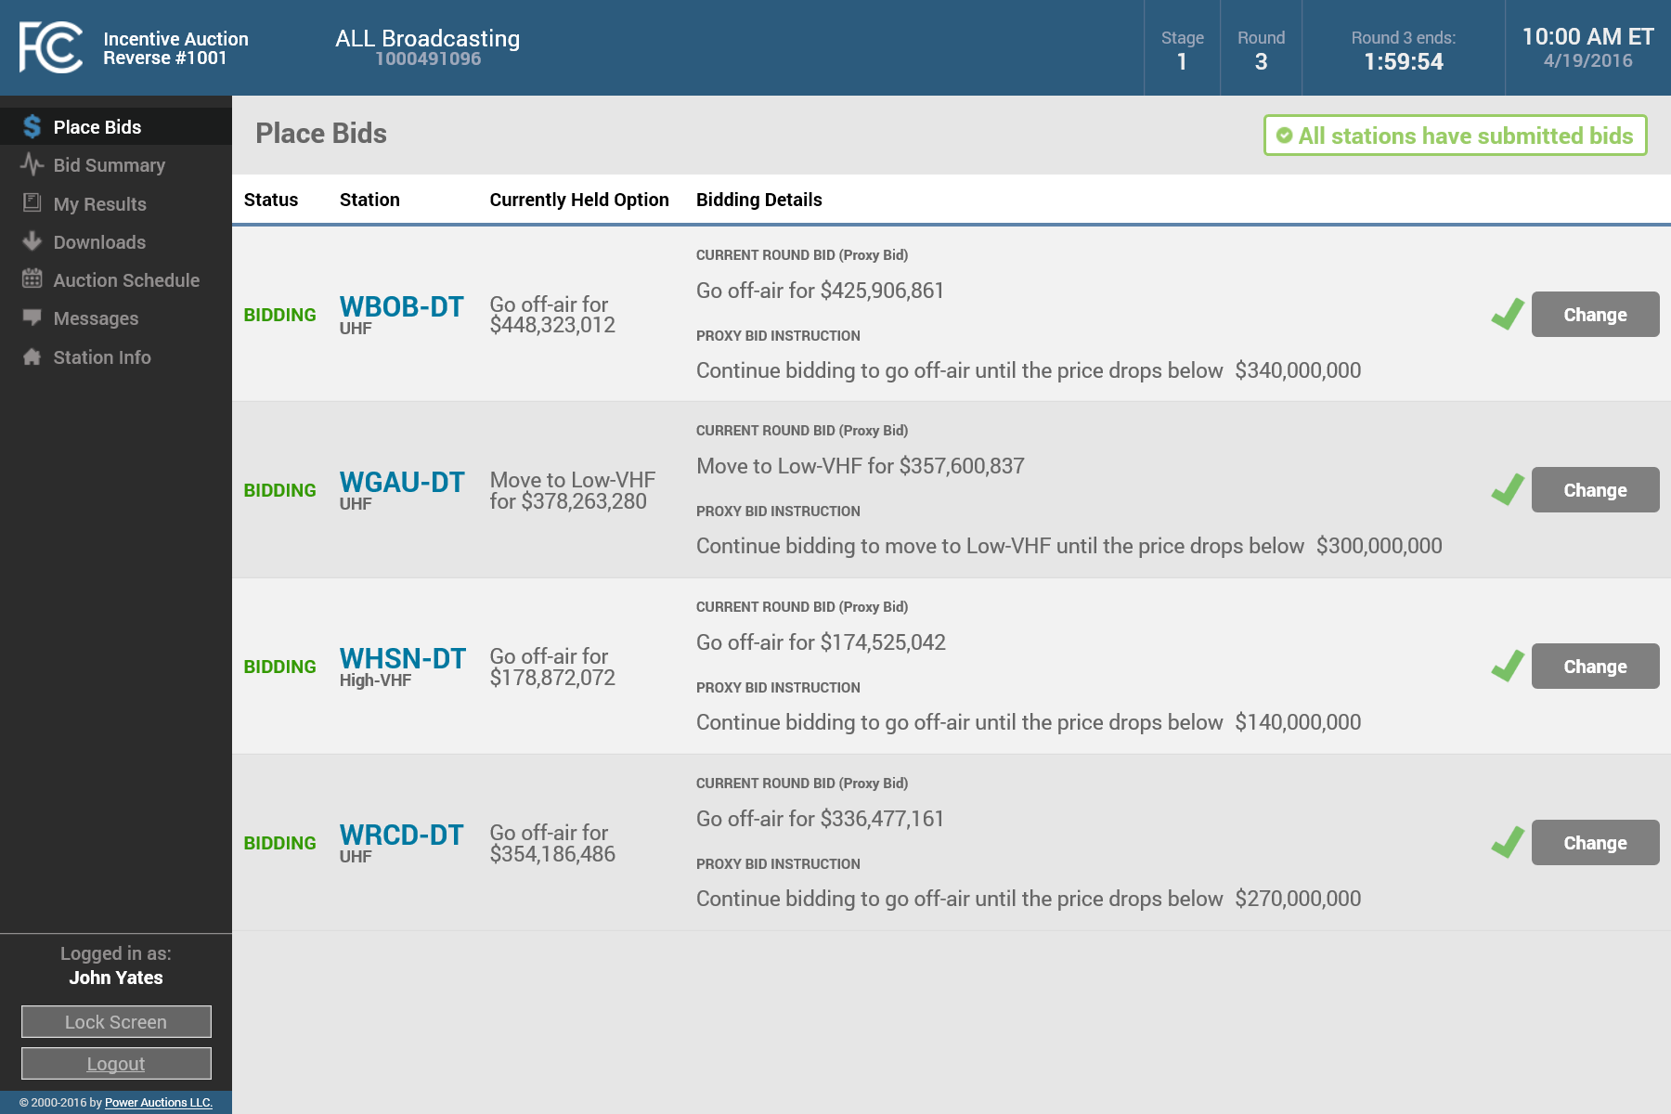
Viewing Bids Placed by Proxy
When the next round starts, you can see on the Place Bids screen that the system has already submitted bids for all stations with proxy instructions in effect
While the round is open, you can change or delete any of these bids using the “Change” button for the station
The Bid Summary screen also confirms that bids have been placed by a Proxy Agent for the stations

Slide 49
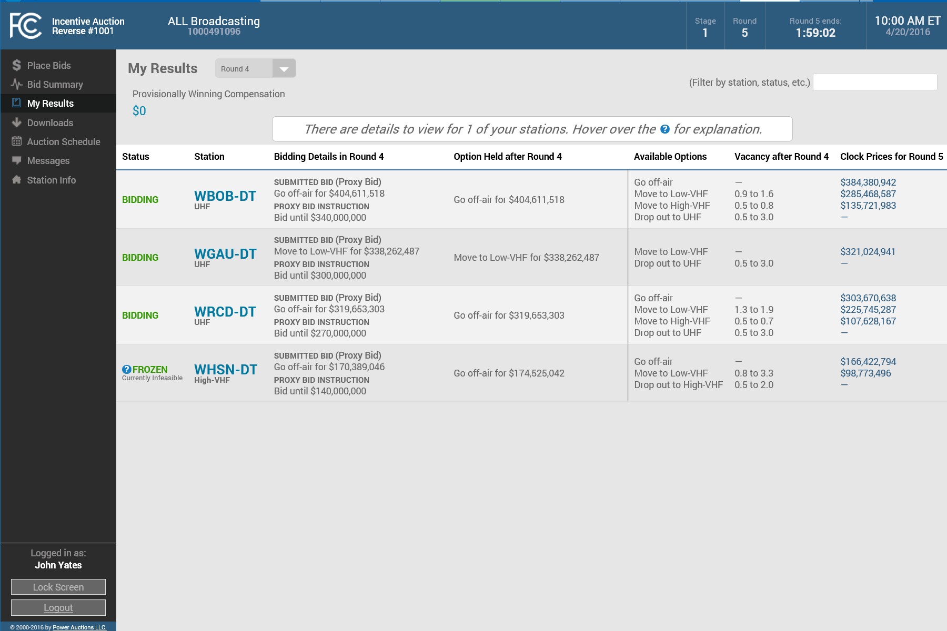
Proxy Instructions for Frozen - Currently Infeasible Stations
Moving forward in this example to the results for Round 4
The bidding status for station WHSN-DT has changed to “FROZEN– Currently Infeasible”
However, the proxy instruction still remains because the station could become unfrozen later in the stage
Suppose the bidder now wants to change one of its proxy instructions and also submit a different bid than the bid submitted by proxy for another station

Slide 50
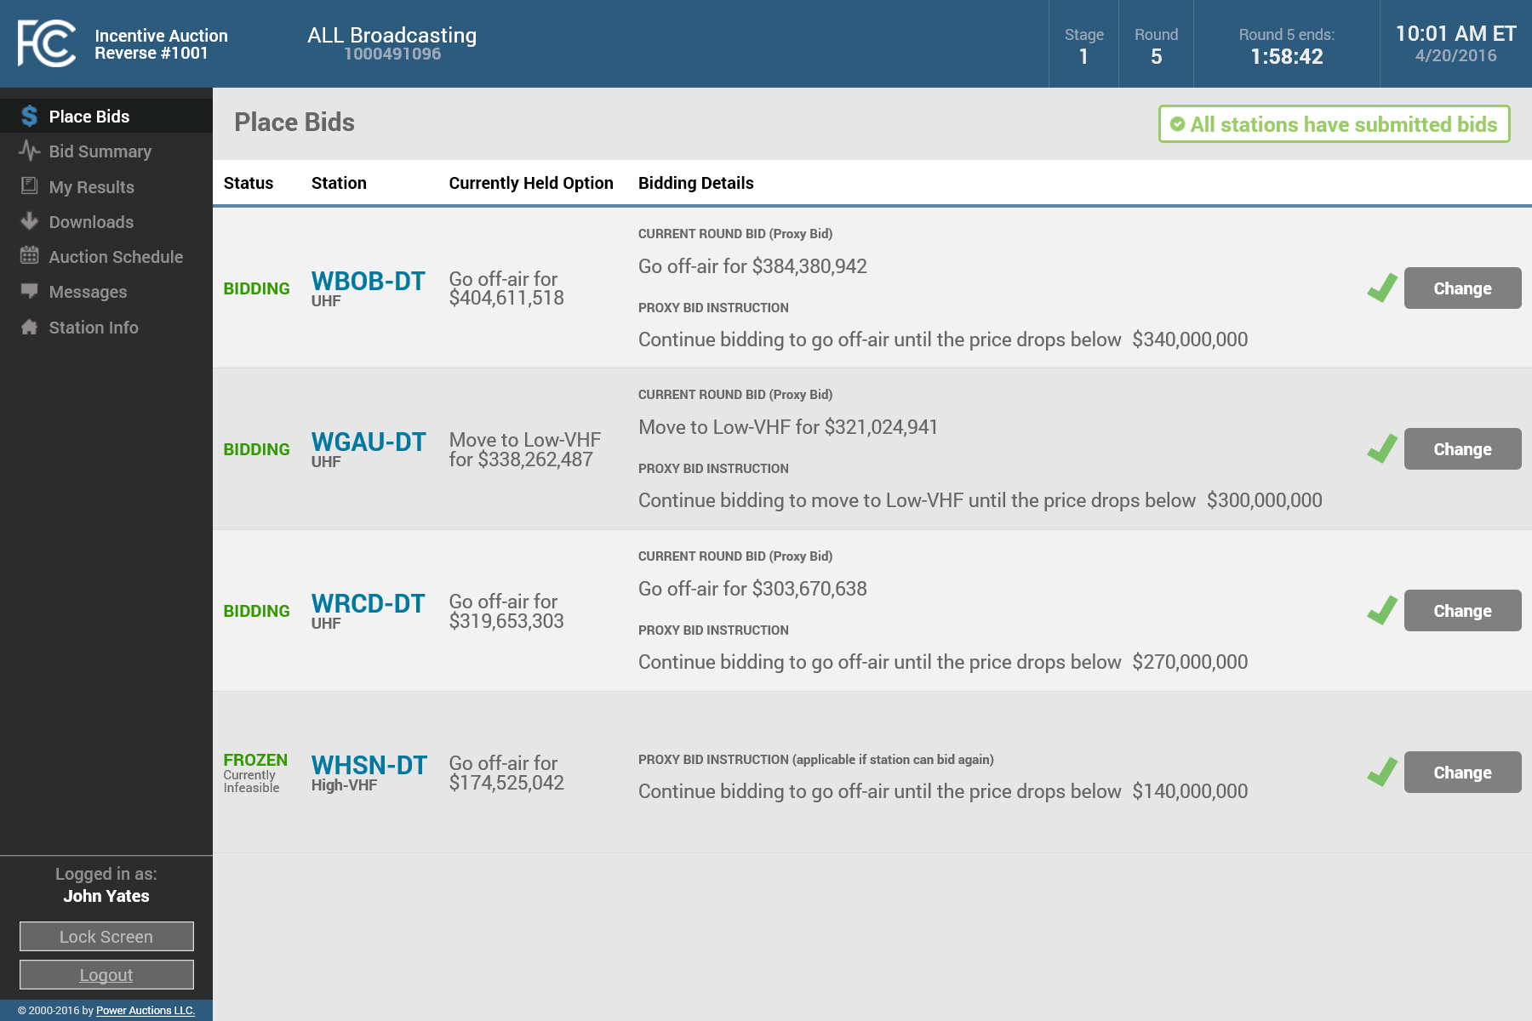
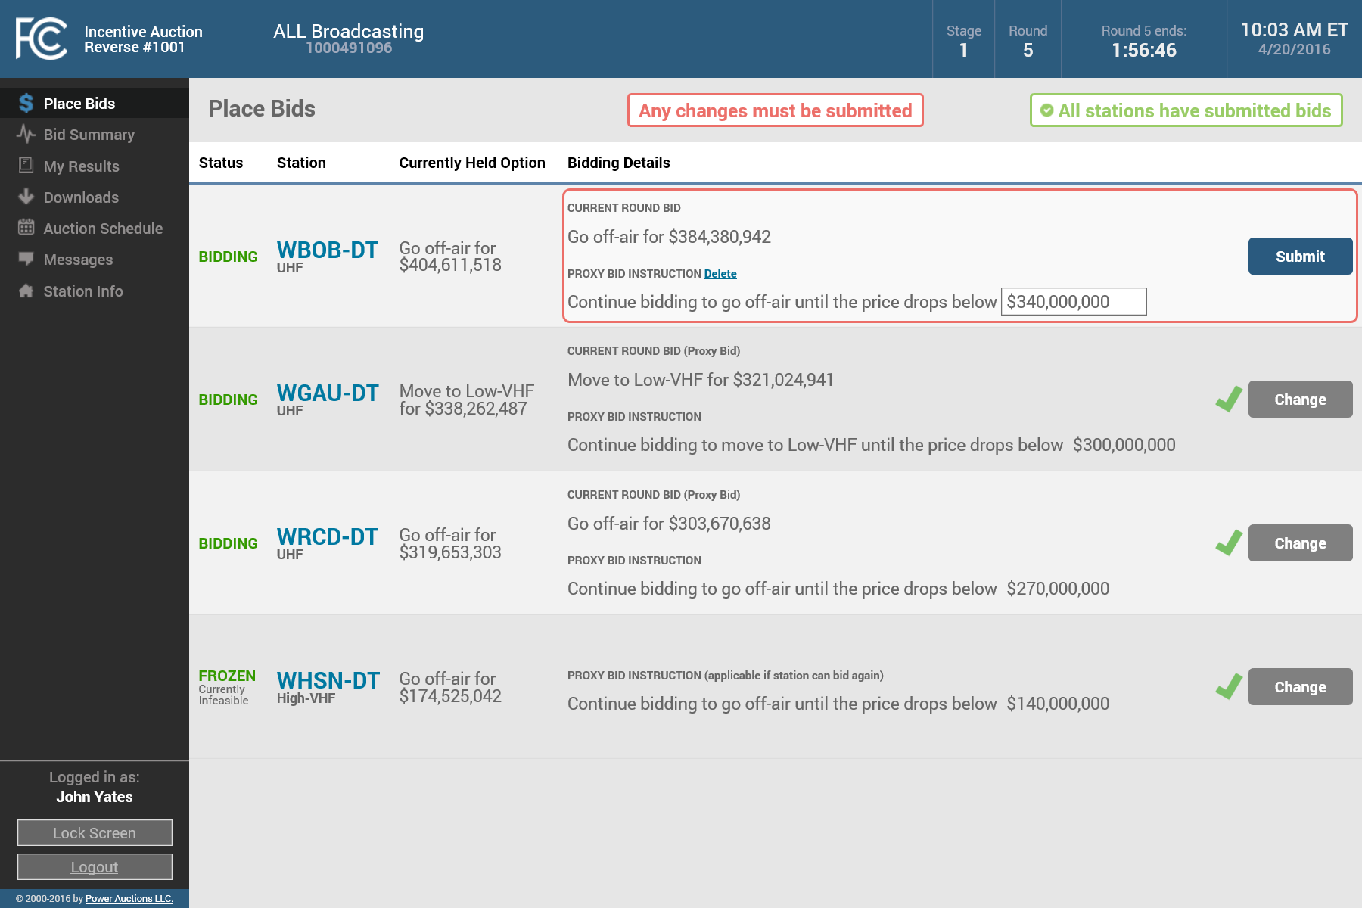


Changing a Proxy Instruction
To change a proxy instruction, click on “Change” for the relevant station on the Place Bids screen
Then enter the new price for the proxy instruction
And then click on the “Submit” button
This can be done for “FROZEN– Currently Infeasible” stations too
As always, this must be done before the round closes

Slide 51
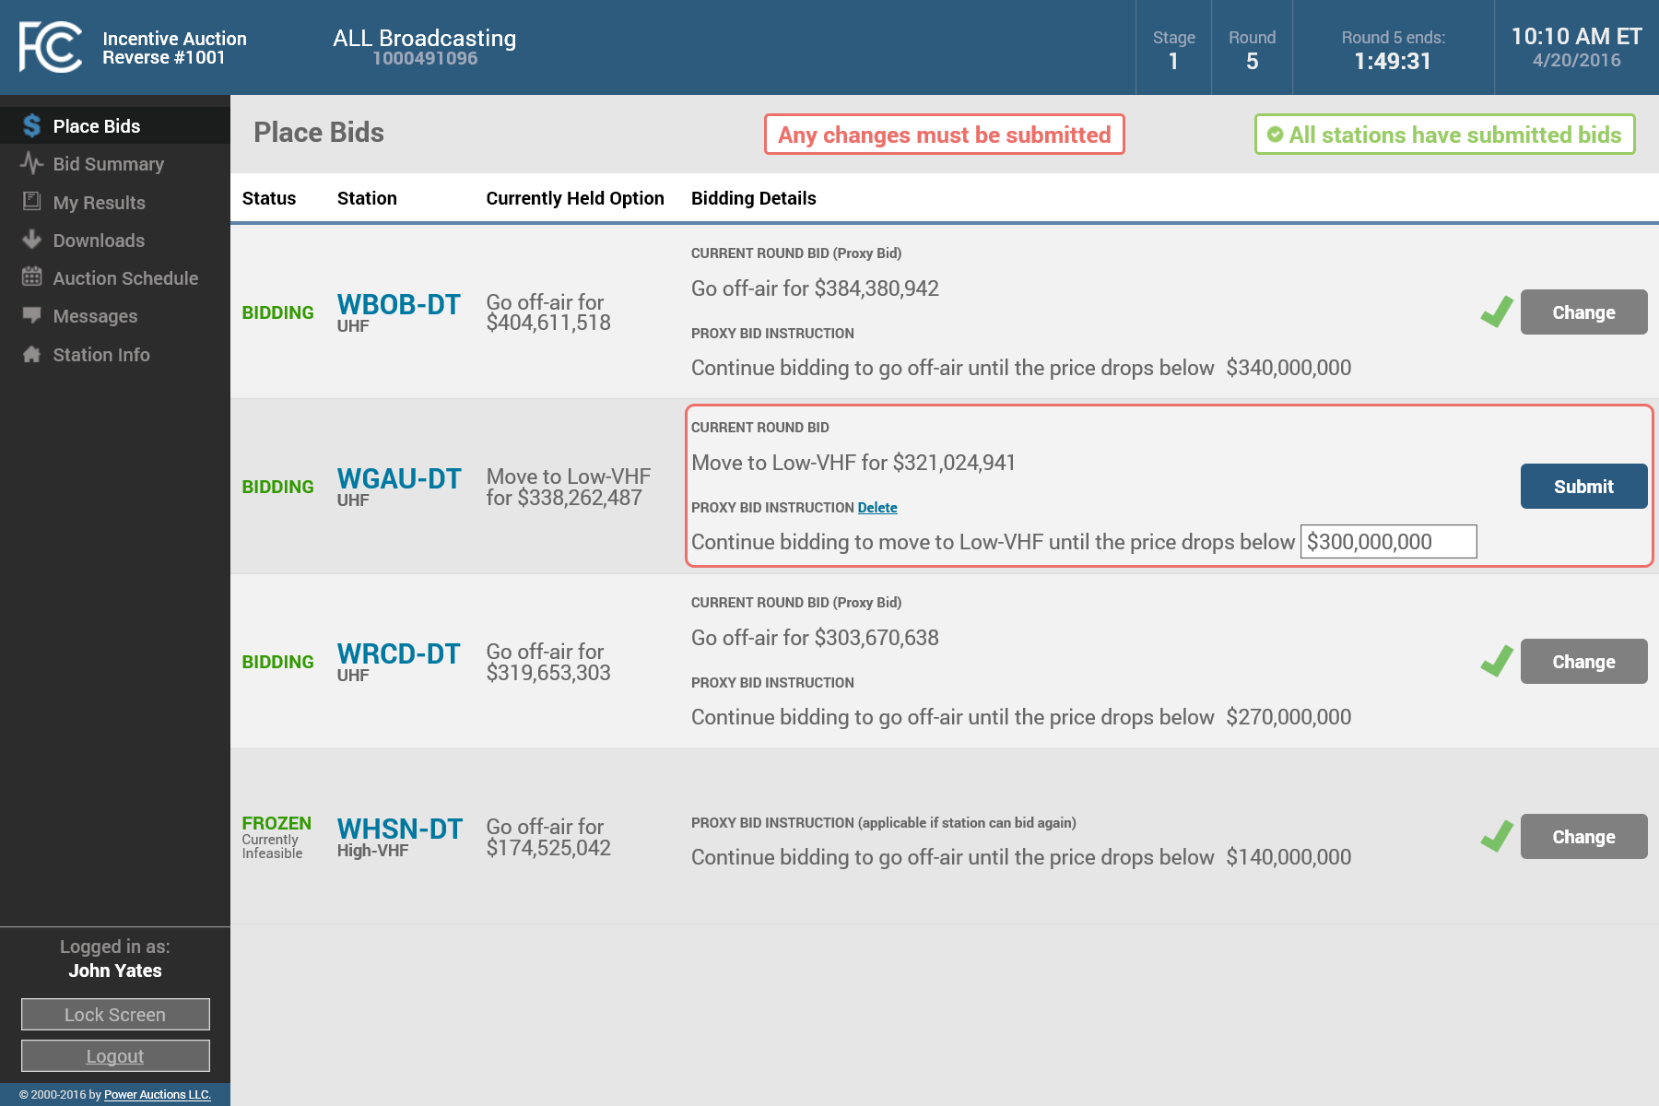
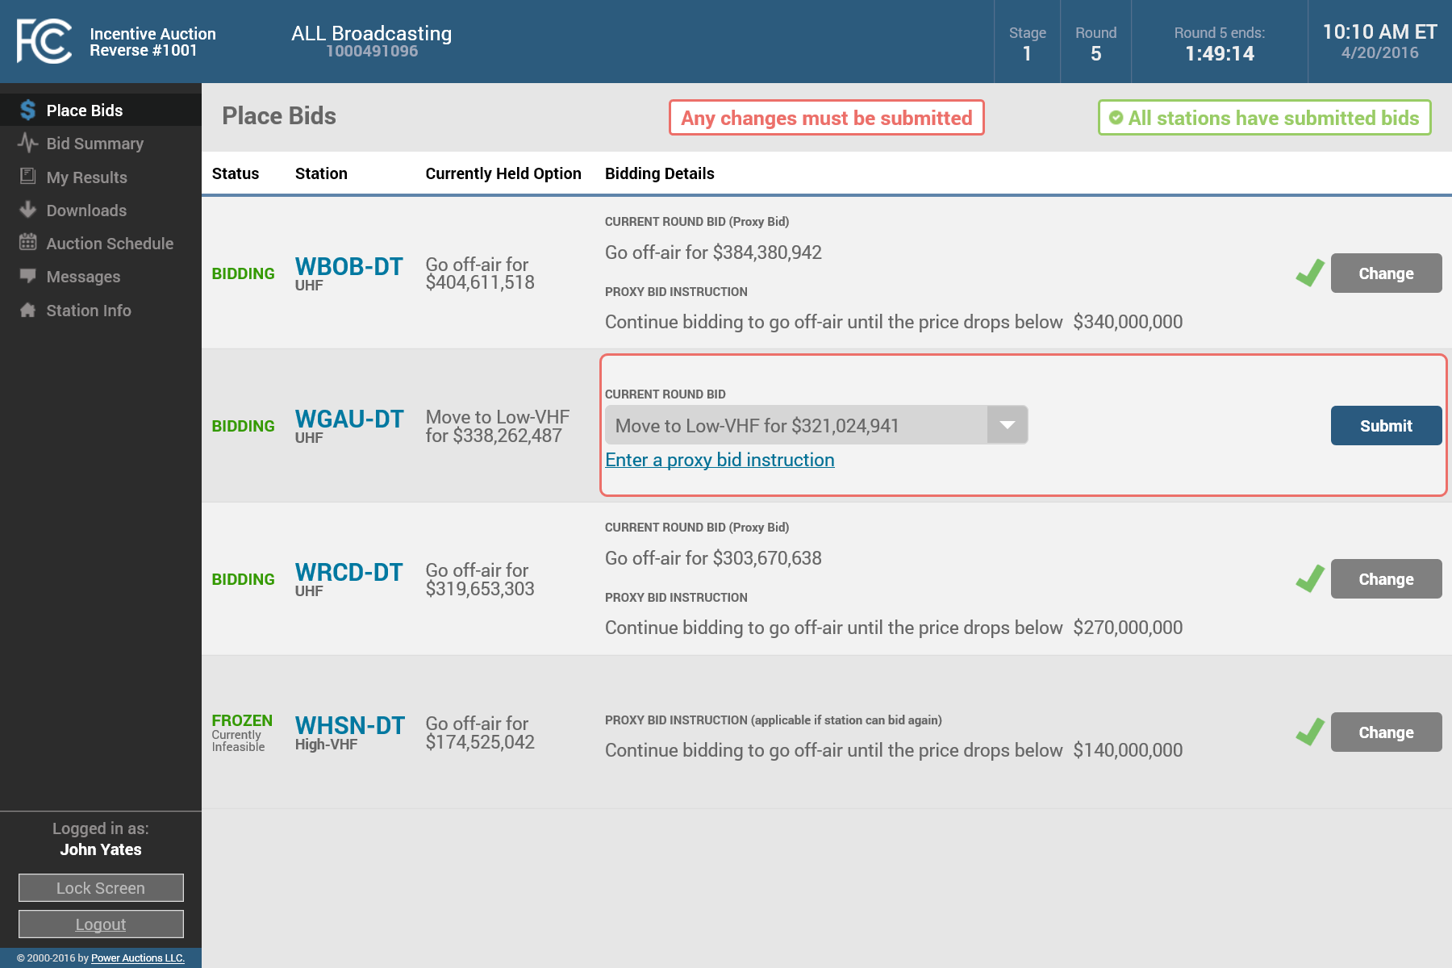
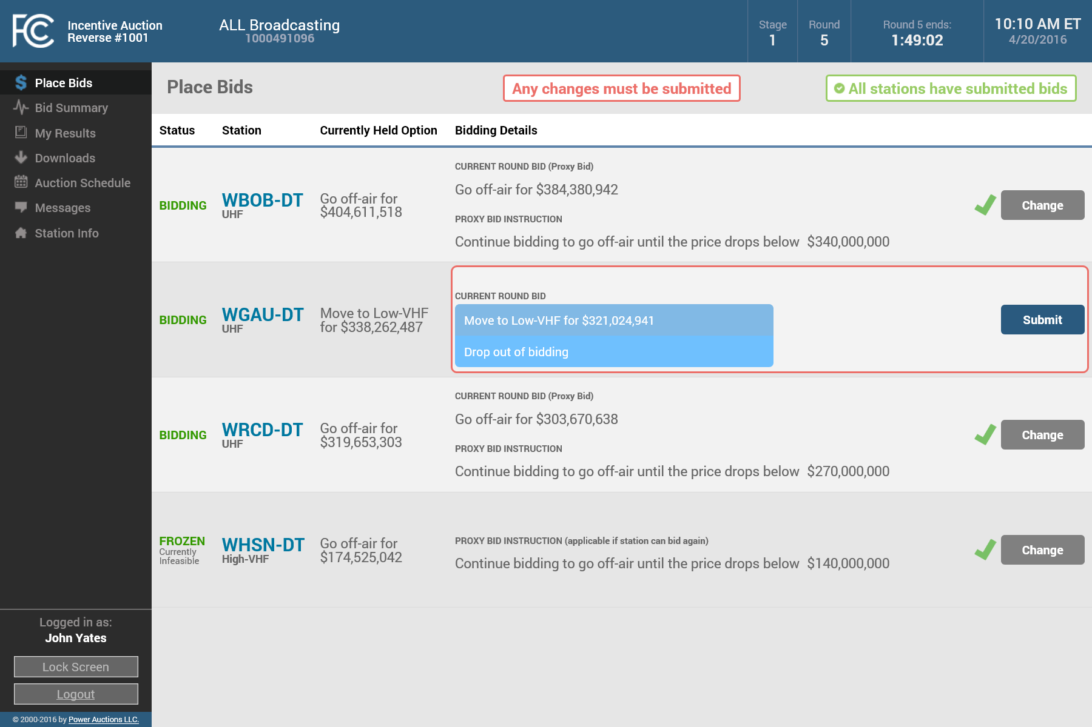
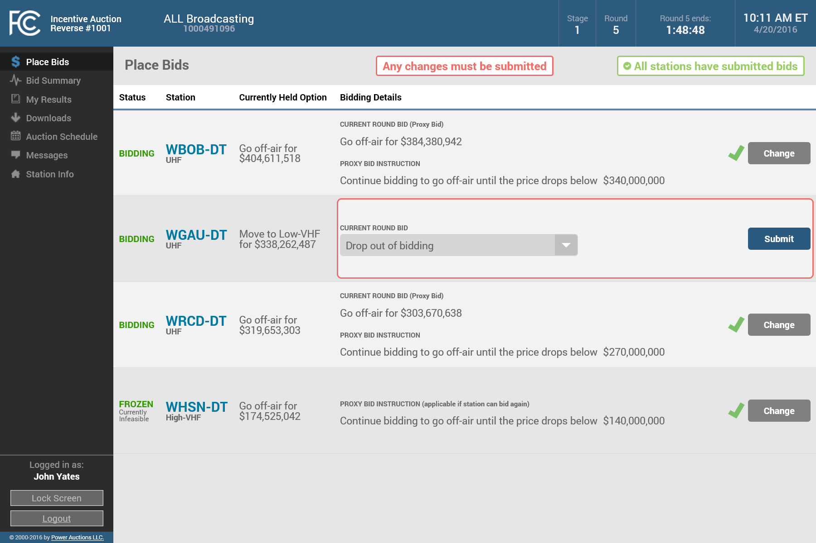


Submitting a Different Bid than the Proxy Bid
If you want to submit a bid for a station that is different from the bid submitted by the proxy agent, you can do that using the following steps
Click on “Change”
Delete the proxy instruction
Select the new bid
Submit the bid
(before the round closes)

Slide 52
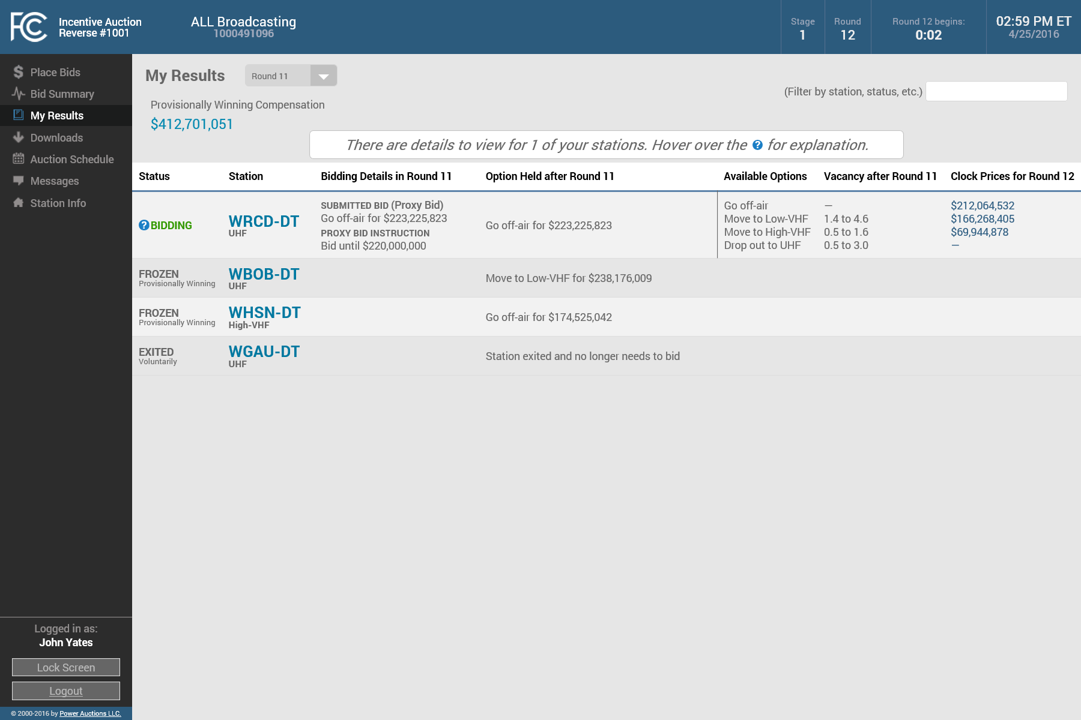
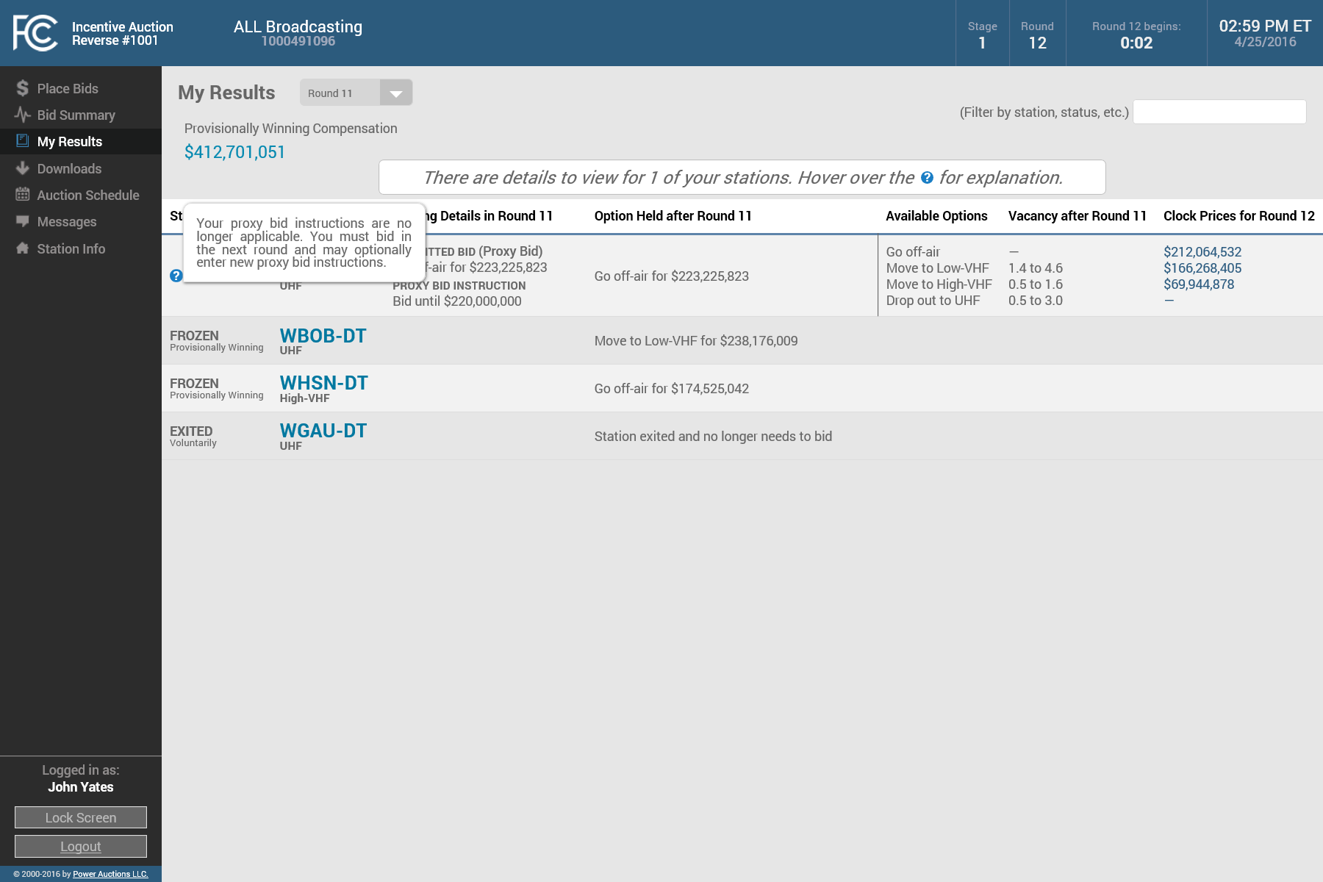
Checking Whether a Proxy Instruction is Expired
You can use the My Results screen to determine whether your proxy instruction will be in effect for the next round
If the next round clock price for your held option is below the proxy amount, then the instruction has expired and is no longer in effect
For a station that had the status “BIDDING” in the last round and continues to have that status this round, the screen will provide a warning
Hovering over the “?” displays the warning

Slide 53
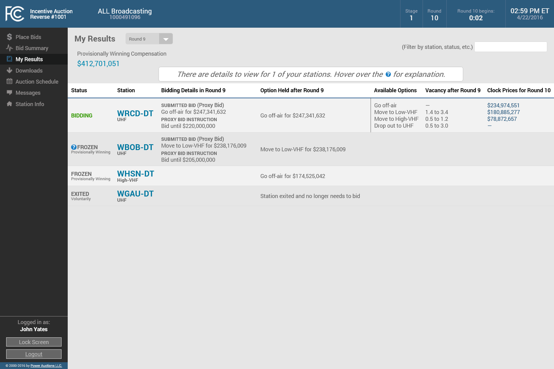
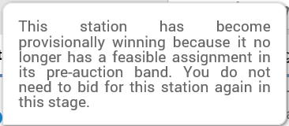
My Results with Provisionally Winning Stations
The My Results screen indicates when a station’s status has changed from the previous round
The status for station WBOB-DT has changed to “FROZEN – Provisionally Winning“ after bid processing of the selected round (as indicated by the “?” icon)
Hovering over the icon reveals details about the change
WHSN-DT was “FROZEN– Provisionally Winning” in an earlier round ( there is no “?” icon)

Slide 54
My Results – Provisionally Winning Compensation
The My Results page also displays your Provisionally Winning Compensation
This amount is calculated as the sum of the compensation of all your “FROZEN – Provisionally Winning” stations
+

Slide 55
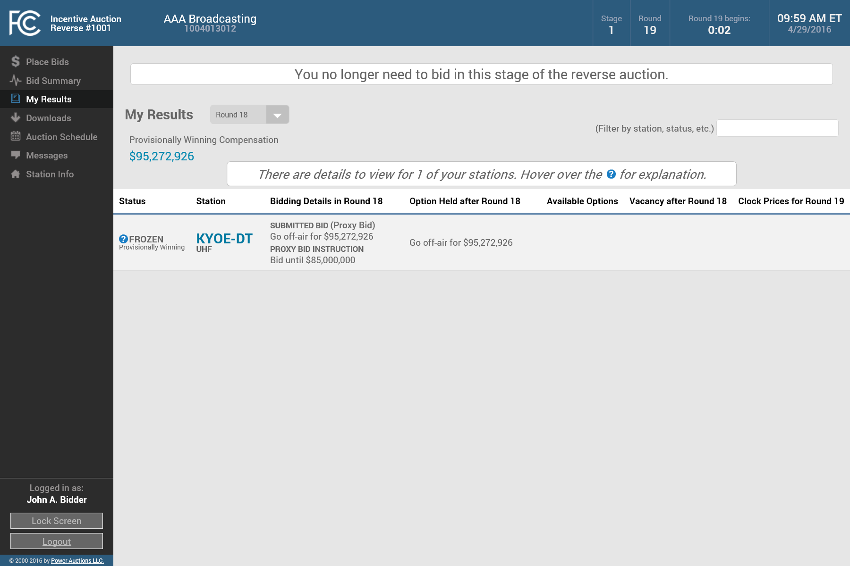
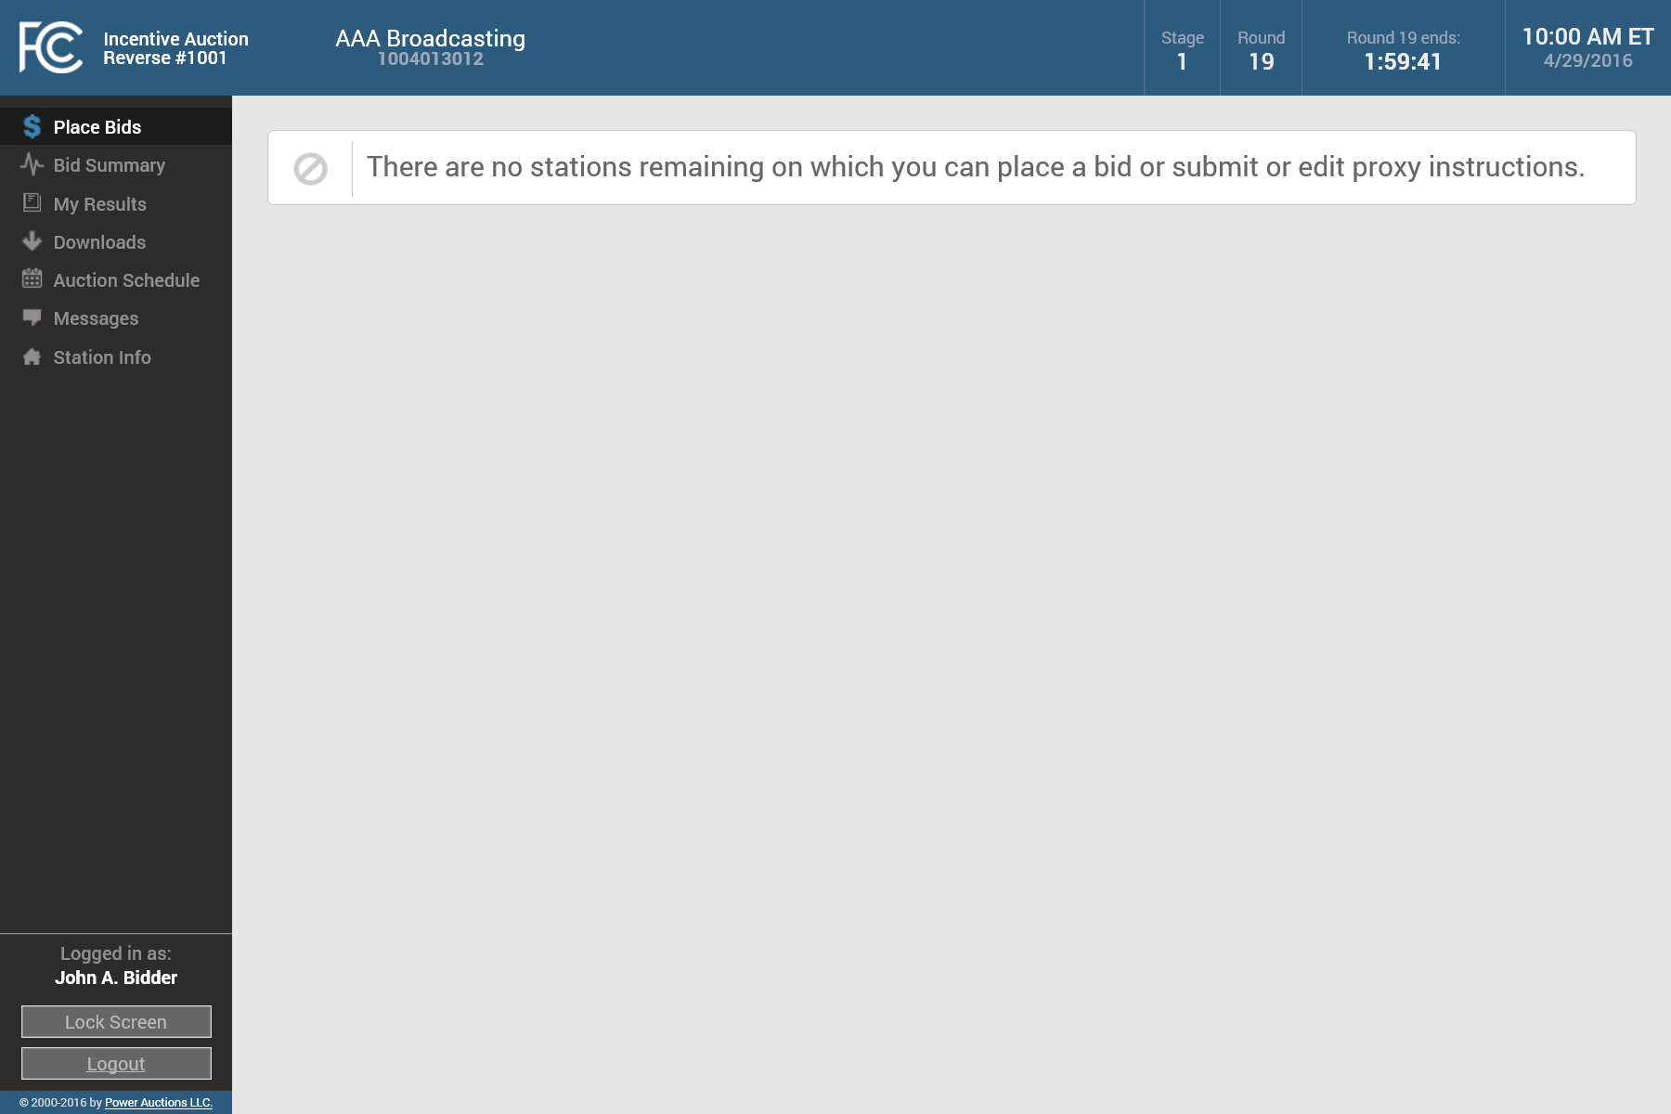
End of Bidding in a Stage for a Bidder
When all of your stations have either exited the auction or become provisionally winning, you no longer need to bid for the remainder of the stage (shown here for a bidder with one station)
The Place Bids screen will not be functional even while a round is open

Slide 56

Viewing the Results when the Stage has Concluded
When the stage has concluded, this is indicated on the top bar in place of the countdown timer
The My Results screen for the last round of the stage displays the status for each of your stations at the conclusion of the stage
As well as your provisionally winning compensation for the stage
+

Slide 57

Downloading the Results when the Stage has Concluded
We recommend that you download all files after the reverse auction for a stage has concluded and take printouts of any screens you wish to keep

Slide 58
Public Reporting system
Reverse Auction Clock Phase Workshop

Slide 59
Incentive Auction Public Reporting System
Beginning May 27th and continuing throughout the incentive auction, the public can access an Incentive Auction Public Reporting System (PRS)
The PRS has three primary functions
  Dashboard: Allows the public to monitor the status of the incentive auction
  Announcements: Allows the public to view announcements from the Auction System that have been made public
  Forward Auction Product Status: Provides information about the products in the forward auction as well as round by round product results during the forward auction clock phase

Slide 60
Incentive Auction Public Reporting System
The FCC will provide a user guide for the PRS on the Auction 1000 website
In this presentation we provide a brief overview of the dashboard
The data in this presentation is for illustrative purposes only and in no way represents predictions on the part of the FCC regarding the outcome of the incentive auction

Slide 61

Dashboard: During Stage 1 of the Reverse Auction
During Stage 1 of the reverse auction the dashboard will display
  The stage number
  An overall status of the incentive auction
  The clearing target and licensed spectrum amount for the current stage
  The current round number in the reverse auction
  The status of the forward auction
  The upcoming bidding schedule in the reverse auction
  When the reverse auction has concluded for a stage, the total clearing cost

Slide 62

Dashboard: During Stage 1 of the Forward Auction
During Stage 1 of the forward auction clock phase the dashboard will display
  The current auction status
  The status of the reverse auction including the clearing cost for the stage
  The status of the forward auction including the current round and the auction proceeds as of the last round
  The upcoming bidding schedule in the forward auction
  The progress toward meeting the final stage rule

Slide 63
Dashboard: Status of Final Stage Rule
The graphic displaying the progress toward meeting the final stage rule in the forward clock auction includes
  Whether the first component has been met
  Whether the second component has been met
  The overall status of meeting the final stage rule

Slide 64


Dashboard: Status of Final Stage Rule
Each component displays
  The target amount needed, and
  The actual or estimated amount as of the last round of the forward clock auction
When a component is met the status box turns green
When both components are met the overall status box turns green and the actual/estimated amounts are no longer reported

Slide 65
Questions?
Send questions to auction1001@fcc.gov

Slide 66
Information about cores
Reverse Auction Clock Phase Workshop

Slide 67
New CORES
CORES, the FCC’s FRN registration system, is being updated
Reverse auction winning bidders and broadcasters receiving money for reimbursement will use the updated CORES to facilitate the post auction payment processes
The FCC will reach out to broadcasters after the completion of the reverse auction’s first stage with information about configuring your updated CORES account
Be on the lookout for more information and training
materials related to the launch of the new CORES

Slide 68
New STAGE
Reverse Auction Clock Phase Workshop

Slide 69
Proceeding to a New Stage
If the final stage rule is not met in a stage, the auction will proceed to a new stage with a lower clearing target
Reverse Auction Bidder
Initial
Commitment
Set Clearing Target for Stage
Reverse Clock Auction
Auction System
Forward Assignment Rounds
Forward Auction Bidder
Final Stage
Rule not met
Forward Clock Auction
Final Stage Rule met
Final TV Channel
Assignment

Slide 70
Setting a New Clearing Target
The clearing target for any subsequent stage of the auction will generally be the next lowest clearing target in the 600 MHz Band Plan
Each lower clearing target adds one or more additional channels to the TV band

Slide 71
Preparing for a New Stage
The Public Reporting System will indicate when a stage has concluded and whether or not the final stage rule was met in that stage
If the auction proceeds to a subsequent stage, the FCC will provide to the qualified bidders any additional information and training needed to participate in the new stage

Slide 72
Participating in a New Stage
Only bidders that had one or more stations with a status of "FROZEN – Provisionally Winning” at the end of the previous stage will be able to log in to the system for the new stage
  Stations that exited the auction in a previous stage, whether voluntarily or because the system determined they were not needed, will continue to have a status of exited in the new stage
Bidders that had only exited stations at the end of the previous stage will not be able to participate in the new stage

Slide 73

New Clearing Target
The Auction Schedule screen will show the new clearing target and highest channel

Slide 74

Using the System in a Subsequent Stage
In a new stage, there will be a preview period before Round 1 of the new stage begins
The functionality of the system is the same in a new stage, but some of the data does not carry over from the previous stage
For example, the download files only contain data for the current stage
However, there is a link to enable you to access the auction system for the previous stage

Slide 75
Questions?
Send questions to auction1001@fcc.gov

Slide 76
Contact Information
FCC Auctions Hotline General Auction Questions Auction Process and Procedures | (888) 225-5322, option two; or (717) 338-2868 Hours of service: 8:00 a.m. – 5:30 p.m. ET, Monday through Friday
Auctions and Spectrum Access Division, Wireless Telecommunications Bureau For general auction questions: For Auction 1001 (reverse) auction legal questions: | Linda Sanderson at (717) 338-2868 Erin Griffith or Kathryn Hinton at (202) 418-0660
Technical Support Electronic Filing FCC Auction System (Hardware/Software Issues) | (877) 480-3201, option nine; or (202) 414-1250 (202) 414-1255 (TTY) Hours of service: 8:00 a.m. – 6:00 p.m. ET, Monday through Friday

